Slide 1
Taking Flight at DEN
May 2025
Notes:
Good afternoon, everyone.
Thank you for being here today for Taking Flight at DEN.
My name is Desiree Mondragon, Outreach Administrator here at DEN.

Slide 2
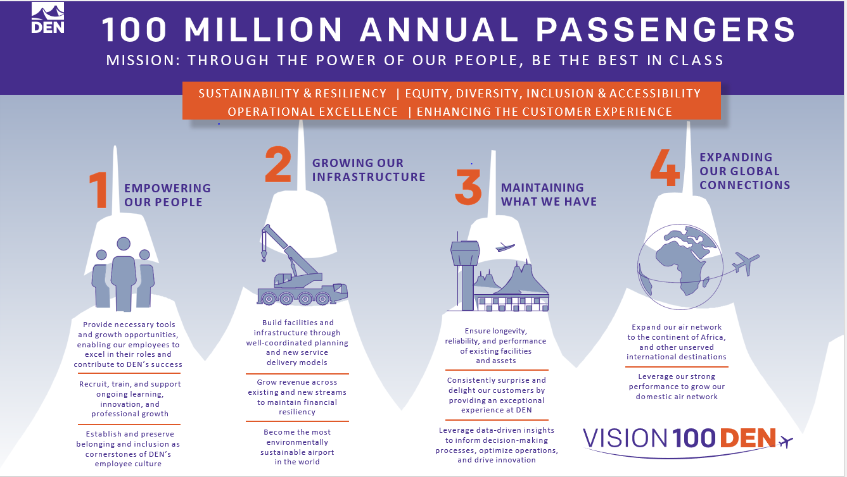
Vision 100 and Operation 2045
Notes:
Vision 100 and Operation 2045 are phases of DEN's strategic plan.
Vision 100 aims to prepare the airport for 100 million annual passengers.
Operation 2045 focuses on the airport's 50th anniversary and plans for over 120 million annual passengers.
Together, they guide decision-making and accountability here at DEN.

Slide 3

Small Business Certification Workshop – June 12
Notes:
Save the Date: Small Business Certification Workshop – June 12
Presented by DSBO & AABO
Simplify the certification process and help small businesses grow by leveraging their certifications (ACDBE, DBE, EBE, MWBE, SBE, SBEC).

Slide 4


Taking Flight at DEN
Monthly event showcasing multiple procurement opportunities, set for the 2nd Thursday of each month at 1 p.m.
**January 23** - Due to holiday schedules
  February 13
March 13
  April 10
May 8
June 12
July 17
August 14
September 11
October 9
November 13
December 11
Notes:
DEN is committed to eliminating barriers for small businesses at the airport.
“Taking Flight at DEN” highlights our procurement opportunities and facilitates networking. project managers, members of the business community, and resource partners.

Slide 5


Meet the Primes
Virtual outreach event held twice a month to connect Prime firms at DEN with local, small, and historically underutilized firms, scheduled for the 3rd Thursday at 1 p.m.
February 20 - Concessions Prime Operators
April 17 - Rental Car Company
June 26- General Contractors
August 21 - Construction Specialty Trade Contractor (MEP, Painting, Millwork, Drywall, Acoustical, Flooring, Concrete, Metals, Glass Glazing, Trucking, More)
October 16 - Airlines, Real Estate, Commercial Development and Hotelier
December 18 - Architecture, Engineering, and Professional Services
Notes:
Meet the Primes aims to connect Prime firms at DEN with the business community.
Our calendar provides various opportunities to engage with different types of companies.

Slide 6


Navigating the ACDBE Series: Pathways to Concessions
Bi-monthly virtual outreach event held on the third Thursday at 1 p.m. will guide ACDBEs on doing business at DEN.
Pathways to Concessions 2025:
January 16 – ACDBE 101
March 20 – ACDBE 201
May 15 – Joint Ventures 101
July 17 – Joint Ventures 201
September 18 – Concessions Connections
November 20 – B2G Compliance
Notes:
The “Navigating the ACDBE Program” series helps retail and F&B businesses understand certification and compliance for concessions.
Here’s are the remaining sessions

Slide 7

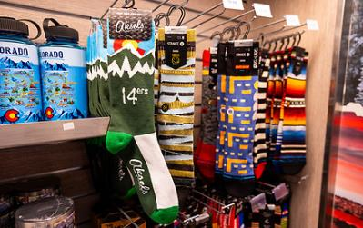

Snack & Souvenir Expo
Local snack and souvenir small businesses
May 21, 2025
Westin Denver International Airport
Small business suppliers will have the opportunity to interact with buyers representing airport concessionaires. You will gain insight into the criteria for selling your merchandise to their shops and eateries located at DEN. Network with DEN, concession partners and other local resources.
Notes:
Registration is now open for the Snack & Souvenir Expo on May 21.
This event connects small business suppliers with airport concession buyers and provides insights into selling merchandise at DEN, along with networking opportunities. Scan the QR code to learn more.

Slide 8
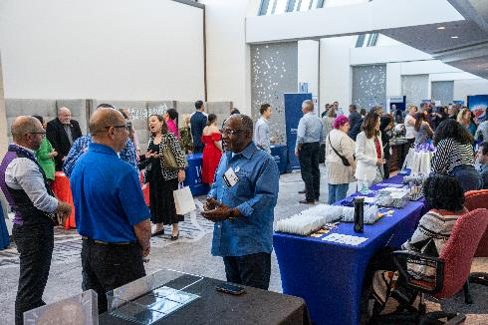
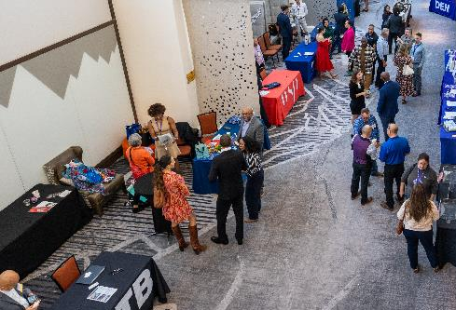

Exhibitor Showcase
Save the Date
Prime Operators and Firms
August 28
Westin Denver International Airport
The Exhibitor Showcase is an event to foster business partnerships between the DEN, the City and County of Denver, prime contractors, small businesses, and resource partners.
Scan the QR Code to receive information related to the exhibitor opportunities. Booth applications open Summer of 2025.
Notes:
Save the date for the Exhibitor Showcase and Tradeshow on August 28.
Sign up for our newsletter and follow us on LinkedIn for more updates as they become available.

Slide 9


Community Panelist Program
Volunteer program for those who want to participate in a procurement evaluation panel.
Great experience for potential primes
Attain an understanding of the evaluation process
Become familiar with DEN’s values
Gain experience with DEN’s interview format
Scan to sign up today!
Notes:
Volunteer as a Community Panelist for an upcoming procurement evaluation.
Gain insights and improve future proposals. Scan the QR Code to learn more.
Already Participated?
We’re seeking testimonials from past panelists!
Share your experience in the event follow-up email

Slide 10
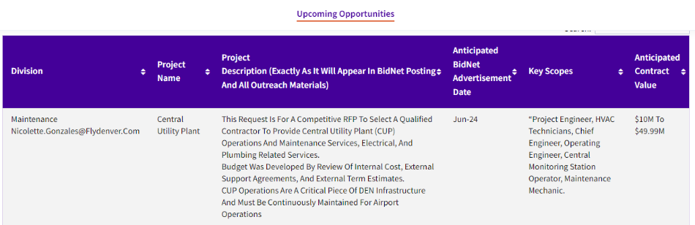

Upcoming Opportunities – Updated Webpage
Notes:
Our website lists procurement opportunities at various procurement stages.
Please be aware that details may change, and the City and County of Denver can modify or cancel projects at their discretion.
Now, we'll hand it over to our project managers.

Slide 11
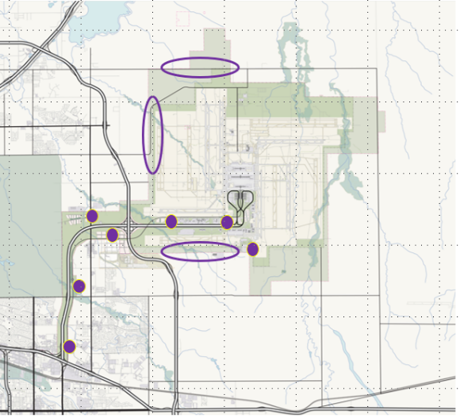
Strategic Development Plan Update DEN Real Estate
At the end of 2018, Denver International Airport released its Strategic Development Plan to outline a vision for transforming 16,000 acres of airport land outside the core aviation areas into a series of vibrant commercial districts. Executing the plan supports the airport’s core aviation mission by leveraging its size, capacity for growth, and centralized location to create innovative, sustainable and economically beneficial development of non-aviation land.
However, surrounding neighborhoods have grown since the plan’s release and market conditions have shifted. As a result, the Strategic Development Plan needs to be updated to better reflect the local context, global conditions, and the airport’s Vision 100 and Operation 2045 initiatives.

Slide 12
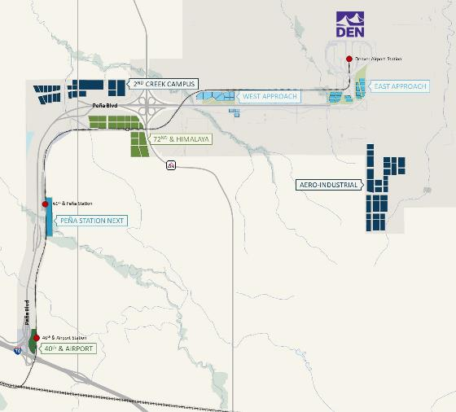
Strategic Development Plan Update DEN Real Estate
KEY INFORMATION
Anticipated Advertisement Date: Q2 2025
Small Business Program Goal: None
Estimated Project Value: $500K
Key Scope/Industry: Urban Planning, Economic Analysis, Stakeholder Engagement
Project Manager: Elise Brenninkmeyer & Julie Saporito| elise.brenninkmeyer@flydenver.com & julie.saporito@flydenver.com

Slide 13
Furniture, Installation, and Related Products and Services
This request is for a competitive Request for Proposal (RFP) to select a qualified firm to provide FF&E (Furniture, Fixtures and Equipment). This Procurement will interface with all Agencies citywide, including DEN.
The products and services include by not limited to the following:
Systems Furniture
Freestanding Furniture
Seating/Chairs
Soft Seating:
Filing Systems, Storage, and Equipment
Technology Support Furniture
Breakroom Furniture
Audio/Visual Furniture
Related Products, Support Services and Solutions
KEY INFORMATION
Anticipated Advertisement Date: Q2 2025
Anticipated Agreement Date: Q4
Small Business Program Goal: 5%
Estimated Project Value: $120M to $150M City Wide
Key Scopes: Commercial Furniture
Project Manager: Lance Jay, Chief Procurement Officer City of Denver | lance.jay@denvergov.org
Notes:
Systems Furniture: A complete and comprehensive catalog of all systems furniture, lines, and accessories available from the Vendor.
Freestanding Furniture: A complete and comprehensive catalog of all case goods, furniture, (including folding and mobile) desks, tables, and accessories available from the Vendor.
Seating/Chairs: A complete and comprehensive catalog of office and break room chairs, tandem seating, and other general seating available from the Vendor.
Soft Seating: A complete and comprehensive catalog selection of soft seating for areas such as common, waiting areas, and open learning spaces. Products include, but not limited to, lounge seating, modular linear seating, tables, and accessories.
Filing Systems, Storage, and Equipment: A complete and comprehensive catalog of filing systems including vertical and lateral files, freestanding file cabinets, bookcases, and equipment and accessories available from the Vendor.
Technology Support Furniture: A complete and comprehensive catalog selection of technology support furniture to support technology-based learning environments.
The products and services include by not limited to the following: (Continued)
Breakroom Furniture: A complete and comprehensive catalog selection of breakroom furniture.
Audio/Visual Furniture: A complete and comprehensive catalog selection of audio/visual furniture.
Related Products, Support Services and Solutions: Related office interior products and design, “Quick Ship”, design and layout, fabric and color design services, installation, systems furniture reconfiguration, assessment tools, and any other related products and services or solutions offered by the Vendor.

Slide 14
Microsoft 365 Professional Services
Denver International Airport (DEN) utilizes various Microsoft 365 technologies for collaboration and data processing. DEN seeks a Microsoft Strategic Project-Based partner to provide professional services and collaborate with DEN to enhance current and future Microsoft solutions, including implementation and support services.
KEY INFORMATION
Anticipated Advertisement Date: Q2 2025
Small Business Program Goal: None
Estimated Project Value: $2.2M
Key Technologies:
Teams, Exchange, OneDrive for Business, Power Platforms, SharePoint Online, Azure, CoPilot, Fabric, Sentinel, Purview
Focus on implementing new E5 features post-transition.
Project Manager: Deneen Stone | Deneen.Stone@flydenver.com
Notes:
Denver International Airport (DEN) utilizes various Microsoft 365 technologies for collaboration and data processing. DEN is seeking a Microsoft Strategic Project-Based partner to provide professional services and collaborate with DEN to enhance both current and future Microsoft solutions, including implementation and support services.
KEY INFORMATION
Anticipated Advertisement Date: Q2 2025
Small Business Program Goal: None
Estimated Project Value: $2.2M
Key Scope/Industry: The focus is on professional services to support DEN in implementing newer Microsoft technology and expanding our current Microsoft footprint. We seek expertise in Teams, Exchange, OneDrive for Business, Power Platforms, SharePoint Online, Azure, CoPilot, Fabric, Sentinel, and Purview. Having recently transitioned to E5, we are looking for a vendor to assist in exploring and implementing the new features that come with E5. We require a partnership with a vendor that can help elevate our current Microsoft services.
Project Manager: Deneen Stone | Deneen.Stone@flydenver.com

Slide 15
On-Call Inside/Outside Plant Telecom Infrastructure Services
Award multiple contracts for Inside/Outside Plant Telecommunications Engineering, Construction, and Installation services.
Scope of Work:
Collaborate with DEN staff to construct, relocate, and install communication infrastructure
Tasks include cabling, installation of new services, and supporting new buildings, telecom huts, and IDF rooms
Cabling: Install new telecommunication cables and systems.
New Services: Support infrastructure for new buildings, telecom huts, and IDF rooms.
Upgrades and Relocations: Manage infrastructure upgrades and cable relocations.
Contract Details:
  3-year term with a $10M maximum per contract
  Optional 2-year extension
KEY INFORMATION
Anticipated Advertisement Date: Q2 2025
Small Business Program Goal: 21% MWBE
Estimated Project Value: $10M to $49.99M
Required Certifications:
Confined Space Entry in compliance with OSHA and local standards.
Skilled in Dura-Line Micro Duct / Future Path and Blown Fiber technologies.
Experienced in Optical Fiber Splicing, Cable and Duct Location Services.
Project Manager: Michael Schneider | Michael.Schneider@flydenver.com
Notes:
Objective: Award multiple contracts for Inside/Outside Plant Telecommunications Engineering, Construction, and Installation services at Denver International Airport (DEN).
Purpose: Support the expansion and maintenance of DEN’s comprehensive telecommunications infrastructure, ensuring effective communication systems across the airport campus.
Scope of Work
Collaboration with DEN Staff: Contractors will work directly with DEN teams to construct, relocate, and install communication infrastructure.
Key Tasks:
Cabling: Install new telecommunication cables and systems.
New Services: Support infrastructure for new buildings, telecom huts, and IDF rooms.
Upgrades and Relocations: Manage infrastructure upgrades and cable relocations.
Contract Details
Duration: 3-year contract term with a maximum value of $10M per contract.
Extension: Optional 2-year extension based on performance and project needs.
Anticipated Advertisement Date: Q2 2025.
Key Information
Small Business Goal: 21% MWBE participation.
Estimated Project Value: $10M to $49.99M.
Required Certifications:
Confined Space Entry in compliance with OSHA and local standards.
Skilled in Dura-Line Micro Duct / Future Path and Blown Fiber technologies.
Experienced in Optical Fiber Splicing, Cable and Duct Location Services.
DEN Infrastructure Overview
Campus Size: 53 square miles, larger than Manhattan, San Francisco, Boston, and Miami combined.
Key Infrastructure: DEN operates more than 50 miles of duct bank, 16,000 linear miles of copper and fiber-optic cable, and over 180 MDF/IDF rooms.
Facilities Supported:
Network/compute/storage devices
Security systems (CCTV, access control, etc.)
Airfield lighting, fire alarms, UHF/VHF radio systems, and more.
Required Skills and Experience
Telecommunications Expertise: Engineering, construction, and installation of inside and outside plant systems.
Standards and Specifications: Must adhere to ANSI, BICSI, EIA, NEC, NECA, NEMA, and NFPA standards.
Service Requirements:
Provide materials, labor, permits, and necessary equipment.
Ability to perform task order-based work and staff augmentation as needed.
Contract Execution & Processes
Work Orders: DEN will issue a scope of work and contractors will provide cost estimates.
Change Orders: Must be preauthorized by DEN before proceeding.
Completion & Invoicing: After task completion, contractors will submit invoices for services rendered.
Performance Bonds: Required for any outstanding or incomplete work.
Conclusion
Goal: Ensure continuous development and maintenance of DEN’s telecommunications infrastructure, supporting thousands of devices, systems, and operations critical to the airport’s daily functions.
Opportunity for Contractors: Multiple contract awards with potential for growth and long-term collaboration with DEN.

Slide 16
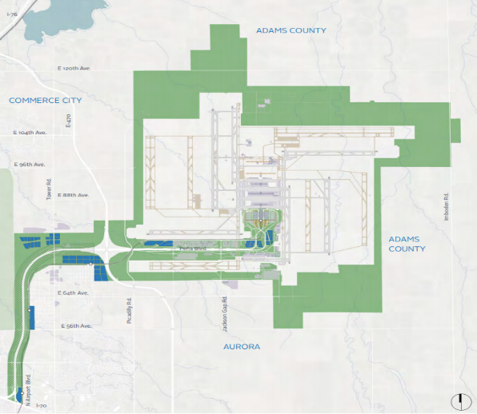
On-Call Inside/Outside Plant Telecom Infrastructure Services

Slide 17
2025 Tunnel Switchgear Heaving Remediation
Six switchgear rooms in the East and West cores of ACON, BCON, and CCON have experienced soil heaving, causing damage to both equipment and enclosures. Additionally, ACON East and West sub-cores face significant water intrusion, impacting switchgear performance.
Replace damaged switchgear and enclosures.
Install new switchgear on elevated steel platforms anchored to the basement foundation to prevent future heaving impact.
Construct code-compliant enclosures with fire-rated walls, fire suppression, and HVAC.
Remove and replace heaved soil and repair room structures.
Implement water mitigation at ACON sub-cores.
KEY INFORMATION
Anticipated Advertisement Date: Q3-Q4
Estimated Project Value: $10M to $49.99M
Small Business Program Goal: TBD
Key Scope/Industry: Electrical, Concrete, Masonry, Earthwork, Civil Utilities, Mechanical, Electrical, Plumbing
Project Manager: Mark Tabugadir| mark.tabugadir@flydenver.com
Notes:
Switchgear Room Rehabilitation Project – ACON, BCON, CCON
Issue: Six switchgear rooms in the East and West cores of ACON, BCON, and CCON have experienced soil heaving, causing damage to both equipment and enclosures. Additionally, ACON East and West sub-cores face significant water intrusion, impacting switchgear performance.
Project Scope:
Replace damaged switchgear and enclosures.
Install new switchgear on elevated steel platforms anchored to the basement foundation to prevent future heaving impact.
Construct code-compliant enclosures with fire-rated walls, fire suppression, and HVAC.
Remove and replace heaved soil and repair room structures.
Implement water mitigation at ACON sub-cores.
Delivery Method: Design-Build, guided by DEN-provided performance specifications.
Critical Considerations:
Electrical switchover from old to new switchgear must avoid operational disruptions; detailed transition planning is essential.
Switchgear is a single point of failure for DEN operations.
Procurement Strategy:
Switchgear has a 12+ month lead time.
Specifications will be finalized early to enable immediate procurement.
Design and construction will advance in parallel to prepare for equipment installation.

Slide 18
GARDI B Northeast – Design
The GARDI B Northeast project is part of the Gate Apron Rehabilitation and Drainage Improvements (GARDI) Program, focusing on the reconstruction of Gates B39, B41, B43, B45, B47, B49, B51, B53, B55, B59, and B61.
Scheduled for Q3 2026 – Q4 2027, based on gate availability, phased to rebuild 2–3 gates at a time.
GARDI Program launched in 2015 to address the heaving and settling of gate apron pavements. Existing apron pavement is 30+ years old, surpassing its 20-year design life.
KEY INFORMATION
Anticipated Advertisement Date: June 2025
Estimated Project Value: $2M to $4.99M
Small Business Program Goal: TBD
Key Scope/Industry: Concrete, Asphalt, Earthwork, Civil Utilities, Jet Fuel
Project Manager: Hunter Wardlaw| hunter.wardlaw@flydenver.com
Notes:
The current request is for the Design phase of the GARDI B Northeast project within the GARDI Program (GARDI = Gate Apron Rehabilitation and Drainage Improvements). This project is for the full reconstruction of Gates B39, B41, B43, B45, B47, B49, B51, B53, B55, B59, B61. The proposed phasing will be to re-build two to three gates at a time, which is dependent on gate availability. The GARDI B Northeast project is planned to be constructed from Q3 2026 through Q4 2027.
In 2015, DEN initiated the GARDI (Gate Apron Rehabilitation and Drainage Improvements) Program to address heaving and settling pavements at the gate apron parking positions. The existing pavement at DEN is now more than 30 years old and has exceeded its originally intended 20-year design life. The differential movement of the gate apron pavement has created non-compliant drainage conditions where water and potentially jet fuel can drain toward the concourses instead of to the trench drains as originally designed. These conditions also contribute to safety hazards for apron workers such as trip hazards, spalling concrete, and ponding on the pavement surface. The heaving and settling also has affected the underground utilities which, in some cases, have been damaged or rendered inoperable due to the differential movement of the pavement sections. These inoperable utilities can lead to costly emergency repairs and gate closures

Slide 19
GARDI A31W
This project will rehabilitate the apron airfield pavement at Concourse A, Gate A31W (Wide Body) from Q4 of 2025 through Q1 of 2026. The pavement rehabilitation includes a full-depth reconstruction and the installation of a drainable base layer. The pavement reconstruction will take place from the Concourse building face to the outer VSR trench drain and will re-establish positive drainage of the apron. In addition to pavement reconstruction, various gate apron utilities will be rehabilitated and replaced as necessary.
Proposed utility improvements include:
Install new drainable base layer
Rehabilitate/replace jet fuel hydrant pit and piping,
Emergency Fuel Shut-Off (EFSO), and storm/sanitary infrastructure
Upgrade Denver Water vaults, fire hydrants, and passenger loading bridge systems
Adjustments to Xcel Energy gas line as needed
KEY INFORMATION
Anticipated Advertisement Date: May 2025
Estimated Project Value: $5M to $9.99M
Small Business Program Goal: 20%
Key Scope/Industry: Civil paving contractors (cemented treated subgrade, asphalt, cement treated permeable base, concrete) and civil utility contractors (sanitary, storm, electrical, jet fuel, water, structures, trench drain)
Project Manager: Hunter Wardlaw| hunter.wardlaw@flydenver.com
Notes:
This project will rehabilitate the apron airfield pavement at Concourse A, Gate A31W (Wide Body) from Q4 of 2025 through Q1 of 2026. The pavement rehabilitation includes a full-depth reconstruction and the installation of a drainable base layer. The pavement reconstruction will take place from the Concourse building face to the outer VSR trench drain and will re-establish positive drainage of the apron. In addition to pavement reconstruction, various gate apron utilities will be rehabilitated and replaced as necessary.
Proposed utility improvements include:
Install new drainable base layer
Rehabilitate/replace jet fuel hydrant pit and piping,
Emergency Fuel Shut-Off (EFSO), and storm/sanitary infrastructure
Upgrade Denver Water vaults, fire hydrants, and passenger loading bridge systems
Adjustments to Xcel Energy gas line as needed

Slide 20
Design & Construction Project Delivery Support Services
Seeking consultant(s) to provide comprehensive project delivery support on a task order basis.
These services may include:
Contract Administration
Project Management (design and construction)
Project Controls (estimating, scheduling, change management)
Operational Readiness, Activation, and Transition (ORAT)
Quality Assurance Inspections (QA)
Commissioning (Cx)
Special Inspections (SI)
Materials Testing
Geotechnical Services
KEY INFORMATION
Anticipated Advertisement Date: Mid-May 2025
Estimated Project Value: $50M to $99.99M
Small Business Program Goal: 18%
Key Scope/Industry: Project Management, Contract Administration, Estimating, Scheduling, ORAT, Quality Assurance Inspections, Building Commissioning, Materials Testing, Geotechnical Services
Project Manager: Cullen Choi | cullen.choi@flydenver.com
Notes:
The Design, Engineering, and Construction (DEC) Division at Denver International Airport (DEN) is seeking proposals for a Consultant(s) who shall provide comprehensive Project Delivery Support Services to DEC. These services are intended to be provided on a project-by-project basis through the issuance of a single task order for all requested services. The task orders for the projects can span from project definition/planning, through construction closeout, operationalization, and activation. These services may include:
Contract Administration
Project Management (design and construction)
Project Controls (estimating, scheduling, change management)
Operational Readiness, Activation, and Transition (ORAT)
Quality Assurance Inspections (QA)
Commissioning (Cx)
Special Inspections (SI)
Materials Testing
Geotechnical Services

Slide 21
Legacy Concourse Restroom Renewal
Renovate 30-year-old restrooms in Concourses A, B, and C to meet modern standards and improve user experience.
Key Goals:
Align with Vision 100 – Maintaining What We Have
Standardize restroom design for easier maintenance and asset management
Implement current ADA standards
The solution is to renovate the legacy restrooms to match the new standard developed for the Concourse Expansion Program (CEP) Restrooms and apply the same concepts throughout Concourses A, B, and C as initial steps towards that goal. The new designs contain visions that improve passenger circulation flow into/out of restrooms, mechanical and electrical plumbing (MEP) systems, wayfinding signage, family rooms, and the availability of baby/adult changing stations. Separate contracts will be awarded to the Center Core and Subcore restrooms.
KEY INFORMATION
Anticipated Advertisement Date: Summer 2025
Estimated Project Value: $$10M to $49.99M each contract
Small Business Program Goal: MWBE Participation Goal TBD%
Key Scope/Industry: General construction, demolition, mechanical, plumbing, electrical, fire protection, concrete, steel, waterproofing, doors, glass, drywall/framing, ceilings, flooring, signage.
Project Manager: Ro-Tien Liang | ro-tien.liang@flydenver.com; Pamela Kohl | pamela.kohl@flydenver.com
Notes:
The Design, Engineering, and Construction (DEC) Division at Denver International Airport (DEN) is seeking proposals for a General Contractor for the renovation of the Legacy Concourse Restrooms.
The existing legacy restrooms are nearly 30 years old, do not provide the best service to the users, and require substantial maintenance. Restroom renewal has been a goal for DEN for several years; under Vision 100 Pillar – Maintaining What We Have, the renovation will expand new standards already implemented in Concourse Expansion Facilities (Vision 100 Pillar – Growing Our Infrastructure), support DEN Maintenance’s standardization of assets, and allow a common systematic approach for maintenance throughout the concourses. Additionally, ADA standards have evolved over the past 30 years, and the project will implement current standards in DEN’s restroom groups.
The solution is to renovate the legacy restrooms to match the new standard developed for the Concourse Expansion Program (CEP) Restrooms and apply the same concepts throughout Concourses A, B, and C as initial steps towards that goal. The new designs contain visions that improve passenger circulation flow into/out of restrooms, mechanical and electrical plumbing (MEP) systems, wayfinding signage, family rooms, and the availability of baby/adult changing stations. Separate contracts will be awarded to the Center Core restrooms and the Sub-core restrooms.

Slide 22
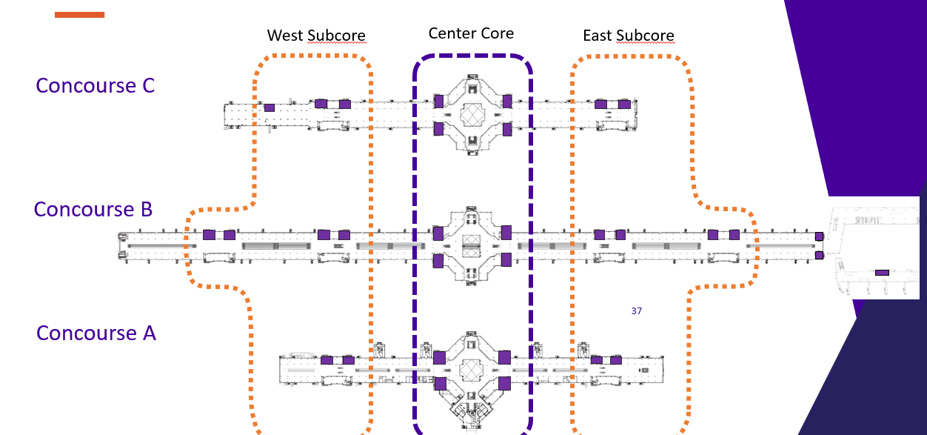
Legacy Concourse Restroom Renewal
22
Notes:
The Design, Engineering, and Construction (DEC) Division at Denver International Airport (DEN) is seeking proposals for a General Contractor for the renovation of the Legacy Concourse Restrooms.
The existing legacy restrooms are nearly 30 years old, do not provide the best service to the users, and require substantial maintenance. Restroom renewal has been a goal for DEN for several years; under Vision 100 Pillar – Maintaining What We Have, the renovation will expand new standards already implemented in Concourse Expansion Facilities (Vision 100 Pillar – Growing Our Infrastructure), support DEN Maintenance’s standardization of assets, and allow a common systematic approach for maintenance throughout the concourses. Additionally, ADA standards have evolved over the past 30 years, and the project will implement current standards in DEN’s restroom groups.
The solution is to renovate the legacy restrooms to match the new standard developed for the Concourse Expansion Program (CEP) Restrooms and apply the same concepts throughout Concourses A, B, and C as initial steps towards that goal. The new designs contain visions that improve passenger circulation flow into/out of restrooms, mechanical and electrical plumbing (MEP) systems, wayfinding signage, family rooms, and the availability of baby/adult changing stations. Separate contracts will be awarded to the Center Core restrooms and the Sub-core restrooms.

Slide 23
AOB Restack CM/GC
Seeking proposals for a Construction Manager/General Contractor (CM/GC) to provide preconstruction services and lead phased renovation during design and construction.
The renovation will encompass open and private offices, conference rooms, break areas, secure storage, and support functions. This phased partial renovation includes selective demolition, new interior construction, finish upgrades, technology improvements, and mechanical, electrical, and plumbing (MEP) system modifications as required. Special consideration must be given to minimize service disruptions to continuously occupied areas, as multiple utilities are shared between floors within the building.
Key Objective
Address overcrowding and outdated infrastructure in DEN’s 30-year-old AOB
Support Vision 100 by creating a modern, flexible workspace for current and future growth
KEY INFORMATION
Anticipated Advertisement Date: Summer 2025
Estimated Project Value: $10M to $49.99M
Small Business Program Goal: MWBE Participation Goal 15%
Key Scope/Industry: Preconstruction Services, General construction, Structural, Electrical, Demolition, Mechanical, Life safety (FA/ECS), Drywall/Painting/Ceiling, Temporary Partitions, Flooring, Millwork/Casework, Doors/Frames/HW Glazing/Storefront, Plumbing, Roofing/Exterior Walls/Exterior Windows, Fire suppression
Project Manager: Ro-Tien Liang | ro-tien.liang@flydenver.com
Notes:
Denver International Airport's Design, Engineering, and Construction (DEC) division is seeking proposals for a Construction Management/General Contractor (CM/GC) for the Airport Office Building (AOB) renovation project of floors 6-10. The selected contractor will join the Project Team during the design phase and provide Preconstruction Services.
The renovation will encompass open and private offices, conference rooms, break areas, secure storage, and support functions. This phased partial renovation includes selective demolition, new interior construction, finish upgrades, technology improvements, and mechanical, electrical, and plumbing (MEP) system modifications as required. Special consideration must be given to minimize service disruptions to continuously occupied areas, as multiple utilities are shared between floors within the building.
Key Objective
The Airport Office Building (AOB) is currently experiencing significant overcrowding across all floors and DEN work groups. This compression has intensified in recent years and meet DEN's Vision 100 Mission and projected growth trajectory. Further complicating matters, the 30-year-old facility features outdated infrastructure that lacks modern amenities and fails to meet the evolving needs of DEN's diverse workforce. This renovation aims to alleviate current space constraints while creating a modern workplace environment capable of accommodating future organizational growth.

Slide 24
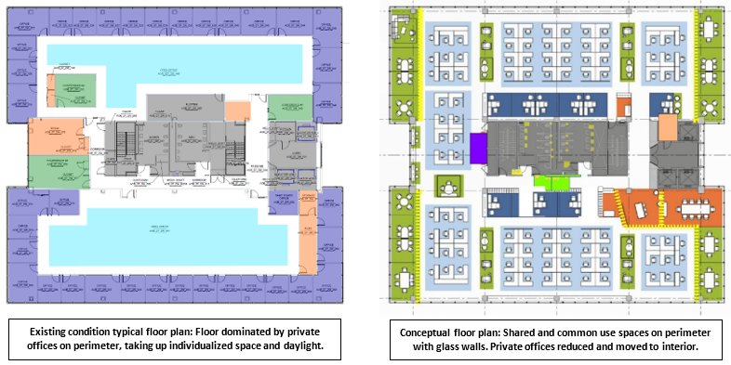
AOB Restack CM/GC

Slide 25
BCON Basement Foundation Rehabilitation
The Design, Engineering, and Construction (DEC) division at Denver International Airport (DEN) will request proposals for the purpose of selecting a vendor to provide engineering and design solutions for degrading building foundation elements in the basement in Concourse B at DEN. Services to be provided by the selected vendor include:
Investigate existing conditions: expansion joints, waterproofing, slabs, elevator pits, walls, columns
Conduct on-site surveys and review existing assessments and original construction documents
Provide structural, geotechnical, civil, and architectural design solutions
Deliver design documents from Schematic Design to Issued for Construction, aligned with DEN standards
Procurement Approach:
Fast-Track, Open Solicitation
Compressed advertisement timeline
Streamlined selection process
No contract negotiations (DEN Standard Terms)
KEY INFORMATION
Anticipated Advertisement Date: April 2025 - Fast Track
Estimated Project Value: $2M to $4.99M
Small Business Program Goal: 20% MWBE
Key Scope/Industry: Architecture and engineering investigation and repair, structural, geotechnical, joint sealant, constructability analysis
Project Manager: Nicholas Martin | nicholas.martin@flydenver.com
Notes:
The Design, Engineering, and Construction (DEC) division at Denver International Airport (DEN) will request proposals for the purpose of selecting a vendor to provide engineering and design solutions for degrading building foundation elements in the basement in Concourse B at DEN. Services to be provided by the selected vendor include:
Investigate and report on existing conditions of exterior expansion joints in concrete basement walls, waterproofing at exterior utility penetrations, basement walls, slabs-on-grade, elevator pits, concrete-masonry walls, and concrete columns. The investigation involves an extensive on-site survey and a complete review of existing condition assessment reports and the original construction documents.
Develop structural, geotechnical, civil, and architectural design solutions and present design documents to DEN at all stages of development (from Schematic to Issue for Construction). Design documents incorporate all DEN standards and thorough collaboration with DEN subject matter experts.
Design Procurement Type: Fast-Track, open solicitation:
Compressed advertisement period
Streamlined selection process
No negotiation of contract (DEN Standard Design Terms)

Slide 26
On-Call Airside Facility Maintenance & Repair Services
Select two contractors (up to $10M each) to provide on-call maintenance and repair services across DEN’s airside facilities.
Scope Includes:
Concourses, Transit Center, Central Utility Plant, and support facilities
Mechanical, Electrical, and Plumbing (MEP) systems, including below-grade infrastructure
Tasks ranging from small repairs to major rehabilitation
​
KEY INFORMATION ​
Anticipated Advertisement Date: Q2 2025
Estimated Project Value: $10M to $20M
Small Business Program Goal: 18 %
Key Scope/Industry:​ Building, HVAC, Electrical, Mechanical, Fire Protection, Plumbing
Project Manager​: Jacqueline Wilson | jacqueline.wilson@flydenver.com
Notes:
This Request for Proposal is a competitive bid for the On-Call Airside Facility Maintenance and Repair Services contract at Denver International Airport (DEN). The Denver International Airport Airside consists of the three (3) airside concourses, transit center, central utility plant, and numerous ancillary support facilities including mechanical, electrical and plumbing (MEP) systems. Some systems are located below grade which serve these above-grade facilities. Through years of construction, operations, and maintenance the facilities around DEN campus have aging external peripheral components and internal infrastructure deteriorations as most of these assets have reached their functional obsolescence.
This RFP On-Call Airside Facility Maintenance Repair and Services contract is intended to have the ability to complete a variety of numerous small, mid-size and large tasks generated within its budget capacity. This contract aligns with DEN Vision 100 strategic plan pillar “Maintaining What We Have” to support the effective lifecycle management, reduce asset downtimes, upgrades to improve efficiency, and rehabilitation of existing facilities.
This contract will be awarded to two (2) contractors $10M each.

Slide 27
On-Call Landside Facility Maintenance & Repair Services
Select two contractors (up to $10M each) to provide on-call maintenance and repair services across DEN’s landside facilities.
Scope Includes:
Main Terminal, AOB, Hotel & Transit Center, Parking Structures, and support facilities
MEP systems, including below-grade infrastructure
Tasks ranging from minor repairs to major rehabilitation
Objective:
  Address aging infrastructure and functional obsolescence
  Support Vision 100 – Maintaining What We Have
  Improve efficiency, reliability, and asset lifecycle performance
​
KEY INFORMATION ​
Anticipated Advertisement Date: Q2 2025
Estimated Project Value: $10M to $20M
Small Business Program Goal: 14 %
Key Scope/Industry:​ Building, HVAC, Electrical, Mechanical, Fire Protection, Plumbing
Project Manager​: Jacqueline Wilson | jacqueline.wilson@flydenver.com
Notes:
This Request for Proposal is competitive bid for the On-Call Landside Facility Maintenance and Repair Services contract at Denver International Airport (DEN). The Denver International Airport Landside consist of the main terminal, north terminal support facility, airport office building, parking structures, hotel and transit center, and numerous ancillary support facilities including mechanical, electrical, and plumbing (MEP) systems. Some systems are located below grade which serve above-grade facilities. Through years of construction, operations, and maintenance the facilities around the DEN campus have aging external peripheral components and internal infrastructure deteriorations as most of these assets have reached their functional obsolescence.
This RFP On-Call Landside Facility Maintenance Repairs and Services contract is intended to have the ability to complete a variety of numerous small, mid-size, and large tasks generated within its budget capacity. This contract aligns with DEN Vision 100 strategic plan pillar “Maintaining What We Have” to support the effective lifecycle management, reduce asset downtimes, upgrades to improve efficiency, and rehabilitation of existing facilities.
This contract will be awarded to two (2) contractors for $10 million each.
​

Slide 28
Central Utility Plant & Outlying Building Boiler Maintenance
Select a qualified contractor to perform inspection, maintenance, repair, testing, and calibration of existing boilers and associated equipment.​
Scope of Work:
Boilers: 1, 2, 3A, 3B, 4, 5A, 5B
Ensure compliance with DEN Safety Standards, OSHA, ASME, and Pressure Vessel Code
Includes internal and external inspections
Requirements:
The contractor must provide all labor, tools, materials, supervision, and equipment necessary to complete the work
KEY INFORMATION ​
Anticipated Advertisement Date: Q2 2025
Estimated Project Value: Less than $500K
Small Business Program Goal: No DSBO program
Key Scope/Industry:​ Commercial and industrial machinery repair and maintenance services / Industrial equipment and machinery repair and maintenance services / Material handling equipment repair and maintenance services / Service machinery and equipment repair and maintenance services
Project Manager​: Jacqueline Wilson | jacqueline.wilson@flydenver.com
Notes:
This is a competitive RFP to select a qualified contractor to perform internal and external inspections, maintenance, repairs, testing, and calibration safety as necessary to remain compliant with DEN Safety standards, OSHA regulations, and the ASME and Pressure Vessel Code requirements. Services will be performed for existing boilers 1, 2, 3A, 3B, 4, 5A, and 5B and associated equipment for the Central Utility Plant will be provided. The contractor shall provide all necessary personnel, equipment, tools, materials, supervision, and other items.

Slide 29
On-Call Safety Management System (SMS) Facilitation and Support Services
​Denver International Airport (DEN) is seeking an experienced consultant to provide on-call support for its Safety Management System (SMS) program. This contract will support tasks such as facilitating safety risk assessments, auditing SMS implementation, developing safety policies and procedures, and enhancing safety promotion efforts. The selected firm must demonstrate recent airport SMS experience and be capable of collaborating across DEN departments to drive continuous safety improvement.
KEY INFORMATION ​
Anticipated Advertisement Date: Q2 2025
Estimated Project Value: Less than $500K
Small Business Program Goal: No Goal
Key Scope/Industry:​ Professional Consulting
Project Manager​: Travis Krabbenhoft | Travis.Krabbenhoft@flydenver.com
Notes:
Denver International Airport (DEN) is seeking an experienced consultant to provide on-call support for its Safety Management System (SMS) program. This contract will support tasks such as facilitating safety risk assessments, auditing SMS implementation, developing safety policies and procedures, and enhancing safety promotion efforts. The selected firm must demonstrate recent airport SMS experience and be capable of collaborating across DEN departments to drive continuous safety improvement.

Slide 30
Passenger Analytics
Develop a comprehensive analytics platform that integrates data from cameras, Lidar, Wi-Fi, IoT sensors, and more to provide a unified view of vehicle and passenger movement, generate insights, and enable real-time recommendations and alerts.
Key Capabilities:
AI & Machine Learning: Analyze complex data sets for predictive and real-time insights
Unified View: Track passenger movement from curb to gate across all touchpoints
Actionable Insights: Identify bottlenecks, optimize flow, and improve decision-making
Real-Time Alerts & Recommendations: Notify staff of anomalies and suggest proactive responses
Use Case Highlights:
AGTS train platform dwell times
Restroom and concession usage tracking
Security and FIS wait time monitoring
Baggage carousel and curbside dwell analysis
Passenger counts across terminals, concourses, and transit centers
​
KEY INFORMATION ​
Anticipated Advertisement Date: Q2 2025
Estimated Project Value: Less than $500K
Small Business Program Goal: TBD
Key Scope/Industry:​ Advanced Analytics, Video Analytics, AI Solutions
Project Manager​: Tracy Whitling; tracy.whitling@flydenver.com
Notes:
To create a comprehensive analytics solution that leverages multiple data inputs including but not limited to Cameras, Lidar, Wi-Fi / Network, and other sensors (IoT) to provide a cohesive view of vehicle and passenger movements, deliver actionable insights, and enhance airport operations through recommendations and alerting.
Analytics and Insights
Requirements:
· Machine Learning and AI: Implement machine learning and AI techniques to analyze data and generate meaningful insights[3][4].
· Cohesive View: Create a unified view of passenger movements from curb to gate, encompassing all relevant touchpoints.
· Actionable Insights: Provide analytics that help in understanding passenger flow patterns, identifying bottlenecks, and optimizing operations.
Key Points:
· Leverage AI and machine learning for advanced analytics.
· Ensure a cohesive and comprehensive view of passenger movements.
· Generate actionable insights to improve airport operations.
3. Recommendations and Alerting
Requirements:
· Real-Time Recommendations: Offer real-time recommendations to enhance passenger experience and operational efficiency.
· Alerting Mechanisms: Implement alerting systems to notify airport staff of potential issues or anomalies in passenger flow.
Key Points:
· Provide timely recommendations to optimize operations.
· Ensure robust alerting mechanisms for proactive issue resolution.
4. Use Cases
Requirements: The solution must minimally address the following potential airport use cases, but ideally will not focus solely on deployment of individual use cases but a comprehensive airport wide analytics solution from Curb to Gate:
· AGTS Train Platform Counts and Dwell Time: Monitor passenger counts and dwell times at train platforms to optimize scheduling and capacity[5].
· Restroom Use: Track restroom usage to ensure cleanliness and availability.
· Passenger Movement Throughout Terminal: Analyze passenger movements to assess planning-related needs and strategies.
· FIS Passenger Wait Times & Dwell Time: Monitor wait times and dwell times at Federal Inspection Services (FIS) areas.
· Security Checkpoint Wait Times: Measure wait times at security checkpoints (South / Bridge) from the end of the line.
· Passenger Movement Throughout Concourses: Analyze passenger movements from a concession lens to optimize retail space.
· Baggage Carousel People Counts and Dwell Time: Monitor people counts and dwell times at baggage carousels.
· Vehicle Counting and Dwell Time - Curbside: Count vehicles and monitor dwell times at curbside areas.
· Conveyance Usage - People Counts: Track people counts using conveyance systems.
· Concessions Wait Time & Dwell Time: Monitor wait times and dwell times at various concession locations.
· Hotel Transit Center - Passenger Counts: Monitor passenger counts at the hotel transit center.

Slide 31
Security Services, Public Area and Curbside Interfaces
Select a qualified firm to provide security services at Denver International Airport (DEN).
Scope of Work:
Traffic control, security at sensitive access points, and door alarm response
Loading dock oversight (50+ deliveries/day), patrols, credential verification, and incident resolution
Public Parking Lot patrols, Airport Office Building access, and person vetting
Enforcement of DEN Rules & Regulations and additional security posts as needed
Workload:
5400 weekly hours (135 FTEs), including Full-Time, Part-Time, and On-Call positions
24/7 staffing for curbside, passenger pick-up/drop-off on levels 4 & 6
Support for 40,000+ vehicle entries per day
​
KEY INFORMATION ​
Anticipated Advertisement Date: Q2 2025
Estimated Project Value: $50M to $99.99M
Small Business Program Goal: 5% MWBE
Key Scope/Industry:​ Security Guard Services, Public Area, and Curbside Interfaces
Project Manager​: Matt Gomez-Peterson; matthew.gomez-peterson@flydenver.com
Breakout Room Closed – Contact Project Manager
Notes:
This request is for a competitive Request for Proposal (RFP) to select a qualified firm to provide essential security coverage at Denver International Airport (DEN).
This Curbside and Public Area Interfaces contract includes terminal traffic control, protection of sensitive security access points, door alarm response in the main terminal, loading dock oversight, security incident resolution, patrols, credential verification, enforcement of all applicable DEN Rules and Regulations, Public Parking Lot Patrols, Airport Office Building Gate Access Point, Loading Dock Operation which facilitates over 50 deliveries per day, person vetting, and additional posts as required.
The selected firm will be responsible for the oversight of approximately 5400 weekly hours or 135 Full Time Equivalent (FTE) employees. All Traffic Officer positions combined support over 40,000 vehicle entries per day into passenger pick-up and drop-off locations at the Main Terminal at DEN. Hours can be broken down by FT (Full Time), PT (Part-Time), and On-Call. The curbside, passenger pick-up, and drop-off must be staffed 24/7 on levels 4 and 6. Hours will be adjusted based on operational needs or security threat directives. Loading Dock Operation, which facilitates over 50 deliveries per day.

Slide 32
2025 On-Call Marketing, Advertising, Media and Creative Services
DEN is looking for a creative on-call marketing, advertising, media, communications and design firm (Agency) to provide DEN with cost-effective, thoughtful, strategic marketing plans and executions that are based in sound business reason and measurable with actionable analytics.
DEN desires to have one marketing and advertising agency of record to bring diversity of thought, skillset and unique specialties in order to service projects and initiatives of various and size and caliber. This RFP is being proposed as a three-year engagement with the potential to extend an additional two years. Due to the nature of onboarding agencies with branding, marketing and creative services, the ramp-up is considerable and time consuming and as such, we have included a five-year budget should DEN decide to exercise the extension options.
KEY INFORMATION
Anticipated Advertisement Date: Q2 2025
Small Business Program Goal: 30% MWBE Participation Goal
Estimated Project Value: $5M to $9.99M
Key Scope/Industry: creative on-call marketing, advertising, media, communications and design.
Project Manager: Brittany Farber | Brittany.Farber@flydenver.com
Notes:
DEN is looking for a creative on-call marketing, advertising, media, communications and design firm (Agency) to provide DEN with cost-effective, thoughtful, strategic marketing plans and executions that are based in sound business reason and measurable with actionable analytics.
DEN desires to have one marketing and advertising agency of record to bring diversity of thought, skillset and unique specialties in order to service projects and initiatives of various and size and caliber. This RFP is being proposed as a three-year engagement with the potential to extend an additional two years. Due to the nature of onboarding agencies with branding, marketing and creative services, the ramp-up is considerable and time consuming and as such, we have included a five-year budget should DEN decide to exercise the extension options.

Slide 33


Program Purpose
To reduce barriers for small businesses to operate autos unescorted airside, we introduce the new Airside Excess Auto Liability Program, also known as the AirsideDrive Program. The program provides $9M in excess of $1M in coverage for entities to meet the minimum unescorted airside driving insurance requirements of $10M Combined Single Limit each occurrence of Auto Liability.
Benefits: Supporting our Airside Partners
Affordable Coverage
Bridging the Gap
Easy Access
Comprehensive Protection
Small/Emerging Business Boost
Scan now to learn more

Slide 34
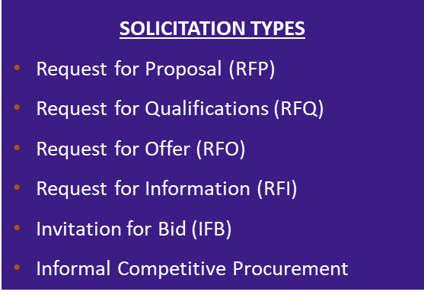
DEN Procurement
Procures competitive contracts:
Professional Services
Construction
Revenue Opportunities
Processes non-competitive contracts:
Sole Source
Professional Preference
Amendments
Grants
Revenue Agreements
Facilitates competitive and non-competitive task order process
Governed by ordinances and regulations including; City and DEN Charter & Ordinances, DSBO, Executive Order 8, and City Procurement and Fiscal Rules

Slide 35
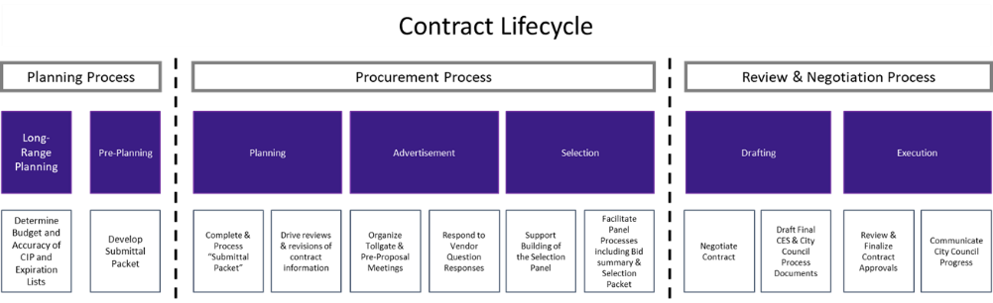
DEN Procurement – Contract Lifecycle
Active DEN Procurements & Solicitations are available on BidNet: https://www.bidnetdirect.com/colorado/cityandcountyofdenverdepartmentofaviation
  Important Dates:
    Published/Advertised Date
    Proposal Due Date
  Important Information:
    Pre-proposal meetings outlining project details
    Proposal Narrative Contents & Evaluation Criteria

Slide 36
Fast-tracking: What Does It Mean
New procurement method for DEN that is currently a pilot program.
Intent is to foster innovation and agility by fast-tracking certain qualified procurement projects. Eliminate steps in the procurement process that are not mandated by city law, ordinances, executive orders, and other governance requirements.
Key features of a fast-tracked opportunity include:
  Compressed advertisement period
  The pre-proposal meeting will not be held, and qualified projects will be advertised for one week. Questions will be due within 2 days of advertisement.
  Simplified selection process
  A 3-member panel composition will make an award recommendation based solely on their independent review and scoring of proposals. No interviews will be held.
  Simplified contract drafting process
  The final written contract will be based solely on what the winning vendor commits to in their proposal. There will be no negotiations to the final written contract.

Slide 37

ACDBE Program
Denver International Airport (DEN) is a primary airport that receives federal financial assistance from the Federal Aviation Administration (FAA).
As a condition of receiving FAA assistance, DEN is responsible for implementing all aspects of the Airport Concessions Disadvantaged Business Enterprise (ACDBE) program (49 CFR Part 26 and Part 23).
Key Objectives:
Non-discrimination​
Fair Competition​
Eligibility Verification​
Promoting Diversity​
Business Development
Notes:
As a primary airport that receives financial assistance from the Federal Aviation Administration (FAA), it is DEN’s Policy to ensure that Airport Concessions Disadvantaged Business Enterprises (ACDBEs) have an equal opportunity to receive, participate in, and fairly compete for all concession opportunities at DEN as defined in 49 CFR Part 23 and Part 26.
Some of our key objectives are outlined on this slide and are also available on our website.

Slide 38




DEN’s ACDBE Team
Goal Setting
Triennial FAA Goals
Concession-Specific Goals
Certification
New Certification
Interstate
Annual DOEs
3-Year Reviews
Compliance
Pre-Award
Post-Award
JV Reviews
Site Visits
Outreach
Volunteering
Networking
Engagement
Education and training
Notes:
DEN’s ACDBE team operates under the Culture & Strategy Division’s Airport Access & Business Opportunity (AABO) team, formerly known as the Commerce Hub. We are a small but mighty team of 6.
Our office is responsible for setting goals on concession-specific opportunities.
We certify new businesses and maintain active certifications, while also maintaining the integrity of the ACDBE program throughout the Lifecyle of a concession agreement including all pre-and-post-award activities.
Most importantly, we volunteer, network, educate, train, and engage with the small business concessions community in meaningful ways (teaching BDTA classes, TFD, MTP, Nav. ACDBE).

Slide 39




DSBO Overview
Promoting equity, maximizing opportunities, and preventing discrimination and its effects against small, minority and women owned businesses.
Auditing and Analytics: Business Utilization, Forensics
Strategic Development and Community Engagement
Certification
Compliance
Notes:
The City and County of Denver's certification programs, and the Division of Small Business Opportunity (DSBO) who administers these programs, were created to promote equity, maximize opportunities, and prevent discrimination and its effects against small, minority and woman owned businesses. ​​
​​
The primary goal of the certification programs is to level the playing field and provide a fair opportunity for small businesses to compete for City and County of Denver and DEN airport contracts.
Strategic Development and Community Engagement
Connects small businesses with the DSBO program and provides resources to help them successfully develop and pursue work with the city
Certification
Approves small businesses’ applications for certification and ensures that all certified businesses remain compliant with program and eligibility requirements
Auditing and Analytics: Business Utilization
Assesses city projects that are locally funded or on city land for MWBE, DBE contract participation goals and SBE defined selection pool designations.
Compliance
Monitors small business utilization from solicitation through the contract term to ensure equity protections.

Slide 40
Compliance
Preventing Discrimination: Ensuring fair practices in solicitation, contracting, and performance activities.​
​
Certified Business Requirements: Upholding commitments and Good Faith Efforts (GFE).​
​
Commercially Useful Functions: Ensuring firms perform a distinct element of the work of a contract and carry out such work, by performing, maintaining control, managing, and supervising the work involved.​
​
Contractor Prompt Payment: Overseeing and enforcing timely subcontractor payments ​
​
Tracking Participation: Monitoring certified business participation and self-performance requirements.​
​
Risk Prevention: Preventing certified subcontractors from working at risk.​
​
Certified Firm Utilization Changes: Ensuring terminations, substitutions, and scope reductions happen for good cause only.​
​
Subcontract Agreement Requirements: Helping stakeholders understand DSBO requirements.​
​
Compliance Reporting: Ensuring comprehensive compliance reporting.​
For more information about DSBO and to find certified firms, please visit: https://www.denvergov.org/content/denvergov/en/denver-office-of-economic-development/do-business-with-denver.html
Notes:
DSBO’s compliance team monitors small business utilization from solicitation through the contract term to ensure equity protections and adherence to our program requirements from enforcing timely subcontractor payments
Bring attention to the Small Biz, Big Wins

Slide 41
Certification (MWBE, EBE, SBE(C), and DBE)
Applying for Certification(s):
Online Application
Monthly webinar “Understanding Certification”
Must be actively certified (in the correct codes) at the time of bid or when the letter of intent is signed
Maintaining Your Certification(s):
Submit an Annual Update every year.
For changes to NAICS codes submit a NAICS Expansion Application
For changes in ownership, business structure, or control submit a Material Change Application
Notes:
Eligible small businesses may apply for certification in one or more of our certification programs.

Slide 42
Connect with Us
Visit our website: www.denvergov.org/dsbo
Call: (720) 913-1714
Sign up for the DSBO weekly newsletter
Certification: certificationinfo@denvergov.org
DEN Compliance: dsbo@flydenver.com
Downtown Compliance: dsbo@denvergov.org
General inquiries: dsbohelp@denvergov.org

Slide 43
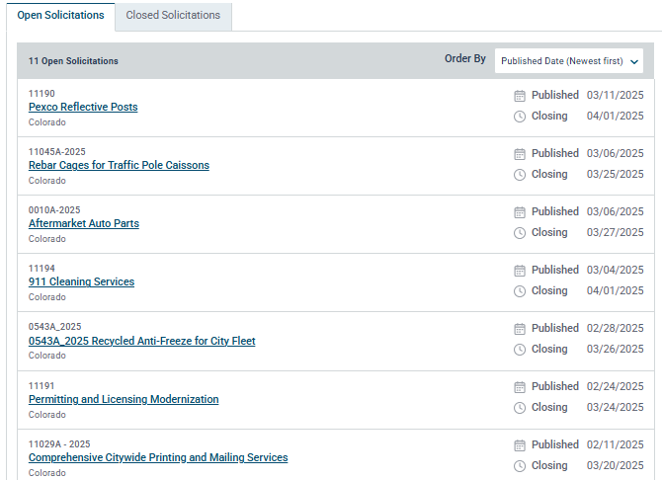

General Services- Purchasing Division
Exclusive management and control of the purchasing of all supplies, equipment and personal property and services in connection therewith, for the City and County and for all departments (including DEN), agencies, boards, commissions and authorities thereof, except the City Council.
Leann Rush
Senior Procurement Analyst (DEN)
303-342-2298
leann.rush@flydenver.com
Natelee Wilson
Associate Procurement Analyst
Natalee.wilson@flydenver.com
You must be registered in Bidnet
to receive solicitation notices
directly to your email. Please make
to choose the correct codes for your
business.

Slide 44


General Services- Purchasing Division Cont.
First Thursday of the month at 9:00am Register on Eventbrite

Slide 45

DCCP Overview
DCCP strives to ensure Denver Residents have the opportunity to obtain sustainable careers on city funded construction projects.
The Workforce Ordinance applies:
  To large construction contracts advertised and large
  work orders issued on or after May 30, 2024.
    When the contracting agency estimates that a
    construction contract or work order will be for $10M+.
    If a bid or proposal for a construction contract or work
    order of $10M+ is accepted. Note: On-Call Work Orders/Task
    Orders are individually evaluated for workforce requirements.
Prime Contractors will be required to return a signed Workforce Commitment Form. It is the responsibility of the Prime Contractor
to meet all Workforce Requirements.
Contractor’s failure to comply may result in a penalty of thirty-one
dollars ($31) for each hour not achieved up to a maximum
of 3% of the maximum contract amount.

Slide 46

DCCP Workforce Requirements for DEN
Construction Projects $10M+
1
WORKFORCE COORDINATOR
3
TRAINING STRATEGY
Identify a Workforce Point-of-Contact to ensure the implementation of the Workforce Plan
        For Vertical Projects:
        15% total construction hours by Registered Apprentices
        3.75% total construction hours by Target Category Apprentices
        3.75% total construction hours by First-Year Apprentices
        For Horizontal Projects:
        3% total construction hours by Registered Apprentices
2
TARGET HIRE/
OUTREACH & ENGAGEMENT
15% total construction hours from Target Categories:
  Priority Neighborhoods
  Veterans
  Graduates of DCCP-Approved
  Pre-Apprenticeship Programs
        Outreach & Engagement to Target Categories
4
REPORTING & TRACKING
Metrics and strategies to track and report progress on meeting the Workforce Plan
LCPtracker (Prevailing Wage System)
Microsoft Power BI: Data Visualization
Connecting Colorado (State Workforce System)

Slide 47
Registered Apprentice Information
Apprentices must be enrolled in registered apprenticeship programs (RAPs)
RAPs can be in-house or multi-employer, union or non-union
Check the Directory to ensure programs are registered, or to find a
multi-employer program to join
Program not registered? Connect with Apprenticeship Colorado, the State Apprenticeship Agency, to establish a registered apprenticeship program and explore funding opportunities
Reminder: the apprentice-to-journeyman ratio for city projects is 1:1

Slide 48
DCCP Contact Information
Direct All Questions to:
dccp@denvergov.org
John Fraundorfer, DCCP Program Coordinator
john.fraundorfer@denvergov.org
p: 720-913-1793 | c: 720-629-1315
Derrick Watson, DCCP Director
derrick.watson@denvergov.org
p: 303-725 4936| c: 303-725-4936
For More Information:
WWW.DENVERGOV.ORG/WORKFORCE/DCCP
Notes:
If you have any questions, here is my contact information.

Slide 49
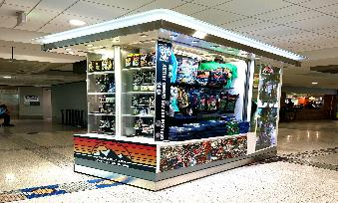
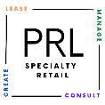

Overview of Program
Provenzano Resources, Inc. (PRI) specializes in creating dynamic, revenue-generating retail spaces in airports while empowering local, veteran, minority, and women-owned businesses through our Small Business Launchpad program. With a proven track record at Denver International Airport (DEN) and San Jose Mineta International Airport (SJC), we bring innovative solutions to airports.
Our mission is to enhance passenger experiences, drive local economic growth, and provide businesses with the tools they need to succeed in the competitive airport environment.
No RFP-No Construction
Short-term, Low-risk commitment
2024 ACDBE sales averaged over 37% of PRL’s merchants’ overall sales
2024 average monthly Kiosk/Retail Merchandising Unit Sales over $30,000
“There is no place like DEN to sell and introduce customers to your brand! It has been amazing seeing customers from all over the world shop at our DEN kiosks.”
Jimmy Bryant - Owner/Designer, Atomic Child
www.PRIRetail.com
Notes:
Hello and thank-you for your interest in learning about the exciting opportunities that we can offer to small businesses here at DEN.
Our company is Provenzano Resources and we provide the Small Business Launchpad for retailers to open or expand their business at DEN with short-term and low-risk commitments.
Our program doesn’t require responding to an RFP.
With our program there’s no construction, nothing to build or buy.
You bring the fantastic sales team and spectacular merchandise and focus on what matters – making the highest sales possible in this busy and exciting airport!

Slide 50
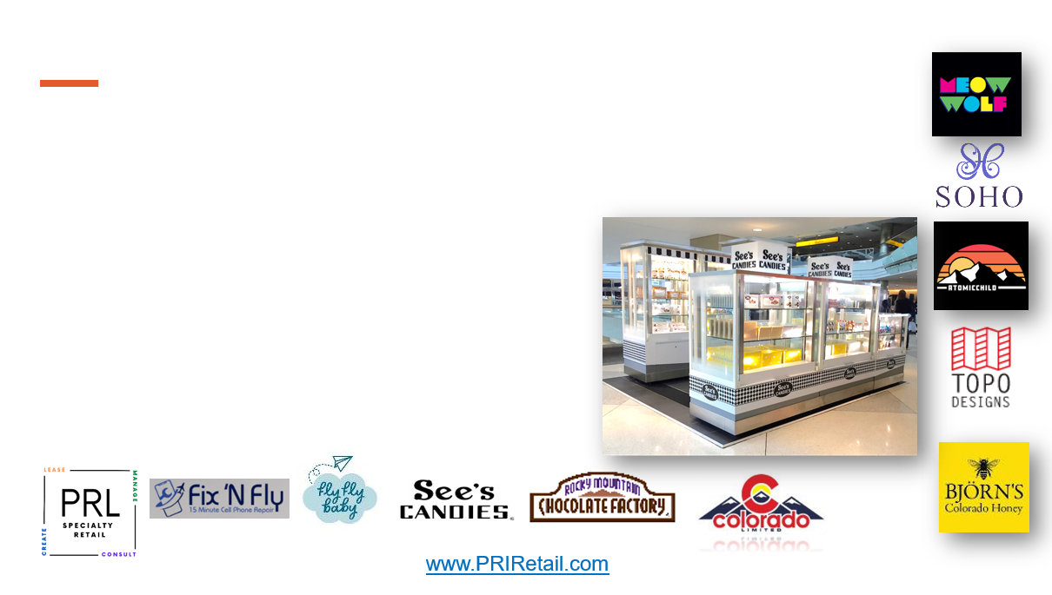
PRL Provides Opportunity and Operational Support
PRL streamlines logistics by offering turnkey services and staff to support product receipt, storage, delivery, onboarding/training, badging, and administrative support, reducing complexity for new merchants.
“PRL provides support for small business in the airport with a two-prong approach, working directly with a leasing team and forgoing the RFP process and also working with the operations team who accepts and delivers product on your business’ behalf. They take all the guesswork out of the equation and work alongside WITH you to make your business successful.”
Kara Dar - ACDBE Owner National Essentials dba See’s Candies

Slide 51
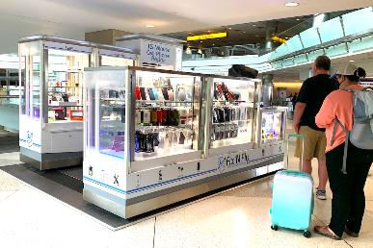
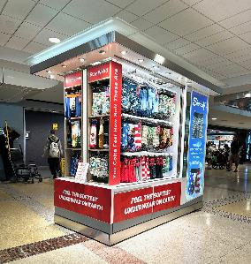

PRL Provides Kiosks and Retail Merchandising Units
Retail units (RMU/Kiosk) are provided by PRL; some custom exceptions
"We always wanted to have a retail presence at DEN. PRL not only gave our small business the opportunity to get started, they were instrumental in helping us become successful. The amount of positive comments we get from local customers as a result of our presence at DIA is incredible. Thank you PRL!"
Chris White - Owner Shinesty
Kiosks: Glass cases configured to allow passenger entry and shopability with a separate cash wrap and POS area
General Participation Costs:
Minimum Monthly Fees (Rent): Generally, $4,000-$6,000 per month
15% over the natural breakpoint (higher of rent or 15% of sales)
Monthly Ancillary Fees: approximately, $650
DEN Marketing Fee: 1/2% of all gross sales
RMUs: 3 sides of retail display area with a 4th side for cash wrap and POS
www.PRIRetail.com
Notes:
The easiest path to entry is using one of our retail units
We have 14 kiosks, which are custom units configured to allow passengers to shop from inside or outside the unit
And we have Retail Merchandising Units, which are similar to shopping center carts with 3 retail sides and a built-in cashwrap area
Monthly fees are plus or minus $5000 depending on a number of factors
For those interested in greater detail I’m happy to go over more details in the breakout session

Slide 52
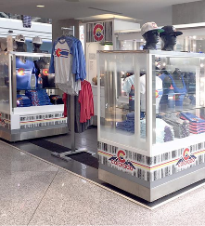


Come Join Us!
Looking forward to answering questions and networking in the breakout room!
"Airport retail is really the only place that retail makes sense anymore. The sheer volume of consistent customers is exponentially more than malls, outlets, etc. Colorado Limited is thrilled to be part of the Specialty Retail program at DEN. If you have a product to sell, you need to be in this airport!"
Dave Kolin-Owner - Colorado Limited
Cord@PriRetail.com
303.342.6818 or 303.342.6817
www.PRIRetail.com
www.PRIRetail.com
Notes:
So that’s the basics!
We have a fantastic group of hardworking and successful merchants in our program and we’re always looking to welcome new retailers, new concepts and new ideas!
I hope some of you will join my breakout session so I can answer your questions and hopefully get to know some great future DEN Specialty Retailers!
Thanks again for your time and enjoy the rest of the presentations!

