Slide 1
Taking Flight at DEN
June 2025
Notes:
Good afternoon, everyone.
Thank you for being here today for Taking Flight at DEN.
My name is Desiree Mondragon, Outreach Administrator here at DEN.

Slide 2
Legal Disclaimer​
This event is intended to provide the business community with early notice for potential procurement opportunities at DEN, allow companies to meet DEN project managers, and allow firms to network and foster relationships with each other. Projects included in this event are in their early stages of planning, and critical information about these projects (e.g. dates and goals) may be unknown and are otherwise subject to change. In its discretion, the City and County of Denver may cancel, modify, or place any project on hold at any time, for any reason. ​
Notes:
This event aims to notify the business community of potential procurement opportunities at DEN,
Attendees can network with project managers and other members of the business community.
Note: Projects are in the early planning stages and the City and County of Denver can cancel or modify any project at any time.

Slide 3
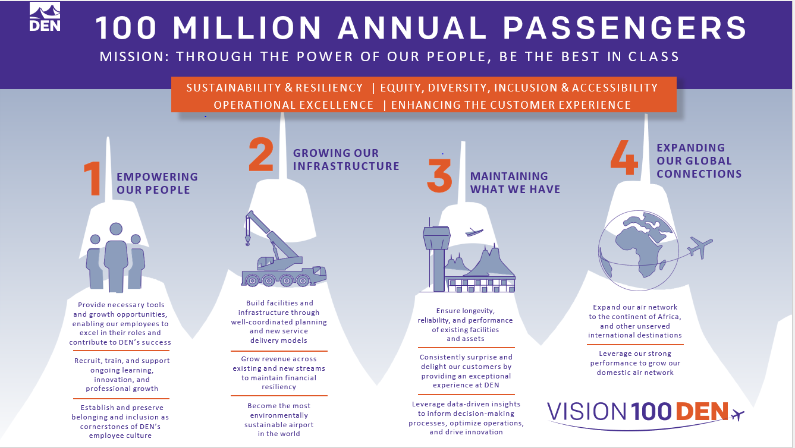
Vision 100 and Operation 2045
Notes:
Vision 100 and Operation 2045 are phases of DEN's strategic plan.
Vision 100 aims to prepare the airport for 100 million annual passengers.
Operation 2045 focuses on the airport's 50th anniversary and plans for over 120 million annual passengers.
Together, they guide decision-making and accountability here at DEN.

Slide 4


Taking Flight at DEN
Monthly event showcasing multiple procurement opportunities, set for the 2nd Thursday of each month at 1 p.m.
**January 23** - Due to holiday schedules
  February 13
March 13
  April 10
May 8
June 12
July 17
August 14
September 11
October 9
November 13
December 11
Notes:
DEN is committed to eliminating barriers for small businesses at the airport.
“Taking Flight at DEN” highlights our procurement opportunities and facilitates networking. project managers, members of the business community, and resource partners.

Slide 5


Meet the Primes
Virtual outreach event held twice a month to connect Prime firms at DEN with local, small, and historically underutilized firms, scheduled for the 3rd Thursday at 1 p.m.
February 20 - Concessions Prime Operators
April 17 - Rental Car Company
June 26- General Contractors
August 21 - Construction Specialty Trade Contractor (MEP, Painting, Millwork, Drywall, Acoustical, Flooring, Concrete, Metals, Glass Glazing, Trucking, More)
October 16 - Airlines, Real Estate, Commercial Development and Hotelier
December 18 - Architecture, Engineering, and Professional Services
Notes:
Meet the Primes aims to connect Prime firms at DEN with the business community.
Our calendar provides various opportunities to engage with different types of companies.

Slide 6


Navigating the ACDBE Series: Pathways to Concessions
Bi-monthly virtual outreach event held on the third Thursday at 1 p.m. will guide ACDBEs on doing business at DEN.
Pathways to Concessions 2025:
January 16 – ACDBE 101
March 20 – ACDBE 201
May 15 – Joint Ventures 101
July 17 – Joint Ventures 201
September 18 – Concessions Connections
November 20 – B2G Compliance
Notes:
The “Navigating the ACDBE Program” series helps retail and F&B businesses understand certification and compliance for concessions.
Here’s are the remaining sessions

Slide 7
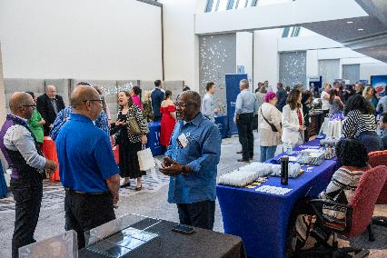
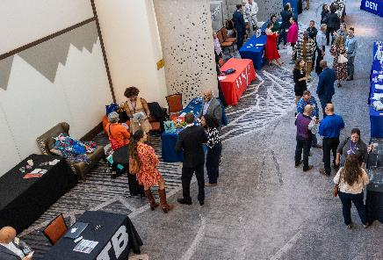
Save the Date - Procurement Tradeshow
August 28, 2025
Westin Denver International Airport
An exciting event designed to foster business partnerships between:
Denver International Airport (DEN)
The City and County of Denver
Prime Contractors
Small Businesses
Resource Partners
Exhibitor Opportunities Coming Soon!
Notes:
Save the date for the Exhibitor Showcase and Tradeshow on August 28.
Sign up for our newsletter and follow us on LinkedIn for more updates as they become available.

Slide 8
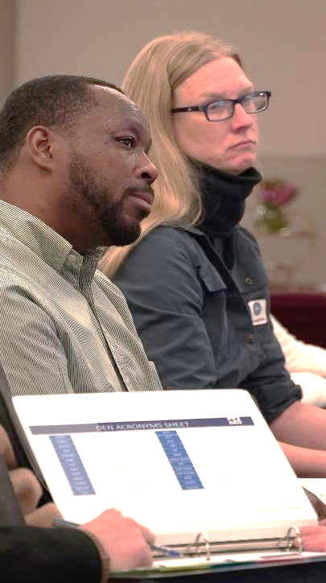



Community Panelist Program
Volunteer program for those who want to participate in a procurement evaluation panel.
Great experience for potential primes
Attain an understanding of the evaluation process
Become familiar with DEN’s values
Gain experience with DEN’s interview format
Scan to Sign Up Today!
We Want Your Story!
Notes:
Volunteer as a Community Panelist for an upcoming procurement evaluation.
Gain insights and improve future proposals. Scan the QR Code to learn more.
Already Participated?
We’re seeking testimonials from past panelists!
Share your experience in the event follow-up email

Slide 9
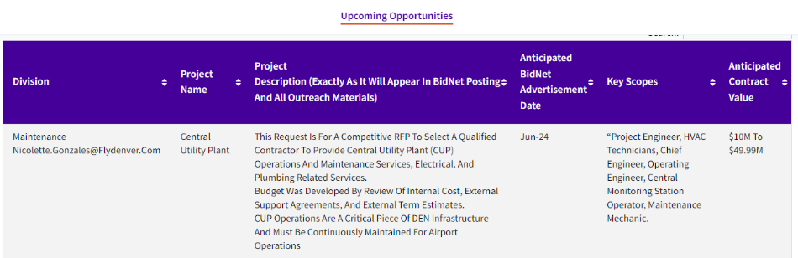

Upcoming Opportunities – Updated Webpage
Notes:
Our website lists procurement opportunities at various procurement stages.
Please be aware that details may change, and the City and County of Denver can modify or cancel projects at their discretion.
Now, we'll hand it over to our project managers.

Slide 10
Customer Experience Consultant
Denver International Airport (DEN) is seeking assistance in creating a comprehensive customer experience strategy, focusing on enhancing the customer journey and overall experience. This scope includes a detailed analysis of the current state, stakeholder interviews, competitive landscape assessment, segmentation development, and strategic imperatives. The goal is to implement a unified customer experience strategy that aligns all DEN employees under a single vision with deliverables that include journey map, updated customer segmentation & profiles, strategic imperatives, and an all-employee visioning campaign to focus on a single customer service philosophy
KEY INFORMATION
Anticipated Advertisement Date: Q2
Estimated Project Value: $$500K to $1.99M
Small Business Program Goal: MWBE Participation Goal 15%
Key Scope/Industry: Consultant
Project Manager: Valeria Rodriguez|Valeria.Rodriguez@flydenver.com
Notes:
Denver International Airport (DEN) is seeking assistance in creating a comprehensive customer experience strategy, focusing on enhancing the customer journey and overall experience. This scope includes a detailed analysis of the current state, stakeholder interviews, competitive landscape assessment, segmentation development, and strategic imperatives. The goal is to implement a unified customer experience strategy that aligns all DEN employees under a single vision with deliverables that include journey map, updated customer segmentation & profiles, strategic imperatives, and an all-employee visioning campaign to focus on a single customer service philosophy
KEY INFORMATION
Anticipated Advertisement Date: Q2
Estimated Project Value: $$500K to $1.99M
Small Business Program Goal: TBD
Key Scope/Industry: Consultant
Project Manager: Efrain Benavides| efrain.benavides@flydenver.com

Slide 11
ATM and Banking Services
Denver International Airport (DEN) will be releasing a Request For Proposals (RFP) competitive selection process for a concessionaire to install, operate and maintain ADA compliant Automated Teller Machines (ATMs) throughout the airport as well as design, build out and operate a banking services branch within the Great Hall at Denver International Airport. ATMs will be installed in compliance with all applicable regulations and standards at identified locations. ATMs will utilize Wi-Fi connections and will not require a wired data connection. ATMs will provide a range of services including cash withdrawals, balance inquiries and fund transfers. The banking services provided will include commercial and personal banking solutions for airport passengers, employees and tenants to include mobile and online banking capabilities. The selected concessionaire will adhere to all regulatory requirements and implement security to protect customer information and transactions.
The proposed term for this opportunity is nine (9) years.
KEY INFORMATION
Anticipated Advertisement Date: August 1, 2025
Small Business Program Goal: 0% ACDBE / 25% MWBE
Key Scope/Industry: ATM & Banking Services
Project Manager: Lindsay Mercier| Lindsay.Mercier@flydenver.com
*Dates are tentative and subject to change​

Slide 12
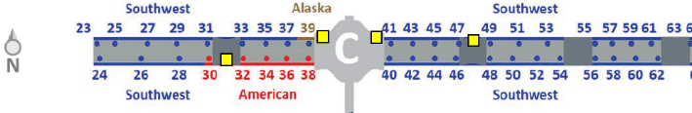
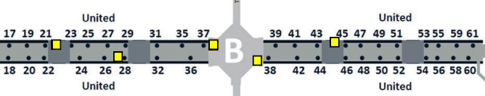
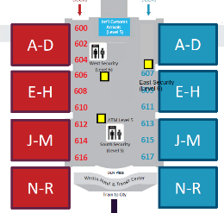
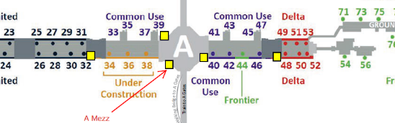
ATM and Banking Services
Seventeen (17) ATM locations as denoted by yellow squares
Three (3) in the terminal
Fourteen (14) on the concourses
Bank Branch:
640 square feet
Great Hall
MOD3, Level 6, East 4
*ATM frequency and locations - Subject to Change​

Slide 13
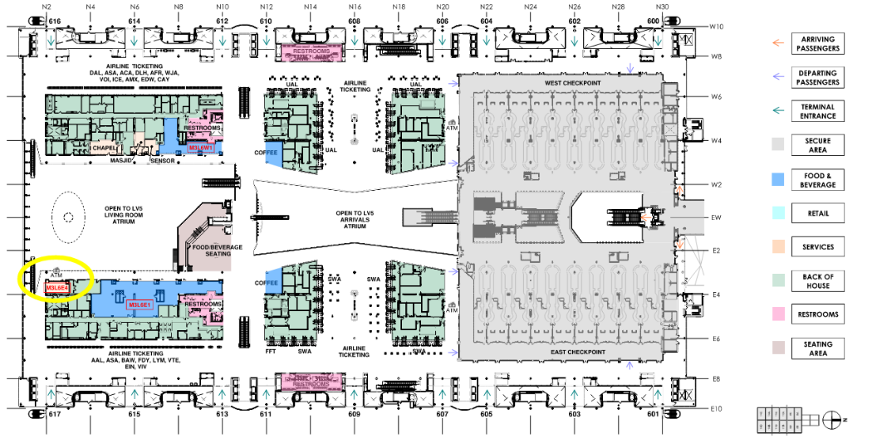
ATM and Banking Services - Level 6 Great Hall
*Draft Location Map – Subject to Change

Slide 14
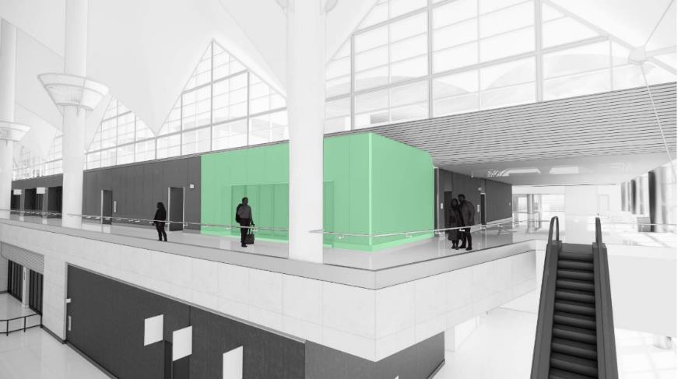
ATM and Banking Services
*Draft Rendering – Subject to Change

Slide 15
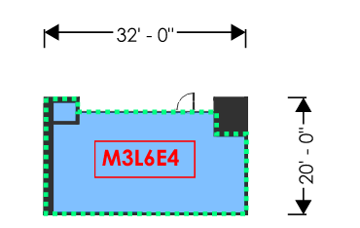

ATM and Banking Services
*Draft Exhibit – Subject to Change

Slide 16
M3L5E1 & M3L5C1 Casual Dining with Bar
Denver International Airport (DEN) will be conducting a Request for Proposals (RFP) competitive selection process for a concessionaire to design, build, and manage a food and beverage location in the Great Hall. This location will be comprised of a Casual Dining Restaurant with Bar concept. The location will be approximately 8343 square feet, and the term will be twelve (12) years.
KEY INFORMATION
Anticipated Advertisement Date: August 1, 2025
Small Business Program Goal:
MWBE Construction Goal: To be determined after award
MWBE Design Goal: 15%
  Primary NAICS Codes Identified: 541310 & 541330
ACDBE: 31.3%
  Primary NAICS Codes Identified: 722513 & 722511
Key Scope/Industry: F&B Concessions Concepts, ACDBE/MWBE Partners, General Contractors, etc.
Project Manager: Branden Sowers| Branden.Sowers@flydenver.com
*Dates are tentative and subject to change
Notes:
Denver International Airport (DEN) will be conducting a Request for Proposals (RFP) competitive selection process for a concessionaire to design, build, and manage a food and beverage location in the Great Hall. This location will be comprised of a Casual Dining Restaurant with Bar concept. The location will be approximately 4005 square feet, and the term will be 12 years.
KEY INFORMATION
Anticipated Advertisement Date: Q3
Estimated Project Value: $2M to $4.99M
Small Business Program Goal: TBD
Key Scope/Industry: F&B Operator and Concessionaire
Project Manager: Branden Sowers| Branden.Sowers@flydenver.com
*Note 4400 sq ft of the 8300 sq ft space is designated as seating area

Slide 17
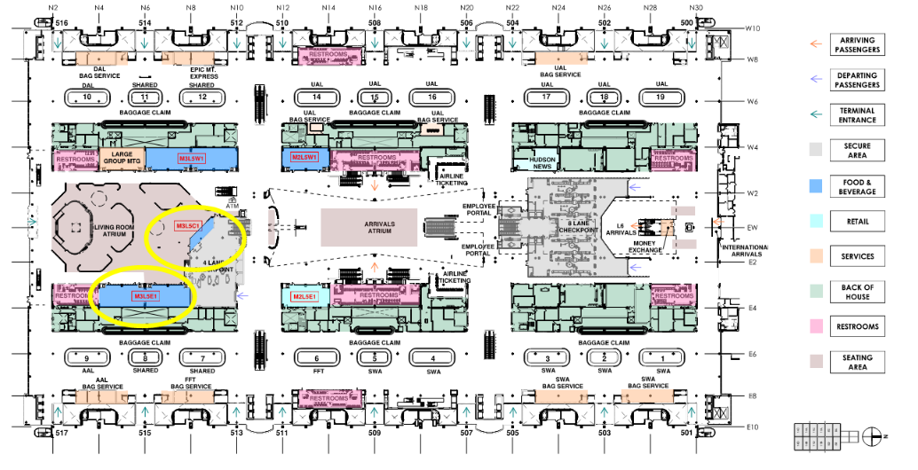
M3L5E1 & M3L5C1 Casual Dining with Bar
*Draft Location Map – Subject to Change

Slide 18
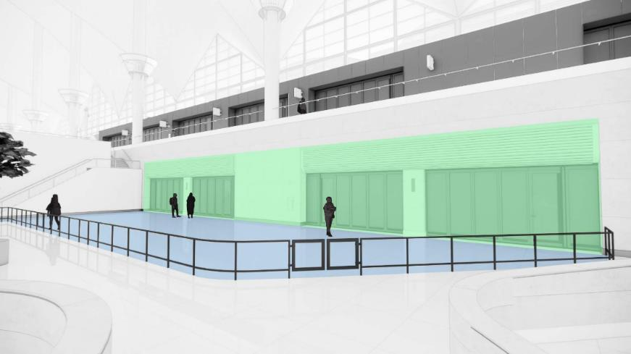
M3L5E1 & M3L5C1 Casual Dining with Bar
*Draft Rendering – Subject to Change

Slide 19
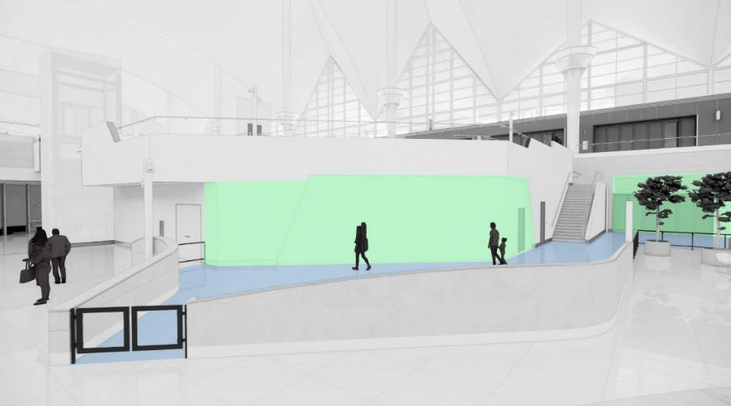
M3L5E1 & M3L5C1 Casual Dining with Bar
*Draft Rendering – Subject to Change

Slide 20
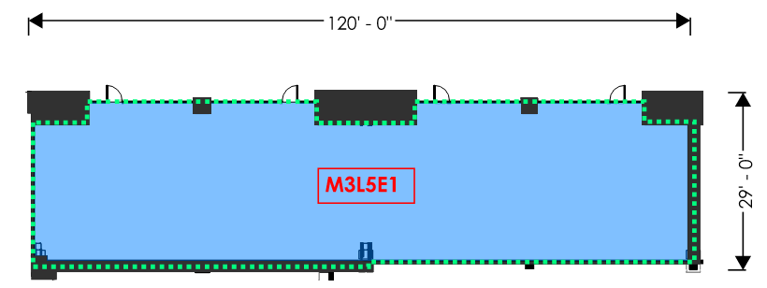

M3L5E1 & M3L5C1 Casual Dining with Bar
*Draft Exhibit – Subject to Change

Slide 21
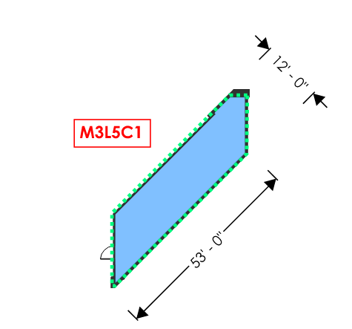

M3L5E1 & M3L5C1 Casual Dining with Bar
*Draft Exhibit – Subject to Change

Slide 22
M3L5W1 Fast Casual Dining
Denver International Airport (DEN) will be conducting a Request for Proposals (RFP) competitive selection process for a concessionaire to design, build, and manage a food and beverage location in the Great Hall. This location will be comprised of a Casual Dining Restaurant with Bar concept. The location will be approximately 3414 square feet, and the term will be twelve (12) years.
KEY INFORMATION
Anticipated Advertisement Date: August 1, 2025
Small Business Program Goal:
MWBE Construction Goal: To be determined after award
MWBE Design Goal: 15%
  Primary NAICS Codes Identified: 541310 & 541330
ACDBE: 31.3%
  Primary NAICS Codes Identified: 722513 & 722511
Key Scope/Industry: F&B Concessions Concepts, ACDBE/MWBE Partners, General Contractors, etc.
Project Manager: Branden Sowers| Branden.Sowers@flydenver.com
*Dates are tentative and subject to change
Notes:
Denver International Airport (DEN) will be conducting a Request for Proposals (RFP) competitive selection process for a concessionaire to design, build, and manage a food and beverage location in the Great Hall. This location will be comprised of a Casual Dining Restaurant with Bar concept. The location will be approximately 4005 square feet, and the term will be 12 years.
KEY INFORMATION
Anticipated Advertisement Date: Q3
Estimated Project Value: $2M to $4.99M
Small Business Program Goal: TBD
Key Scope/Industry: F&B Operator and Concessionaire
Project Manager: Branden Sowers| Branden.Sowers@flydenver.com

Slide 23
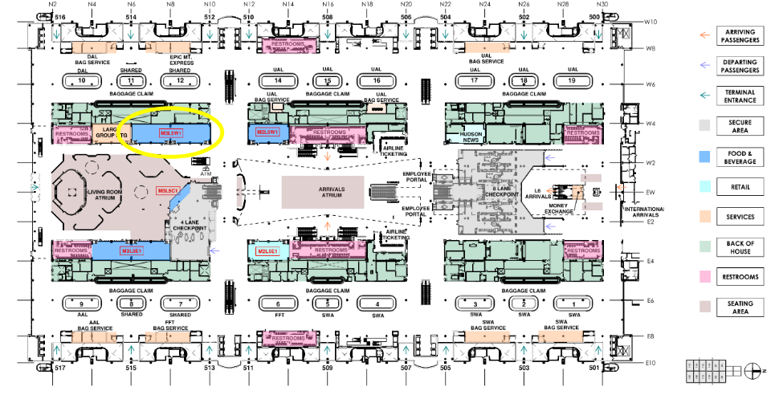
M3L5W1 Fast Casual Dining
*Draft Location Map – Subject to Change
Notes:
Denver International Airport (DEN) will be conducting a Request for Proposals (RFP) competitive selection process for a concessionaire to design, build, and manage a food and beverage location in the Great Hall. This location will be comprised of a Casual Dining Restaurant with Bar concept. The location will be approximately 4005 square feet, and the term will be 12 years.
KEY INFORMATION
Anticipated Advertisement Date: Q3
Estimated Project Value: $2M to $4.99M
Small Business Program Goal: TBD
Key Scope/Industry: F&B Operator and Concessionaire
Project Manager: Branden Sowers| Branden.Sowers@flydenver.com

Slide 24
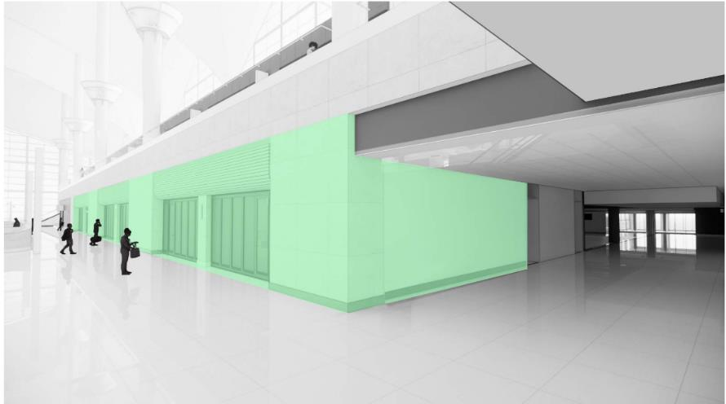
M3L5W1 Fast Casual Dining
*Draft Rendering – Subject to Change
Notes:
Denver International Airport (DEN) will be conducting a Request for Proposals (RFP) competitive selection process for a concessionaire to design, build, and manage a food and beverage location in the Great Hall. This location will be comprised of a Casual Dining Restaurant with Bar concept. The location will be approximately 4005 square feet, and the term will be 12 years.
KEY INFORMATION
Anticipated Advertisement Date: Q3
Estimated Project Value: $2M to $4.99M
Small Business Program Goal: TBD
Key Scope/Industry: F&B Operator and Concessionaire
Project Manager: Branden Sowers| Branden.Sowers@flydenver.com

Slide 25
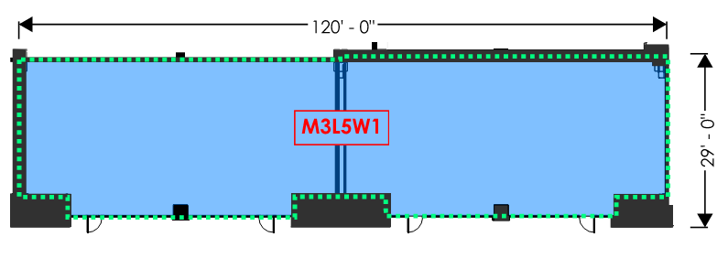

M3L5W1 Fast Casual Dining
*Draft Exhibit – Subject to Change
Notes:
Denver International Airport (DEN) will be conducting a Request for Proposals (RFP) competitive selection process for a concessionaire to design, build, and manage a food and beverage location in the Great Hall. This location will be comprised of a Casual Dining Restaurant with Bar concept. The location will be approximately 4005 square feet, and the term will be 12 years.
KEY INFORMATION
Anticipated Advertisement Date: Q3
Estimated Project Value: $2M to $4.99M
Small Business Program Goal: TBD
Key Scope/Industry: F&B Operator and Concessionaire
Project Manager: Branden Sowers| Branden.Sowers@flydenver.com

Slide 26
M2L5E1 Travel Convenience Marketplace
Denver International Airport (DEN) will be conducting a Request for Proposals (RFP) competitive selection process for a concessionaire to design, build, and manage a retail location in the Great Hall. This location is intended for the development of a 100% SBEC-owned and certified Travel Convenience Marketplace concept. The location will be approximately 1818 square feet, and the term will be nine (9) years.
KEY INFORMATION
Anticipated Advertisement Date: August 1, 2025
Small Business Program Goal:
MWBE Construction Goal: To be determined after award
MWBE Design Goal: No Goal
SBEC: 100%
  Primary NAICS Codes Identified: 459510, 445131, 455320 & 459420
Key Scope/Industry: Retail Concessions Concepts, SBEC/MWBE Partners, General Contractors, etc.
Project Manager: Branden Sowers| Branden.Sowers@flydenver.com
*Dates are tentative and subject to change
Notes:
Denver International Airport (DEN) will be conducting a Request for Proposals (RFP) competitive selection process for a concessionaire to design, build, and manage a retail location in the Great Hall. This location is intended for the development of a 100% SBEC-owned and certified Travel Convenience Marketplace concept. The location will be approximately 2016 square feet, and the term will be 9 years.
KEY INFORMATION
Anticipated Advertisement Date: Q3
Estimated Project Value: $2M to $4.99M
Small Business Program Goal: TBD
Key Scope/Industry: Retail Operator, Concessionaire, SBEC
Project Manager: Branden Sowers| Branden.Sowers@flydenver.com

Slide 27
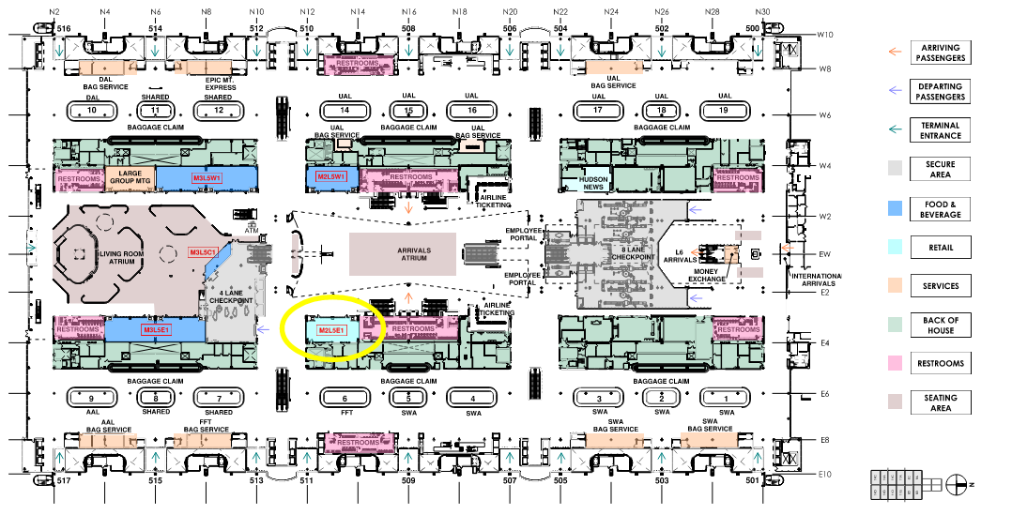
M2L5E1 Travel Convenience Marketplace
*Draft Location Map – Subject to Change
Notes:
Denver International Airport (DEN) will be conducting a Request for Proposals (RFP) competitive selection process for a concessionaire to design, build, and manage a retail location in the Great Hall. This location is intended for the development of a 100% SBEC-owned and certified Travel Convenience Marketplace concept. The location will be approximately 2016 square feet, and the term will be 9 years.
KEY INFORMATION
Anticipated Advertisement Date: Q3
Estimated Project Value: $2M to $4.99M
Small Business Program Goal: TBD
Key Scope/Industry: Retail Operator, Concessionaire, SBEC
Project Manager: Branden Sowers| Branden.Sowers@flydenver.com

Slide 28
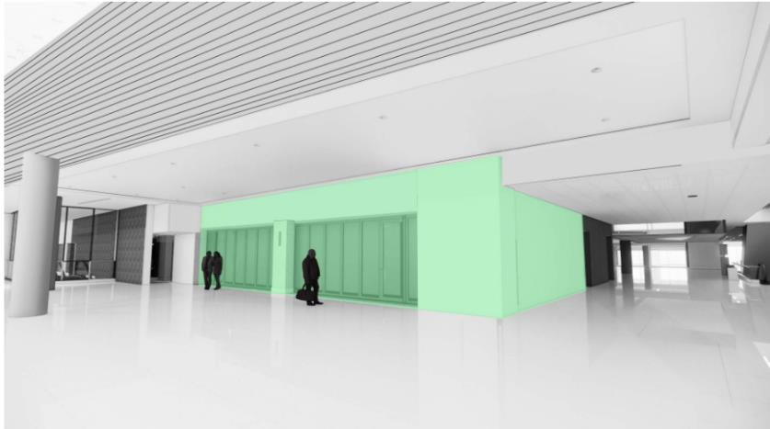
M2L5E1 Travel Convenience Marketplace
*Draft Rendering – Subject to Change
Notes:
Denver International Airport (DEN) will be conducting a Request for Proposals (RFP) competitive selection process for a concessionaire to design, build, and manage a retail location in the Great Hall. This location is intended for the development of a 100% SBEC-owned and certified Travel Convenience Marketplace concept. The location will be approximately 2016 square feet, and the term will be 9 years.
KEY INFORMATION
Anticipated Advertisement Date: Q3
Estimated Project Value: $2M to $4.99M
Small Business Program Goal: TBD
Key Scope/Industry: Retail Operator, Concessionaire, SBEC
Project Manager: Branden Sowers| Branden.Sowers@flydenver.com

Slide 29
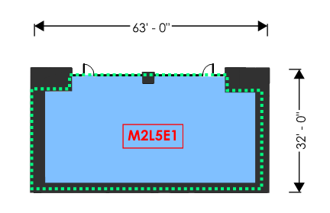

M2L5E1 Travel Convenience Marketplace
*Draft Exhibit – Subject to Change
Notes:
Denver International Airport (DEN) will be conducting a Request for Proposals (RFP) competitive selection process for a concessionaire to design, build, and manage a retail location in the Great Hall. This location is intended for the development of a 100% SBEC-owned and certified Travel Convenience Marketplace concept. The location will be approximately 2016 square feet, and the term will be 9 years.
KEY INFORMATION
Anticipated Advertisement Date: Q3
Estimated Project Value: $2M to $4.99M
Small Business Program Goal: TBD
Key Scope/Industry: Retail Operator, Concessionaire, SBEC
Project Manager: Branden Sowers| Branden.Sowers@flydenver.com

Slide 30
M2L5W1 Grab and Go Café
Denver International Airport (DEN) will be conducting a Request for Proposals (RFP) competitive selection process for a concessionaire to design, build, and manage a food and beverage location in the Great Hall. This location is intended for the development of a 100% SBEC-owned and certified Grab and Go Café concept. The location will be approximately 1779 square feet, and the term will be twelve (12) years.
KEY INFORMATION
Anticipated Advertisement Date: August 1, 2025
Small Business Program Goal:
MWBE Construction Goal: To be determined after award
MWBE Design Goal: No Goal
SBEC: 100%
  Primary NAICS Codes Identified: 722515, 722513 & 722330
Key Scope/Industry: F&B Concessions Concepts, SBEC/MWBE Partners, General Contractors, etc.
Project Manager: Branden Sowers| Branden.Sowers@flydenver.com
*Dates are tentative and subject to change
Notes:
Denver International Airport (DEN) will be conducting a Request for Proposals (RFP) competitive selection process for a concessionaire to design, build, and manage a food and beverage location in the Great Hall. This location is intended for the development of a 100% SBEC-owned and certified Grab and Go Café concept. The location will be approximately 2016 square feet, and the term will be 12 years.
KEY INFORMATION
Anticipated Advertisement Date: Q3
Estimated Project Value: $2M to $4.99M
Small Business Program Goal: TBD
Key Scope/Industry: F&B Operator, Concessionaire, SBEC
Project Manager: Branden Sowers| Branden.Sowers@flydenver.com

Slide 31
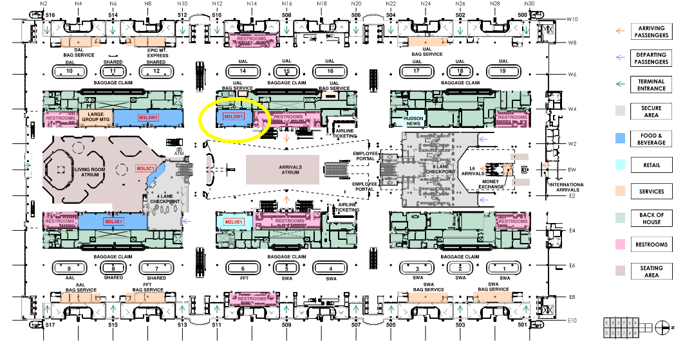
M2L5W1 Grab and Go Café
*Draft Location Map – Subject to Change
Notes:
Denver International Airport (DEN) will be conducting a Request for Proposals (RFP) competitive selection process for a concessionaire to design, build, and manage a food and beverage location in the Great Hall. This location is intended for the development of a 100% SBEC-owned and certified Grab and Go Café concept. The location will be approximately 2016 square feet, and the term will be 12 years.
KEY INFORMATION
Anticipated Advertisement Date: Q3
Estimated Project Value: $2M to $4.99M
Small Business Program Goal: TBD
Key Scope/Industry: F&B Operator, Concessionaire, SBEC
Project Manager: Branden Sowers| Branden.Sowers@flydenver.com

Slide 32
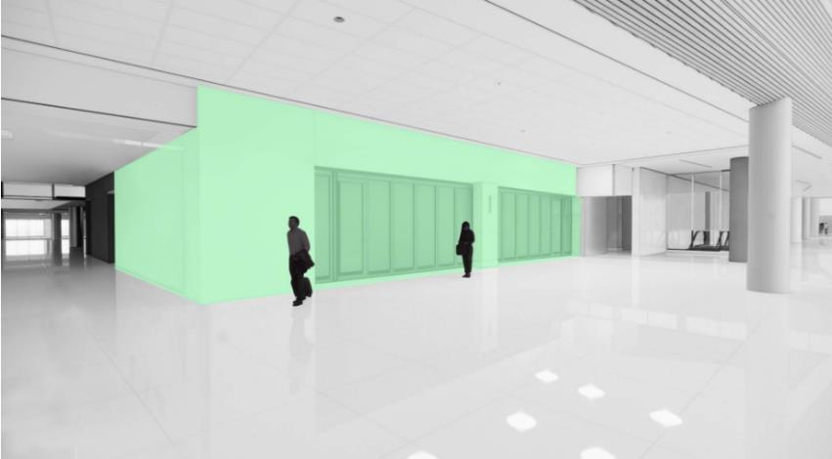
M2L5W1 Grab and Go Café
*Draft Rendering – Subject to Change
Notes:
Denver International Airport (DEN) will be conducting a Request for Proposals (RFP) competitive selection process for a concessionaire to design, build, and manage a food and beverage location in the Great Hall. This location is intended for the development of a 100% SBEC-owned and certified Grab and Go Café concept. The location will be approximately 2016 square feet, and the term will be 12 years.
KEY INFORMATION
Anticipated Advertisement Date: Q3
Estimated Project Value: $2M to $4.99M
Small Business Program Goal: TBD
Key Scope/Industry: F&B Operator, Concessionaire, SBEC
Project Manager: Branden Sowers| Branden.Sowers@flydenver.com

Slide 33
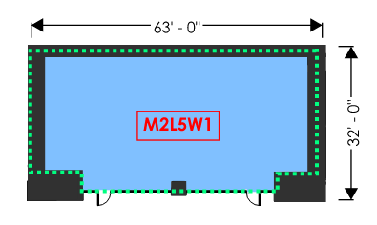

M2L5W1 Grab and Go Café
*Draft Exhibit – Subject to Change
Notes:
Denver International Airport (DEN) will be conducting a Request for Proposals (RFP) competitive selection process for a concessionaire to design, build, and manage a food and beverage location in the Great Hall. This location is intended for the development of a 100% SBEC-owned and certified Grab and Go Café concept. The location will be approximately 2016 square feet, and the term will be 12 years.
KEY INFORMATION
Anticipated Advertisement Date: Q3
Estimated Project Value: $2M to $4.99M
Small Business Program Goal: TBD
Key Scope/Industry: F&B Operator, Concessionaire, SBEC
Project Manager: Branden Sowers| Branden.Sowers@flydenver.com

Slide 34
M3L6W1 Arrivals Lounge
Denver International Airport (DEN) will be conducting a Request for Proposals (RFP) competitive selection process for a concessionaire to design, build, and manage a passenger service concession location in the Great Hall. This location will be an Arrivals Lounge concept. The location will be approximately 2060 square feet, and the term will be nine (9) years.
KEY INFORMATION
Anticipated Advertisement Date: August 1, 2025
Small Business Program Goal:
MWBE Construction Goal: To be determined after award
MWBE Design Goal: No Goal
ACDBE: 0%
  Primary NAICS Codes Identified: 812990
Key Scope/Industry: F&B Concessions Concepts, SBEC/MWBE Partners, General Contractors, etc.
Project Manager: Branden Sowers| Branden.Sowers@flydenver.com
*Dates are tentative and subject to change
Notes:
Denver International Airport (DEN) will be conducting a Request for Proposals (RFP) competitive selection process for a concessionaire to design, build, and manage a food and beverage location in the Great Hall. This location is intended for the development of a 100% SBEC-owned and certified Grab and Go Café concept. The location will be approximately 2016 square feet, and the term will be 12 years.
KEY INFORMATION
Anticipated Advertisement Date: Q3
Estimated Project Value: $2M to $4.99M
Small Business Program Goal: TBD
Key Scope/Industry: F&B Operator, Concessionaire, SBEC
Project Manager: Branden Sowers| Branden.Sowers@flydenver.com

Slide 35
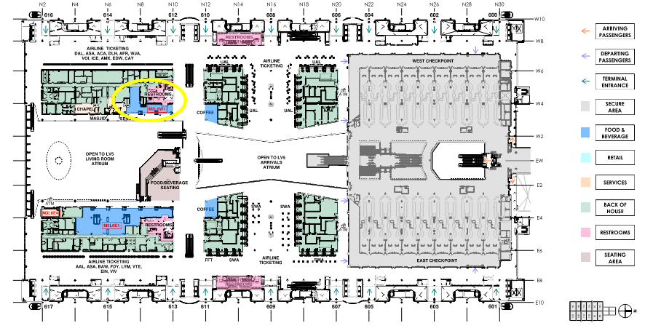
M3L6W1 Arrivals Lounge
*Draft Location Map – Subject to Change
Notes:
Denver International Airport (DEN) will be conducting a Request for Proposals (RFP) competitive selection process for a concessionaire to design, build, and manage a food and beverage location in the Great Hall. This location is intended for the development of a 100% SBEC-owned and certified Grab and Go Café concept. The location will be approximately 2016 square feet, and the term will be 12 years.
KEY INFORMATION
Anticipated Advertisement Date: Q3
Estimated Project Value: $2M to $4.99M
Small Business Program Goal: TBD
Key Scope/Industry: F&B Operator, Concessionaire, SBEC
Project Manager: Branden Sowers| Branden.Sowers@flydenver.com

Slide 36
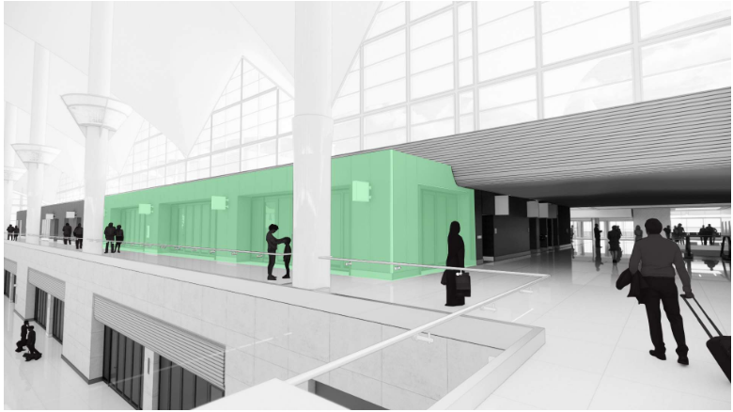
M3L6W1 Arrivals Lounge
*Draft Rendering – Subject to Change
Notes:
Denver International Airport (DEN) will be conducting a Request for Proposals (RFP) competitive selection process for a concessionaire to design, build, and manage a food and beverage location in the Great Hall. This location is intended for the development of a 100% SBEC-owned and certified Grab and Go Café concept. The location will be approximately 2016 square feet, and the term will be 12 years.
KEY INFORMATION
Anticipated Advertisement Date: Q3
Estimated Project Value: $2M to $4.99M
Small Business Program Goal: TBD
Key Scope/Industry: F&B Operator, Concessionaire, SBEC
Project Manager: Branden Sowers| Branden.Sowers@flydenver.com

Slide 37
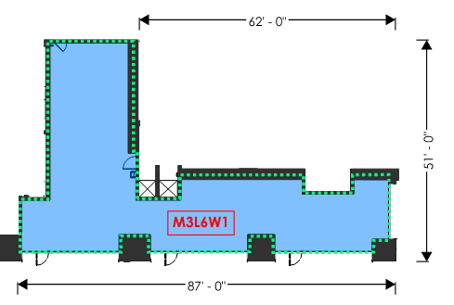

M3L6W1 Arrivals Lounge
*Draft Exhibit – Subject to Change
Notes:
Denver International Airport (DEN) will be conducting a Request for Proposals (RFP) competitive selection process for a concessionaire to design, build, and manage a food and beverage location in the Great Hall. This location is intended for the development of a 100% SBEC-owned and certified Grab and Go Café concept. The location will be approximately 2016 square feet, and the term will be 12 years.
KEY INFORMATION
Anticipated Advertisement Date: Q3
Estimated Project Value: $2M to $4.99M
Small Business Program Goal: TBD
Key Scope/Industry: F&B Operator, Concessionaire, SBEC
Project Manager: Branden Sowers| Branden.Sowers@flydenver.com

Slide 38
M3L6E1 Food Hall
Denver International Airport (DEN) will be conducting a Request for Proposals (RFP) competitive selection process for a concessionaire to design, build, and manage a food and beverage location in the Great Hall. This location will be a Food Hall comprised of three quick service restaurant concepts. The location will be approximately 5812 square feet, and the term will be twelve (12) years.
KEY INFORMATION
Anticipated Advertisement Date: August 1, 2025
Small Business Program Goal:
MWBE Construction Goal: To be determined after award
MWBE Design Goal: 15%
  Primary NAICS Codes Identified: 541310 & 541330
ACDBE: 31.3%
  Primary NAICS Codes Identified: 722515, 722513, 722330, & 722511
Key Scope/Industry: F&B Concessions Concepts, SBEC/MWBE Partners, General Contractors, etc.
Project Manager: Branden Sowers| Branden.Sowers@flydenver.com
*Dates are tentative and subject to change
Notes:
Denver International Airport (DEN) will be conducting a Request for Proposals (RFP) competitive selection process for a concessionaire to design, build, and manage a food and beverage location in the Great Hall. This location is intended for the development of a 100% SBEC-owned and certified Grab and Go Café concept. The location will be approximately 2016 square feet, and the term will be 12 years.
KEY INFORMATION
Anticipated Advertisement Date: Q3
Estimated Project Value: $2M to $4.99M
Small Business Program Goal: TBD
Key Scope/Industry: F&B Operator, Concessionaire, SBEC
Project Manager: Branden Sowers| Branden.Sowers@flydenver.com

Slide 39
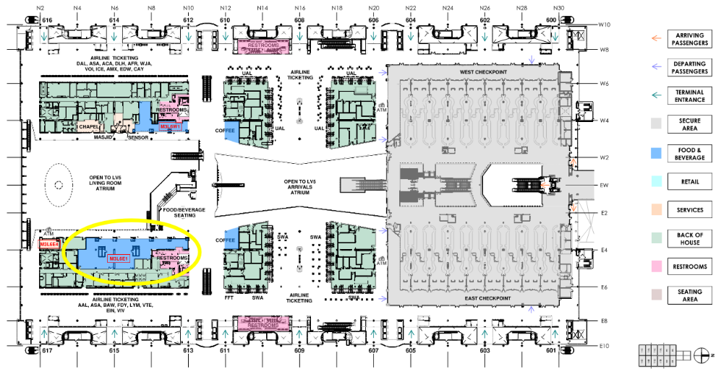
M3L6E1 Food Hall
*Draft Location Map – Subject to Change
Notes:
Denver International Airport (DEN) will be conducting a Request for Proposals (RFP) competitive selection process for a concessionaire to design, build, and manage a food and beverage location in the Great Hall. This location is intended for the development of a 100% SBEC-owned and certified Grab and Go Café concept. The location will be approximately 2016 square feet, and the term will be 12 years.
KEY INFORMATION
Anticipated Advertisement Date: Q3
Estimated Project Value: $2M to $4.99M
Small Business Program Goal: TBD
Key Scope/Industry: F&B Operator, Concessionaire, SBEC
Project Manager: Branden Sowers| Branden.Sowers@flydenver.com

Slide 40
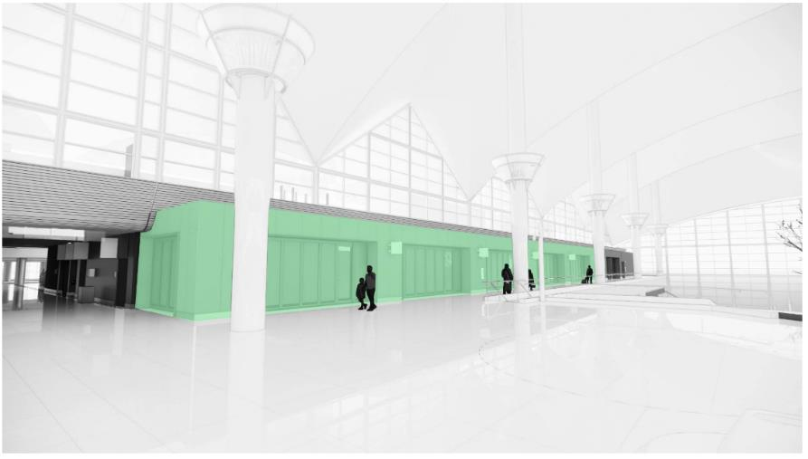
M3L6E1 Food Hall
*Draft Rendering – Subject to Change
Notes:
Denver International Airport (DEN) will be conducting a Request for Proposals (RFP) competitive selection process for a concessionaire to design, build, and manage a food and beverage location in the Great Hall. This location is intended for the development of a 100% SBEC-owned and certified Grab and Go Café concept. The location will be approximately 2016 square feet, and the term will be 12 years.
KEY INFORMATION
Anticipated Advertisement Date: Q3
Estimated Project Value: $2M to $4.99M
Small Business Program Goal: TBD
Key Scope/Industry: F&B Operator, Concessionaire, SBEC
Project Manager: Branden Sowers| Branden.Sowers@flydenver.com

Slide 41
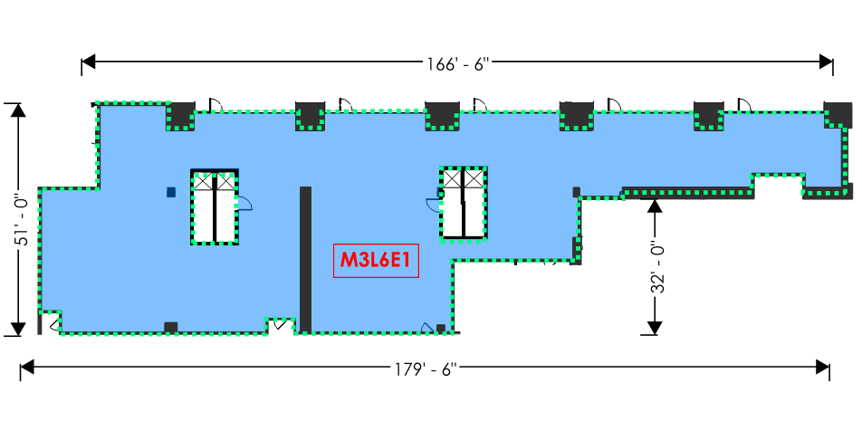

M3L6E1 Food Hall
*Draft Exhibit – Subject to Change
Notes:
Denver International Airport (DEN) will be conducting a Request for Proposals (RFP) competitive selection process for a concessionaire to design, build, and manage a food and beverage location in the Great Hall. This location is intended for the development of a 100% SBEC-owned and certified Grab and Go Café concept. The location will be approximately 2016 square feet, and the term will be 12 years.
KEY INFORMATION
Anticipated Advertisement Date: Q3
Estimated Project Value: $2M to $4.99M
Small Business Program Goal: TBD
Key Scope/Industry: F&B Operator, Concessionaire, SBEC
Project Manager: Branden Sowers| Branden.Sowers@flydenver.com

Slide 42
2025 Tunnel Switchgear Heaving Remediation
Six switchgear rooms in the East and West cores of ACON, BCON, and CCON have experienced soil heaving, causing damage to both equipment and enclosures. Additionally, ACON East and West sub-cores face significant water intrusion, impacting switchgear performance.
Replace damaged switchgear and enclosures.
Install new switchgear on elevated steel platforms anchored to the basement foundation to prevent future heaving impact.
Construct code-compliant enclosures with fire-rated walls, fire suppression, and HVAC.
Remove and replace heaved soil and repair room structures.
Implement water mitigation at ACON sub-cores.
KEY INFORMATION
Anticipated Advertisement Date: Q3-Q4
Estimated Project Value: $10M to $49.99M
Small Business Program Goal: TBD
Key Scope/Industry: Electrical, Concrete, Masonry, Earthwork, Civil Utilities, Mechanical, Electrical, Plumbing
Project Manager: Mark Tabugadir| mark.tabugadir@flydenver.com
Notes:
Switchgear Room Rehabilitation Project – ACON, BCON, CCON
Issue: Six switchgear rooms in the East and West cores of ACON, BCON, and CCON have experienced soil heaving, causing damage to both equipment and enclosures. Additionally, ACON East and West sub-cores face significant water intrusion, impacting switchgear performance.
Project Scope:
Replace damaged switchgear and enclosures.
Install new switchgear on elevated steel platforms anchored to the basement foundation to prevent future heaving impact.
Construct code-compliant enclosures with fire-rated walls, fire suppression, and HVAC.
Remove and replace heaved soil and repair room structures.
Implement water mitigation at ACON sub-cores.
Delivery Method: Design-Build, guided by DEN-provided performance specifications.
Critical Considerations:
Electrical switchover from old to new switchgear must avoid operational disruptions; detailed transition planning is essential.
Switchgear is a single point of failure for DEN operations.
Procurement Strategy:
Switchgear has a 12+ month lead time.
Specifications will be finalized early to enable immediate procurement.
Design and construction will advance in parallel to prepare for equipment installation.

Slide 43
GARDI B Northeast – Design
The GARDI B Northeast project is part of the Gate Apron Rehabilitation and Drainage Improvements (GARDI) Program, focusing on the reconstruction of Gates B39, B41, B43, B45, B47, B49, B51, B53, B55, B59, and B61. GARDI Program launched in 2015 to address the heaving and settling of gate apron pavements and replacing all supporting utilities. Existing apron pavement is 30+ years old, surpassing its 20-year design life.
Construction scheduled for Q3 2026 – Q4 2027, based on gate availability, phased to rebuild 2–3 gates at a time.
KEY INFORMATION
Anticipated Advertisement Date: July 2025
Estimated Project Value: $2M to $4.99M
Small Business Program Goal: TBD
Key Scope/Industry: Concrete, Asphalt, Earthwork, Civil Utilities, Jet Fuel
Project Manager: Hunter Wardlaw| hunter.wardlaw@flydenver.com
Notes:
The current request is for the Design phase of the GARDI B Northeast project within the GARDI Program (GARDI = Gate Apron Rehabilitation and Drainage Improvements). This project is for the full reconstruction of Gates B39, B41, B43, B45, B47, B49, B51, B53, B55, B59, B61. The proposed phasing will be to re-build two to three gates at a time, which is dependent on gate availability. The GARDI B Northeast project is planned to be constructed from Q3 2026 through Q4 2027.
In 2015, DEN initiated the GARDI (Gate Apron Rehabilitation and Drainage Improvements) Program to address heaving and settling pavements at the gate apron parking positions. The existing pavement at DEN is now more than 30 years old and has exceeded its originally intended 20-year design life. The differential movement of the gate apron pavement has created non-compliant drainage conditions where water and potentially jet fuel can drain toward the concourses instead of to the trench drains as originally designed. These conditions also contribute to safety hazards for apron workers such as trip hazards, spalling concrete, and ponding on the pavement surface. The heaving and settling also has affected the underground utilities which, in some cases, have been damaged or rendered inoperable due to the differential movement of the pavement sections. These inoperable utilities can lead to costly emergency repairs and gate closures

Slide 44
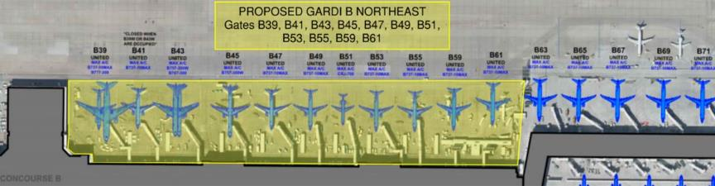
GARDI B Northeast – Design
The GARDI scope includes removing the failing concrete panels, reconditioning and re-grading the underlying subgrade as necessary to promote correct drainage and eliminating historical issues that have promoted the differential movement in the area. The new GARDI pavement section includes a subgrade pavement drainage layer (cement treated permeable base) that will collect any water that leaks through the surface joints and will send the water to the underdrain piping system. The typical GARDI pavement section from bottom to top is 4” of Upper Select Fill, 12” of Cement Treated Soil Base Course, 3” of Asphalt Mix Pavement, 6” of Cement Treated Permeable Base (CTPB) Course, and 17” of Portland Cement Concrete Pavement
Utilities included are jet fuel pipe and hydrant pits, fire hydrants and supporting water vaults, storm drainpipe and manholes, sanitary sewer pipe and manholes, electrical conduit and handholes, cathodic pits and wiring, trench drains and underdrains, ground power units, removal of abandoned baggage tunnels to the basement, Passenger Loading Bridge modifications and potable water cabinet unit installation
Notes:
The current request is for the Design phase of the GARDI B Northeast project within the GARDI Program (GARDI = Gate Apron Rehabilitation and Drainage Improvements). This project is for the full reconstruction of Gates B39, B41, B43, B45, B47, B49, B51, B53, B55, B59, B61. The proposed phasing will be to re-build two to three gates at a time, which is dependent on gate availability. The GARDI B Northeast project is planned to be constructed from Q3 2026 through Q4 2027.
In 2015, DEN initiated the GARDI (Gate Apron Rehabilitation and Drainage Improvements) Program to address heaving and settling pavements at the gate apron parking positions. The existing pavement at DEN is now more than 30 years old and has exceeded its originally intended 20-year design life. The differential movement of the gate apron pavement has created non-compliant drainage conditions where water and potentially jet fuel can drain toward the concourses instead of to the trench drains as originally designed. These conditions also contribute to safety hazards for apron workers such as trip hazards, spalling concrete, and ponding on the pavement surface. The heaving and settling also has affected the underground utilities which, in some cases, have been damaged or rendered inoperable due to the differential movement of the pavement sections. These inoperable utilities can lead to costly emergency repairs and gate closures

Slide 45
Design & Construction Project Delivery Support Services
Seeking consultant(s) to provide comprehensive project delivery support on a task order basis.
These services may include:
Contract Administration
Project Management (design and construction)
Project Controls (estimating, scheduling, change management)
Operational Readiness, Activation, and Transition (ORAT)
Quality Assurance Inspections (QA)
Commissioning (Cx)
Special Inspections (SI)
Materials Testing
Geotechnical Services
KEY INFORMATION
Anticipated Advertisement Date: Late to end of June 2025
Estimated Project Value: $50M to $99.99M
Small Business Program Goal: 24% MWBE (updated from 18%)
Key Scope/Industry: Project Management, Contract Administration, Estimating, Scheduling, ORAT, Quality Assurance Inspections, Building Commissioning, Materials Testing, Geotechnical Services
Project Manager: Cullen Choi | cullen.choi@flydenver.com
Notes:
The Design, Engineering, and Construction (DEC) Division at Denver International Airport (DEN) is seeking proposals for a Consultant(s) who shall provide comprehensive Project Delivery Support Services to DEC. These services are intended to be provided on a project-by-project basis through the issuance of a single task order for all requested services. The task orders for the projects can span from project definition/planning, through construction closeout, operationalization, and activation. These services may include:
Contract Administration
Project Management (design and construction)
Project Controls (estimating, scheduling, change management)
Operational Readiness, Activation, and Transition (ORAT)
Quality Assurance Inspections (QA)
Commissioning (Cx)
Special Inspections (SI)
Materials Testing
Geotechnical Services
Likely 2 to 3 contracts

Slide 46
Legacy Concourse Restroom Renewal
Renovate 30-year-old restrooms in Concourses A, B, and C to meet modern standards and improve user experience.
Key Goals:
Align with Vision 100 – Maintaining What We Have
Standardize restroom design for easier maintenance and asset management
Implement current ADA standards
The solution is to renovate the legacy restrooms to match the new standard developed for the Concourse Expansion Program (CEP) Restrooms and apply the same concepts throughout Concourses A, B, and C as initial steps towards that goal. The new designs contain visions that improve passenger circulation flow into/out of restrooms, mechanical and electrical plumbing (MEP) systems, wayfinding signage, family rooms, and the availability of baby/adult changing stations. Separate contracts will be awarded to the Center Core and Subcore restrooms.
KEY INFORMATION
Anticipated Advertisement Date: Summer 2025
Estimated Project Value: $10M to $49.99M each contract
Small Business Program Goal: MWBE Participation Goal TBD%
Key Scope/Industry: General construction, demolition, mechanical, plumbing, electrical, fire protection, concrete, steel, waterproofing, doors, glass, drywall/framing, ceilings, flooring, signage.
Project Manager: Ro-Tien Liang | ro-tien.liang@flydenver.com; Pamela Kohl | pamela.kohl@flydenver.com
Notes:
The Design, Engineering, and Construction (DEC) Division at Denver International Airport (DEN) is seeking proposals for a General Contractor for the renovation of the Legacy Concourse Restrooms.
The existing legacy restrooms are nearly 30 years old, do not provide the best service to the users, and require substantial maintenance. Restroom renewal has been a goal for DEN for several years; under Vision 100 Pillar – Maintaining What We Have, the renovation will expand new standards already implemented in Concourse Expansion Facilities (Vision 100 Pillar – Growing Our Infrastructure), support DEN Maintenance’s standardization of assets, and allow a common systematic approach for maintenance throughout the concourses. Additionally, ADA standards have evolved over the past 30 years, and the project will implement current standards in DEN’s restroom groups.
The solution is to renovate the legacy restrooms to match the new standard developed for the Concourse Expansion Program (CEP) Restrooms and apply the same concepts throughout Concourses A, B, and C as initial steps towards that goal. The new designs contain visions that improve passenger circulation flow into/out of restrooms, mechanical and electrical plumbing (MEP) systems, wayfinding signage, family rooms, and the availability of baby/adult changing stations. Separate contracts will be awarded to the Center Core restrooms and the Sub-core restrooms.

Slide 47
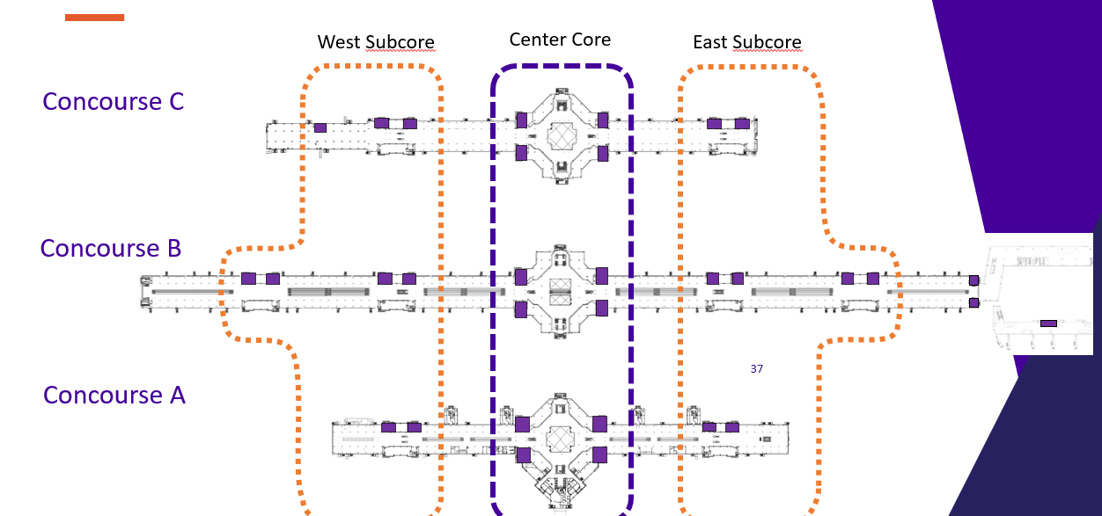
Legacy Concourse Restroom Renewal
47
Notes:
The Design, Engineering, and Construction (DEC) Division at Denver International Airport (DEN) is seeking proposals for a General Contractor for the renovation of the Legacy Concourse Restrooms.
The existing legacy restrooms are nearly 30 years old, do not provide the best service to the users, and require substantial maintenance. Restroom renewal has been a goal for DEN for several years; under Vision 100 Pillar – Maintaining What We Have, the renovation will expand new standards already implemented in Concourse Expansion Facilities (Vision 100 Pillar – Growing Our Infrastructure), support DEN Maintenance’s standardization of assets, and allow a common systematic approach for maintenance throughout the concourses. Additionally, ADA standards have evolved over the past 30 years, and the project will implement current standards in DEN’s restroom groups.
The solution is to renovate the legacy restrooms to match the new standard developed for the Concourse Expansion Program (CEP) Restrooms and apply the same concepts throughout Concourses A, B, and C as initial steps towards that goal. The new designs contain visions that improve passenger circulation flow into/out of restrooms, mechanical and electrical plumbing (MEP) systems, wayfinding signage, family rooms, and the availability of baby/adult changing stations. Separate contracts will be awarded to the Center Core restrooms and the Sub-core restrooms.

Slide 48
Basement Foundation Rehabilitation On-Call
The Design, Engineering, and Construction (DEC) division at Denver International Airport (DEN) will request proposals for the purpose of selecting a vendor to provide engineering and design solutions for degrading building foundation elements in the basement across the Terminal Complex at DEN. Services to be provided by the selected vendor include:
Investigate existing conditions: expansion joints, waterproofing systems, slabs, elevator pits, foundation walls, columns
Conduct on-site surveys and review existing assessments and original construction documents
Provide structural, geotechnical, civil, and architectural design solutions
Deliver design documents from Schematic Design to Issued for Construction, aligned with DEN standards
Procurement Approach:
Open Solicitation for On-Call Professional Services
KEY INFORMATION
Anticipated Advertisement Date: TBD
Estimated Project Value: TBD
Small Business Program Goal: Expected 20% MWBE
Key Scope/Industry: Architecture and engineering investigation and repair, structural, geotechnical, joint sealant, constructability analysis
Project Manager: Nicholas Martin | nicholas.martin@flydenver.com
Notes:
The Design, Engineering, and Construction (DEC) division at Denver International Airport (DEN) will request proposals for the purpose of selecting a vendor to provide engineering and design solutions for degrading building foundation elements in the basement in Concourse B at DEN. Services to be provided by the selected vendor include:
Investigate and report on existing conditions of exterior expansion joints in concrete basement walls, waterproofing at exterior utility penetrations, basement walls, slabs-on-grade, elevator pits, concrete-masonry walls, and concrete columns. The investigation involves an extensive on-site survey and a complete review of existing condition assessment reports and the original construction documents.
Develop structural, geotechnical, civil, and architectural design solutions and present design documents to DEN at all stages of development (from Schematic to Issue for Construction). Design documents incorporate all DEN standards and thorough collaboration with DEN subject matter experts.
Design Procurement Type: Fast-Track, open solicitation:
Compressed advertisement period
Streamlined selection process
No negotiation of contract (DEN Standard Design Terms)

Slide 49
Overhead Door Installation and Maintenance
Consultant shall provide comprehensive overhead door services across DEN facilities, including:
Installation of new overhead doors with all necessary hardware and accessories
Routine maintenance of existing overhead and automatic doors
24/7 emergency service response
Replacement of doors on an as-needed basis
Procurement of relevant goods and services as required
Scope Includes:
Maintenance and servicing of over 147 high-speed fabric doors and low-energy handicap automatic doors
Coverage of existing and future installations throughout the airport complex
​
KEY INFORMATION ​
Anticipated Advertisement Date: Q2 2025
Estimated Project Value: $$500K to $1.99M
Small Business Program Goal: TBD
Key Scope/Industry:​ Garage Door Maintenance
Project Manager​: Cara James | Cara.James@flydenver.com

Slide 50
Ceiling, Vent Grill, Louver, Wall, and Hard Surface Cleaning Services
DEN seeks vendors for specialized cleaning in public and tenant areas, including:
Surface cleaning and dust control
Vacuuming ceilings, lights, and walls
Cleaning air diffusers with certified biodegradable solution
Solution Must Be:
Biodegradable, non-abrasive, phosphate-free, non-flammable, and SCS-certified
Hours: 24/7 (scheduled per task)
Equipment:
  19–20 ft lift with operator
  HEPA backpack vacuum (or equivalent)
  Extension cords, vacuum pole, soft brushes
  Telescoping spray wand, dual-layer drop cloths
KEY INFORMATION ​
Anticipated Advertisement Date: Q3 2025
Estimated Project Value: $$500K to $1.99M
Small Business Program Goal: TBD
Key Scope/Industry:​ Janitorial. Need to be able to use a lift and ladders, work is above 20’.
Project Manager​: Cara James| Cara.James@flydenver.com

Slide 51
Sanitary, Stormwater, & Deice Water System Underground Utility Repair Service
DEN Operations & Maintenance is seeking a qualified contractor to provide comprehensive maintenance, repair, and replacement services for onsite sanitary sewer, stormwater, and deice water piping systems. This includes knowledge of the NAICS Code 221300, Water, Sewage and Other Systems. Relative locations include sewer system, glycol rehabilitation treatment plants, retention ponds and underground drainage system.
Scope Highlights:
Safety & Permitting:
  Ensure compliance with relevant safety protocols during excavation and repair work to include traffic control and hazard identification
  Permitting as required
  Minimum impact on airport operations, preferably conducting scheduled work during off-peak hours
Excavation & Restoration: Utility locating, pipe repair/replacement, surface restoration, testing & commissioning.
Point Repairs: Abandon laterals, root intrusion, offset joints, water infiltration, cracks, and holes.
​
KEY INFORMATION ​
Anticipated Advertisement Date: Q3 2025
Estimated Project Value: $5M to $9.99M
Small Business Program Goal: TBD
Key Scope/Industry:​ GPR (Ground-penetrating radar), Traffic Control, Power Equipment Operators, Welding, Plumbing, Pipe Assessment Management, Landscaping, Trenching & Excavation, Permitting
Project Manager​: Jacqueline Wilson | jacqueline.wilson@flydenver.com
Notes:
DEN Operations & Maintenance is seeking a qualified contractor to provide comprehensive maintenance, repair, and replacement services for onsite sanitary sewer, stormwater, and deice water piping systems. This includes areas such as retention ponds, glycol rehab treatment plants, and underground drainage infrastructure.
Scope Highlights:
Safety & Permitting: Compliance with all safety protocols, traffic control, hazard identification, and scheduling to minimize impact to airport operations.
Excavation & Restoration: Utility locating, pipe repair/replacement, surface restoration, testing & commissioning.
Point Repairs: Abandon laterals, address root intrusion, offset joints, infiltration, cracks, and holes.
​
KEY INFORMATION ​
Anticipated Advertisement Date: Q3 2025
Estimated Project Value: $5M to $9.99M
Small Business Program Goal: TBD
Key Scope/Industry:​ GPR (Ground-penetrating radar), Traffic Control, Power Equipment Operators, Welding, Plumbing, Pipe Assessment Management, Landscaping, Trenching & Excavation, Permitting
Project Manager​: Jacqueline Wilson | jacqueline.wilson@flydenver.com

Slide 52
Aircraft Deicing System
DEN is seeking a qualified contractor for oversight, maintenance, and technical support of the Aircraft Deicing System. This includes technical expertise for software, upgrades, maintenance and hardware interface for the SCADA (Supervisory Control and Data Acquisitions) system.
Scope of Work Includes but not limited to:
System Management
  Monitor water system status to include pressure, flow and temperatures.
  Identify potential issues and implement corrective measures
  Conduct regular inspections and maintenance of water systems
  Ensure compliance with relevant safety regulations and industry standards
Deicing Operations
  Plan and coordinate deice activities
  Monitor the effectiveness of deicing operations
  Provide technical guidance involving the system
Data Analysis and Reporting
  Collect and analyze data related to water system performance and deice operations
  Prepare reports on water system conditions, detailing effectiveness and potential improvements.
KEY INFORMATION ​
Anticipated Advertisement Date: Q4 2025
Estimated Project Value: $10M
Small Business Program Goal: TBD
Key/Scope/Industry: Deicing Operations, Water Quality Management, Environment Impact Assessment Management, Sustainability, Inland Pump Station System upgrades, Glycol Retention Ponds, Glycol Rehabilitation Treatment Systems, SCADA System Analysis and Reporting
Project Manager​: Jacqueline Wilson | jacqueline.wilson@flydenver.com
Notes:
Denver International Airport Maintenance and Operations division is seeking a contractor for the oversight of maintenance services for the Aircraft Deicing System. This RFP is being generated to obtain a qualified contractor to maintain, repair, replace, and address all safety pertinent to the system. This includes technical expertise for software, upgrades, maintenance and hardware interface for the SCADA (Supervisory Control and Data Acquisitions) system.
The selected contractor will work alongside DEN Environmental, Asset Management, Facility Management and Field Management teams. Contractor must be able to communicate effectively with the public, providing information about the deicing operations and potential impacts, if necessary.
This scope of work will include but is not limited to:
• System Management
o Monitor water system status to include pressure, flow and temperatures.
o Identify potential issues and implement corrective measures.
o Conduct regular inspections and maintenance of water systems.
o Ensure compliance with relevant safety regulations and industry standards.
• Deicing Operations
o Plan and coordinate deice activities.
o Monitor the effectiveness of deicing operations.
o Provide technical guidance involving the system.
• Data Analysis and Reporting
o Collect and analyze data related to water system performance and deice operations.
o Prepare reports on water system conditions, detailing effectiveness and potential improvements.

Slide 53
On-Call Airside Facility Maintenance & Repair Services
Select two contractors (up to $10M each) to provide on-call maintenance and repair services across DEN’s airside facilities.
Scope Includes:
Concourses, Transit Center, Central Utility Plant, and support facilities
Mechanical, Electrical, and Plumbing (MEP) systems, including below-grade infrastructure
Tasks ranging from small repairs to major rehabilitation
​
KEY INFORMATION ​
Anticipated Advertisement Date: Q2 2025
Estimated Project Value: $10M to $20M
Small Business Program Goal: 18% MWBE
Key Scope/Industry:​ Building, HVAC, Electrical, Mechanical, Fire Protection, Plumbing
Project Manager​: Jacqueline Wilson | jacqueline.wilson@flydenver.com
Notes:
This Request for Proposal is a competitive bid for the On-Call Airside Facility Maintenance and Repair Services contract at Denver International Airport (DEN). The Denver International Airport Airside consists of the three (3) airside concourses, transit center, central utility plant, and numerous ancillary support facilities including mechanical, electrical and plumbing (MEP) systems. Some systems are located below grade which serve these above-grade facilities. Through years of construction, operations, and maintenance the facilities around DEN campus have aging external peripheral components and internal infrastructure deteriorations as most of these assets have reached their functional obsolescence.
This RFP On-Call Airside Facility Maintenance Repair and Services contract is intended to have the ability to complete a variety of numerous small, mid-size and large tasks generated within its budget capacity. This contract aligns with DEN Vision 100 strategic plan pillar “Maintaining What We Have” to support the effective lifecycle management, reduce asset downtimes, upgrades to improve efficiency, and rehabilitation of existing facilities.
This contract will be awarded to two (2) contractors $10M each.

Slide 54
On-Call Landside Facility Maintenance & Repair Services
Select two contractors (up to $10M each) to provide on-call maintenance and repair services across DEN’s landside facilities.
Scope Includes:
Main Terminal, AOB, Hotel & Transit Center, Parking Structures, and support facilities
MEP systems, including below-grade infrastructure
Tasks ranging from minor repairs to major rehabilitation
Objective:
  Address aging infrastructure and functional obsolescence
  Support Vision 100 – Maintaining What We Have
  Improve efficiency, reliability, and asset lifecycle performance
​
KEY INFORMATION ​
Anticipated Advertisement Date: Q2 2025
Estimated Project Value: $10M to $20M
Small Business Program Goal: 14% MWBE
Key Scope/Industry:​ Building, HVAC, Electrical, Mechanical, Fire Protection, Plumbing
Project Manager​: Jacqueline Wilson | jacqueline.wilson@flydenver.com
Notes:
This Request for Proposal is competitive bid for the On-Call Landside Facility Maintenance and Repair Services contract at Denver International Airport (DEN). The Denver International Airport Landside consist of the main terminal, north terminal support facility, airport office building, parking structures, hotel and transit center, and numerous ancillary support facilities including mechanical, electrical, and plumbing (MEP) systems. Some systems are located below grade which serve above-grade facilities. Through years of construction, operations, and maintenance the facilities around the DEN campus have aging external peripheral components and internal infrastructure deteriorations as most of these assets have reached their functional obsolescence.
This RFP On-Call Landside Facility Maintenance Repairs and Services contract is intended to have the ability to complete a variety of numerous small, mid-size, and large tasks generated within its budget capacity. This contract aligns with DEN Vision 100 strategic plan pillar “Maintaining What We Have” to support the effective lifecycle management, reduce asset downtimes, upgrades to improve efficiency, and rehabilitation of existing facilities.
This contract will be awarded to two (2) contractors for $10 million each.
​

Slide 55
Central Utility Plant & Outlying Building Boiler Maintenance
Select a qualified contractor to perform inspection, maintenance, repair, testing, and calibration safety as necessary to be compliant DEN Safety standards, OSHA regulations, and ASME and Pressure Vessel Code requirements.
Scope of Work:
Boilers: 1, 2, 3A, 3B, 4, 5A, 5B
Ensure compliance with DEN Safety Standards, OSHA, ASME, and Pressure Vessel Code
Includes internal and external inspections
Requirements:
The contractor must provide all labor, tools, materials, supervision, and equipment necessary to complete the work
KEY INFORMATION ​
Anticipated Advertisement Date: Q2 2025
Estimated Project Value: Less than $500K
Small Business Program Goal: TBD
Key Scope/Industry:​ Commercial and industrial machinery repair and maintenance services / Industrial equipment and machinery repair and maintenance services / Material handling equipment repair and maintenance services / Service machinery and equipment repair and maintenance services
Project Manager​: Jacqueline Wilson | jacqueline.wilson@flydenver.com
Notes:
This is a competitive RFP to select a qualified contractor to perform internal and external inspections, maintenance, repairs, testing, and calibration safety as necessary to remain compliant with DEN Safety standards, OSHA regulations, and the ASME and Pressure Vessel Code requirements. Services will be performed for existing boilers 1, 2, 3A, 3B, 4, 5A, and 5B and associated equipment for the Central Utility Plant will be provided. The contractor shall provide all necessary personnel, equipment, tools, materials, supervision, and other items.

Slide 56
On-Call Safety Management System (SMS) Facilitation and Support Services
​Denver International Airport (DEN) is seeking an experienced consultant to provide on-call support for its Safety Management System (SMS) program. This contract will support tasks such as facilitating safety risk assessments, auditing SMS implementation, developing safety policies and procedures, and enhancing safety promotion efforts. The selected firm must demonstrate recent airport SMS experience and be capable of collaborating across DEN departments to drive continuous safety improvement.
KEY INFORMATION ​
Anticipated Advertisement Date: Q2 2025
Estimated Project Value: Less than $500K
Small Business Program Goal: TBD
Key Scope/Industry:​ Professional Consulting
Project Manager​: Travis Krabbenhoft | Travis.Krabbenhoft@flydenver.com
Notes:
Denver International Airport (DEN) is seeking an experienced consultant to provide on-call support for its Safety Management System (SMS) program. This contract will support tasks such as facilitating safety risk assessments, auditing SMS implementation, developing safety policies and procedures, and enhancing safety promotion efforts. The selected firm must demonstrate recent airport SMS experience and be capable of collaborating across DEN departments to drive continuous safety improvement.

Slide 57
Passenger Analytics
Develop a comprehensive analytics platform that integrates data from cameras, Lidar, Wi-Fi, IoT sensors, and more to provide a unified view of vehicle and passenger movement, generate insights, and enable real-time recommendations and alerts.
Key Capabilities:
AI & Machine Learning: Analyze complex data sets for predictive and real-time insights
Unified View: Track passenger movement from curb to gate across all touchpoints
Actionable Insights: Identify bottlenecks, optimize flow, and improve decision-making
Real-Time Alerts & Recommendations: Notify staff of anomalies and suggest proactive responses
Use Case Highlights:
AGTS train platform dwell times
Restroom and concession usage tracking
Security and FIS wait time monitoring
Baggage carousel and curbside dwell analysis
Passenger counts across terminals, concourses, and transit centers
​
KEY INFORMATION ​
Anticipated Advertisement Date: Q2 2025
Estimated Project Value: Less than $500K
Small Business Program Goal: TBD
Key Scope/Industry:​ Advanced Analytics, Video Analytics, AI Solutions
Project Manager​: Tracy Whitling; tracy.whitling@flydenver.com
Notes:
To create a comprehensive analytics solution that leverages multiple data inputs including but not limited to Cameras, Lidar, Wi-Fi / Network, and other sensors (IoT) to provide a cohesive view of vehicle and passenger movements, deliver actionable insights, and enhance airport operations through recommendations and alerting.
Analytics and Insights
Requirements:
· Machine Learning and AI: Implement machine learning and AI techniques to analyze data and generate meaningful insights[3][4].
· Cohesive View: Create a unified view of passenger movements from curb to gate, encompassing all relevant touchpoints.
· Actionable Insights: Provide analytics that help in understanding passenger flow patterns, identifying bottlenecks, and optimizing operations.
Key Points:
· Leverage AI and machine learning for advanced analytics.
· Ensure a cohesive and comprehensive view of passenger movements.
· Generate actionable insights to improve airport operations.
3. Recommendations and Alerting
Requirements:
· Real-Time Recommendations: Offer real-time recommendations to enhance passenger experience and operational efficiency.
· Alerting Mechanisms: Implement alerting systems to notify airport staff of potential issues or anomalies in passenger flow.
Key Points:
· Provide timely recommendations to optimize operations.
· Ensure robust alerting mechanisms for proactive issue resolution.
4. Use Cases
Requirements: The solution must minimally address the following potential airport use cases, but ideally will not focus solely on deployment of individual use cases but a comprehensive airport wide analytics solution from Curb to Gate:
· AGTS Train Platform Counts and Dwell Time: Monitor passenger counts and dwell times at train platforms to optimize scheduling and capacity[5].
· Restroom Use: Track restroom usage to ensure cleanliness and availability.
· Passenger Movement Throughout Terminal: Analyze passenger movements to assess planning-related needs and strategies.
· FIS Passenger Wait Times & Dwell Time: Monitor wait times and dwell times at Federal Inspection Services (FIS) areas.
· Security Checkpoint Wait Times: Measure wait times at security checkpoints (South / Bridge) from the end of the line.
· Passenger Movement Throughout Concourses: Analyze passenger movements from a concession lens to optimize retail space.
· Baggage Carousel People Counts and Dwell Time: Monitor people counts and dwell times at baggage carousels.
· Vehicle Counting and Dwell Time - Curbside: Count vehicles and monitor dwell times at curbside areas.
· Conveyance Usage - People Counts: Track people counts using conveyance systems.
· Concessions Wait Time & Dwell Time: Monitor wait times and dwell times at various concession locations.
· Hotel Transit Center - Passenger Counts: Monitor passenger counts at the hotel transit center.

Slide 58
Security Services, Public Area and Curbside Interfaces
Select a qualified firm to provide security services at Denver International Airport (DEN).
Scope of Work:
Traffic control, security at sensitive access points, and door alarm response
Loading dock oversight (50+ deliveries/day), patrols, credential verification, and incident resolution
Public Parking Lot patrols, Airport Office Building access, and person vetting
Enforcement of DEN Rules & Regulations and additional security posts as needed
Workload:
5400 weekly hours (135 FTEs), including Full-Time, Part-Time, and On-Call positions
24/7 staffing for curbside, passenger pick-up/drop-off on levels 4 & 6
Support for 40,000+ vehicle entries per day
​
KEY INFORMATION ​
Anticipated Advertisement Date: Q2 2025
Estimated Project Value: $50M to $99.99M
Small Business Program Goal: 5% MWBE
Key Scope/Industry:​ Security Guard Services, Public Area, and Curbside Interfaces
Project Manager​: Matt Gomez-Peterson; matthew.gomez-peterson@flydenver.com
Notes:
This request is for a competitive Request for Proposal (RFP) to select a qualified firm to provide essential security coverage at Denver International Airport (DEN).
This Curbside and Public Area Interfaces contract includes terminal traffic control, protection of sensitive security access points, door alarm response in the main terminal, loading dock oversight, security incident resolution, patrols, credential verification, enforcement of all applicable DEN Rules and Regulations, Public Parking Lot Patrols, Airport Office Building Gate Access Point, Loading Dock Operation which facilitates over 50 deliveries per day, person vetting, and additional posts as required.
The selected firm will be responsible for the oversight of approximately 5400 weekly hours or 135 Full Time Equivalent (FTE) employees. All Traffic Officer positions combined support over 40,000 vehicle entries per day into passenger pick-up and drop-off locations at the Main Terminal at DEN. Hours can be broken down by FT (Full Time), PT (Part-Time), and On-Call. The curbside, passenger pick-up, and drop-off must be staffed 24/7 on levels 4 and 6. Hours will be adjusted based on operational needs or security threat directives. Loading Dock Operation, which facilitates over 50 deliveries per day.

Slide 59

Program Purpose
To reduce barriers for small businesses to operate autos unescorted airside, DEN Risk Management introduces the new Airside Excess Auto Liability Program, also known as the AirsideDrive Program. The program provides $9M in excess of $1M in coverage for entities to meet the minimum unescorted airside driving insurance requirements of $10M Combined Single Limit each occurrence of Auto Liability.
Benefits: Supporting our Airside Partners
Affordable Coverage
Bridging the Gap
Easy Access
Comprehensive Protection
Small/Emerging Business Boost
Scan now to learn more

Slide 60

DEN Procurement
Contract Types
  Competitive: Professional Services, Construction, Revenue Opportunities
  Non-Competitive: Sole Source, Professional Preference, Amendments, Grants, Revenue Agreements
Processes Supported
  Task Orders (competitive & non-competitive)
  Governed by City/DEN Charter, Ordinances, DSBO, Exec. Order 8, Fiscal Rules
Opportunities
  Find current solicitations: BidNet
    Key Dates: Advertisement & Proposal Due Dates
    Pre-Proposal Meetings (when applicable) include project details, narrative guidance, and evaluation criteria
Fast-Tracking: Pilot Procurement Method
  Goal: Increase agility by eliminating non-mandated steps
  Key Features:
    1-week ad period, no pre-proposal meeting
    2-day Q&A window
    3-member panel review, no interviews
    No contract negotiation – based on proposal terms
To learn more about DEN’s procurement process, please visit us in our breakout room or scan the QR Code to view the website.

Slide 61
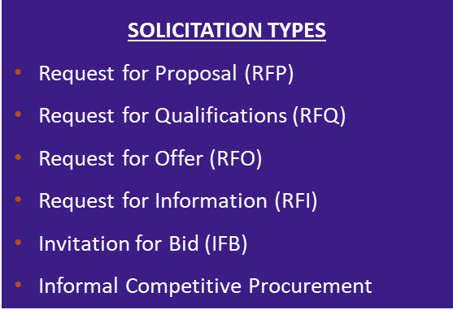
DEN Procurement
Procures competitive contracts:
Professional Services
Construction
Revenue Opportunities
Processes non-competitive contracts:
Sole Source
Professional Preference
Amendments
Grants
Revenue Agreements
Facilitates competitive and non-competitive task order process
Governed by ordinances and regulations including; City and DEN Charter & Ordinances, DSBO, Executive Order 8, and City Procurement and Fiscal Rules

Slide 62
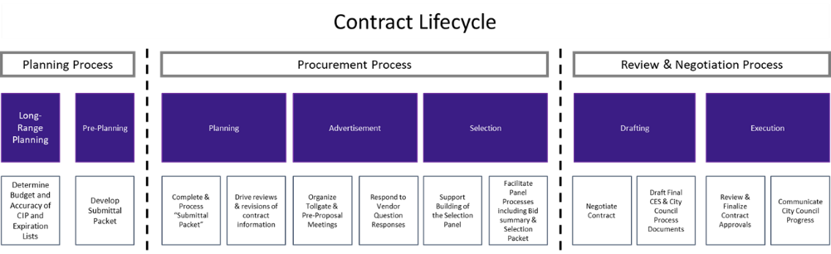
DEN Procurement – Contract Lifecycle
Active DEN Procurements & Solicitations are available on BidNet: https://www.bidnetdirect.com/colorado/cityandcountyofdenverdepartmentofaviation
  Important Dates:
    Published/Advertised Date
    Proposal Due Date
  Important Information:
    Pre-proposal meetings outlining project details
    Proposal Narrative Contents & Evaluation Criteria

Slide 63
Fast-tracking: What Does It Mean
New procurement method for DEN that is currently a pilot program.
Intent is to foster innovation and agility by fast-tracking certain qualified procurement projects. Eliminate steps in the procurement process that are not mandated by city law, ordinances, executive orders, and other governance requirements.
Key features of a fast-tracked opportunity include:
  Compressed advertisement period
  The pre-proposal meeting will not be held, and qualified projects will be advertised for one week. Questions will be due within 2 days of advertisement.
  Simplified selection process
  A 3-member panel composition will make an award recommendation based solely on their independent review and scoring of proposals. No interviews will be held.
  Simplified contract drafting process
  The final written contract will be based solely on what the winning vendor commits to in their proposal. There will be no negotiations to the final written contract.

Slide 64

ACDBE/SBEC Programs
Purpose:
As a primary airport receiving FAA funding, DEN ensures Airport Concessions Disadvantaged Business Enterprises (ACDBEs) have equal opportunities to compete for all concession contracts, in accordance with 49 CFR Parts 23 and 26.
The SBEC program is a locally funded, race- and gender-neutral, defined-pool set-aside program in accordance with Chapter 28, Article 7 of the Denver Revised Municipal Code (DRMC).
Requirements:
ACDBE Concession-specific Goals: Calculated as a percentage of total estimated annual gross receipts from the concession (23.25(e)(1)(i)).
  Concession goal can be met through Direct Ownership, Joint Venture, or G&S purchases from ACDBEs
SBEC Concession program requirements: ONLY small businesses certified with CCD as SBEC in applicable NAICS codes can propose as a concessionaire.
  Concession must be owned and operated by certified SBEC firm(s)
Certification:
Apply and maintain certification with City & County of Denver
Access Small Business Certification & Contract Mgmt. System (BG2Now) Directory
How to Get Involved:
Attend / Apply / Access / Sign Up
Scan the QR Code to learn more about the ACDBE Program
Contact us at DEN-ACDBE@flydenver.com

Slide 65

Small Business Certification Programs
Minority and Women Owned Business Enterprise (MWBE) Program
Eligible small, independent businesses, owned and controlled by socially and economically disadvantaged individual(s) may participate as a MWBE
Subcontracting opportunities on City funded projects with MWBE goals
D.R.M.C. Chapter 28, Article III
Small Business Enterprise (SBE) Programs
Eligible small, independent businesses, owned and controlled by economically disadvantaged individual(s) may participate as an SBE, EBE, SBEC
City defined pool contracts
D.R.M.C. Chapter 28, Articles V and VII
Disadvantaged Business Enterprise (DBE) Program
Eligible small, independent businesses, owned and controlled by socially and economically disadvantaged individual(s) may participate as a DBE
Subcontracting opportunities on federally funded transportation projects (state-wide)
49 CFR Part 26
TO LEARN MORE ABOUT DSBO, PLEASE VISIT US IN THE BREAKOUT ROOM OR SCAN THE QR CODE.

Slide 66




DSBO Pillars
Promoting equity, maximizing opportunities, and preventing discrimination and its effects against small, minority and women owned businesses.
Auditing and Analytics: Business Utilization, Forensics
Strategic Development and Community Engagement
Certification
Compliance
TO LEARN MORE ABOUT DSBO, PLEASE VISIT US IN THE BREAKOUT ROOM OR SCAN THE QR CODE.
Notes:
The City and County of Denver's certification programs, and the Division of Small Business Opportunity (DSBO) who administers these programs, were created to promote equity, maximize opportunities, and prevent discrimination and its effects against small, minority and woman owned businesses. ​​
​​
The primary goal of the certification programs is to level the playing field and provide a fair opportunity for small businesses to compete for City and County of Denver and DEN airport contracts.
Strategic Development and Community Engagement
Connects small businesses with the DSBO program and provides resources to help them successfully develop and pursue work with the city
Certification
Approves small businesses’ applications for certification and ensures that all certified businesses remain compliant with program and eligibility requirements
Auditing and Analytics: Business Utilization
Assesses city projects that are locally funded or on city land for MWBE, DBE contract participation goals and SBE defined selection pool designations.
Compliance
Monitors small business utilization from solicitation through the contract term to ensure equity protections.

Slide 67
Compliance
Preventing Discrimination: Ensuring fair practices in solicitation, contracting, and performance activities.​
​
Certified Business Requirements: Upholding commitments and Good Faith Efforts (GFE).​
​
Commercially Useful Functions: Ensuring firms perform a distinct element of the work of a contract and carry out such work, by performing, maintaining control, managing, and supervising the work involved.​
​
Contractor Prompt Payment: Overseeing and enforcing timely subcontractor payments ​
​
Tracking Participation: Monitoring certified business participation and self-performance requirements.​
​
Risk Prevention: Preventing certified subcontractors from working at risk.​
​
Certified Firm Utilization Changes: Ensuring terminations, substitutions, and scope reductions happen for good cause only.​
​
Subcontract Agreement Requirements: Helping stakeholders understand DSBO requirements.​
​
Compliance Reporting: Ensuring comprehensive compliance reporting.​
For more information about DSBO and to find certified firms, please visit: https://www.denvergov.org/content/denvergov/en/denver-office-of-economic-development/do-business-with-denver.html
Notes:
DSBO’s compliance team monitors small business utilization from solicitation through the contract term to ensure equity protections and adherence to our program requirements from enforcing timely subcontractor payments
Bring attention to the Small Biz, Big Wins

Slide 68
Certification (MWBE, EBE, SBE(C), and DBE)
Applying for Certification(s):
Online Application
Monthly webinar “Understanding Certification”
Must be actively certified (in the correct codes) at the time of bid or when the letter of intent is signed
Maintaining Your Certification(s):
Submit an Annual Update every year.
For changes to NAICS codes submit a NAICS Expansion Application
For changes in ownership, business structure, or control submit a Material Change Application
Notes:
Eligible small businesses may apply for certification in one or more of our certification programs.

Slide 69
Connect with Us
Visit our website: www.denvergov.org/dsbo
Call: (720) 913-1714
Sign up for the DSBO weekly newsletter
Certification: certificationinfo@denvergov.org
DEN Compliance: dsbo@flydenver.com
Downtown Compliance: dsbo@denvergov.org
General inquiries: dsbohelp@denvergov.org

Slide 70

General Services- Purchasing Division
Procures goods and related services (excludes construction/design) using competitive bidding and open market methods. Follows City Charter, D.R.M.C., and Fiscal Accountability Rules.
Key Roles: Manages bids, contracts, assets, surplus sales, vendor relations, and sustainable purchasing.
Vendor Support:
  Uses Rocky Mountain E-Purchasing System.
  Offers bid tools, updates, and resources on its website.
  Sends weekly notices on bids, events, and opportunities.
  Join the vendor list by completing the Purchasing Communication Form.
Upcoming Vendor Event
Learn about Denver agencies, procurement processes, and networking opportunities.
Open to providers of goods, services, and construction.
Scan the QR Code to learn more about
Notes:
To learn more about General Services Purchasing, please visit us in the breakout room at the end of the event.

Slide 71

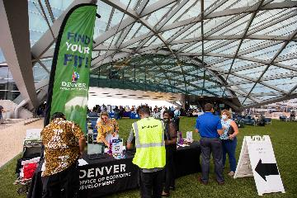
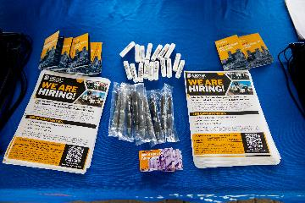
Save the Date - DEN Hiring Fair!
Date: Monday, August 12
Time: 11:00 a.m. – 1:30 p.m.
Location: DEN Plaza
Your Career Takes Off Here!
Meet top employers and explore:
Full-time • Part-time • Seasonal roles
Opportunities in Sales, Housekeeping, Driving, Maintenance, Supervision, Management & more!
Registration opens soon – don’t miss out!

Slide 72

DCCP Overview
Workforce Ordinance Applies To:
Contracts/work orders ≥ $10M, advertised/issued after May 30, 2024
On-call/task orders evaluated individually
Contractors must sign a Workforce Commitment Form
Key Requirements
Priority Areas: Track/report hours worked by residents from DCCP-identified priority neighborhoods
Pre-Apprenticeship Grads: Track/report hours worked by grads from DCCP-approved programs
Veterans: Track/report hours worked by veterans
Why It Matters
Meets high demand for skilled construction workers
Builds career pathways for Denver residents
Aligns workforce with city infrastructure investments
Reporting & Enforcement
Use tools like LCPtracker to track and submit data
DCCP monitors compliance; non-compliance may lead to penalties
Get Involved
Jobseekers, employers, and community orgs — connect with DEDO & DCCP to grow Denver’s construction workforce.
To Learn More: Visit me in the breakout room and scan the QR code.

Slide 73
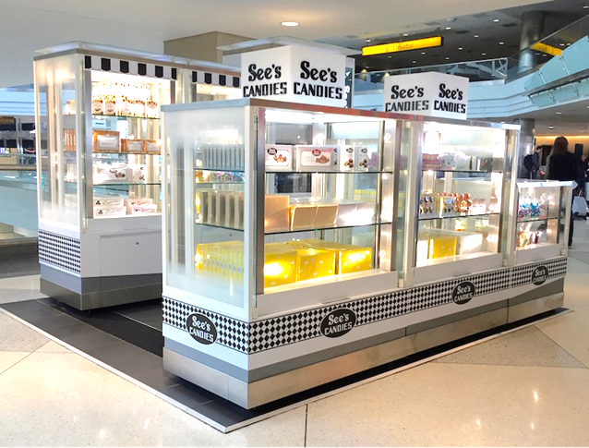
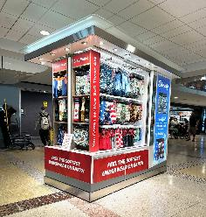
Empowering Small Business in Airport Retail
Who We Are
PRI offers dynamic, revenue generating retail opportunities in airports
Proven success at DEN and SJC
We support local, small, minority and women-owned business through our Small Business Launchpad
Our Mission
  Enhance passenger experience, drive local economic growth and equip small businesses to succeed in airport retail
Key Benefits
No RFP, No Construction
Short-term, low-risk commitment
2024 highlights
  37% of sales represented by ACDBE businesses and average monthly Kiosk/RMU sales over $30,000

Slide 74














Participation, Services & Contract
Turnkey Support for Merchants
Product receipt, storage & delivery
Onboarding, training & badging
Full administrative and operational support
Retail Space/Structure
  Kiosks & RMUs provided by PRI (some custom exceptions)
General Participation Costs
Monthly Minimum: ~$4000 - $6000
Sales Overage: 15% over natural breakpoint
Ancillary Fees: ~$650
DEN Marketing Fee: 0.5% of all gross sales
Let’s Connect!
Cord Rauba
cord@priretail.com
303.342.6817 of 303.885.0815

Slide 75

Event Follow Up
This information will be shared with all attendees in a follow-up email from Eventbrite.com, which will also include the registration list and presentations.
Additionally, it will be posted on our website at www.flydenver.com/business-and-community/outreach-and-engagement/#pastevents within the next 3 business days.
Post-Event Survey

