Slide 1
Meet the Primes
General Contractors
June 2025
Notes:
Good afternoon, everyone.
Thank you for being here today for Meet the Primes

Slide 2
Agenda
Housekeeping
Who Is In The Audience?
About DEN
Procurement Opportunities
Breakout Rooms And Networking
REMINDER:
This information will be shared with all attendees in a follow-up email from Eventbrite.com, which will also include the registration list and presentations.
Additionally, it will be posted on our website at www.flydenver.com/business-and-community/outreach-and-engagement/#pastevents within the next 3 business days.
Notes:
As you can see here we have a pretty full day ahead of us.
Please note all slides and rosters will be posted within 3 business days to our website.

Slide 3
Housekeeping
Please note the following Zoom housekeeping items as you enter:
All cameras and microphones must remain off during the main session
Hold all questions for the breakout rooms
Notes:
As our final piece of housekeeping:
Please keep your cameras and microphones off to maintain focus during the event and minimize distractions for our speakers. If you are muted at any point during the presentation, please be advised that you will have difficulties accessing your mics during the breakout rooms.

Slide 4
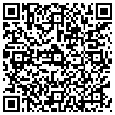
Interest Form
Please take a few minutes to introduce yourself, describe your company, and specify the firms that you are interested in. This information will be shared with all attendees in a follow-up email, including the registration list and presentations. Additionally, it will be posted on our website at www.flydenver.com/business-and-community/outreach-and-engagement/#pastevents
Complete Your Interest Form
Notes:
Please let us know who is in the audience, scan this QR code, and tell us about the opportunities that brought you here today.
This information will be shared with all attendees and PMs via our website.

Slide 5

Vision 100 and Operation 2045
Notes:
Vision 100 and Operation 2045 are phases of DEN's strategic plan.
Vision 100 aims to prepare the airport for 100 million annual passengers.
Operation 2045 focuses on the airport's 50th anniversary and plans for over 120 million annual passengers.
Together, they guide decision-making and accountability here at DEN.

Slide 6


Taking Flight at DEN
Monthly event showcasing multiple procurement opportunities, set for the 2nd Thursday of each month at 1 p.m.
**January 23** - Due to holiday schedules
  February 13
March 13
  April 10
May 8
June 12
July 17
August 14
September 11
October 9
November 13
December 11
Notes:
DEN is committed to eliminating barriers for small businesses at the airport.
“Taking Flight at DEN” highlights our procurement opportunities and facilitates networking. project managers, members of the business community, and resource partners.

Slide 7


Meet the Primes
Virtual outreach event held twice a month to connect Prime firms at DEN with local, small, and historically underutilized firms, scheduled for the 3rd Thursday at 1 p.m.
February 20 - Concessions Prime Operators
April 17 - Rental Car Company
June 26- General Contractors
August 21 - Construction Specialty Trade Contractor (MEP, Painting, Millwork, Drywall, Acoustical, Flooring, Concrete, Metals, Glass Glazing, Trucking, More)
October 16 - Airlines, Real Estate, Commercial Development and Hotelier
December 18 - Architecture, Engineering, and Professional Services
Notes:
Meet the Primes aims to connect Prime firms at DEN with the business community.
Our calendar provides various opportunities to engage with different types of companies.

Slide 8


Navigating the ACDBE Series: Pathways to Concessions
Bi-monthly virtual outreach event held on the third Thursday at 1 p.m. will guide ACDBEs on doing business at DEN.
Pathways to Concessions 2025:
January 16 – ACDBE 101
March 20 – ACDBE 201
May 15 – Joint Ventures 101
July 17 – Joint Ventures 201
September 18 – Concessions Connections
November 20 – B2G Compliance
Notes:
The “Navigating the ACDBE Program” series helps retail and F&B businesses understand certification and compliance for concessions.
Here’s are the remaining sessions

Slide 9
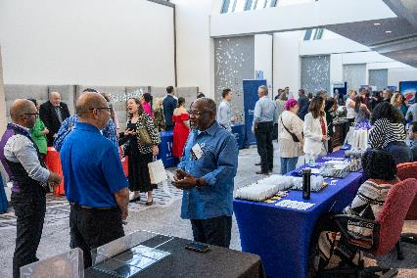
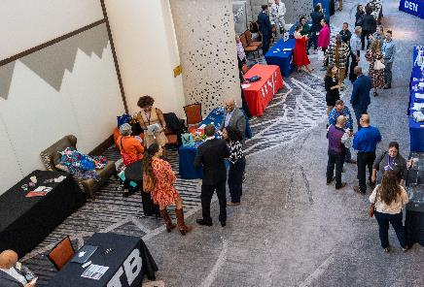
Save the Date - Procurement Tradeshow
August 28, 2025
Westin Denver International Airport
An exciting event designed to foster business partnerships between:
Denver International Airport (DEN)
The City and County of Denver
Prime Contractors
Small Businesses
Resource Partners
Exhibitor Opportunities Coming Soon!
Notes:
Save the date for the Exhibitor Showcase and Tradeshow on August 28.
Sign up for our newsletter and follow us on LinkedIn for more updates as they become available.

Slide 10
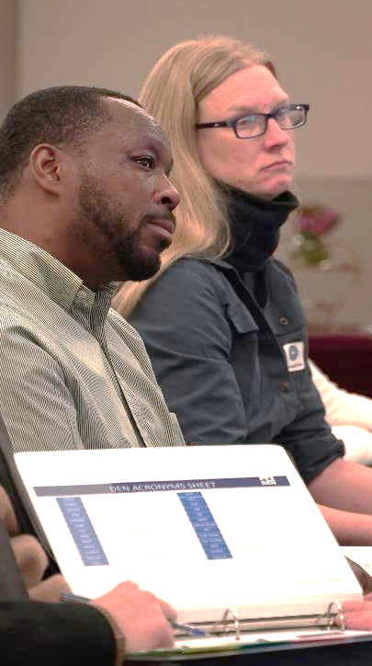



Community Panelist Program
Volunteer program for those who want to participate in a procurement evaluation panel.
Great experience for potential primes
Attain an understanding of the evaluation process
Become familiar with DEN’s values
Gain experience with DEN’s interview format
Scan to Sign Up Today!
We Want Your Story!
Notes:
Volunteer as a Community Panelist for an upcoming procurement evaluation.
Gain insights and improve future proposals. Scan the QR Code to learn more.
Already Participated?
We’re seeking testimonials from past panelists!
Share your experience in the event follow-up email

Slide 11
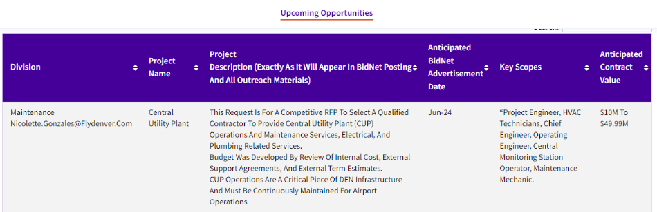

Upcoming Opportunities – Updated Webpage
Notes:
Our website lists procurement opportunities at various procurement stages.
Please be aware that details may change, and the City and County of Denver can modify or cancel projects at their discretion.
Now, we'll hand it over to our project managers.

Slide 12
DEN
Meet the Primes 2025
FlatironDragados Constructors, Inc.
June 26, 2025

Slide 13
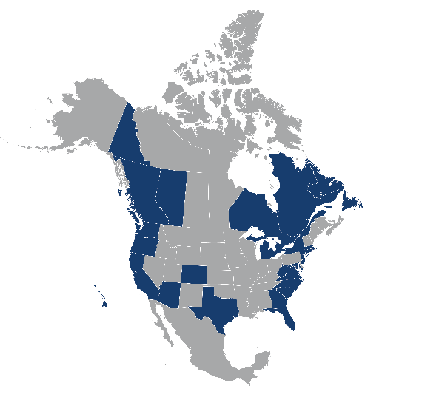
FlatironDragados
Flatiron Dragados is the North American heavy civil construction arm of the ACS Group, one of the world’s largest engineering and construction firms, consistently ranked first overall on ENR’s Top 250 International Contractors list, with 2023 revenues of more than $45 billion.
In 2024, the ACS Group consolidated its presence in the North American heavy civil construction market by integrating Flatiron and Dragados, creating the U.S.’ second-largest domestic heavy civil contractor with unparalleled civil infrastructure experience and exceptional geographic scope.
Combining the long histories of both Flatiron and Dragados (founded in 1947 and 1941, respectively), Flatiron Dragados brings a proven track record delivering some of the most significant, most complex projects in North America.

Slide 14
Our Projects
Water
Pump Stations
Lift Stations
Dams/Reservoirs
Drainage/Stream Restoration
Flood Prevention
Airports
Runways
Taxiways
Aprons/Airfield
Rail
Light Rail
Commuter Rail
Stations/Intermodal Facilities
Track Construction/Reconstruction
Heavy Rail
Road and Bridge
Interchanges
Bridges
Concrete Paving
Interstate/Local

Slide 15
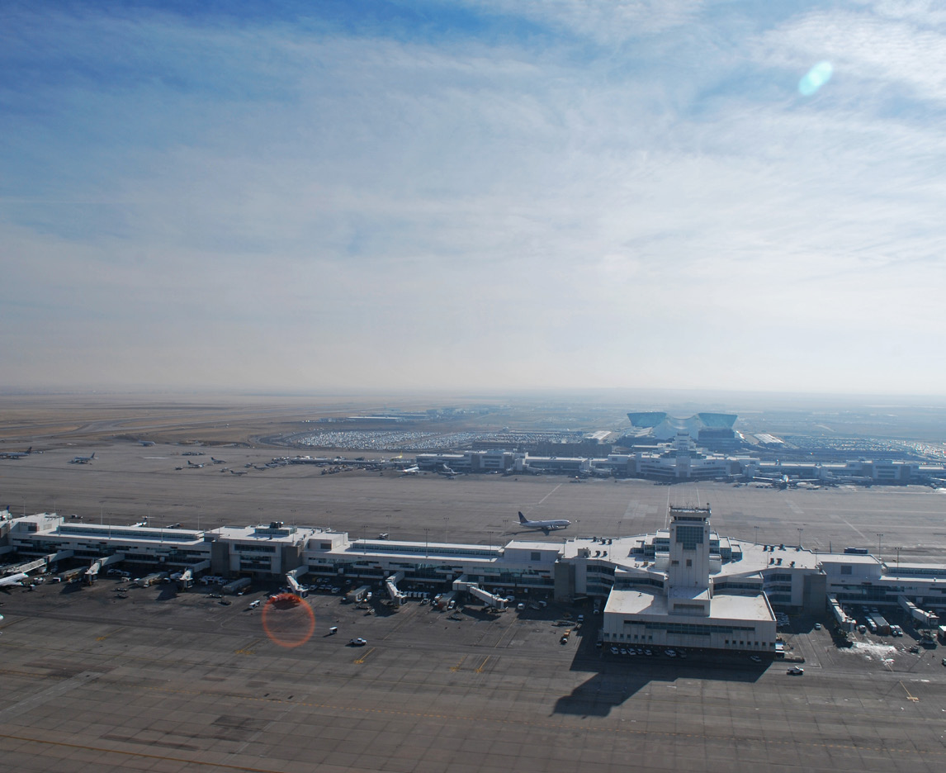
Our DEN Projects
DEN C40/42 GARDI Rehab
DEN Taxiway DS East
On-Call Landside Roadways and Parking Lot Improvements
Peña Blvd Phase 1B Construction
UAL RAPP
Taxilane CN
Taxiway 16L 35R Wildlife Mitigation
Complex Pavement Rehabilitation and Electric Upgrades
DEN Taxiway EE

Slide 16
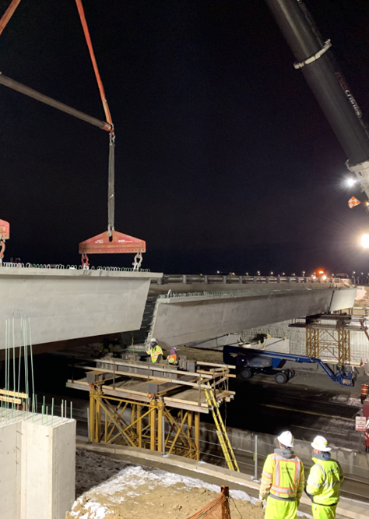
Pena Blvd Phase 1B
Reconstruction of Peña Boulevard Outbound and widening of Peña Boulevard bridges (inbound and outbound) over Jackson Gap Street
Construction of new Direct Connect Ramps from both East and West Terminals to New Castle Street and 78th Avenue
Dedicated routes for buses will remove the buses from the Jackson Gap interchange and will not mix with public traffic​
Reconstruction of Peña Boulevard and Jackson Gap Street to a new diverging diamond interchange
Construction began August 2024
Substantial completion expected October 2026

Slide 17
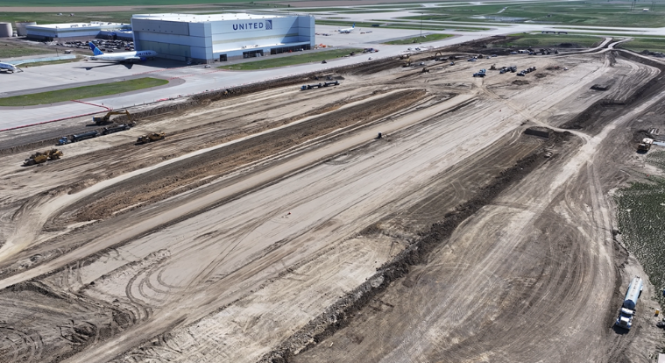
UAL Remote Aircraft Parking Pad
CMAR Contract with United Airlines
Storm water infrastructure
50,000gal Oil/Water Separator System
Relocation of DIWF system
Utility pits for ground power units / aircraft charging
Mast lighting
OFCI Security and IT devices
Project NTP December 2024
Substantial Completion July 2026
20 Narrow Body (A320, 737) or 5 Wide Body (747, 777) RON parking spots

Slide 18
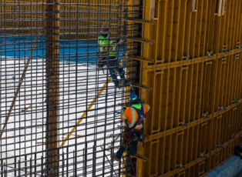
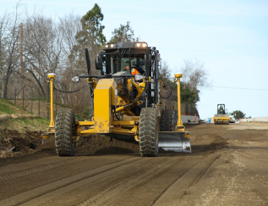
Typical Opportunities on Our Projects
Traditional | Specialty | Professional Services | Supply/Material
Asphalt | Erosion Control | Quality Control Testing | Aggregates
Electrical | Traffic Control | Seeding | Cement
Pavement Marking | Sweeping | Surveying | Fly Ash
Rebar Installation | Saw-Cutting | Public Information | Rebar Supply
Trucking & Hauling |  |  | Geotextiles

Slide 19
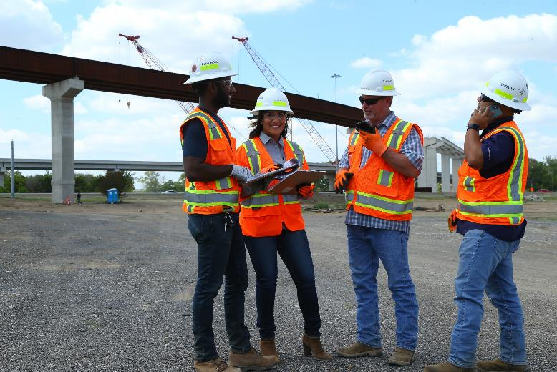
Small and Diverse Business Support
Closely aligned with the DBE/MWBE community.
Break out packages to increase participation from small and diverse businesses.
Mentor-Protégé programs with Denver and CDOT.
Women in Construction Week

Slide 20
Partnering with Flatiron
Email Us (mountaincentral@flatironcorp.com)
The email will make us aware you are interested in working with us and allows our team to set you up in Building Connected. (If you are already a user of Building Connected we will update)
Complete your registration in Building Connected(www.buOutreach Events
Networking is the key to building any relationship and we value face to face opportunities and look forward to meeting with you.
New Prequalification Process
Applies to all new vendors
Submit prequals now or as part of a bid
Only for CMGC/PDM delivery methods
Email us for a link

Slide 21
FlatironDragados Colorado
Stephanie Sudduth
Business Development Manager
303.358.7664 Cell
ssudduth@fdcorp.com
Catherine Harrison
Lead Estimating Admin
720.494.8111 Office
caharrison@fdcorp.com

Slide 22
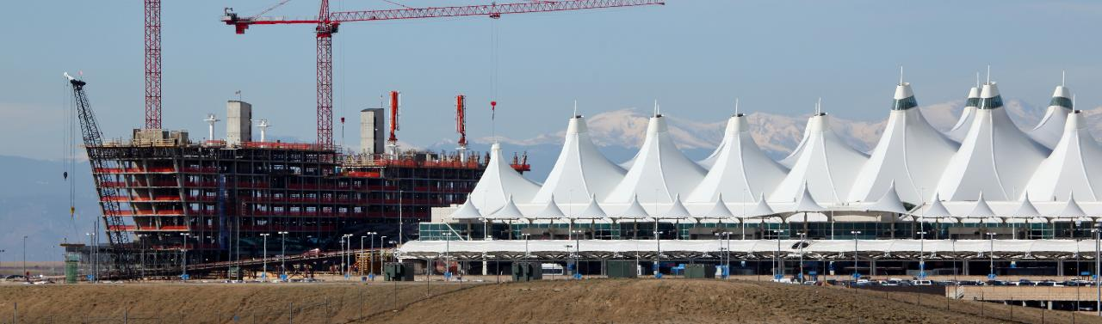


Meet The Primes
Gilmore Construction Corporation
June 26, 2025

Slide 23
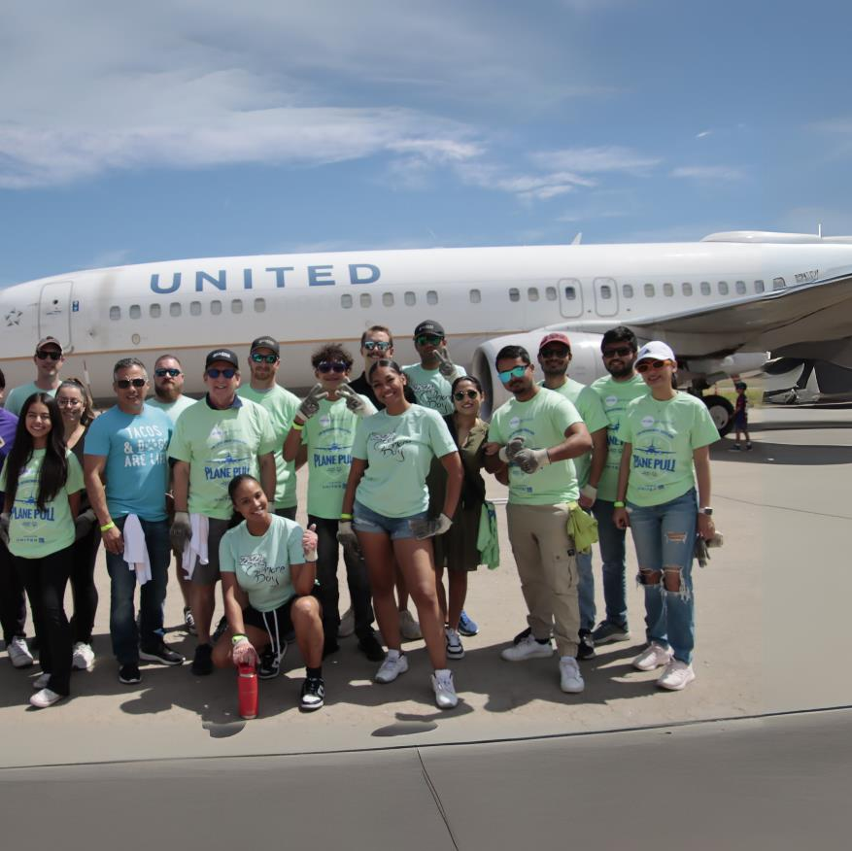

Who is Gilmore?
Strong and Reliable General Contractor
28 Years in the Colorado Construction Industry
20 years at DEN
Services
Diverse Portfolio
  Construction Management
  General Contracting
  Design-Build
  Pre-construction
  Estimating
  HSSE Management & Training
  BIM
  Quality Control
Long-Term Client Relationships
Thoughtful Planners
We begin with the end in mind
Lean construction best practices
Community Commitment
We believe in giving back and growing our workforce
SBE, DBE and MBE Certified

Slide 24

















Where We Work, What We Do?
Aviation & Transportation
Corporate Office & Interiors
K-12 & Higher Education
Airport
Airline Carrier
Transit Facilities
Maintenance & Operations
Private
Public
Interiors
Remodel
Classrooms
Athletics
Summer Renovations
Capital Improvements
Civic & Recreation
Residential & Mixed-Use
Healthcare
Libraries
Recreation Centers
Religious
Renovation
Hospital
Medical Office Building
Surgery Center
Pharmacy
Residential
Commercial
Tenant Improvement
Cultural & Entertainment

Slide 25
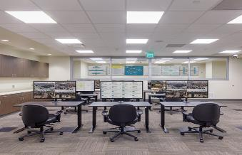
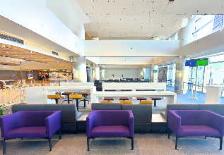
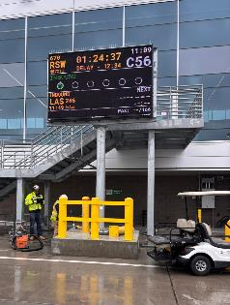
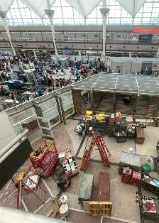
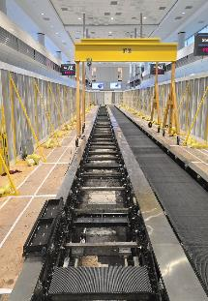
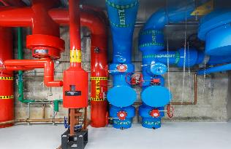
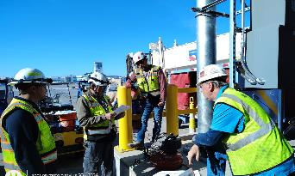
GILMORE’S WORK AT DEN
Previous Projects
TSA Breakroom & Offices
DEN South Checkpoint
DEN Pump Room
DEN Hotel and Transit Center
DEN Great Hall
DEN Terminal Space Relocation/Renovation
Current Projects
DEN On-Call Contract
Turner-Flatiron JV
United Airlines
TKE Conveyance Modernization Program
Future Opportunities
  DEN On-Call Conract
  United Airlines Tenant Improvements
  Concessions Renovations

Slide 26
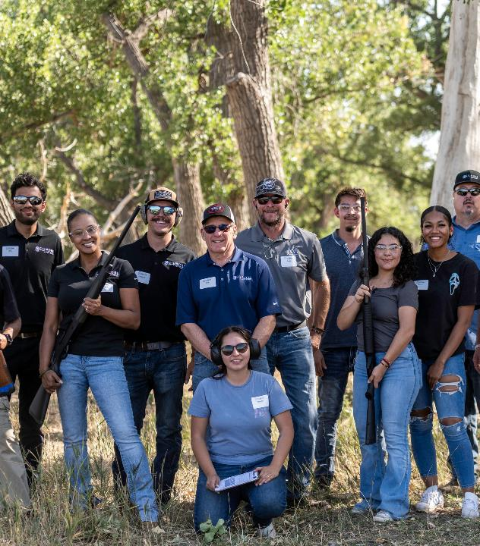

Why Partner with Gilmore?
  Transparent and constant communication
  Collaboration from the start
  Fair and inclusive bidding practices
  We want to be a partner!
Tips for Success
  Follow all safety protocols
    Our focus
  Communicate early and often
  Be proactive when noticing constructability issues or value engineering

Slide 27
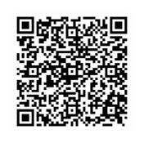


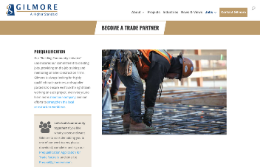
Prequalify Today!
Scan for Prequal application
1. Visit Gilmorecc.com
2. Click on the “Jobs” tab.
3. Select “Become a Trade Partner”
4. Complete application and email to: prequal@gilmorecc.com
Targeted Trade Scopes
Aviation/Terminal & Concession Projects
  Electrical (Low & High Voltage)
  Mechanical/HVAC
  Plumbing
  Fire Suppression
  Security & Access Control Systems
  Temporary Barriers/Phasing Contractors
  Drywall & Framing
  Painting
  Flooring (Tile, Carpet, Resilient)
  Millwork & Casework
  Wayfinding & Signage
  Doors, Frames, & Hardware
The following key risk factors will be reviewed:
  Experience
  Experience Modification Rate (EMR)
  Insurance
  Financial Strength
  Bonding Ability
  References
Site & Core Construction
  Demolition
  Earthwork & Excavation
  Concrete (Foundations & Flatwork)
  Structural & Misc. Steel
  Roofing
  Site Utilities
  Traffic Control/Site Logistics
  Final Cleaning

Slide 28





TEAM
CONTACT
INFORMATION
Steve King | Construction Manager
sking@gilmorecc.com
Viraj Bhandari | Assistant Project Manager
vbhandari@gilmorecc.com
Justin Gilmore | Business Development Director
jtgilmore@gilmorecc.com
THANK YOU!
Grisel Gray | Director of Preconstruction/Estimating
ggray@gilmorecc.com
We value the opportunity to partner with you.
4949 Ironton Street, Denver, CO 80239
Phone: 303.371.5700 Website: gilmorecc.com

Slide 29


GREAT HALL PROJECT
Meet the Primes
Notes:
Tubbs

Slide 30
GREAT HALL PROJECT
Meet the Primes
Notes:
Tubbs

Slide 31



MWBE Participation & Outreach
Contract goal for MWBE participation: 18%
Total MWBE participation to date: 26%
Contract apprenticeship goal: 5%
Apprenticeship to date: 11%
Total Outreach Events: 1008 and counting!
  MWBE = 366
  Workforce = 642
Notes:
Tubbs

Slide 32
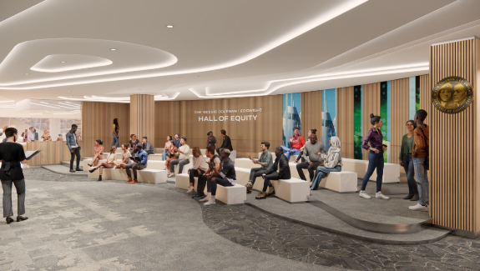
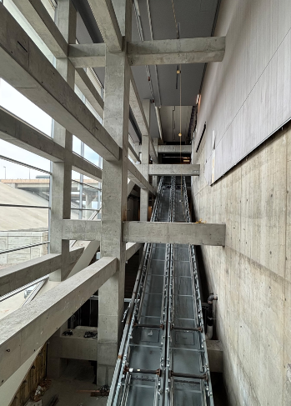
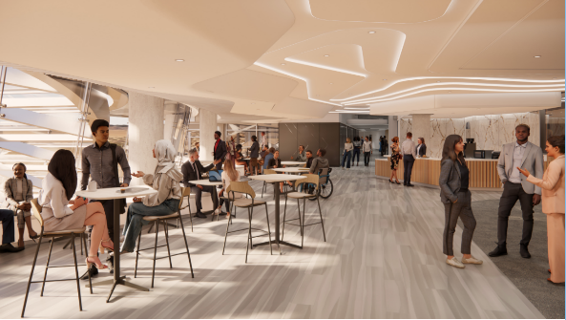
Phase 3A – L4 PTC Buildout – Status Update
Sky Blue Builders
Hensel Phelps
Studio Completiva
Stantec
Escalator Construction Progress
Construction Complete
December 2025
Notes:
Tubbs

Slide 33

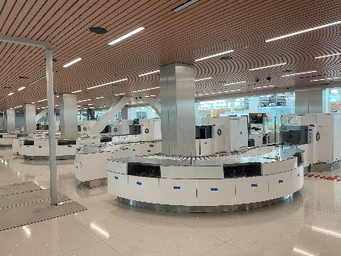
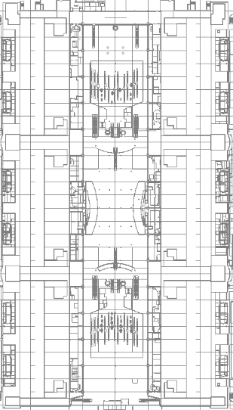
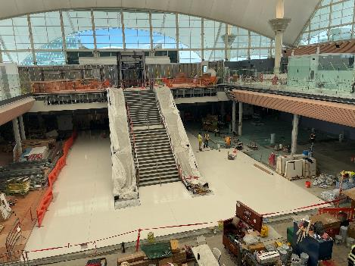
Phase 3B – MOD 1E – Status Update
MOD 1
PHASE 3B
East Security Checkpoint
Opens August 2025
MOD 2
MOD 3
MOD 1 Atrium
Opens September 2026
100% Subcontracted
Notes:
Tubbs

Slide 34
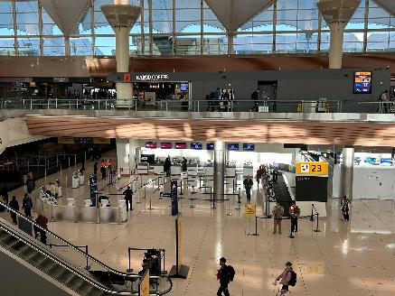
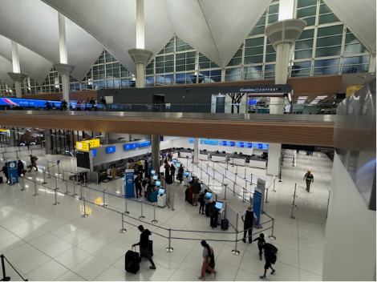
Phase 3C – Interim Ticketing – Status Update
MOD 1
West Side Activation
April 2025
MOD 2
PHASE 3C
MOD 3
East Side Activation
June 2025
Notes:
Tubbs

Slide 35
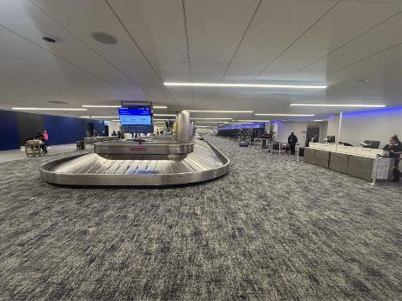
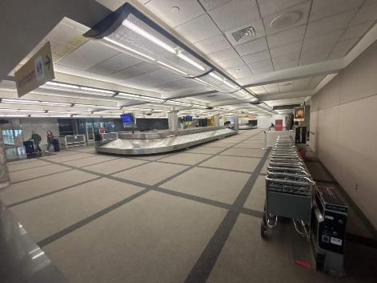
Phase 3D – Baggage Refresh – Status Update
~50% construction complete
100% subcontracted
MOD 1
MOD 2
PHASE 3D
PHASE 3D
MOD 3
Phase 4 of 6
Begins July 2025
Notes:
Tubbs

Slide 36
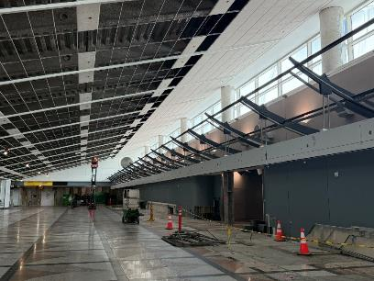
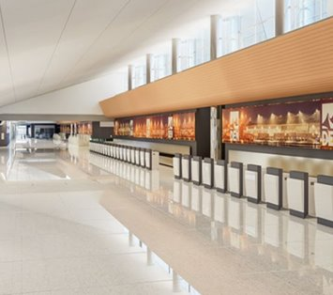
Phase 3E – MOD 3 – Status Update
MOD 1
May 2025: Construction Start
Remaining Opportunities:
Access Flooring
Final Clean
FF&E
MOD 2
New Finishes
Updated MEP Systems
Baggage Handling System Replacement
MOD 3
PHASE 3E
Notes:
Tubbs

Slide 37
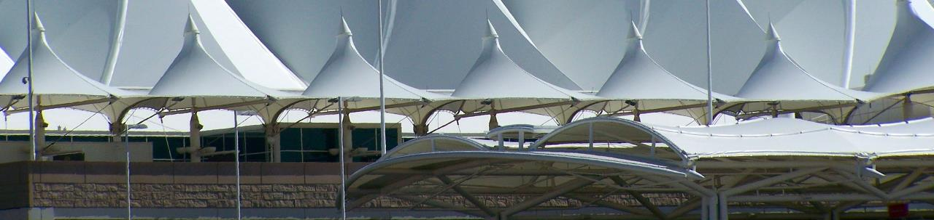

Thank you for joining us!

Slide 38


Meet The Primes - 2025
W
illstone Weber
Presented by Curtis Daniels – Chief Estimator West

Slide 39
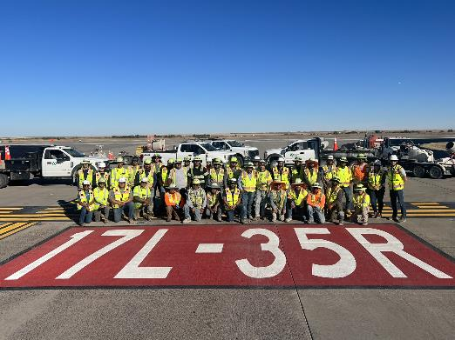
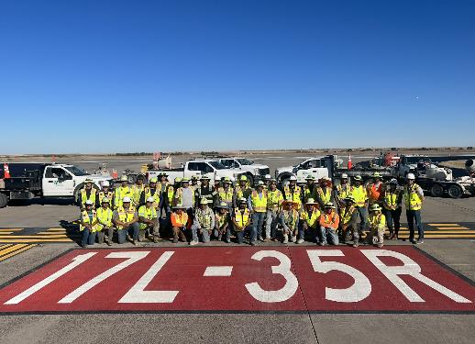

Core Purpose/Values
We are:
  Team First – We treat everyone with honesty, integrity and respect.
  Problem Solvers – We exceed our customers’ expectations.
  Passionate About Results – We develop solutions bringing value to our customers.
  Get Better Every Day– We get better every day.
Leading Transportation Infrastructure Builder solving complex needs for the communities we work in
Leading Transportation Infrastructure Builder solving complex needs for the communities we work in

Slide 40


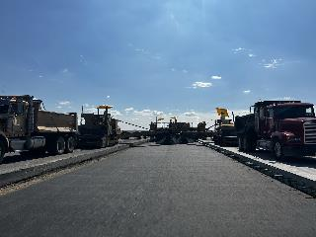
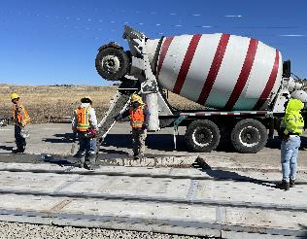
Working with MW
Open & honest communication - We understand that problems and schedule conflicts occur but the earlier these are communicated the quicker they can be resolved.
Bring Innovative Ideas – We love thinking through new ways to accomplish work, alternative materials, and other ideas that expedite construction, increase participation, and provide superior quality.
Best Effort at Bid Time – Majority of our work is bid-build with M/WBE or DBE goals. We don’t have a second chance when bidding and we WILL NOT ask you to “Sharpen your pencils” after bid time.
xxxx
xxxxxx

Slide 41
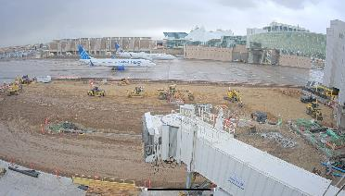
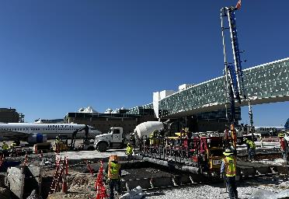
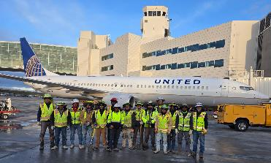
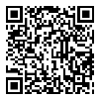
Recent / Current Projects
On-Call Airside
On-Call Landside
GARDI A Southeast
South Worldport Parking Lot
17L – 35R Complex Pavement Rehab
75th & Gun Club Site Readiness
DS West De-Icing Pad - Phase 1
To Prequal as a Subcontractor with Us, Check Out:
https://www.millstoneweber.com/suppliers-registration/Weber

Slide 42
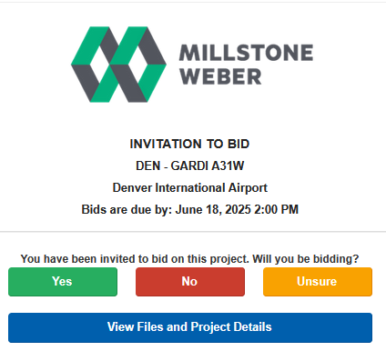







Upcoming Opportunities
Bid Solicitations
Project Name | Description | Estimated Bid Date | Estimated Construction
Pena Blvd Low Spot Repair | Fix Drainage Issue (~30,000 SY) | Q4 2025 | 2025
On-Call Infrastructure 2025 | On-Call (Airside & Landside) | Q3 2025 | 2025-2027
Water Quality Infrastructure Improvements | Regional Water Quality Pond | Q4 2025 | 2025
Construct Taxiway Lima | Complete Taxiway Lima ~ 1 Mile | 2026 | 2026-2027
Longs Peak Parking Lot | 6" Concrete Overlay | 2026 | 2026-2027
GARDI B-NE | 11 Gate GARDI | 2026 | 2026-2027
Other Owners we have worked for:
PreconSuite
Notes:
Free to use – No logins or passwords to forget like other programs
Categorized by scopes of work being solicited for each project.
All project documents can be found here
Includes pertinent information for each job such as DEI Goals, Start dates, bid dates, tax and labor details, and contacts for the Millstone Weber Team
Notices for changes & quantities are sent directly through this system.
RFI’s & Quotes can be uploaded directly to the system.

Slide 43
Commonly Required Scopes
Subcontractors
Suppliers
CIP Structures & Flatwork
Asphalt Placement & Milling
Electrical & Mechanical
Utilities (Storm, Water, Sanitary)
Saw Cutting & Joint Sealant
Traffic Control, Striping and Signage
Hourly Trucking
Sweeping, Erosion Control & Seeding
Quality Control & Survey
Concrete Paving Accessories
Aggregates
Geotextiles
Ready-Mix
Pipe Products & Structures
Reinforcing Steel
Fabricated Metals

Slide 44
Thank You
Brandon Bates
Subcontractor Info
Curtis Daniels
VP – West Region
www.millstoneweber.com/
suppliers-registration/
Chief Estimator - West
EMAIL
EMAIL
EMAIL
Brandon.bates@millstoneweber.com
Bids@millstoneweber.com
Curtis.daniels@millstoneweber.com
PHONE NUMBER
PHONE NUMBER
PHONE NUMBER
720.484.6298
636.949.0038
314.610.4068

Slide 45
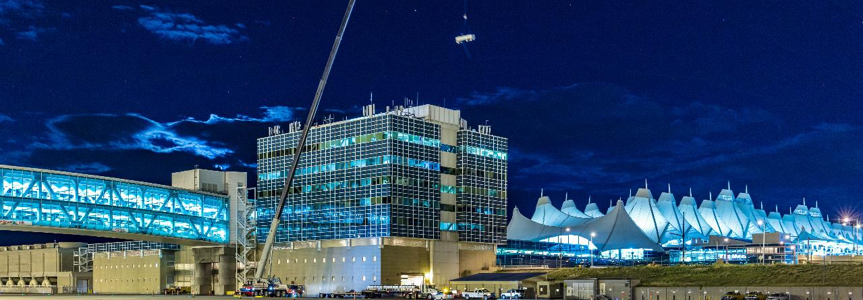



PCL CONSTRUCTION
TOGETHER WE BUILD SUCCESS.

Slide 46

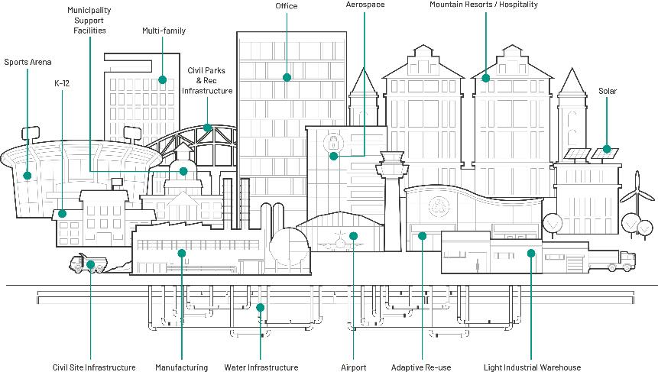




ABOUT PCL
50
YEARS OF EXPERIENCE IN COLORADO
30+
YEARS OF CONTINUOUS WORK AT DEN
150+
COMPLETED DEN PROJECTS
$1.2B
IN WORK AT DEN
Inclusion
Collaboration
Innovation
Transparency

Slide 47

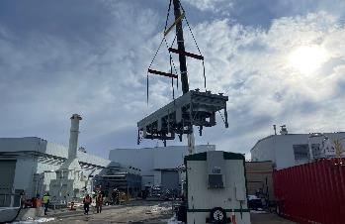

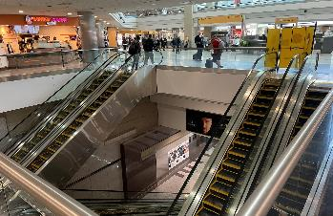








OUR RECENT DEN EXPERIENCE
| Airfield Deicing System Modernization
| On-Call Task Order: MOD 1 Airline Relocation
| Concourse A Center Core Escalator Replacement
SCOPES OF WORK:
Renovation
Secure / Airside
| United Airlines Concourse B East Gates of the Future TI
| CGFE FedEx Building Repair
| ARFF Concourse A Tower
MEP Upgrades
Structural Upgrades
System Improvements

Slide 48

CURRENT OPPORTUNITIES
TSA RECAPITALIZATION AND BHS MODERNIZATION
PHYSICAL ACCESS CONTROLS SYSTEM – PHASE III
ON-CALL GC SERVICES
Task orders for various construction projects within airport, including upgrades, infrastructure improvements, renovations, and other construction services
All trades
Replacement of existing inline EDS machines with new screening machines, replacement of CBIS, and replacement of end-of-life BHS equipment
Baggage handling systems
Electrical
Mechanical
Traffic control
Labor
Replacement of the physical access control systems for all of DEN, including over 1,500 doors and portals
Design
Electrical
Miscellaneous carpentry

Slide 49
OUTREACH OPPORTUNITIES
Outreach Consults
Meet & Greets and One-on-Ones
Community Wide PCL Outreach Events
Trade Collaboration
Community connectors
Database of available trades
Bid solicitations
Training and capacity building
Formal meet and greet opportunities with PCL Preconstruction Team
One-on-one meetings with specific staff for specific needs
Commerce Hub
Partner organizations / events
Conferences / conventions
Owner project info sessions
GC Collab
Small business trade associations
Subcontractor connections
Small business program consultation

Slide 50




MWBE ENGAGEMENT
Sample of Recent Work
PROJECT | MWBE GOAL | MWBE ACTUAL
Ross Barnum Library Renovation | 21% | 32%
Coors Field Upper Concourse Concrete Repair | 20% | 53%
DPS Thomas Jefferson High School | 30% | 34%
DPS Steele Elementary | 24% | 30%
DPS Bradley & Holm | 10% | 34%
DPS Lake Middle School | 10% | 11.5%
DPS Centennial School | 24% | 24.5%
Prequalification
& Outreach
Bid Solicitation
& Analysis
Partnerships
& Associations
Transparency
& Accountability

Slide 51




PCL CONTACTS
JESSE MEYER
OPERATIONS MANAGER
JJMeyer@pcl.com
ETHAN POWELL
SPECIAL PROJECTS OPERATIONS MANAGER
ETPowell@pcl.com
DIEDRA GARCIA
INCLUSIVE CONTRACTING MANAGER
DGarcia@pcl.com
MERCEDES NARANJO
PREQUALIFICATION COORDINATOR
MRNaranjo@pcl.com

Slide 52


Swinerton
We’ve been
building America
for over 135 years.
1888 Founding Year
80+ Years in Colorado
100% Employee Owned
4,500+ Employees
23 Offices

Slide 53

Aviation Expertise
1960
Began Building Aviation
$400M
Annual Aviation Revenue
30+
Completed DEN Projects

Slide 54



Aviation Expertise @ DEN
Process-driven solutions that keep passengers moving.
AVIATION HIGHLIGHTS
DEN Southwest Technical Operations Center
DEN United Airlines Concourse B GOTF
Mission Yogurt Marketplace C
Highlights
10,000 SF marketplace in Concourse C $10.5 million Restaurants: Marczyk, Teatulia, and Cholon
Highlights
128,000 SF maintenance hangar $91 million Achieved 20% MWBE participation
Highlights
Modernization of 55 flight hold rooms $34 million Achieved over 40% diversity participation

Slide 55







Work with Swinerton
Prequalification & Master Services Agreements
Bid Solicitation via Building Connected
  Offer trade specific pre-bid meetings
  Pre-award and pre-work meetings
  Post-bid debriefing opportunities
Quick Pay Options
Brews with Builders
Prep for Success
Prequalification Evaluations
Financial
Bonding
Insurance
Safety
Certifications
Credit
W-9

Slide 56















Swinerton Outreach & Engagement
External Events
Association Events
DEN BDTA Program
HCC Contractor's Academy
CCD Mentor / Protégé Program
Find Us!

Slide 57

Bid Opportunities
Contact us:
https://swinerton.com/subcontractors/

Slide 58




Contact Us
Bradley Monson
Project Executive
720.390.0225
bradley.monson@swinerton.com
Lindsay Brown
Community Relations Manager
720.762.1103
lindsay.brown@swinerton.com
Dawson Jones
Chief Estimator
303.418.0270
dajones@swinerton.com
Matt Curtis
Operations Manager
720.951.0387
matthew.curtis@swinerton.com

Slide 59



Slide show cover page
Meet the Primes

Slide 60

WCG – DEN Experience
DEN Experience
14+ Years at DEN
$63.3M+ Work in Place
45+ Projects
$15M+ On-Call Projects
25+ Unique Task Orders
23 Badged Team Members

Slide 61

WCG – Active projects
DEN Active Projects
BJORN Honey – Concourse C
WH Smith – Larimer Street
WH Smith – Arts District
Freshens – Concourse B
WCG Construction has been awarded upcoming projects at DEN which are scheduled to start later this year. In addition, our team is actively pricing new concession opportunities projected to start in 2025-2026.

Slide 62

WCG – Supplier Program
Diversity Supplier Program
WCG Construction is a proud supporter of our MWBE design/trade partners and the role they play in facilitating the growth of our local Colorado based companies. In each of our DEN projects, WCG Construction has met or exceeded the MWBE participation goals.
WCG Construction maintains an active database of MWBE trade partners. To join this list please reference the contact information slide and reach out to Ryan Meredith.

Slide 63

WCG – TradeTapp Qualification
TradeTapp
Prequalified Trade Partner Process
WCG uses TradeTapp to make Trade Partner engagement more efficient
Trade Partners can simply login to this easy-to-use system to submit an application
Once prequalified, Trade Partners receive project updates and BID information via BuildingConnected
To join TradeTapp please reference the contact information slide and reach out to Gena Hannaway

Slide 64

WCG Arrow Program
ARROW Program
Fixture Replacement
Paint
Drywall
Flooring
Equipment Handling
Plumbing
And More …

Slide 65




WCG – Primary Contact Information
Contact Information
Rachel Gawley
Project Manager
rgawley@wcgconstruct.com
Gena Hannaway
Trade Partner Engagement
ghannaway@wcgconstruct.com
Ryan Meredith
Chief Estimator
rmeredith@wcgconstruct.com

Slide 66
Outreach Wrap Up and Breakout Rooms

Slide 67

Event Follow Up
This information will be shared with all attendees in a follow-up email from Eventbrite.com, which will also include the registration list and presentations.
Additionally, it will be posted on our website at www.flydenver.com/business-and-community/outreach-and-engagement/#pastevents within the next 3 business days.
Post-Event Survey

Slide 68

Breakout Room Assignments
Notes:
Michelle
Thank you to all of today’s speakers!
Here is a list of breakout rooms, feel free to join any of the rooms at your leisure
In addition to the projects we have also included resource rooms such as DSBO, ACDBE, Contract, and Purchasing
Please Take advantage of this opportunity to connect with the DEN PMs before these RFPs are posted and then they go into a cone of silence
Turn on your cameras
Introduce yourself and your company
Ask questions
Make connections with others in the room for possible connections
Let them know if you are interested in priming or subbing?
If you are a large firm, I would encourage you to
take advantage of this space to connect with small business partners
If you are a Small Business
Prepare and get ready now before these RFPs are released
Identify Business Partners who are pursuing the work you are interested in
Make sure your certifications are up to date
If you are looking to sub, connect with those Prime firms who are interested in pursuing the work and
Find out their qualification process
Get on their bidlist
Identify your point of contact
Continue to build your relationship
And finally, please take a few minutes before leaving the event today and help us improve our programs by scanning the QR code and taking a quick survey for us
Lets open the rooms, if you cannot see a window pop up click on the More Button with 3 dots at the bottom of your screen and click on breakout rooms

