Slide 1
Taking Flight at DEN
July 2025
Notes:
Good afternoon, everyone.
Thank you for being here today for Taking Flight at DEN.
My name is Desiree Mondragon, Outreach Administrator here at DEN.

Slide 2
Legal Disclaimer​
This event is intended to provide the business community with early notice for potential procurement opportunities at DEN, allow companies to meet DEN project managers, and allow firms to network and foster relationships with each other. Projects included in this event are in their early stages of planning, and critical information about these projects (e.g. dates and goals) may be unknown and are otherwise subject to change. In its discretion, the City and County of Denver may cancel, modify, or place any project on hold at any time, for any reason. ​
Notes:
This event aims to notify the business community of potential procurement opportunities at DEN,
Attendees can network with project managers and other members of the business community.
Note: Projects are in the early planning stages and the City and County of Denver can cancel or modify any project at any time.

Slide 3
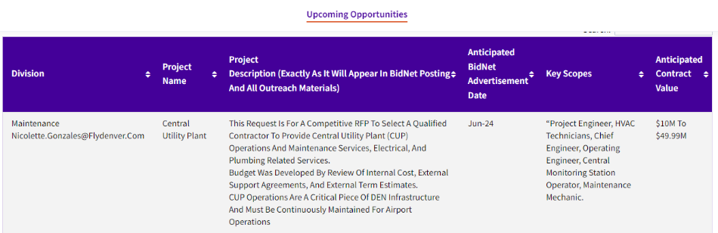

Upcoming Opportunities – Updated Webpage
Notes:
Our website lists procurement opportunities at various procurement stages.
Please be aware that details may change, and the City and County of Denver can modify or cancel projects at their discretion.
Now, we'll hand it over to our project managers.

Slide 4
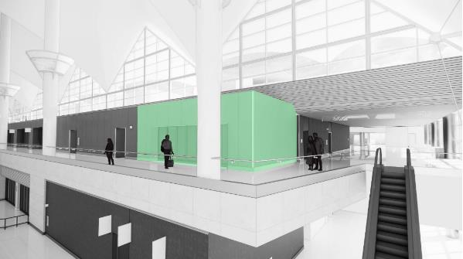
ATM and Banking Services
Denver International Airport (DEN) will be releasing a Request For Proposals (RFP) competitive selection process for a concessionaire to install, operate and maintain ADA compliant Automated Teller Machines (ATMs) throughout the airport as well as design, build out and operate a banking services branch within the Great Hall at Denver International Airport. ATMs will be installed in compliance with all applicable regulations and standards at identified locations. ATMs will utilize Wi-Fi connections and will not require a wired data connection. ATMs will provide a range of services including cash withdrawals, balance inquiries and fund transfers. The banking services provided will include commercial and personal banking solutions for airport passengers, employees and tenants to include mobile and online banking capabilities. The selected concessionaire will adhere to all regulatory requirements and implement security to protect customer information and transactions.
The proposed term for this opportunity is nine (9) years.
KEY INFORMATION
Anticipated Advertisement Date: August 1, 2025
Small Business Program Goal: 0% ACDBE / 25% MWBE
Key Scope/Industry: ATM & Banking Services
Project Manager: Lindsay Mercier| Lindsay.Mercier@flydenver.com
*Dates are tentative and subject to change​
*Draft Rendering – Subject to Change
Notes:
Talking Points – 45-50 seconds max
DEN will soon release an RFP for ADA-compliant ATMs and a bank branch in the Great Hall.
ATMs will run on Wi-Fi, offer standard services, and meet all regulatory and security requirements.
The bank branch will support personal and commercial banking, including online and mobile services.
Term: 9 years
Release Date: August 1, 2025
Goal: 0% ACDBE / 25% MWBE
Contact: Lindsay.Mercier@flydenver.com
To learn more, visit me in the breakout room after this session.
Next, we’ll show draft ATM locations in the terminal and concourses. These may change. You’ll also see a draft bank space rendering and layout.

Slide 5
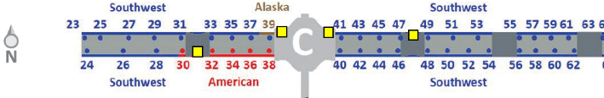
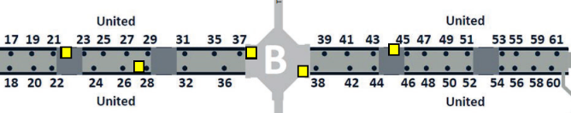
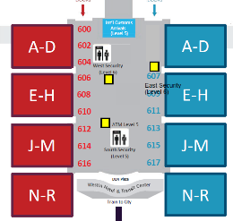
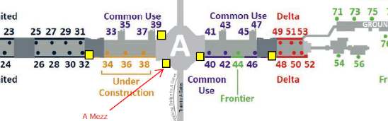
ATM and Banking Services
Seventeen (17) ATM locations as denoted by yellow squares
Three (3) in the terminal
Fourteen (14) on the concourses
Bank Branch:
640 square feet
Great Hall
MOD3, Level 6, East 4
*ATM frequency and locations - Subject to Change​
Notes:
The images you see are maps of the terminal and all three concourses, showing 17 proposed ATM locations marked by yellow squares:
3 in the terminal
14 across Concourses A, B, and C
Keep in mind, locations and frequency are subject to change based on final design and operational needs.
The selected concessionaire will also build and operate a 640 sq. ft. bank branch in the Great Hall, located at MOD3, Level 6, East 4 — a central, high-traffic area.

Slide 6
M3L5E1 & M3L5C1 Casual Dining with Bar
Denver International Airport (DEN) will be conducting a Request for Proposals (RFP) competitive selection process for a concessionaire to design, build, and manage a food and beverage location in the Great Hall. This location will be comprised of a Casual Dining Restaurant with Bar concept. The location will be approximately 8343 square feet, and the term will be twelve (12) years.
KEY INFORMATION
Anticipated Advertisement Date: August 1, 2025
Small Business Program Goal:
MWBE Construction Goal: To be determined after award
MWBE Design Goal: 15%
  Primary NAICS Codes Identified: 541310 & 541330
ACDBE: 31.3%
  Primary NAICS Codes Identified: 722513 & 722511
Key Scope/Industry: F&B Concessions Concepts, ACDBE/MWBE Partners, General Contractors, etc.
Project Manager: Branden Sowers| Branden.Sowers@flydenver.com
*Dates are tentative and subject to change
Notes:
Good afternoon, I’m Branden Sowers, and I’ll be presenting on the next several concessions opportunities. For more details, be sure to join the team in the breakout room. A
DEN will soon release an RFP for a Casual Dining Restaurant with Bar in the Great Hall — approx. 8,343 sq. ft. with a 12-year term.
We’re seeking strong F&B operators, ACDBE/MWBE partners, and qualified design and construction teams.
Release Date: August 1, 2025
Goals: 31.3% ACDBE, 15% MWBE Design, Construction TBD
Contact: Branden.Sowers@flydenver.com
Next, you'll see a draft rendering and layout of the space. Locations may change based on final design.

Slide 7
M3L5W1 Fast Casual Dining
Denver International Airport (DEN) will be conducting a Request for Proposals (RFP) competitive selection process for a concessionaire to design, build, and manage a food and beverage location in the Great Hall. This location will be comprised of a Casual Dining Restaurant with Bar concept. The location will be approximately 3414 square feet, and the term will be twelve (12) years.
KEY INFORMATION
Anticipated Advertisement Date: August 1, 2025
Small Business Program Goal:
MWBE Construction Goal: To be determined after award
MWBE Design Goal: No Program
  Primary NAICS Codes Identified: 541310 & 541330
ACDBE: 31.3%
  Primary NAICS Codes Identified: 722513 & 722511
Key Scope/Industry: F&B Concessions Concepts, ACDBE/MWBE Partners, General Contractors, etc.
Project Manager: Branden Sowers| Branden.Sowers@flydenver.com
*Dates are tentative and subject to change
Notes:
Denver International Airport is launching an RFP to find a concessionaire to design, build, and manage a casual dining restaurant with a bar in the Great Hall. The space is about 3,400 square feet, and the contract will run for 12 years.
KEY INFORMATION
Anticipated Advertisement Date: Q3
Estimated Project Value: $2M to $4.99M
Small Business Program Goal: TBD
Key Scope/Industry: F&B Operator and Concessionaire
Next, you'll see a draft rendering and layout of the space. Locations may change based on final design.

Slide 8
M2L5E1 Travel Convenience Marketplace
Denver International Airport (DEN) will be conducting a Request for Proposals (RFP) competitive selection process for a concessionaire to design, build, and manage a retail location in the Great Hall. This location is intended for the development of a 100% SBEC-owned and certified Travel Convenience Marketplace concept. The location will be approximately 1818 square feet, and the term will be nine (9) years.
KEY INFORMATION
Anticipated Advertisement Date: August 1, 2025
Small Business Program Goal:
MWBE Construction Goal: To be determined after award
MWBE Design Goal: No Program
SBEC: 100%
  Primary NAICS Codes Identified: 459510, 445131, 455320 & 459420
Key Scope/Industry: Retail Concessions Concepts, SBEC/MWBE Partners, General Contractors, etc.
Project Manager: Branden Sowers| Branden.Sowers@flydenver.com
*Dates are tentative and subject to change
Notes:
Denver International Airport (DEN) will be conducting a Request for Proposals (RFP) competitive selection process for a concessionaire to design, build, and manage a retail location in the Great Hall. This location is intended for the development of a 100% SBEC-owned and certified Travel Convenience Marketplace concept. The location will be approximately 2016 square feet, and the term will be 9 years.
KEY INFORMATION
Anticipated Advertisement Date: Q3
Estimated Project Value: $2M to $4.99M
Small Business Program Goal: TBD
Key Scope/Industry: Retail Operator, Concessionaire, SBEC
Next, you'll see a draft rendering and layout of the space. Locations may change based on final design.

Slide 9
M2L5W1 Grab and Go Café
Denver International Airport (DEN) will be conducting a Request for Proposals (RFP) competitive selection process for a concessionaire to design, build, and manage a food and beverage location in the Great Hall. This location is intended for the development of a 100% SBEC-owned and certified Grab and Go Café concept. The location will be approximately 1779 square feet, and the term will be twelve (12) years.
KEY INFORMATION
Anticipated Advertisement Date: August 1, 2025
Small Business Program Goal:
MWBE Construction Goal: To be determined after award
MWBE Design Goal: No Program
SBEC: 100%
  Primary NAICS Codes Identified: 722515, 722513 & 722330
Key Scope/Industry: F&B Concessions Concepts, SBEC/MWBE Partners, General Contractors, etc.
Project Manager: Branden Sowers| Branden.Sowers@flydenver.com
*Dates are tentative and subject to change
Notes:
Denver International Airport is launching an RFP for a concessionaire to design, build, and operate a Grab and Go Café in the Great Hall. This opportunity is reserved for a 100% SBEC-owned and certified business. The space is around 2,000 square feet, with a 12-year contract.KEY INFORMATION
Anticipated Advertisement Date: Q3
Estimated Project Value: $2M to $4.99M
Small Business Program Goal: TBD
Key Scope/Industry: F&B Operator, Concessionaire, SBEC
Next, you'll see a draft rendering and layout of the space. Locations may change based on final design.

Slide 10
M3L5W1 Arrivals Lounge
Denver International Airport (DEN) will be conducting a Request for Proposals (RFP) competitive selection process for a concessionaire to design, build, and manage a passenger service concession location in the Great Hall. This location will be an Arrivals Lounge concept. The location will be approximately 2060 square feet, and the term will be nine (9) years.
KEY INFORMATION
Anticipated Advertisement Date: August 1, 2025
Small Business Program Goal:
MWBE Construction Goal: To be determined after award
MWBE Design Goal: No Program
ACDBE: 0%
  Primary NAICS Codes Identified: 812990
Key Scope/Industry: F&B Concessions Concepts, SBEC/MWBE Partners, General Contractors, etc.
Project Manager: Branden Sowers| Branden.Sowers@flydenver.com
*Dates are tentative and subject to change
Notes:
Denver International Airport will soon issue an RFP to select a concessionaire to design, build, and manage an Arrivals Lounge in the Great Hall. The space is about 2,060 square feet, with a 9-year contract term.
KEY INFORMATION
Anticipated Advertisement Date: Q3
Estimated Project Value: $2M to $4.99M
Small Business Program Goal: TBD
Key Scope/Industry: F&B Operator, Concessionaire, SBEC
Next, you'll see a draft rendering and layout of the space. Locations may change based on final design.

Slide 11
M3L6E1 Food Hall
Denver International Airport (DEN) will be conducting a Request for Proposals (RFP) competitive selection process for a concessionaire to design, build, and manage a food and beverage location in the Great Hall. This location will be a Food Hall comprised of three quick service restaurant concepts. The location will be approximately 5812 square feet, and the term will be twelve (12) years.
KEY INFORMATION
Anticipated Advertisement Date: August 1, 2025
Small Business Program Goal:
MWBE Construction Goal: To be determined after award
MWBE Design Goal: 15%
  Primary NAICS Codes Identified: 541310 & 541330
ACDBE: 31.3%
  Primary NAICS Codes Identified: 722515, 722513, 722330, & 722511
Key Scope/Industry: F&B Concessions Concepts, SBEC/MWBE Partners, General Contractors, etc.
Project Manager: Branden Sowers| Branden.Sowers@flydenver.com
*Dates are tentative and subject to change
Notes:
Denver International Airport will soon issue an RFP to select a concessionaire to design, build, and manage a Food Hall in the Great Hall, featuring three quick-service restaurant concepts. The space is about 5,800 square feet, with a 12-year contract term.
KEY INFORMATION
Anticipated Advertisement Date: Q3
Estimated Project Value: $2M to $4.99M
Small Business Program Goal: TBD
Key Scope/Industry: F&B Operator, Concessionaire, SBEC
Next, you'll see a draft rendering and layout of the space. Locations may change based on final design.

Slide 12
On-Call Infrastructure Design
Task-order-based professional engineering and design services for projects at Denver International Airport (DEN), including rehabilitation, reconstruction, expansion and renovation of heavy civil projects, landside and airside.
Typical Services May Include:
Airfield, roadway, bridge, and parking design
Structural, geotechnical, and traffic engineering
Surveying, mapping, drainage, and erosion control design
Cost estimating, planning, permitting, and construction administration
KEY INFORMATION
Anticipated Advertisement Date: Q3 2025
Estimated Project Value: $10M
Small Business Program Goal: 21% MWBE Goal
Key Scope/Industry: Civil engineering, electrical engineering, surveying, structural engineering, geotechnical engineering, cost estimating, traffic engineering, drainage engineering
Project Manager: Irene St.Martin| irene.st.martin@flydenver.com
Notes:
DEN will release a procurement opportunity for task-order-based professional services to support construction projects, including facility upgrades, infrastructure improvements, and renovations at Denver International Airport.
Scope Includes:
Airfield, roadway, bridge, and parking design
Structural, geotechnical, traffic, and drainage engineering
Surveying, cost estimating, permitting, and construction administration
Project Types: Facility upgrades, new facility design, studies, evaluations
Standards: Must follow DEN Design Standards and applicable regulations
Estimated Value: $10M
Anticipated Ad Date: Q3–Q4
Contact: : Irene St.Martin| irene.st.martin@flydenver.com
Visit me in the breakout room for more details!

Slide 13
2025 Tunnel Switchgear Heaving Remediation
Six switchgear rooms in the East and West cores of ACON, BCON, and CCON have experienced soil heaving, causing damage to both equipment and enclosures. Additionally, ACON East and West sub-cores face significant water intrusion, impacting switchgear performance.
Replace damaged switchgear and enclosures.
Install new switchgear on elevated steel platforms anchored to the basement foundation to prevent future heaving impact.
Construct code-compliant enclosures with fire-rated walls, fire suppression, and HVAC.
Remove and replace heaved soil and repair room structures.
Implement water mitigation at ACON sub-cores.
Design-Build Contract
KEY INFORMATION
Anticipated Advertisement Date: Q3-Q4
Estimated Project Value: $10M to $49.99M
Small Business Program Goal: 6% MWBE Goal
Key Scope/Industry: Electrical, Concrete, Masonry, Earthwork, Civil Utilities, Mechanical, Electrical, Plumbing
Project Manager: Mark Tabugadir| mark.tabugadir@flydenver.com
Notes:
DEN will release a Design-Build RFP to address soil heaving and water intrusion in six switchgear rooms across Concourses A, B, and C.
The scope includes:
Replacing damaged switchgear and enclosures
Elevating new switchgear on steel platforms to prevent future damage
Constructing fire-rated, code-compliant enclosures with suppression and HVAC
Soil removal, structural repair, and water mitigation in ACON sub-cores
Anticipated Release: Q3–Q4
Estimated Value: $10M–$49.99M
Small Business Goal: 10%
Key Trades: Electrical, Civil, Earthwork, MEP
Contact: Mark Tabugadir – mark.tabugadir@flydenver.com
Visit me in the breakout room for more details!

Slide 14
GARDI B Northeast – Design
The GARDI B Northeast project is part of the Gate Apron Rehabilitation and Drainage Improvements (GARDI) Program, focusing on the reconstruction of 11 gates, Gates B39, B41, B43, B45, B47, B49, B51, B53, B55, B59, and B61. The GARDI Program launched in 2015 to address the heaving and settling of gate apron pavements and replacing all supporting utilities. Existing apron pavement is 30+ years old, surpassing its 20-year design life.
Construction scheduled for Q3 2026 – Q4 2027, based on gate availability, phased to rebuild 2–3 gates at a time.
KEY INFORMATION
Anticipated Advertisement Date: July 2025
Estimated Project Value: $2M to $4.99M
Small Business Program Goal: 20% MWBE Goal
Key Scope/Industry: Concrete, Asphalt, Earthwork, Civil Utilities, Jet Fuel
Project Manager: Hunter Wardlaw| hunter.wardlaw@flydenver.com
Notes:
The GARDI B Northeast project is part of DEN’s broader effort to rebuild aging gate apron pavement and infrastructure at Gates B39 through B61.
The existing pavement is over 30 years old, well beyond its design life. This phase will address heaving, drainage issues, and utility upgrades, including jet fuel, fire and stormwater systems, electrical, and passenger loading equipment.
Construction is planned for Q3 2026 to Q4 2027, rebuilding 2–3 gates at a time to minimize disruption.
RFP Release: July 2025
Project Value: $2M–$4.99M
Small Business Goal: TBD
Key Trades: Concrete, Asphalt, Earthwork, Civil Utilities, Jet Fuel
Contact: Hunter Wardlaw – hunter.wardlaw@flydenver.com
The next slide will include a map of gates B39-B61
For more details, join me in the breakout room!

Slide 15
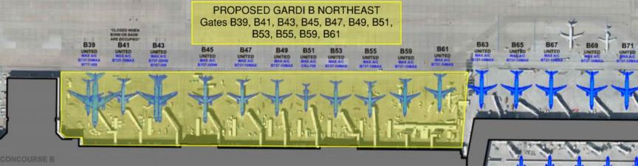
GARDI B Northeast – Design
The GARDI scope includes removing the failing concrete panels, reconditioning and re-grading the underlying subgrade as necessary to promote correct drainage and eliminating historical issues that have promoted the differential movement in the area. The new GARDI pavement section includes a subgrade pavement drainage layer (cement treated permeable base) that will collect any water that leaks through the surface joints and will send the water to the underdrain piping system. The typical GARDI pavement section from bottom to top is 4” of Upper Select Fill, 12” of Cement Treated Soil Base Course, 3” of Asphalt Mix Pavement, 6” of Cement Treated Permeable Base (CTPB) Course, and 17” of Portland Cement Concrete Pavement. Pavement Marking adjustments in coordination with DEN Planning, Airline Affairs and the airlines.
Utilities included are jet fuel pipe and hydrant pits, fire hydrants and supporting water vaults, storm drainpipe and manholes, sanitary sewer pipe and manholes, electrical conduit and handholes, cathodic pits and wiring, trench drains and underdrains, Xcel gas line adjustments, ground power units, removal of abandoned baggage tunnels to the basement, Passenger Loading Bridge modifications and potable water cabinet unit installation

Slide 16
Design & Construction Project Delivery Support Services
Seeking consultant(s) to provide comprehensive project delivery support on a task order basis.
These services may include:
Contract Administration
Project Management (design and construction)
Project Controls (estimating, scheduling, change management)
Operational Readiness, Activation, and Transition (ORAT)
Quality Assurance Inspections (QA)
Commissioning (Cx)
Special Inspections (SI)
KEY INFORMATION
Anticipated Advertisement Date: July 2025
Estimated Project Value: $50M to $99.99M
Small Business Program Goal: 24% MWBE (updated from 18%)
Key Scope/Industry: Project Management, Contract Administration, Estimating, Scheduling, ORAT, Quality Assurance Inspections, Building Commissioning
Project Manager: Cullen Choi | cullen.choi@flydenver.com
Notes:
Denver International Airport is seeking consultants to provide comprehensive project delivery support on a task order basis.
Services may include:
Contract administration
Project management for design and construction
Project controls like estimating, scheduling, and change management
Operational readiness, activation, and transition (ORAT)
Quality assurance inspections and commissioning
Special inspections
Key info:
Advertisement expected July 2025
Project value: $50M to $99.99M
Small business goal: 24% MWBE
Scope: Project management, contract administration, QA, commissioning, and more
Contact: Cullen Choi at cullen.choi@flydenver.com
For details, please visit me in the breakout room after this session!

Slide 17
Basement Foundation Rehabilitation On-Call
The Design, Engineering, and Construction (DEC) division at Denver International Airport (DEN) will request proposals for the purpose of selecting a vendor to provide engineering and design solutions for degrading building foundation elements in the basement across the Terminal Complex at DEN. Services to be provided by the selected vendor include:
Investigate existing conditions: expansion joints, waterproofing systems, slabs, elevator pits, foundation walls, columns
Conduct on-site surveys and review existing assessments and original construction documents
Provide structural, geotechnical, civil, and architectural design solutions
Deliver design documents from Schematic Design to Issued for Construction, aligned with DEN standards
Procurement Approach:
Open Solicitation for On-Call Professional Services
KEY INFORMATION
Anticipated Advertisement Date: TBD
Estimated Project Value: TBD
Small Business Program Goal: 20% MWBE Goal
Key Scope/Industry: Architecture and engineering investigation and repair, structural, geotechnical, joint sealant, constructability analysis
Project Manager: Nicholas Martin | nicholas.martin@flydenver.com
Notes:
Denver International Airport’s Design, Engineering, and Construction division will soon issue a request for proposals to select a vendor for engineering and design solutions addressing deteriorating building foundations in the Terminal Complex basement.
The work includes investigating existing conditions like expansion joints, waterproofing, slabs, elevator pits, walls, and columns. The vendor will conduct on-site surveys, review past assessments, and deliver design documents from schematic through construction phases.
This will be an open solicitation for on-call professional services, with an expected 20% MWBE participation goal.
Key areas include structural, geotechnical, civil, and architectural design and repair.
Advertisement date and project value are TBD
Contact: Nicholas Martin at nicholas.martin@flydenver.com
For more info, join me in the breakout room!

Slide 18
Fire Suppression (Fire Pump & Emergency Services)
Denver International Airport is seeking a contractor to provide 24/7 emergency repair and testing services for fire suppression systems. This includes weekends and holidays to ensure uninterrupted airport operations and safety.
A key component is the annual testing of eight fire pumps, in compliance with NFPA 25 and NFPA 20. Contractors must have the capability to respond quickly to emergencies and meet all regulatory standards.
Scope Overview:
24/7 emergency repair & testing services for fire suppression systems
Year-round availability, including weekends and holidays
Rapid response required to ensure safety and airport operations continuity
Annual testing of 8 fire pumps per NFPA 25 & NFPA 20 standards
Ensures compliance and full functionality of fire protection systems
​
KEY INFORMATION ​
Anticipated Advertisement Date: Q3 2025
Estimated Project Value: $2M to $4.99M
Small Business Program Goal: TBD
Key Scope/Industry:​ Fire Suppression repair and testing
Project Manager​: Cara James | Cara.James@flydenver.com
Notes:
Denver International Airport is seeking a contractor to provide 24/7 emergency repair and testing services for fire suppression systems. This includes weekends and holidays to ensure uninterrupted airport operations and safety.
A key component is the annual testing of eight fire pumps, in compliance with NFPA 25 and NFPA 20. Contractors must have the capability to respond quickly to emergencies and meet all regulatory standards.
The estimated project value is $2M to $4.99M, with the advertisement expected in Q3 of 2025. The Small Business goal is still being determined, and we encourage qualified vendors in fire suppression repair and testing to prepare for this opportunity.
For more details, contact Cara James at Cara.James@flydenver.com.
For more details, please visit me in the breakout room!

Slide 19
Overhead Door Installation and Maintenance
Consultant shall provide comprehensive overhead door services across DEN facilities, including:
Installation of new overhead doors with all necessary hardware and accessories
Routine maintenance of existing overhead and automatic doors
24/7 emergency service response
Replacement of doors on an as-needed basis
Procurement of relevant goods and services as required
Scope Includes:
Maintenance and servicing of over 147 high-speed fabric doors and low-energy handicap automatic doors
Coverage of existing and future installations throughout the airport complex
​
KEY INFORMATION ​
Anticipated Advertisement Date: Q3 2025
Estimated Project Value: $$500K to $1.99M
Small Business Program Goal: TBD
Key Scope/Industry:​ Garage Door Maintenance
Project Manager​: Cara James | Cara.James@flydenver.com
Notes:
Denver International Airport is seeking a consultant to provide comprehensive overhead door services across the airport.
This includes installing new overhead doors with all hardware, routine maintenance of existing doors—including over 147 high-speed fabric and handicap automatic doors—and 24/7 emergency response.
The scope covers current and future door installations throughout DEN.
Anticipated advertisement: Q2 2025
Estimated value: $500K to $1.99M
Small business goal: TBD
Key area: Garage door maintenance
Contact: Cara James at Cara.James@flydenver.com
For more details, please visit me in the breakout room!

Slide 20
High Ceiling and Hard Surface Cleaning
DEN seeks vendors for specialized cleaning in public and tenant areas, including:
Surface cleaning and dust control
Vacuuming ceilings, lights, and walls
Cleaning air diffusers with certified biodegradable solution
Solution Must Be:
Biodegradable, non-abrasive, phosphate-free, non-flammable, and SCS-certified
Hours: 24/7 (scheduled per task)
Equipment:
  19–20 ft lift with operator
  HEPA backpack vacuum (or equivalent)
  Extension cords, vacuum pole, soft brushes
  Telescoping spray wand, dual-layer drop cloths
KEY INFORMATION ​
Anticipated Advertisement Date: Q3 2025
Estimated Project Value: $$500K to $1.99M
Small Business Program Goal: TBD
Key Scope/Industry:​ Janitorial. Need to be able to use a lift and ladders, work is above 20’.
Project Manager​: Cara James| Cara.James@flydenver.com
Notes:
Denver International Airport is seeking vendors for specialized cleaning in public and tenant areas. This includes surface cleaning, dust control, vacuuming ceilings, lights, walls, and cleaning air diffusers using certified biodegradable solutions.
Products must be biodegradable, non-abrasive, phosphate-free, non-flammable, and SCS-certified.
Work will be scheduled 24/7 and requires equipment like a 19–20 ft lift with operator and HEPA backpack vacuums.
Advertisement expected Q3 2025
Project value $500K to $1.99M
Small business goal TBD
Contact: Cara James at Cara.James@flydenver.com
Join me in the breakout room to learn more!

Slide 21
Sanitary, Stormwater, & Deice Water System Underground Utility Repair Service
DEN Operations & Maintenance is seeking a qualified contractor to provide comprehensive maintenance, repair, and replacement services for onsite sanitary sewer, stormwater, and deice water piping systems. This includes knowledge of the NAICS Code 221300, Water, Sewage and Other Systems. Relative locations include sewer system, glycol rehabilitation treatment plants, retention ponds and underground drainage system.
Scope of Work Includes but not limited to:
Safety & Permitting:
  Ensure compliance with relevant safety protocols during excavation and repair work to include traffic control and hazard identification
  Permitting as required
  Minimum impact on airport operations, preferably conducting scheduled work during off-peak hours
Excavation & Restoration: Utility locating, pipe repair/replacement, surface restoration, testing & commissioning.
Point Repairs: Abandon laterals, root intrusion, offset joints, water infiltration, cracks, and holes.
​
KEY INFORMATION ​
Anticipated Advertisement Date: Q3 2025
Estimated Project Value: $5M to $9.99M
Small Business Program Goal: TBD
Key Scope/Industry:​ GPR (Ground-penetrating radar), Traffic Control, Power Equipment Operators, Welding, Plumbing, Pipe Assessment Management, Landscaping, Trenching & Excavation, Permitting
Procurement Project Manager​: Jacqueline Wilson | jacqueline.wilson@flydenver.com
Notes:
Denver International Airport’s Operations & Maintenance is seeking a contractor to maintain, repair, and replace onsite sanitary sewer, stormwater, and deice water piping systems. This includes work at glycol treatment plants, retention ponds, and underground drainage.
Key tasks include utility locating, excavation, pipe repairs, surface restoration, and safety compliance with traffic control and permitting. Work will minimize impact on airport operations, ideally done during off-peak hours.
Anticipated advertisement: Q3 2025
Estimated value: $5M to $9.99M
Small business goals: TBD
Contact: Jacqueline Wilson at jacqueline.wilson@flydenver.com
Visit me in the breakout room to learn more!

Slide 22
Deicing Water System
DEN is seeking a qualified contractor for oversight, maintenance, and technical support of the Aircraft Deicing System. This includes technical expertise for software, upgrades, maintenance and hardware interface for the SCADA (Supervisory Control and Data Acquisitions) system.
Scope of Work Includes but not limited to:
System Management
  Monitor water system status to include pressure, flow and temperatures.
  Identify potential issues and implement corrective measures
  Conduct regular inspections and maintenance of water systems
  Ensure compliance with relevant safety regulations and industry standards
Deicing Operations
  Plan and coordinate deice activities
  Monitor the effectiveness of deicing operations
  Provide technical guidance involving the system
Data Analysis and Reporting
  Collect and analyze data related to water system performance and deice operations
  Prepare reports on water system conditions, detailing effectiveness and potential improvements.
KEY INFORMATION ​
Anticipated Advertisement Date: Q4 2025
Estimated Project Value: < $10M
Small Business Program Goal: TBD
Key/Scope/Industry: Deicing Operations, Water Quality Management, Environment Impact Assessment Management, Sustainability, Inland Pump Station System upgrades, Glycol Retention Ponds, Glycol Rehabilitation Treatment Systems, SCADA System Analysis and Reporting
Procurement Project Manager : Jacqueline Wilson | jacqueline.wilson@flydenver.com
Notes:
Denver International Airport is seeking a qualified contractor for oversight, maintenance, and technical support of the Aircraft Deicing System. This includes managing the SCADA system for software, upgrades, and hardware interface.
Key responsibilities include monitoring water system pressure, flow, and temperature, conducting inspections, and ensuring safety compliance. The contractor will also coordinate deicing operations, provide technical guidance, and analyze system performance data to improve effectiveness.
Anticipated advertisement: Q4 2025
Estimated project value: $10 million
Small business goal: TBD
Contact: Jacqueline Wilson at jacqueline.wilson@flydenver.com
Join me in the breakout room to learn more!

Slide 23
Passenger Analytics
Develop a comprehensive analytics platform that integrates data from cameras, Lidar, Wi-Fi, IoT sensors, and more to provide a unified view of vehicle and passenger movement, generate insights, and enable real-time recommendations and alerts.
Key Capabilities:
AI & Machine Learning: Analyze complex data sets for predictive and real-time insights
Unified View: Track passenger movement from curb to gate across all touchpoints
Actionable Insights: Identify bottlenecks, optimize flow, and improve decision-making
Real-Time Alerts & Recommendations: Notify staff of anomalies and suggest proactive responses
Use Case Highlights:
AGTS train platform dwell times
Restroom and concession usage tracking
Security and FIS wait time monitoring
Baggage carousel and curbside dwell analysis
Passenger counts across terminals, concourses, and transit centers
​
KEY INFORMATION ​
Anticipated Advertisement Date: TBD
Estimated Project Value: Less than $500K
Small Business Program Goal: 10% MWBE Goal
Key Scope/Industry:​ Advanced Analytics, Video Analytics, AI Solutions
Project Manager​: Tracy Whitling | tracy.whitling@flydenver.com
Notes:
Denver Airport is developing a smart analytics platform using cameras, Lidar, Wi-Fi, and sensors to track real-time passenger and vehicle flow.
Estimated under $500K with a 10% MWBE goal.
Contact Tracy Whitling at tracy.whitling@flydenver.com. The breakout room is closed due to a scheduling conflict.

Slide 24
Security Services, Public Area and Curbside Interfaces
Select a qualified firm to provide security services at Denver International Airport (DEN).
Scope of Work:
Traffic control, security at sensitive access points, and door alarm response
Loading dock oversight (50+ deliveries/day), patrols, credential verification, and incident resolution
Public Parking Lot patrols, Airport Office Building access, and person vetting
Enforcement of DEN Rules & Regulations and additional security posts as needed
Workload:
5400 weekly hours (135 FTEs), including Full-Time, Part-Time, and On-Call positions
24/7 staffing for curbside, passenger pick-up/drop-off on levels 4 & 6
Support for 40,000+ vehicle entries per day
​
KEY INFORMATION ​
Anticipated Advertisement Date: Late July 2025
Estimated Project Value: $50M to $99.99M
Small Business Program Goal: 5% MWBE Goal
Key Scope/Industry:​ Security Guard Services, Public Area, and Curbside Interfaces
Project Manager​: Matt Gomez-Peterson; matthew.gomez-peterson@flydenver.com
Notes:
Denver International Airport is seeking a qualified firm to provide full-scale security services across the airport.
The scope includes traffic control, security at access points, alarm response, patrols, credential checks, and oversight of 50+ daily deliveries.
Staff will support 24/7 operations, including curbside, parking areas, and office building access—totaling 5,400 hours per week across 135 positions.
The project value is estimated between $50 and $99.99 million, with a 5% MWBE participation goal.
Advertisement is expected in Q2 of 2025.
For more details or to ask questions, please visit the breakout room after this session to connect directly with the project team.

Slide 25
Legacy Concourse Restroom Renewal
Renovate 30-year-old restrooms in Concourses A, B, and C to meet modern standards and improve user experience.
Key Goals:
Align with Vision 100 – Maintaining What We Have
Standardize restroom design for easier maintenance and asset management
Implement current ADA standards
The solution is to renovate the legacy restrooms to match the new standard developed for the Concourse Expansion Program (CEP) Restrooms and apply the same concepts throughout Concourses A, B, and C as initial steps towards that goal. The new designs contain visions that improve passenger circulation flow into/out of restrooms, mechanical and electrical plumbing (MEP) systems, wayfinding signage, family rooms, and the availability of baby/adult changing stations. Separate contracts will be awarded to the Center Core and Subcore restrooms.
KEY INFORMATION
Anticipated Advertisement Date: Late Summer 2025
Estimated Project Value: $10M to $49.99M each contract
Small Business Program Goal: MWBE Goal 10%
Key Scope/Industry: General construction, demolition, mechanical, plumbing, electrical, fire protection, concrete, steel, waterproofing, doors, glass, drywall/framing, ceilings, flooring, signage.
Project Manager: Ro-Tien Liang | ro-tien.liang@flydenver.com; Pamela Kohl | pamela.kohl@flydenver.com
Notes:
DEN will renovate 30-year-old restrooms in Concourses A, B, and C to meet modern standards, improve ADA compliance, and enhance passenger flow and amenities.
This follows Vision 100 goals to maintain and standardize facilities for easier upkeep.
Separate contracts will cover Center Core and Subcore restrooms.
Advertisement: Summer 2025
Value: $10M–$49.99M each
MWBE Goal: 10%
Scope: Construction, MEP, signage, and more
Contacts: Ro-Tien Liang & Pamela Kohl
The next slide shows a map of the concourses with restroom locations.
Visit me in the breakout room for details!

Slide 26
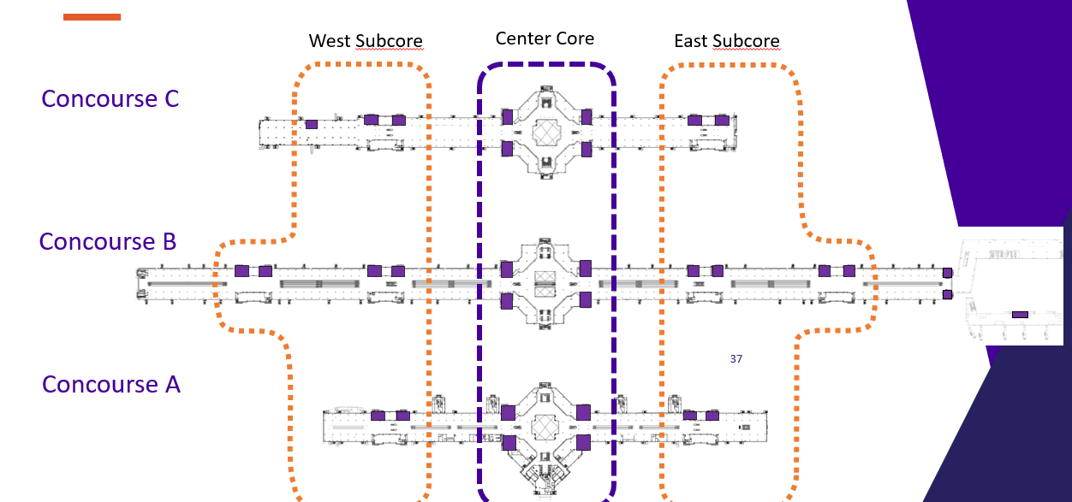
Legacy Concourse Restroom Renewal
26

Slide 27


Program Purpose
To reduce barriers for small businesses to operate autos unescorted airside, DEN Risk Management introduces the new Airside Excess Auto Liability Program, also known as the AirsideDrive Program. The program provides $9M in excess of $1M in coverage for entities to meet the minimum unescorted airside driving insurance requirements of $10M Combined Single Limit each occurrence of Auto Liability.
Benefits: Supporting our Airside Partners
Affordable Coverage
Bridging the Gap
Easy Access
Comprehensive Protection
Small/Emerging Business Boost
Scan now to learn more

Slide 28

DEN Procurement
Contract Types:
Competitive: Professional Services, Construction, Revenue Opportunities
Non-Competitive: Sole Source, Professional Preference, Amendments, Grants, Revenue Agreements
Task Orders:
Supports both competitive and non-competitive processes
Governance:
City & DEN Charter, Ordinances, and Regulations
Solicitation Types:
RFP, RFQ, RFO, RFI, IFB, Informal Competitive Procurement
Fast-Track Procurement Pilot
Goal: Increase agility by eliminating non-mandated steps
Shortened Advertisement: 1-week post, no pre-proposal meeting, 2-day Q&A
Streamlined Selection: 3-member panel; no interviews
Simplified Contracting: No negotiations—contract mirrors vendor proposal
Learn More: Visit our breakout room or scan the QR code to explore DEN’s procurement process on our website.

Slide 29
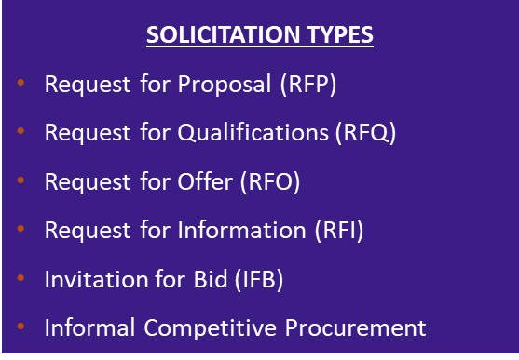
DEN Procurement
Procures competitive contracts:
Professional Services
Construction
Revenue Opportunities
Processes non-competitive contracts:
Sole Source
Professional Preference
Amendments
Grants
Revenue Agreements
Facilitates competitive and non-competitive task order process
Governed by ordinances and regulations including; City and DEN Charter & Ordinances, DSBO, Executive Order 8, and City Procurement and Fiscal Rules

Slide 30
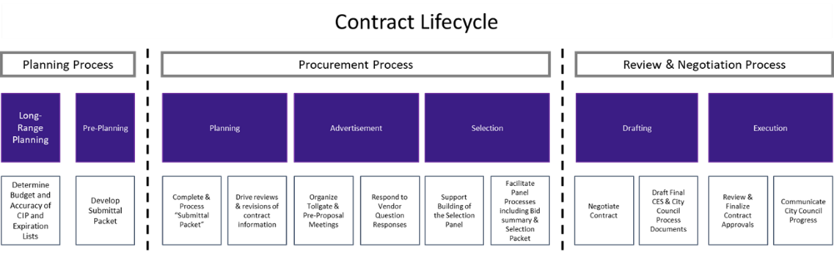
DEN Procurement – Contract Lifecycle
Active DEN Procurements & Solicitations are available on BidNet: https://www.bidnetdirect.com/colorado/cityandcountyofdenverdepartmentofaviation
  Important Dates:
    Published/Advertised Date
    Proposal Due Date
  Important Information:
    Pre-proposal meetings outlining project details
    Proposal Narrative Contents & Evaluation Criteria

Slide 31
Fast-tracking: What Does It Mean
New procurement method for DEN that is currently a pilot program.
Intent is to foster innovation and agility by fast-tracking certain qualified procurement projects. Eliminate steps in the procurement process that are not mandated by city law, ordinances, executive orders, and other governance requirements.
Key features of a fast-tracked opportunity include:
  Compressed advertisement period
  The pre-proposal meeting will not be held, and qualified projects will be advertised for one week. Questions will be due within 2 days of advertisement.
  Simplified selection process
  A 3-member panel composition will make an award recommendation based solely on their independent review and scoring of proposals. No interviews will be held.
  Simplified contract drafting process
  The final written contract will be based solely on what the winning vendor commits to in their proposal. There will be no negotiations to the final written contract.

Slide 32

ACDBE/SBEC Programs
Purpose:
As a primary airport receiving FAA funding, DEN ensures Airport Concessions Disadvantaged Business Enterprises (ACDBEs) have equal opportunities to compete for all concession contracts, in accordance with 49 CFR Parts 23 and 26.
The Small Business Enterprise Concessions (SBEC) program is a locally funded, race- and gender-neutral, defined-pool set-aside program in accordance with Chapter 28, Article 7 of the Denver Revised Municipal Code (DRMC).
Requirements:
ACDBE Concession-specific Goals: Calculated as a percentage of total estimated annual gross receipts from the concession (23.25(e)(1)(i)).
  Concession goals can be met through Direct Ownership, Joint Venture, or G&S purchases from ACDBEs
SBEC Concession “defined-pool” program requirements: ONLY small businesses certified with CCD as SBEC in applicable NAICS codes at time of proposal due date can propose as a concessionaire.
  Concession must be owned and operated by certified SBEC firm(s)
Certification:
Apply and maintain certification with City & County of Denver
Access Small Business Certification & Contract Mgmt. System (BG2Now) Directory
How to Get Involved:
Attend / Apply / Sign Up
Scan the QR Code to learn more about the ACDBE Program at DEN
Contact our team at DEN-ACDBE@flydenver.com
Notes:
Talking Points – 45 seconds - MAX – Remember you don’t have to read every line on the slide
At DEN, we’re committed to providing small and disadvantaged businesses with fair opportunities in airport concessions.
As a recipient of FAA funding, we follow federal regulations that require us to set participation goals for ACDBEs—Airport Concessions Disadvantaged Business Enterprises.
We also offer the SBEC Program, a local, race- and gender-neutral initiative that reserves certain concession opportunities exclusively for small, certified businesses.
These goals can be achieved by owning a concession, forming joint ventures, or purchasing goods and services from ACDBEs.
To qualify, businesses must be certified by the City & County of Denver and listed in the BG2Now Directory.
Getting involved is easy—attend events, apply, or simply scan the QR code to learn more.
If you want to learn more about our program, please visit us in the breakout rooms.

Slide 33





DSBO Pillars
Promoting equity, maximizing opportunities, and preventing discrimination and its effects against small, minority and women owned businesses.
Auditing and Analytics: Business Utilization, Forensics
Strategic Development and Community Engagement
Certification
Compliance
TO LEARN MORE ABOUT DSBO, PLEASE VISIT US IN THE BREAKOUT ROOM OR SCAN THE QR CODE.
Notes:
45 Seconds
Who Is the Division of Small Business Opportunity (DSBO)?
DSBO is committed to promoting equity, maximizing opportunity, and preventing discrimination for small, minority-, and women-owned businesses.
We manage Denver’s certification programs, helping local firms compete for City, County, and DEN contracts.
DSBO handles certification applications, monitors compliance, and tracks participation on City-funded projects.
We provide resources, guidance, and support to help your business grow and succeed in public contracting.
Have questions? Visit the breakout room—DSBO is here to help you take the next step.

Slide 34
Small Business Certification Programs
Minority and Women Owned Business Enterprise (MWBE) Program
Eligible small, independent businesses, owned and controlled by socially and economically disadvantaged individual(s) may participate as a MWBE
Subcontracting opportunities on City funded projects with MWBE goals
D.R.M.C. Chapter 28, Article III
Small Business Enterprise (SBE) Programs
Eligible small, independent businesses, owned and controlled by economically disadvantaged individual(s) may participate as an SBE, EBE, SBEC
City defined pool contracts
D.R.M.C. Chapter 28, Articles V and VII
Disadvantaged Business Enterprise (DBE) Program
Eligible small, independent businesses, owned and controlled by socially and economically disadvantaged individual(s) may participate as a DBE
Subcontracting opportunities on federally funded transportation projects (state-wide)
49 CFR Part 26
TO LEARN MORE ABOUT DSBO, PLEASE VISIT US IN THE BREAKOUT ROOM OR SCAN THE QR CODE.

Slide 35
Compliance
Preventing Discrimination: Ensuring fair practices in solicitation, contracting, and performance activities.​
​
Certified Business Requirements: Upholding commitments and Good Faith Efforts (GFE).​
​
Commercially Useful Functions: Ensuring firms perform a distinct element of the work of a contract and carry out such work, by performing, maintaining control, managing, and supervising the work involved.​
​
Contractor Prompt Payment: Overseeing and enforcing timely subcontractor payments ​
​
Tracking Participation: Monitoring certified business participation and self-performance requirements.​
​
Risk Prevention: Preventing certified subcontractors from working at risk.​
​
Certified Firm Utilization Changes: Ensuring terminations, substitutions, and scope reductions happen for good cause only.​
​
Subcontract Agreement Requirements: Helping stakeholders understand DSBO requirements.​
​
Compliance Reporting: Ensuring comprehensive compliance reporting.​
For more information about DSBO and to find certified firms, please visit: https://www.denvergov.org/content/denvergov/en/denver-office-of-economic-development/do-business-with-denver.html
Notes:
DSBO’s compliance team monitors small business utilization from solicitation through the contract term to ensure equity protections and adherence to our program requirements from enforcing timely subcontractor payments
Bring attention to the Small Biz, Big Wins

Slide 36
Certification (MWBE, EBE, SBE(C), and DBE)
Applying for Certification(s):
Online Application
Monthly webinar “Understanding Certification”
Must be actively certified (in the correct codes) at the time of bid or when the letter of intent is signed
Maintaining Your Certification(s):
Submit an Annual Update every year.
For changes to NAICS codes submit a NAICS Expansion Application
For changes in ownership, business structure, or control submit a Material Change Application
Notes:
Eligible small businesses may apply for certification in one or more of our certification programs.

Slide 37
Connect with Us
Visit our website: www.denvergov.org/dsbo
Call: (720) 913-1714
Sign up for the DSBO weekly newsletter
Certification: certificationinfo@denvergov.org
DEN Compliance: dsbo@flydenver.com
Downtown Compliance: dsbo@denvergov.org
General inquiries: dsbohelp@denvergov.org

Slide 38

General Services- Purchasing Division
Procures goods and related services (excludes construction/design) using competitive bidding and open market methods. Follows City Charter, D.R.M.C., and Fiscal Accountability Rules.
Key Roles: Manages bids, contracts, assets, surplus sales, vendor relations, and sustainable purchasing.
Vendor Support:
  Uses Rocky Mountain E-Purchasing System (BidNet).
  Offers bid tools, updates, and resources on its website.
  Sends weekly notices on bids, events, and opportunities.
  Join the vendor list by completing the Purchasing Communication Form.
Upcoming Vendor Event
Learn about Denver agencies, procurement processes, and networking opportunities.
Open to providers of goods, services, and construction.
To learn more, visit me in the breakout room and scan the QR code.
Notes:
45 seconds
General Services Purchasing – What We Do
We handle the purchase of goods and services (except for construction and design) through competitive bidding and open market methods.
Everything we do adheres to city rules and guidelines to ensure fairness and accountability.
Our primary responsibilities include managing bids and contracts, tracking assets and surplus sales, collaborating with vendors, and promoting sustainable purchasing practices.
If you’re a vendor, all opportunities are posted on BidNet, the Rocky Mountain E-Purchasing System.
You’ll also find bid tools, updates, and helpful info on our website.
We send weekly emails with new bids, events, and important opportunities.
To learn more, visit me in the breakout room and scan the QR code.

Slide 39

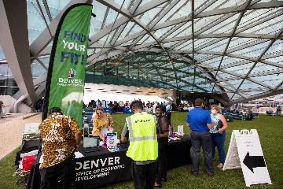
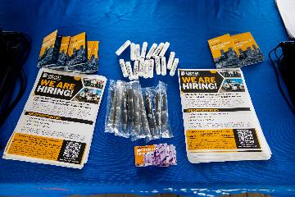
Save the Date - DEN Hiring Fair!
Date: Monday, August 12
Time: 11:00 a.m. – 1:30 p.m.
Location: DEN Plaza
Your Career Takes Off Here!
Meet top employers and explore:
Full-time
Part-time
Seasonal roles
Opportunities in Sales, Housekeeping, Driving, Maintenance, Supervision, Management & more!
Registration opens soon – don’t miss out!
Notes:
Talking Points – 45 seconds to 60 seconds - MAX
Save the date! The DEN Hiring Fair is happening Monday, August 12, from 11:00 a.m. to 1:30 p.m. at the DEN Plaza.
It’s your chance to meet top employers and explore full-time, part-time, and seasonal roles in sales, housekeeping, driving, maintenance, and more.
Registration opens soon—don’t miss it!
And if you have any questions, feel free to stop by the breakout room for more info.

Slide 40

Denver Construction Careers Program (DCCP)
Overview
Workforce Ordinance Applies To:
Contracts/work orders ≥ $10M, advertised/issued after May 30, 2025
On-call/task orders evaluated individually
Contractors must sign a Workforce Commitment Form
Key Percentage Requirements
Priority Areas: Track/report hours worked by residents from DCCP-identified priority neighborhoods
Pre-Apprenticeship Grads: Track/report hours worked by grads from DCCP-approved programs
Veterans: Track/report hours worked by veterans
Registered Apprenticeships: Track/report hours by workers in registered apprenticeship programs
including first-year and target category registered apprentices
Reporting & Enforcement
LCPtracker is used to track and submit data
DCCP monitors compliance; non-compliance may lead to penalties
Get Involved
Jobseekers, employers, and community orgs — connect with DEDO & DCCP to grow Denver’s construction workforce.
Why It Matters
Meets high demand for skilled construction workers
Builds career pathways for Denver residents
Aligns workforce with city infrastructure investments
To learn more, visit me in the breakout room or scan the above QR code.
Notes:
Talking Points – 45 seconds to 60 seconds - MAX
This workforce ordinance applies to contracts and work orders of $10 million or more, starting after May 30, 2025. On-call and task orders are reviewed case by case. Contractors need to sign a Workforce Commitment Form.
There are key tracking requirements: you’ll report hours worked by residents from priority neighborhoods, pre-apprenticeship grads from approved programs, veterans, and workers in registered apprenticeships—including first-year and target categories.
All data is tracked and submitted through LCPtracker. DCCP monitors compliance, and penalties may apply if rules aren’t followed.
Whether you’re a jobseeker, employer, or community organization, DEDO and DCCP want to connect with you to help grow Denver’s construction workforce.
This program is important because it meets the high demand for skilled workers, builds career paths for local residents, and supports the city’s infrastructure projects.
To learn more, visit me in the breakout room or scan the QR code on the screen.

Slide 41
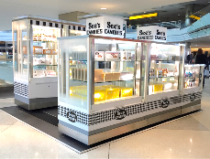

Empowering Small Business in Airport Retail
Who We Are
Retail partner at DEN empowering local, small, minority & women-owned businesses.
Mission
Enhance travel, grow local economies, launch small businesses.
Why PRI?
No RFP, no construction
Short-term, low-risk
Turnkey support: logistics, onboarding, training
PRI-provided kiosks/RMUs
2024 Highlights
37% sales from ACDBE partners
Avg. kiosk sales: $30K+/mo
Costs
Monthly: $4K–$6K
Overage: 15%
Fees: ~$650 + 0.5% (DEN marketing)
Connect
Cord Rauba | cord@priretail.com
📞 303.342.6817 | 📱 303.885.0815
https://www.priretail.com/den-airport
Notes:
Talking Points – 45 seconds to 60 seconds - MAX
Talking Points for Cord/Cherrie
Who Is Provenzano Resources, Inc.? (45 Seconds)
Hi, I’m with Provenzano Resources, or PRI — we’re a specialty retail partner at the Denver and San Jose airports.
What we do is help local small businesses — especially those owned by minorities, women, and veterans — get started with airport retail. We make it simple by handling the complex parts, such as construction and lengthy RFP processes.
Our approach is low-risk and flexible. We offer kiosks, carts, RMUs, and pop-ups in high-traffic airport locations — plus we provide comprehensive support with onboarding, setup, and training.
Last year, 37% of our sales came from ACDBE partners, and our kiosks typically generate over $ 30,000 a month.
Costs typically range from $4,000 to $6,000 per month, with a 15% overage and additional fees.
Interested? Swing by the breakout room and scan the QR code to get all the details on costs, benefits, and how to join.

Slide 42

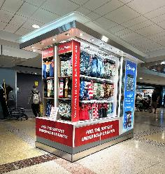
Empowering Small Business in Airport Retail
Who We Are
PRI offers dynamic, revenue generating retail opportunities in airports
Proven success at DEN and SJC
We support local, small, minority and women-owned business through our Small Business Launchpad
Our Mission
  Enhance passenger experience, drive local economic growth and equip small businesses to succeed in airport retail
Key Benefits
No RFP, No Construction
Short-term, low-risk commitment
2024 highlights
  37% of sales represented by ACDBE businesses and average monthly Kiosk/RMU sales over $30,000

Slide 43














Participation, Services & Contract
Turnkey Support for Merchants
Product receipt, storage & delivery
Onboarding, training & badging
Full administrative and operational support
Retail Space/Structure
  Kiosks & RMUs provided by PRI (some custom exceptions)
General Participation Costs
Monthly Minimum: ~$4000 - $6000
Sales Overage: 15% over natural breakpoint
Ancillary Fees: ~$650
DEN Marketing Fee: 0.5% of all gross sales
Let’s Connect!
Cord Rauba
cord@priretail.com
303.342.6817 of 303.885.0815

