Slide 1
Taking Flight at DEN
August 2025
Notes:
Good afternoon, everyone.
Thank you for being here today for Taking Flight at DEN.
My name is Desiree Mondragon, Outreach Administrator here at DEN.

Slide 2
Legal Disclaimer​
This event is intended to provide the business community with early notice for potential procurement opportunities at DEN, allow companies to meet DEN project managers, and allow firms to network and foster relationships with each other. Projects included in this event are in their early stages of planning, and critical information about these projects (e.g. dates and goals) may be unknown and are otherwise subject to change. In its discretion, the City and County of Denver may cancel, modify, or place any project on hold at any time, for any reason. ​
Notes:
This event aims to notify the business community of potential procurement opportunities at DEN,
Attendees can network with project managers and other members of the business community.
Note: Projects are in the early planning stages and the City and County of Denver can cancel or modify any project at any time.

Slide 3
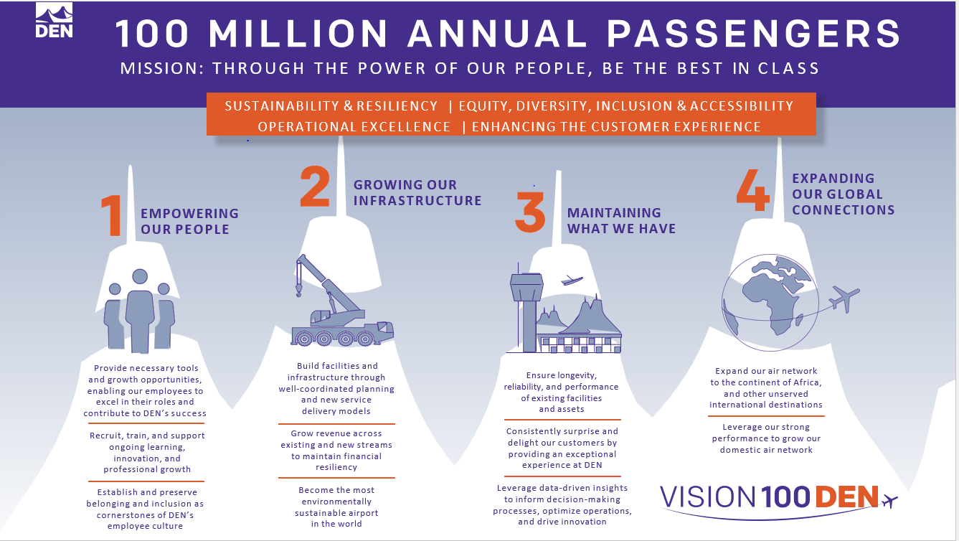
Vision 100 and Operation 2045
Notes:
Vision 100 and Operation 2045 are phases of DEN's strategic plan.
Vision 100 aims to prepare the airport for 100 million annual passengers.
Operation 2045 focuses on the airport's 50th anniversary and plans for over 120 million annual passengers.
Together, they guide decision-making and accountability here at DEN.

Slide 4


Taking Flight at DEN
Monthly event showcasing multiple procurement opportunities, set for the 2nd Thursday of each month at 1 p.m.
**January 23** - Due to holiday schedules
  February 13
March 13
  April 10
May 8
June 12
July 10
August 14
September 11
October 9
November 13
December 11
Notes:
DEN is committed to eliminating barriers for small businesses at the airport.
“Taking Flight at DEN” highlights our procurement opportunities and facilitates networking. project managers, members of the business community, and resource partners.

Slide 5


Meet the Primes
Virtual outreach event held twice a month to connect Prime firms at DEN with local, small, and historically underutilized firms, scheduled for the 3rd Thursday at 1 p.m.
February 20 - Concessions Prime Operators
April 17 - Rental Car Company
June 26- General Contractors
August 21 - Construction Specialty Trade Contractor (MEP, Painting, Millwork, Drywall, Acoustical, Flooring, Concrete, Metals, Glass Glazing, Trucking, More)
October 16 - Airlines, Real Estate, Commercial Development and Hotelier
December 18 - Architecture, Engineering, and Professional Services
Notes:
Meet the Primes aims to connect Prime firms at DEN with the business community.
Our calendar provides various opportunities to engage with different types of companies.

Slide 6


Navigating the ACDBE Series: Pathways to Concessions
Bi-monthly virtual outreach event held on the third Thursday at 1 p.m. will guide ACDBEs on doing business at DEN.
Pathways to Concessions 2025:
January 16 – ACDBE 101
March 20 – ACDBE 201
May 15 – Joint Ventures 101
July 17 – Joint Ventures 201
September 18 – Concessions Connections
November 20 – B2G Compliance
Notes:
The “Navigating the ACDBE Program” series helps retail and F&B businesses understand certification and compliance for concessions.
Here’s are the remaining sessions

Slide 7
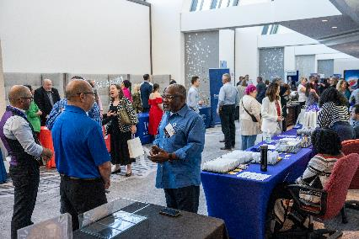
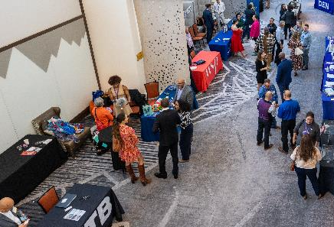
Register Today
August 28, 2025
Westin Denver International Airport
An exciting event designed to foster business partnerships between:
Denver International Airport (DEN)
The City and County of Denver
Prime Contractors
Small Businesses
Resource Partners
Notes:
Save the date for the Exhibitor Showcase and Tradeshow on August 28.
Sign up for our newsletter and follow us on LinkedIn for more updates as they become available.

Slide 8

Small Business Certification with the City & County of Denver
Get Certified with the City & County of Denver
DBE | EBE | MWBE | SBE | SBEC | ACDBE
Event Details
Date: Thursday, August 21, 2025
Time: 9:30 a.m. – 12:30 p.m.
Where: Blair-Caldwell African American Research Library, Community Room 2401 Welton St, Denver, CO 80205
Accelerate your small business with certification through:
Denver Economic Development & Opportunity – DSBO
Denver International Airport – ACDBE Program
What You’ll Learn
Jumpstart your application
Cross the finish line of submission
Get help on specific application sections
Find out more about utilizing your certification
Learn More & Register

Slide 9




Community Panelist Program
Volunteer program for those who want to participate in a procurement evaluation panel.
Great experience for potential primes
Attain an understanding of the evaluation process
Become familiar with DEN’s values
Gain experience with DEN’s interview format
Scan to Sign Up Today!
We Want Your Story!
Notes:
Volunteer as a Community Panelist for an upcoming procurement evaluation.
Gain insights and improve future proposals. Scan the QR Code to learn more.
Already Participated?
We’re seeking testimonials from past panelists!
Share your experience in the event follow-up email

Slide 10
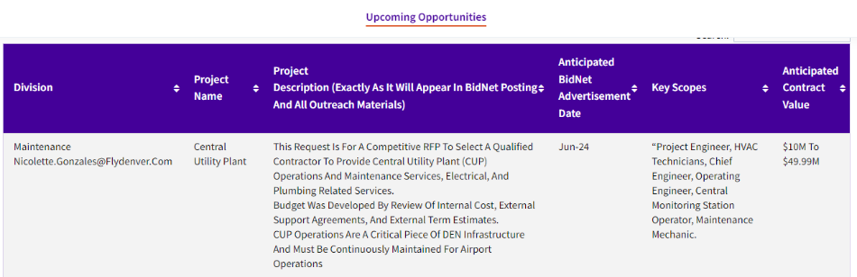

Upcoming Opportunities – Updated Webpage
Notes:
Our website lists procurement opportunities at various procurement stages.
Please be aware that details may change, and the City and County of Denver can modify or cancel projects at their discretion.
Now, we'll hand it over to our project managers.

Slide 11
Peña Station Lot Maintenance
DEN will be issuing a Request for Bids (RFB) for Lot Maintenance, Landscaping, and Snow Removal Services at the 61st & Peña Station Parking Lot, located at:
6195 N. Panasonic Way
Denver, CO 80249
Scope of Work Overview
Services include lot maintenance, landscaping, irrigation, and snow removal.
The project area is approximately 350,000 sq. ft., consisting of:
  85% paved parking lot (approx. 800 spaces)
  15% landscaped area
  Associated sidewalks and Peña Plaza perimeter
KEY INFORMATION
Anticipated Advertisement Date: Late 2025
Estimated Project Value: Less than $500K
Small Business Program Goal: SBE defined pool, only Small Business Enterprises with CCD can bid.
Key Scope/Industry: Landscaper, Snow Removal, Irrigation
Project Manager: Julie Saporito | julie.saporito@flydenver.com

Slide 12
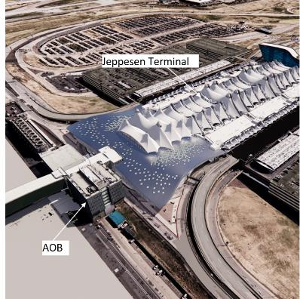
North Terminal Expansion – Request for Qualifications (RFQ) for
Program Management Support Services
Select a Program Management Team (PMT) to oversee the East & West Processor expansions of the North Terminal, ensuring delivery that meets quality, schedule, and budget goals.
Strategic Alignment
Supports Operation 2045, expands terminal capacity, and enables future growth.
Sustainability
Complies with CCD Executive Order 123 – targeting LEED Gold.
PMT Scope
Project & design management
Procurement & contract support
Stakeholder engagement
Cost, schedule, risk & quality control
KEY INFORMATION
Estimated Project Value: $135M
Project Manager: Rajeev Tillu Rajeev.Tillu@flydenver.com
KEY MILESTONES
Planning: Q3–Q4 2025
Advertisement & Proposals: Q4 2025
Selection & Contracting: Q1–Q2 2026
Execution: Q2–Q3 2026
Notes:
Purpose & Objective
Select a Program Management Team (PMT) to oversee the East & West Processor expansions, ensuring delivery that meets quality, schedule, and budget goals.
Strategic Alignment
Supports Operation 2045 growth goals
Increases terminal capacity (ticketing, SSCP lanes, FIS, baggage)
Enables future concourse & circulation connectivity
Sustainability
Complies with Executive Order 123 – targeting LEED Gold certification.
PMT Scope
Program/project management
Planning & design oversight
Procurement & contract management
Stakeholder engagement
Cost, schedule, risk & quality controls
Records & activation support
Contract Overview
Type: Task order-based
Term: 10 years
Budget: $135M
Key Milestones
Planning: Q3–Q4 2025
Advertisement & Proposals: Q4 2025
Selection & Contracting: Q1–Q2 2026
Execution: Q2–Q3 2026

Slide 13
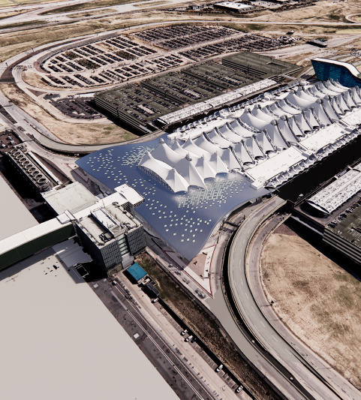
Executive Summary
Overview:
The RFQ aims to identify and select a Program Management Team (PMT) to oversee the successful execution of the North Terminal Expansion Project.
Jeppesen Terminal
Objective:
To ensure effective project management and the delivery of the North Terminal Expansion, meeting all quality, schedule, and budgetary goals.
Scope:
The PMT will be responsible for comprehensive project management, oversight, and alignment with the Operation 2045 Strategic Plan.
PMT will report to the assigned Special Projects Principal Project Manager.
The project team will function as a hybrid, integrated team with DEN Special Projects staff.
AOB
Notes:
The purpose of this RFQ is to select a PMT that will manage and deliver the North Terminal Expansion Project.
Our objective is to ensure effective project management and integration with DEN's Operation 2045 strategic plan

Slide 14
North Terminal Expansion: Project Overview
Purpose:
To construct the East and West Processor expansions of the North Terminal, enhancing the terminal capacity.
Key Elements:
Expansion of ticketing facilities
Addition of Security Screening Checkpoint (SSCP) Lanes
Expansion of Federal Inspection Services (FIS) areas for international arrivals including Customs and Border Protection (CBP) processing and international baggage claims
Addition of domestic baggage claims
Plan connectivity for future East and West concourse expansions and FIS sterile circulation
Development of associated building systems.
Enabling Work:
Relocation of existing utilities to facilitate new construction and ensure uninterrupted service.

Slide 15
North Terminal Expansion: Project Benefits
Operation 2045 Contribution:
Directly supports DEN’s long-term strategic plan, Operation 2045, by addressing key growth and operational objectives.
Operational Capacity:
Increases terminal capacity to support future growth at DEN including enhanced processor and FIS capabilities.
Commitment to Sustainability:
Compliance with City Executive Order No. 123 requiring LEED Gold certification for the project.

Slide 16
Contract Type & General Scope of Work
Key Services:
Program and project management
Planning and Preliminary design
Environmental Services
Procurement and Contract Management
Design management and Permitting coordination
Stakeholder and Community Engagement
Activation Support
Records management and Documentation controls
Cost and Budget Management
Schedule and Project Controls
Quality Assurance and Risk Management
Other Project-Related Activities.
Contract Type:
Task order based with a defined overall capacity
Anticipated Contract Term
10 Years
Contract Budget
$135M
Notes:
The scope of work includes a wide range of services essential for the successful completion of the projects.
This covers program and project management, environmental services, design and baseline development, permitting, and delivery method evaluation.
The PMT will also assist with program oversight, cost and schedule management, risk management, quality control, and community engagement, among other responsibilities.

Slide 17
Anticipated Procurement Timeline
Planning Phase (Tentative: Q3 2025 – Q4 2025)
Conduct vendor outreach and advertisement tollgate.
Contract Drafting (Tentative: Q1 2026)
Finalize contract terms
Vendor signs the contract.
Advertisement Phase (Tentative: Q4 2025)
Publish advertisement on Bidnet
Host Pre-proposal meeting
Receive proposals.
Execution (Tentative: Q2- Q3 2026)
Obtain the agency approval
Complete City Council approval process
Finalize contract with all signatures.
Selection Phase (Tentative Q4 2025 – Q1 2026)
Review qualifications/ proposals
Develop a shortlist of firms
Issue Request for Proposals (RFP)
Conduct interviews
Complete selection tollgate.
Notes:
This slide summarizes the RFQ process, from planning and advertisement to selection, contract drafting, and execution.

Slide 18
Summary
Summary:
The selection of a qualified Program Management Team (PMT) is critical to the successful delivery of this key infrastructure project.
The Request for Qualifications (RFQ) process is designed to identify a team that aligns with DEN’s strategic goals and upholds City values.
7
Notes:
In summary, selecting the right PMT is crucial for the successful completion of the NTE.
The RFQ process is designed to find a team that aligns with DEN’s strategic goals and City values.
Special Projects will be proceeding with the RFQ process for PMT services.

Slide 19
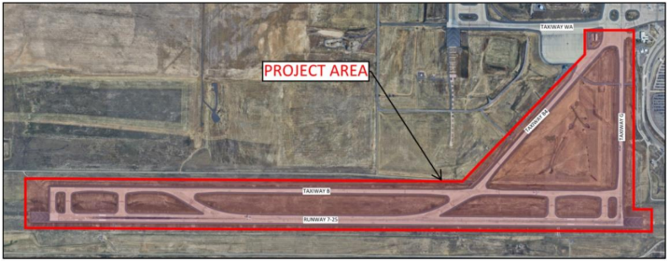
Runway 7-25 Pavement Rehabilitation
This project covers rehabilitation work within the Runway 7-25 Complex and will include the removal and replacement of deteriorated concrete pavement slabs, spall and crack repair of concrete pavement slabs not slated for replacement, removal and replacement of joint sealant, and the obliteration and application of pavement markings. This project will also address some drainage concerns within the grassy island of Deice Pad WA and address some cracking in the asphalt shoulders.
KEY INFORMATION
Anticipated Advertisement Date: Q4 2025
Estimated Project Value: $10M to $20M
Small Business Program Goal: TBD
Key Scope/Industry:
Concrete Paving,
Joint Seal Work,
Airfield Electrical,
Pavement Markings
Project Manager: Kathryn Stevens | Kathryn.Stevens@flydenver.com

Slide 20
On Call SBE Environmental Testing and Hazardous
Material Mitigation Services
We are seeking at least two Small Business Enterprise (SBE)-certified firms to lead environmental testing services, including asbestos, lead, mold, and other hazardous materials. If hazardous materials are identified, selected firms will also be responsible for coordinating mitigation efforts. This opportunity will be structured as a construction contract, due to the inclusion of mitigation activities, and will include the professional services of environmental testing and reporting.
KEY INFORMATION
Anticipated Advertisement Date: Q4 2025
Estimated Project Value: up to (2) Contracts at $1M ea.
Small Business Program Goal: SBE defined pool, only Small Business Enterprises with CCD can bid.
SBE Goal: set at 30% self perform.
Key Scope/Industry:
Environmental Testing (Asbestos, Lead, Mold, etc.)
Environmental Mitigation Coordination
Prime Firm must hold SBE certification
Project Manager: David Mashburn | david.mashburn@flydenver.com

Slide 21
2026 Annual Airfield Pavement Rehabilitation
This project addresses deteriorated concrete pavement and other Part 139 compliance issues to ensure a safe, reliable airfield for airline partners and passengers.
Typical Scope Includes:
Removal and replacement of concrete panels
Full and partial-depth spall and crack repairs
Drainage structure adjustments
Minor in-pavement lighting work (base cans, fixtures, conduits)
Surface-painted pavement marking refresh
KEY INFORMATION
Anticipated Advertisement Date: Q4 2025
Estimated Project Value: $2M to $4.99M
Small Business Program Goal: TBD
Key Scope/Industry: Heavy Civil Construction
Project Manager: Jae Lee | jae.lee@flydenver.com

Slide 22
2025 Tunnel Switchgear Heaving Remediation
Six switchgear rooms in the East and West cores of ACON, BCON, and CCON have experienced soil heaving, causing damage to both equipment and enclosures. Additionally, ACON East and West sub-cores face significant water intrusion, impacting switchgear performance.
Replace damaged switchgear and enclosures.
Install new switchgear on a structural element that prevents any future heaving will not damage new switchgear
Construct code-compliant enclosures with fire-rated walls, fire suppression, and HVAC.
Demolish existing switchgear rooms
Implement water mitigation at ACON sub-cores.
Design-Build, Two-part procurement with RFQ & RFP
KEY INFORMATION
Anticipated Advertisement Date: Q4 2025
Estimated Project Value: $10M to $49.99M
Small Business Program Goal: 10% MWBE Goal
Key Scope/Industry: Electrical, Concrete, Masonry, Earthwork, Civil Utilities, Mechanical, Electrical, Plumbing
Project Manager: Mark Tabugadir| mark.tabugadir@flydenver.com
Notes:
DEN will release a Design-Build RFP to address soil heaving and water intrusion in six switchgear rooms across Concourses A, B, and C.
The scope includes:
Replacing damaged switchgear and enclosures
Elevating new switchgear on steel platforms to prevent future damage
Constructing fire-rated, code-compliant enclosures with suppression and HVAC
Soil removal, structural repair, and water mitigation in ACON sub-cores
Anticipated Release: Q3–Q4
Estimated Value: $10M–$49.99M
Small Business Goal: 10%
Key Trades: Electrical, Civil, Earthwork, MEP
Contact: Mark Tabugadir – mark.tabugadir@flydenver.com
Visit me in the breakout room for more details!

Slide 23
Gate Apron Rehabilitation (GARDI Program) – B39 to B61 (11 Gates)
Construction Timeline: Phased from Q4 2026 to Q4 2028 (2–3 gates at a time)
Scope Highlights:
Demolition and replacement of failing pavement & subgrade regrading for improved drainage
New GARDI Pavement Section:
  4” Upper Select Fill
  12” Cement Treated Soil Base
  3” Asphalt Mix
  6” Cement Treated Permeable Base (CTPB)
  17” Portland Cement Concrete
Pavement markings coordinated with DEN Planning & Airlines
Utility Work Includes:
Jet fuel pipes & hydrant pits
Storm, sanitary, and water
Electrical, cathodic protection, trench drains, underdrains
Xcel gas adjustments & baggage tunnel removal
Passenger loading bridge mods & potable water units
KEY INFORMATION
Anticipated Advertisement Date: September 2025
Estimated Project Value: $2M to $4.99M
Small Business Program Goal: 20% MWBE Goal
Key Scope/Industry: Concrete, Asphalt, Earthwork, Civil Utilities, Jet Fuel
Project Manager: Hunter Wardlaw| hunter.wardlaw@flydenver.com

Slide 24
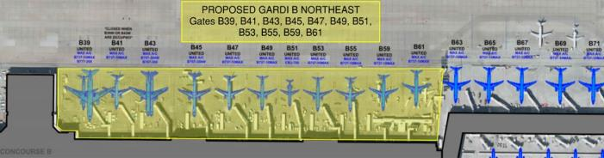
GARDI B Northeast – Design
The GARDI scope includes removing the failing concrete panels, reconditioning and re-grading the underlying subgrade as necessary to promote correct drainage and eliminating historical issues that have promoted the differential movement in the area. The new GARDI pavement section includes a subgrade pavement drainage layer (cement treated permeable base) that will collect any water that leaks through the surface joints and will send the water to the underdrain piping system. The typical GARDI pavement section from bottom to top is 4” of Upper Select Fill, 12” of Cement Treated Soil Base Course, 3” of Asphalt Mix Pavement, 6” of Cement Treated Permeable Base (CTPB) Course, and 17” of Portland Cement Concrete Pavement. Pavement Marking adjustments in coordination with DEN Planning, Airline Affairs and the airlines.
Phasing of this project will be very crucial to the airlines and DEN Operations. The design team will need to provide strong aviation planning services to coordinate the anticipated 5 phases within this project. The phasing will encompass the 11 gates and microphasing for Vehicle Service Raods, Taxiway and other operational needs
Utilities included are jet fuel pipe and hydrant pits, fire hydrants and supporting water vaults, storm drainpipe and manholes, sanitary sewer pipe and manholes, electrical conduit and handholes, cathodic pits and wiring, trench drains and underdrains, Xcel gas line adjustments, ground power units, removal of abandoned baggage tunnels to the basement, Passenger Loading Bridge modifications and potable water cabinet unit installation

Slide 25
Basement Foundation Rehabilitation On-Call
The Design, Engineering, and Construction (DEC) division at Denver International Airport (DEN) will request proposals for the purpose of selecting a vendor to provide engineering and design solutions for degrading building foundation elements in the basement across the Terminal Complex at DEN. Services to be provided by the selected vendor include:
Investigate existing conditions: expansion joints, waterproofing systems, slabs, elevator pits, foundation walls, columns
Conduct on-site surveys and review existing assessments and original construction documents
Provide structural, geotechnical, civil, and architectural design solutions
Deliver design documents from Schematic Design to Issued for Construction, aligned with DEN standards
Procurement Approach:
Open Solicitation for On-Call Professional Services
KEY INFORMATION
Anticipated Advertisement Date: September 2025
Estimated Project Value: $25,000,000.00
Small Business Program Goal: 20% MWBE Goal
Key Scope/Industry: Architecture and engineering investigation and design, structural, geotechnical, joint sealant, constructability analysis
Project Manager: Nicholas Martin | nicholas.martin@flydenver.com
Notes:
Denver International Airport’s Design, Engineering, and Construction division will soon issue a request for proposals to select a vendor for engineering and design solutions addressing deteriorating building foundations in the Terminal Complex basement.
The work includes investigating existing conditions like expansion joints, waterproofing, slabs, elevator pits, walls, and columns. The vendor will conduct on-site surveys, review past assessments, and deliver design documents from schematic through construction phases.
This will be an open solicitation for on-call professional services, with an expected 20% MWBE participation goal.
Key areas include structural, geotechnical, civil, and architectural design and repair.
Advertisement date and project value are TBD
Contact: Nicholas Martin at nicholas.martin@flydenver.com
For more info, join me in the breakout room!

Slide 26
Holiday Decor 2026-2027
DEN is seeking a full-service vendor to manage and deliver holiday decorations for the 2026 and 2027 seasons. Each year, millions of travelers pass through DEN between mid-November and early January, celebrating diverse cultural traditions.
This contract includes:
  Planning and design
  Materials procurement
  Installation and ongoing maintenance
  Seasonal removal and offsite storage
The décor should reflect the diversity of our passengers and the holiday spirit.
Key Information
Anticipated Advertisement Date: Q4 2025
Estimated Project Value: Under $486,000.00
Small Business Program Goal: N/A
Key Scope/Industry:
  Decoration & Design
  Installation & Maintenance
  Seasonal Removal & Offsite Storage
Project Manager: Valeria Rodriguez | valeria.rodriguez@flydenver.com
Notes:
45- 60 Seconds Max

Slide 27
Fire Extinguisher Inspections and Service
DEN is seeking a vendor to perform annual, 6-year, and hydrostatic inspections of fire extinguishers. The scope includes:
Replacing missing or used extinguishers
Assessing if additional extinguishers are needed per code
Reporting inspection data via Maximo system
Areas covered include the Terminal, Concourses, and all DEN-managed outbuildings. Approximately 2,000–2,200 extinguishers are involved.
KEY INFORMATION ​
Anticipated Advertisement Date: Q1 2026
Estimated Project Value: Less than $500K
Small Business Program Goal: TBD
Key Scope/Industry:​ Fire Extinguisher Inspector/Technician
Project Manager​: Cara James | Cara.James@flydenver.com
Notes:
45- 60 Seconds Max

Slide 28
Fire Suppression (Fire Pump & Emergency Services)
Denver International Airport is seeking a contractor to provide 24/7 emergency repair and testing services for fire suppression systems. This includes weekends and holidays to ensure uninterrupted airport operations and safety.
A key component is the annual testing of eight fire pumps, in compliance with NFPA 25 and NFPA 20. Contractors must have the capability to respond quickly to emergencies and meet all regulatory standards.
Scope Overview:
24/7 emergency repair & testing services for fire suppression systems
Year-round availability, including weekends and holidays
Rapid response required to ensure safety and airport operations continuity
Annual testing of 8 fire pumps per NFPA 25 & NFPA 20 standards
Ensures compliance and full functionality of fire protection systems
​
KEY INFORMATION ​
Anticipated Advertisement Date: Q4 2025
Estimated Project Value: $2M to $4.99M
Small Business Program Goal: TBD
Key Scope/Industry:​ Fire Suppression repair and testing
Project Manager​: Cara James | Cara.James@flydenver.com
Notes:
45- 60 Seconds Max

Slide 29
Overhead Door Installation and Maintenance
Consultant shall provide comprehensive overhead door services across DEN facilities, including:
Installation of new overhead doors with all necessary hardware and accessories
Routine maintenance of existing overhead and automatic doors
24/7 emergency service response
Replacement of doors on an as-needed basis
Procurement of relevant goods and services as required
Scope Includes:
Maintenance and servicing of over 147 high-speed fabric doors and low-energy handicap automatic doors
Coverage of existing and future installations throughout the airport complex
​
KEY INFORMATION ​
Anticipated Advertisement Date: Q3 2025
Estimated Project Value: $5M to $9.99M
Small Business Program Goal: TBD
Key Scope/Industry:​ Garage Door Maintenance
Project Manager​: Cara James | Cara.James@flydenver.com
Notes:
45- 60 Seconds Max

Slide 30
High Ceiling and Hard Surface Cleaning
DEN seeks vendors for specialized cleaning in public and tenant areas, including:
Surface cleaning and dust control
Vacuuming ceilings, lights, and walls
Cleaning air diffusers with certified biodegradable solution
Solution Must Be:
Biodegradable, non-abrasive, phosphate-free, non-flammable, and SCS-certified
Hours: 24/7 (scheduled per task)
Equipment:
  19–20 ft lift with operator
  HEPA backpack vacuum (or equivalent)
  Extension cords, vacuum pole, soft brushes
  Telescoping spray wand, dual-layer drop cloths
KEY INFORMATION ​
Anticipated Advertisement Date: Q3 2025
Estimated Project Value: $5M to $9.99M
Small Business Program Goal: TBD
Key Scope/Industry:​ Janitorial. Need to be able to use a lift and ladders, work is above 20’.
Project Manager​: Cara James| Cara.James@flydenver.com
Notes:
45- 60 Seconds Max

Slide 31
Sanitary, Stormwater, & Deice Water System Underground Utility Repair Service
DEN Operations & Maintenance is seeking a qualified contractor to provide comprehensive maintenance, repair, and replacement services for onsite sanitary sewer, stormwater, and deice water piping systems. This includes knowledge of the NAICS Code 221300, Water, Sewage and Other Systems. Relative locations include sewer system, glycol rehabilitation treatment plants, retention ponds and underground drainage system.
Scope of Work Includes but not limited to:
Safety & Permitting:
  Ensure compliance with relevant safety protocols during excavation and repair work to include traffic control and hazard identification
  Permitting as required
  Minimum impact on airport operations, preferably conducting scheduled work during off-peak hours
Excavation & Restoration: Utility locating, pipe repair/replacement, surface restoration, testing & commissioning.
Point Repairs: Abandon laterals, root intrusion, offset joints, water infiltration, cracks, and holes.
​
KEY INFORMATION ​
Anticipated Advertisement Date: Q3 2025
Estimated Project Value: $5M to $9.99M
Small Business Program Goal: TBD
Key Scope/Industry:​ GPR (Ground-penetrating radar), Traffic Control, Power Equipment Operators, Welding, Plumbing, Pipe Assessment Management, Landscaping, Trenching & Excavation, Permitting
Project Manager​: Jacqueline Wilson | jacqueline.wilson@flydenver.com
Notes:
v

Slide 32
Deicing Water System
DEN is seeking a qualified contractor for oversight, maintenance, and technical support of the Aircraft Deicing System. This includes technical expertise for software, upgrades, maintenance and hardware interface for the SCADA (Supervisory Control and Data Acquisitions) system.
Scope of Work Includes:
System Management:
  Monitor water system performance (pressure, flow, temperature)
  Conduct inspections and preventive maintenance
  Ensure safety and regulatory compliance
Deicing Operations Support:
  Coordinate and optimize deicing activities
  Provide system-specific technical guidance
Data & Reporting:
  Analyze water system and deicing data
  Deliver reports with performance insights and improvement recommendations
KEY INFORMATION ​
Anticipated Advertisement Date: Q4 2025
Estimated Project Value: < $10M
Small Business Program Goal: TBD
Key/Scope/Industry: Deicing Operations, Water Quality Management, Environment Impact Assessment Management, Sustainability, Inland Pump Station System upgrades, Glycol Retention Ponds, Glycol Rehabilitation Treatment Systems, SCADA System Analysis and Reporting
Procurement Project Manager : Jacqueline Wilson | jacqueline.wilson@flydenver.com
Project Manager (Director of Facilities) : Joel Maynes |joel.maynes@flydenver.com
Notes:
45- 60 Seconds Max

Slide 33
Building Information Modeling On-Call Services
DEN is seeking a qualified firm to provide On-Call Building Information Modeling (BIM) Services and Staff Augmentation to support the Digital Facilities & Infrastructure (DFI) team. The selected company will help deliver BIM and asset management solutions by recruiting, managing, and overseeing qualified Contingent Workers for various ongoing and upcoming DFI projects.
​
KEY INFORMATION ​
Anticipated Advertisement Date: September 2025
Estimated Project Value: $500K to $1.99M
Small Business Program Goal: SBE Defined Pool, only CCD-certified firms will be able to bid on this solicitation and must self-perform an commercially valuable function of no less than 30% of the work with their own staff.
Key Scope/Industry:​ Architecture; Engineering; Building Information Modeling (BIM)Asset Management
Project Manager​: Brendan Dillon |brendan.dillon@flydenver.com
Notes:
45- 60 Seconds Max

Slide 34
Climate Technology (ClimateTech) Driven Utility Data Validation & Sustainability Reporting for Airport Energy Demand Management
The City and County of Denver, Department of Aviation (DEN), is soliciting proposals from qualified vendors to provide a comprehensive suite of utility data management services and deliverables. The scope of work encompasses both ongoing services—such as automated data capture, billing validation, payment processing support, and integration with enterprise systems—and tangible outputs, including validated datasets, analytical insights, and sustainability reports. These deliverables are intended for use within modern data platforms to support DEN’s operational efficiency and sustainability goals.
This effort supports DEN’s energy and climate goals by leveraging advanced ClimateTech solutions, including:
Data validation and forecasting
Machine learning and cloud-based analytics using low-carbon technologies
High-level, interpreted, object-oriented, multi-paradigm programming language with dynamic semantics (e.g. Python)
Proposed solutions must be fully compatible with modern systems and compliant with the City and County of Dever financial standards and protocols for seamless integration, usability, and long-term performance.
​KEY INFORMATION ​
Anticipated Advertisement Date: September-October 2025
Estimated Project Value: Less than $500K
Small Business Program Goal: TBD
Key Scope/Industry:​ Information Technology, Data Management, Cloud-Based Data Analysis, Machine Learning, Professional Services
Project Manager​: Akiya Simms | akiya.simms@flydenver.com
Notes:
45- 60 Seconds Max

Slide 35

Program Purpose
To reduce barriers for small businesses to operate autos unescorted airside, DEN Risk Management introduces the new Airside Excess Auto Liability Program, also known as the AirsideDrive Program. The program provides $9M in excess of $1M in coverage for entities to meet the minimum unescorted airside driving insurance requirements of $10M Combined Single Limit each occurrence of Auto Liability.
Benefits: Supporting our Airside Partners
Affordable Coverage
Bridging the Gap
Easy Access
Comprehensive Protection
Small/Emerging Business Boost
Scan now to learn more
Notes:
45- 60 Seconds Max

Slide 36

DEN Procurement
Contract Types:
Competitive: Professional Services, Construction, Revenue Opportunities
Non-Competitive: Sole Source, Professional Preference, Amendments, Grants, Revenue Agreements
Task Orders:
Supports both competitive and non-competitive processes
Governance:
City & DEN Charter, Ordinances, and Regulations
Solicitation Types:
RFP, RFQ, RFO, RFI, IFB, Informal Competitive Procurement
Fast-Track Procurement Pilot
Goal: Increase agility by eliminating non-mandated steps
Shortened Advertisement: 1-week post, no pre-proposal meeting, 2-day Q&A
Streamlined Selection: 3-member panel; no interviews
Simplified Contracting: No negotiations—contract mirrors vendor proposal
Learn More: Visit our breakout room or scan the QR code to explore DEN’s procurement process on our website.
Notes:
45- 60 Seconds Max

Slide 37
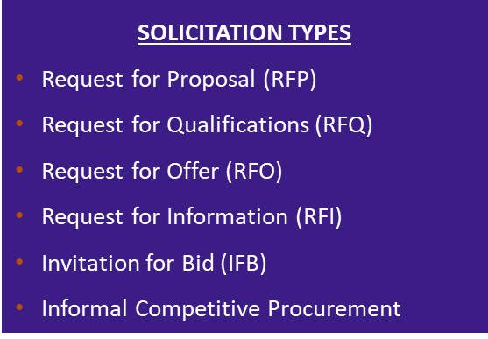
DEN Procurement
Procures competitive contracts:
Professional Services
Construction
Revenue Opportunities
Processes non-competitive contracts:
Sole Source
Professional Preference
Amendments
Grants
Revenue Agreements
Facilitates competitive and non-competitive task order process
Governed by ordinances and regulations including; City and DEN Charter & Ordinances, DSBO, Executive Order 8, and City Procurement and Fiscal Rules

Slide 38
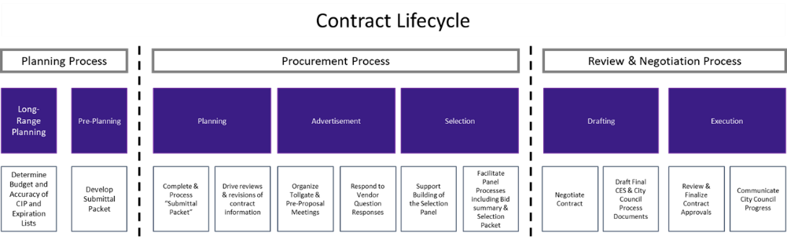
DEN Procurement – Contract Lifecycle
Active DEN Procurements & Solicitations are available on BidNet: https://www.bidnetdirect.com/colorado/cityandcountyofdenverdepartmentofaviation
  Important Dates:
    Published/Advertised Date
    Proposal Due Date
  Important Information:
    Pre-proposal meetings outlining project details
    Proposal Narrative Contents & Evaluation Criteria

Slide 39
Fast-tracking: What Does It Mean
New procurement method for DEN that is currently a pilot program.
Intent is to foster innovation and agility by fast-tracking certain qualified procurement projects. Eliminate steps in the procurement process that are not mandated by city law, ordinances, executive orders, and other governance requirements.
Key features of a fast-tracked opportunity include:
  Compressed advertisement period
  The pre-proposal meeting will not be held, and qualified projects will be advertised for one week. Questions will be due within 2 days of advertisement.
  Simplified selection process
  A 3-member panel composition will make an award recommendation based solely on their independent review and scoring of proposals. No interviews will be held.
  Simplified contract drafting process
  The final written contract will be based solely on what the winning vendor commits to in their proposal. There will be no negotiations to the final written contract.

Slide 40

ACDBE/SBEC Programs
Purpose:
As a primary airport receiving FAA funding, DEN ensures Airport Concessions Disadvantaged Business Enterprises (ACDBEs) have equal opportunities to compete for all concession contracts, in accordance with 49 CFR Parts 23 and 26.
The Small Business Enterprise Concessions (SBEC) program is a locally funded, race- and gender-neutral, defined-pool set-aside program in accordance with Chapter 28, Article 7 of the Denver Revised Municipal Code (DRMC).
Requirements:
ACDBE Concession-specific Goals: Calculated as a percentage of total estimated annual gross receipts from the concession (23.25(e)(1)(i)).
  Concession goals can be met through Direct Ownership, Joint Venture, or G&S purchases from ACDBEs
SBEC Concession “defined-pool” program requirements: ONLY small businesses certified with CCD as SBEC in applicable NAICS codes at time of proposal due date can propose as a concessionaire.
  Concession must be owned and operated by certified SBEC firm(s)
Certification:
Apply and maintain certification with City & County of Denver
Access Small Business Certification & Contract Mgmt. System (BG2Now) Directory
How to Get Involved:
Attend / Apply / Sign Up
Scan the QR Code to learn more about the ACDBE Program at DEN
Contact our team at DEN-ACDBE@flydenver.com
Notes:
Talking Points – 45 seconds - MAX – Remember you don’t have to read every line on the slide
At DEN, we’re committed to providing small and disadvantaged businesses with fair opportunities in airport concessions.
As a recipient of FAA funding, we follow federal regulations that require us to set participation goals for ACDBEs—Airport Concessions Disadvantaged Business Enterprises.
We also offer the SBEC Program, a local, race- and gender-neutral initiative that reserves certain concession opportunities exclusively for small, certified businesses.
These goals can be achieved by owning a concession, forming joint ventures, or purchasing goods and services from ACDBEs.
To qualify, businesses must be certified by the City & County of Denver and listed in the BG2Now Directory.
Getting involved is easy—attend events, apply, or simply scan the QR code to learn more.
If you want to learn more about our program, please contact our team at DEN-ACDBE@flydenver.com.

Slide 41





DSBO Pillars
Promoting equity, maximizing opportunities, and preventing discrimination and its effects against small, minority and women owned businesses.
Auditing and Analytics: Business Utilization, Forensics
Strategic Development and Community Engagement
Certification
Compliance
TO LEARN MORE ABOUT DSBO, PLEASE VISIT US IN THE BREAKOUT ROOM OR SCAN THE QR CODE.
Notes:
45- 60 Seconds Max

Slide 42
Small Business Certification Programs
Minority and Women Owned Business Enterprise (MWBE) Program
Eligible small, independent businesses, owned and controlled by socially and economically disadvantaged individual(s) may participate as a MWBE
Subcontracting opportunities on City funded projects with MWBE goals
D.R.M.C. Chapter 28, Article III
Small Business Enterprise (SBE) Programs
Eligible small, independent businesses, owned and controlled by economically disadvantaged individual(s) may participate as an SBE, EBE, SBEC
City defined pool contracts
D.R.M.C. Chapter 28, Articles V and VII
Disadvantaged Business Enterprise (DBE) Program
Eligible small, independent businesses, owned and controlled by socially and economically disadvantaged individual(s) may participate as a DBE
Subcontracting opportunities on federally funded transportation projects (state-wide)
49 CFR Part 26
TO LEARN MORE ABOUT DSBO, PLEASE VISIT US IN THE BREAKOUT ROOM OR SCAN THE QR CODE.

Slide 43
Compliance
Preventing Discrimination: Ensuring fair practices in solicitation, contracting, and performance activities.​
​
Certified Business Requirements: Upholding commitments and Good Faith Efforts (GFE).​
​
Commercially Useful Functions: Ensuring firms perform a distinct element of the work of a contract and carry out such work, by performing, maintaining control, managing, and supervising the work involved.​
​
Contractor Prompt Payment: Overseeing and enforcing timely subcontractor payments ​
​
Tracking Participation: Monitoring certified business participation and self-performance requirements.​
​
Risk Prevention: Preventing certified subcontractors from working at risk.​
​
Certified Firm Utilization Changes: Ensuring terminations, substitutions, and scope reductions happen for good cause only.​
​
Subcontract Agreement Requirements: Helping stakeholders understand DSBO requirements.​
​
Compliance Reporting: Ensuring comprehensive compliance reporting.​
For more information about DSBO and to find certified firms, please visit: https://www.denvergov.org/content/denvergov/en/denver-office-of-economic-development/do-business-with-denver.html
Notes:
DSBO’s compliance team monitors small business utilization from solicitation through the contract term to ensure equity protections and adherence to our program requirements from enforcing timely subcontractor payments
Bring attention to the Small Biz, Big Wins

Slide 44
Certification (MWBE, EBE, SBE(C), and DBE)
Applying for Certification(s):
Online Application
Monthly webinar “Understanding Certification”
Must be actively certified (in the correct codes) at the time of bid or when the letter of intent is signed
Maintaining Your Certification(s):
Submit an Annual Update every year.
For changes to NAICS codes submit a NAICS Expansion Application
For changes in ownership, business structure, or control submit a Material Change Application
Notes:
Eligible small businesses may apply for certification in one or more of our certification programs.

Slide 45
Connect with Us
Visit our website: www.denvergov.org/dsbo
Call: (720) 913-1714
Sign up for the DSBO weekly newsletter
Certification: certificationinfo@denvergov.org
DEN Compliance: dsbo@flydenver.com
Downtown Compliance: dsbo@denvergov.org
General inquiries: dsbohelp@denvergov.org

Slide 46

General Services- Purchasing Division
Procures goods and related services (excludes construction/design) using competitive bidding and open market methods. Follows City Charter, D.R.M.C., and Fiscal Accountability Rules.
Key Roles: Manages bids, contracts, assets, surplus sales, vendor relations, and sustainable purchasing.
Vendor Support:
  Uses Rocky Mountain E-Purchasing System (BidNet).
  Offers bid tools, updates, and resources on its website.
  Sends weekly notices on bids, events, and opportunities.
  Join the vendor list by completing the Purchasing Communication Form.
Upcoming Vendor Event
Learn about Denver agencies, procurement processes, and networking opportunities.
Open to providers of goods, services, and construction.
To learn more, visit me in the breakout room and scan the QR code.
Notes:
45- 60 Seconds Max
General Services Purchasing – What We Do
We handle the purchase of goods and services (except for construction and design) through competitive bidding and open market methods.
Everything we do adheres to city rules and guidelines to ensure fairness and accountability.
Our primary responsibilities include managing bids and contracts, tracking assets and surplus sales, collaborating with vendors, and promoting sustainable purchasing practices.
If you’re a vendor, all opportunities are posted on BidNet, the Rocky Mountain E-Purchasing System.
You’ll also find bid tools, updates, and helpful info on our website.
We send weekly emails with new bids, events, and important opportunities.
To learn more, visit me in the breakout room and scan the QR code.

Slide 47

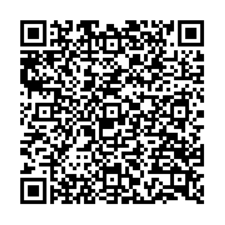
Denver Construction Careers Program (DCCP)
Overview
Workforce Ordinance Applies To:
Contracts/work orders ≥ $10M, advertised/issued after May 30, 2025
On-call/task orders evaluated individually
Contractors must sign a Workforce Commitment Form
Key Percentage Requirements
Priority Areas: Track/report hours worked by residents from DCCP-identified priority neighborhoods
Pre-Apprenticeship Grads: Track/report hours worked by grads from DCCP-approved programs
Veterans: Track/report hours worked by veterans
Registered Apprenticeships: Track/report hours by workers in registered apprenticeship programs
including first-year and target category registered apprentices
Reporting & Enforcement
LCPtracker is used to track and submit data
DCCP monitors compliance; non-compliance may lead to penalties
Get Involved
Jobseekers, employers, and community orgs — connect with DEDO & DCCP to grow Denver’s construction workforce.
Why It Matters
Meets high demand for skilled construction workers
Builds career pathways for Denver residents
Aligns workforce with city infrastructure investments
To learn more, visit me in the breakout room or scan the above QR code.
Notes:
45- 60 Seconds Max

Slide 48
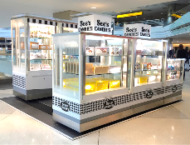

Empowering Small Business in Airport Retail
Who We Are
Retail partner at DEN empowering local, small, minority & women-owned businesses.
Mission
Enhance travel, grow local economies, launch small businesses.
Why PRI?
No RFP, no construction
Short-term, low-risk
Turnkey support: logistics, onboarding, training
PRI-provided kiosks/RMUs
2024 Highlights
37% sales from ACDBE partners
Avg. kiosk sales: $30K+/mo
Costs
Monthly: $4K–$6K
Overage: 15%
Fees: ~$650 + 0.5% (DEN marketing)
Connect
Cord Rauba | cord@priretail.com
📞 303.342.6817 | 📱 303.885.0815
https://www.priretail.com/den-airport
Notes:
45- 60 Seconds Max

Slide 49

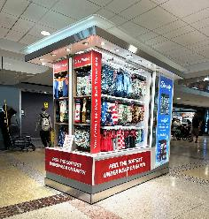
Empowering Small Business in Airport Retail
Who We Are
PRI offers dynamic, revenue generating retail opportunities in airports
Proven success at DEN and SJC
We support local, small, minority and women-owned business through our Small Business Launchpad
Our Mission
  Enhance passenger experience, drive local economic growth and equip small businesses to succeed in airport retail
Key Benefits
No RFP, No Construction
Short-term, low-risk commitment
2024 highlights
  37% of sales represented by ACDBE businesses and average monthly Kiosk/RMU sales over $30,000

Slide 50














Participation, Services & Contract
Turnkey Support for Merchants
Product receipt, storage & delivery
Onboarding, training & badging
Full administrative and operational support
Retail Space/Structure
  Kiosks & RMUs provided by PRI (some custom exceptions)
General Participation Costs
Monthly Minimum: ~$4000 - $6000
Sales Overage: 15% over natural breakpoint
Ancillary Fees: ~$650
DEN Marketing Fee: 0.5% of all gross sales
Let’s Connect!
Cord Rauba
cord@priretail.com
303.342.6817 of 303.885.0815

