Slide 1
Taking Flight at DEN
October 2025
Notes:
Good afternoon, everyone.
Thank you for being here today for Taking Flight at DEN.
My name is Desiree Mondragon, Outreach Administrator here at DEN.

Slide 2
Agenda
Housekeeping
Who Is In The Audience?
About DEN
Procurement Opportunities
Breakout Rooms And Networking
REMINDER:
This information will be shared with all attendees in a follow-up email from Eventbrite.com, which will also include the registration list and presentations.
Additionally, it will be posted on our website at www.flydenver.com/business-and-community/outreach-and-engagement/#pastevents within the next 3 business days.
Notes:
As you can see here we have a pretty full day ahead of us.
Please note all slides and rosters will be posted within 3 business days to our website.

Slide 3
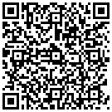
Housekeeping
Please note the following Zoom housekeeping items as you enter:
All cameras and microphones must remain off during the main session
Please note that the Chat and Q&A Functions are closed
  If you would like to introduce your firm to everyone, please scan the QR Code and let us know the projects you are interested in.
Complete Your Project Interest Form
Notes:
As our final piece of housekeeping:
Please keep your cameras and microphones off to maintain focus during the event and minimize distractions for our speakers. If you are muted at any point during the presentation, please be advised that you will have difficulties accessing your mics during the breakout rooms.

Slide 4
Legal Disclaimer​
This event is intended to provide the business community with early notice for potential procurement opportunities at DEN, allow companies to meet DEN project managers, and allow firms to network and foster relationships with each other. Projects included in this event are in their early stages of planning, and critical information about these projects (e.g. dates and goals) may be unknown and are otherwise subject to change. In its discretion, the City and County of Denver may cancel, modify, or place any project on hold at any time, for any reason. ​
Notes:
This event aims to notify the business community of potential procurement opportunities at DEN,
Attendees can network with project managers and other members of the business community.
Note: Projects are in the early planning stages and the City and County of Denver can cancel or modify any project at any time.

Slide 5
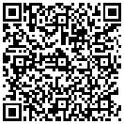
Project Interest Form
Please take a few minutes to introduce yourself, describe your company, and specify the projects you are interested in. This information will be shared with all attendees in a follow-up email, including the registration list and presentations. Additionally, it will be posted on our website at www.flydenver.com/business-and-community/outreach-and-engagement/#pastevents
Complete Your Project Interest Form
Notes:
Please let us know who is in the audience, scan this QR code, and tell us about the opportunities that brought you here today.
This information will be shared with all attendees and PMs via our website.

Slide 6

Vision 100 and Operation 2045
Notes:
Vision 100 and Operation 2045 are phases of DEN's strategic plan.
Vision 100 aims to prepare the airport for 100 million annual passengers.
Operation 2045 focuses on the airport's 50th anniversary and plans for over 120 million annual passengers.
Together, they guide decision-making and accountability here at DEN.

Slide 7


Taking Flight at DEN
Monthly event showcasing multiple procurement opportunities, set for the 2nd Thursday of each month at 1 p.m.
**January 23** - Due to holiday schedules
  February 13
March 13
  April 10
May 8
June 12
July 10
August 14
September 11
October 9
November 13
December 11
Notes:
“Taking Flight at DEN” is your chance to connect, learn about upcoming opportunities, and stay engaged.

Slide 8


Meet the Primes
Virtual outreach event held twice a month to connect Prime firms at DEN with local, small, and historically underutilized firms, scheduled for the 3rd Thursday at 1 p.m.
February 20 - Concessions Prime Operators
April 17 - Rental Car Company
June 26- General Contractors
August 21 - Construction Specialty Trade Contractor (MEP, Painting, Millwork, Drywall, Acoustical, Flooring, Concrete, Metals, Glass Glazing, Trucking, More)
December 18 - Architecture, Engineering, and Professional Services
Notes:
Meet the Primes helps connect DEN’s prime contractors with the business community. We’ll drop our events calendar in the chat so you can explore what’s coming up

Slide 9


Navigating the ACDBE Series: Pathways to Concessions
Bi-monthly virtual outreach event held on the third Thursday at 1 p.m. will guide ACDBEs on doing business at DEN.
Pathways to Concessions 2025:
January 16 – ACDBE 101
March 20 – ACDBE 201
May 15 – Joint Ventures 101
July 17 – Joint Ventures 201
September 18 – Concessions Connections
November 20 – B2G Compliance
Notes:
The “Navigating the ACDBE Program” series helps retail and F&B businesses with certification and compliance. We’ll drop the link to upcoming sessions in the chat!

Slide 10

Small Business Certification with the City & County of Denver
Get Certified with the City & County of Denver
DBE | EBE | MWBE | SBE | SBEC | ACDBE
Event Details
Date: Thursday, Oct. 22, 2025
Time: 9 a.m. – Noon
Where: Park Hill Innovation (PHI) Hub, 4965 48th Ave, Denver, CO 80216
Accelerate your small business with certification through:
Denver Economic Development & Opportunity – DSBO
Denver International Airport – ACDBE Program
What You’ll Learn
Jumpstart your application
Cross the finish line of submission
Get help on specific application sections
Find out more about utilizing your certification
Learn More & Register

Slide 11




Community Panelist Program
Volunteer program for those who want to participate in a procurement evaluation panel.
Great experience for potential primes
Attain an understanding of the evaluation process
Become familiar with DEN’s values
Gain experience with DEN’s interview format
Scan to Sign Up Today!
We Want Your Story!
Notes:
Volunteer as a Community Panelist to help review procurement proposals and share your valuable insights. It’s a great way to influence future projects! We will drop a link in the chat to learn more.

Slide 12
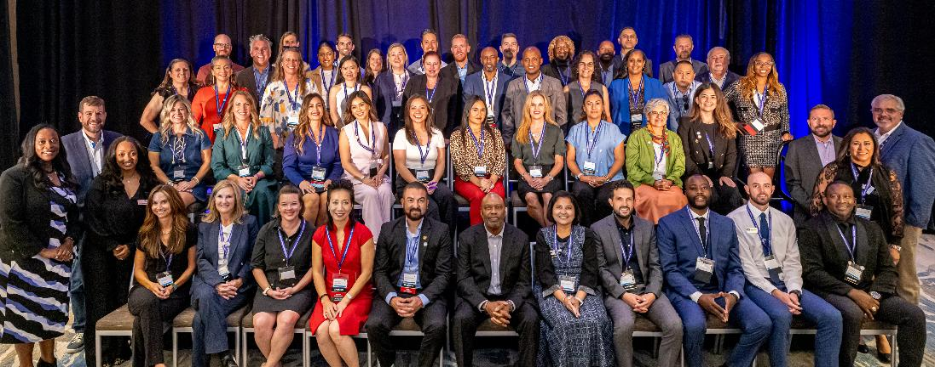



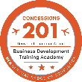
Business Development Training Academy Graduation 2024
62
Companies graduated in 2025
2026 Applications Open in Q4
Notes:
We just want to give a congratulations to the recent graduates of the BDTA program. We will be dropping in a link in the chat to learn more about the program.

Slide 13
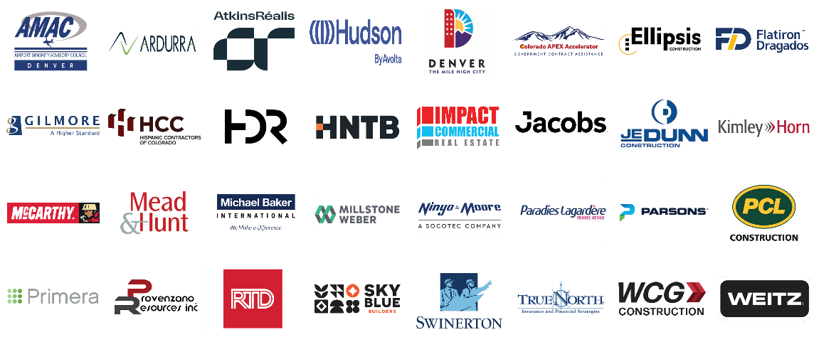
2025 DEN Procurement Tradeshow
Thank you to our exhibitors!
Notes:
Thank you to our exhibitors that participated in our in-person 2025 Procurement Tradeshow. We had over 400 attendees. Follow our newsletter for our 2026 tradeshow.

Slide 14
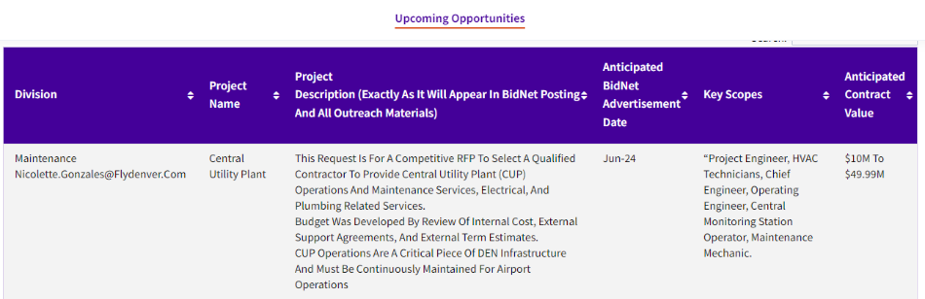

Upcoming Opportunities – Updated Webpage
Notes:
Our website lists procurement opportunities at various procurement stages.
Please be aware that details may change, and the City and County of Denver can modify or cancel projects at their discretion.
Now, we'll hand it over to our project managers.

Slide 15
DEN Insider Employee App
DEN seeks a comprehensive, user-friendly Employee Communication App to enhance internal communication, increase employee engagement, and streamline information sharing across all departments and locations. The app should support multi-platform access (iOS, Android, Web) and integrate seamlessly with existing systems. The employee app should allow the airport to post news items and other content and push notifications for time-sensitive safety or operational impacts in a user-friendly and adaptable format.
KEY INFORMATION
Anticipated Advertisement Date: Q4 2025
Estimated Project Value: $1.35 million
Small Business Program Goal: None
Key Scope/Industry: App development
Project Manager: Courtney Law | courtney.law@flydenver.com
Notes:
45- 60 Seconds Max

Slide 16
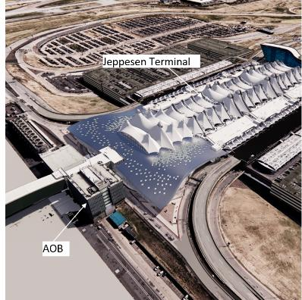
North Terminal Expansion – Request for Qualifications (RFQ) for
Program Management Support Services
Select a Program Management Team (PMT) to oversee the East & West Processor expansions of the North Terminal, ensuring delivery that meets quality, schedule, and budget goals.
Strategic Alignment
Supports Operation 2045, expands terminal capacity, and enables future growth.
Sustainability
Complies with CCD Executive Order 123 – targeting LEED Gold.
PMT Scope
Project & design management
Procurement & contract support
Stakeholder engagement
Cost, schedule, risk & quality control
KEY INFORMATION
Estimated Project Value: $135M
Project Manager: Rajeev Tillu Rajeev.Tillu@flydenver.com
KEY MILESTONES
Planning: Q3–Q4 2025
Advertisement & Proposals: Q4 2025
Selection & Contracting: Q1–Q2 2026
Execution: Q2–Q3 2026
Notes:
45- 60 Seconds Max

Slide 17
Executive Summary
Overview:
The RFQ aims to identify and select a Program Management Team (PMT) to oversee the successful execution of the North Terminal Expansion Project.
Objective:
To ensure effective project management and the delivery of the North Terminal Expansion, meeting all quality, schedule, and budgetary goals.
Scope:
The PMT will be responsible for comprehensive project management, oversight, and alignment with the Operation 2045 Strategic Plan.
PMT will report to the assigned Special Projects Principal Project Manager.
The project team will function as a hybrid, integrated team with DEN Special Projects staff.
Notes:
The purpose of this RFQ is to select a PMT that will manage and deliver the North Terminal Expansion Project.
Our objective is to ensure effective project management and integration with DEN's Operation 2045 strategic plan

Slide 18
North Terminal Expansion: Project Overview
Purpose:
To construct the East and West Processor expansions of the North Terminal, enhancing the terminal capacity.
Key Elements:
Expansion of ticketing facilities
Addition of Security Screening Checkpoint (SSCP) Lanes
Expansion of Federal Inspection Services (FIS) areas for international arrivals including Customs and Border Protection (CBP) processing and international baggage claims
Addition of domestic baggage claims
Plan connectivity for future East and West concourse expansions and FIS sterile circulation
Development of associated building systems.
Enabling Work:
Relocation of existing utilities to facilitate new construction and ensure uninterrupted service.

Slide 19
North Terminal Expansion: Project Benefits
Operation 2045 Contribution:
Directly supports DEN’s long-term strategic plan, Operation 2045, by addressing key growth and operational objectives.
Operational Capacity:
Increases terminal capacity to support future growth at DEN including enhanced processor and FIS capabilities.
Commitment to Sustainability:
Compliance with City Executive Order No. 123 requiring LEED Gold certification for the project.

Slide 20
Contract Type & General Scope of Work
Key Services:
Program and project management
Planning and Preliminary design
Environmental Services
Procurement and Contract Management
Design management and Permitting coordination
Stakeholder and Community Engagement
Activation Support
Records management and Documentation controls
Cost and Budget Management
Schedule and Project Controls
Quality Assurance and Risk Management
Other Project-Related Activities.
Contract Type:
Task order based with a defined overall capacity
Anticipated Contract Term
10 Years
Contract Budget
$135M
MWBE Participation Goal
20%
Notes:
The scope of work includes a wide range of services essential for the successful completion of the projects.
This covers program and project management, environmental services, design and baseline development, permitting, and delivery method evaluation.
The PMT will also assist with program oversight, cost and schedule management, risk management, quality control, and community engagement, among other responsibilities.

Slide 21
Anticipated Procurement Timeline
Planning Phase (Tentative: Q3 2025 – Q4 2025)
Conduct vendor outreach and advertisement tollgate.
Contract Drafting (Tentative: Q1 2026)
Finalize contract terms
Vendor signs the contract.
Advertisement Phase (Tentative: Q4 2025)
Publish advertisement on Bidnet
Host Pre-proposal meeting
Receive proposals.
Execution (Tentative: Q2- Q3 2026)
Obtain the agency approval
Complete City Council approval process
Finalize contract with all signatures.
Selection Phase (Tentative Q4 2025 – Q1 2026)
Review qualifications/ proposals
Develop a shortlist of firms
Issue Request for Proposals (RFP)
Conduct interviews
Complete selection tollgate.
Notes:
This slide summarizes the RFQ process, from planning and advertisement to selection, contract drafting, and execution.

Slide 22
Summary
Summary:
The selection of a qualified Program Management Team (PMT) is critical to the successful delivery of this key infrastructure project.
The Request for Qualifications (RFQ) process is designed to identify a team that aligns with DEN’s strategic goals and upholds City values.
7
Notes:
In summary, selecting the right PMT is crucial for the successful completion of the NTE.
The RFQ process is designed to find a team that aligns with DEN’s strategic goals and City values.
Special Projects will be proceeding with the RFQ process for PMT services.

Slide 23
DEN Consolidated Receiving and Distribution Center (CRDC)
Request for Information
Denver International Airport (DEN) is seeking input from industry partners to inform the potential development of a Consolidated Receiving and Distribution Center (CRDC). This centralized facility would improve the efficiency, security, and safety of deliveries into secure airport areas. It would support over 185 concessionaires, and potentially airlines and private clubs.
The CRDC would manage a wide range of inventory—from perishable goods requiring refrigeration or freezer storage to durable, long shelf-life products—arriving through various delivery channels (e.g., semi-truck pallets, FedEx, UPS, USPS).
KEY INFORMATION
Anticipated Advertisement Date: Q1 2026
Estimated Project Value: Less than $500K
Small Business Program Goal: TBD
Key Scope/Industry:
Logistics & Supply Chain Consulting(Facility operations, routing, reverse logistics)
Architectural & Engineering Design(Facility planning, secure access, cold storage design)
Technology & Systems Integration(Inventory management, screening tech, smart cart/recheck systems)
Food & Beverage Operators / Suppliers(With experience in secure, high-volume facilities
Project Manager: Zachary Selby | zachary.selby@flydenver.com
Notes:
45- 60 Seconds Max

Slide 24
DS (Delta Sierra) West Phase 2
The DS West Ph 2 project will construct up to 18 deice spots to the north and west of Concourse C in two separate schedules. This project also include the construction of Taxilanes DS and DN, and the extension of Taxiway H. A new GSE/SRE pad, an AGTS Maintenance access road, and the rerouting of a jet fuel line are also in this project. Design is scheduled to be completed by November to December of 2025, and construction bid will start in December of 2025. Construction duration will go from June 2026 to October 2027 with NTP planned for early June of 2026.
KEY INFORMATION
Anticipated Advertisement Date: Q4 2025
Estimated Project Value: $100M+
Small Business Program Goal: TBD
Key Scope/Industry:
General civil contractor
Specialty Contractors:
Earthwork (subgrade prep and embankment)
PCC and HMA pavement
Storm sewer piping
Structural vaults
Jet fuel line installation
Geotechnical testing
Surveying
Traffic control management
Tunnel boring
Electrical
Project Manager: John Yu | john.yu@flydenver.com & Terry Seifert: terry.seifert@flydenver.com
Notes:
45- 60 Seconds Max

Slide 25
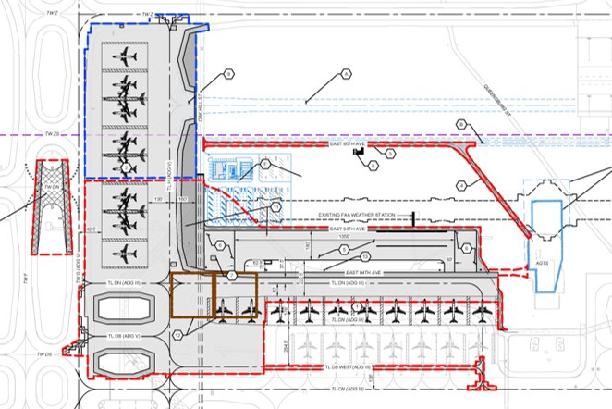
DS West Phase 2 Site Plan Layout
Notes:
45- 60 Seconds Max

Slide 26
Annual Tent Roof Maintenance, Inspection and Repair RFP
This RFP is for the annual inspection, testing, maintenance, and repair of the Polytetrafluoroethylene (PTFE) coated tensile fabric roofs at DEN. Tasks may be on any individual element of the tent structure including inner and outer fabric membranes, cables, struts, tie-downs, masts, or any other integrated element.
KEY INFORMATION
Anticipated Advertisement Date: Q4 2025
Estimated Project Value: $2M to $4.99M
Small Business Program Goal: TBD
Key Scope/Industry:
Polytetrafluoroethylene (PTFE) coated tensile fabric roof contractor, designer, vendor
Project Manager: Trang Tran | trang.tran@flydenver.com
Notes:
45- 60 Seconds Max

Slide 27
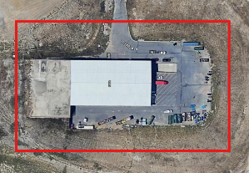
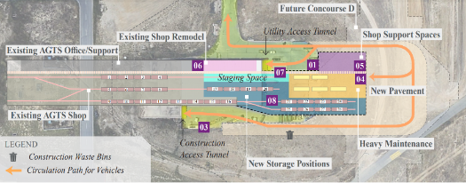
AGTS Maintenance Facility Expansion
The AGTS Maintenance Facility Expansion project will modernize and expand the existing facility to accommodate the growing fleet of AGTS cars and increasing operational demands at DEN. This will include adding / upgrading maintenance bays, storage, admin spaces, energy-efficient systems, power, security & safety. Phased construction will minimize operational disruptions.
  Anticipated to advertise in December 2025, with NTP before 30% CDs in Q4 2026
  CMGC
KEY INFORMATION
Anticipated Advertisement Date: Q4 2025
Estimated Project Value: $50M to $99.99M
Small Business Program Goal: TBD
Key Scope/Industry:
General Construction Contractors --
  Automated Guideway Transit
  Structural Steel
  Electrical
  Mechanical
  Plumbing
  Earthwork
  Concrete
  Civil Utilities
Project Manager: Brittney Warga| Brittney.Warga@flydenver.com, Victor Macedo| Victor.Macedo@flydenver.com,
Ella Giammo | Ella.Giammo@flydenver.com
Conceptual Design
Current Conditions
Notes:
45- 60 Seconds Max

Slide 28
Peña Blvd Outbound Low-Point Reconstruction & Drainage Improvements
Peña Blvd Outbound Low-Point Reconstruction & Drainage Improvements at DEN. Scope includes 0.7 miles of pavement reconstruction, subgrade stabilization, drainage improvements and tunnel removal.
KEY INFORMATION
Anticipated Advertisement Date: Q4 2025
Estimated Project Value: $5M $9.99M
Small Business Program Goal: TBD
Key Scope/Industry:
Concrete Paving, Excavation & Grading
Landscape Improvements and Erosion Control
Traffic Control
Signage and Striping
Storm Drainage
Project Manager: Tom Cotton | booker.cotton@flydenver.com
Notes:
45- 60 Seconds Max

Slide 29
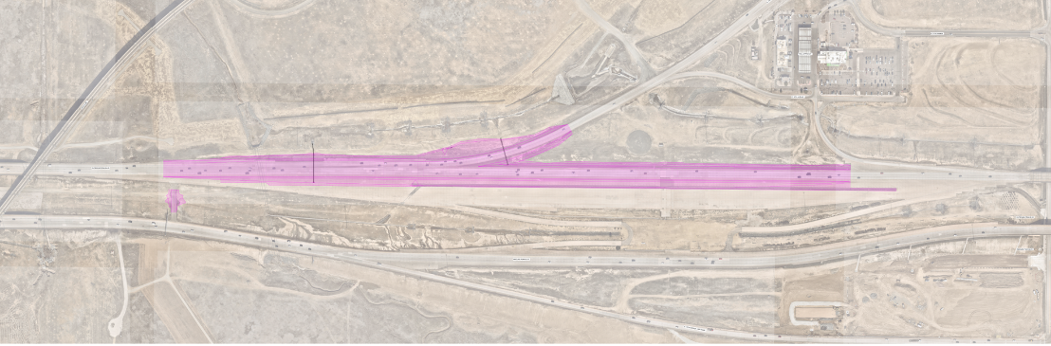
Peña Blvd Outbound Low-Point Reconstruction & Drainage Improvements
Notes:
45- 60 Seconds Max

Slide 30
Water Quality Infrastructure Improvements
Two project sites focused on constructing regional water quality and stormwater detention infrastructure.
Site 1: 75th & Gun Club (East of Second Creek)
Regional water quality & detention pond (21 ac-ft volume, 140-acre tributary area)
Scope:
Earthwork & grading
Concrete pond structures (trickle channel, forebay, outlet works)
Decommissioning of 3 existing ponds
Erosion control
Site 2: 24735 E 75th Ave (North of WorldPort)
Consolidated pond replacing 2 existing water quality ponds
Scope:
Earthwork & grading
Concrete pond structures & storm drainage infrastructure
Asphalt pavement replacement
Decommissioning of 2 ponds
Erosion control
KEY INFORMATION
Anticipated Advertisement Date: November 7th, 2025
Estimated Project Value: $5M to $9.99M
Small Business Program Goal: 16%
Key Scope/Industry:
Earthwork, Concrete, Erosion Control
Project Manager: Matthew Love| matthew.love@flydenver.com
Notes:
45- 60 Seconds Max

Slide 31
2025 Annual Landside Pavement Rehabilitation - Guardrail Replacement
Denver International Airport (DEN) is upgrading guardrail along Peña Boulevard from I-70 to Jackson Gap Street through the Federal Highway Safety Improvement Program (HSIP). Most of the nearly 100 guardrail segments are over 30 years old, do not meet current MASH standards, and are in poor condition.
After completing the highest-priority replacements in 2024, HSIP funding will support the remaining upgrades. All federal requirements associated with HSIP funding will be incorporated into the contract documents.
The project is anticipated to advertise in December 2025, with construction expected to begin in Q1 2026.
Scope:
~7,000 Guardrail removal & replacement
Traffic control
Installation of MASH-compliant hardware
KEY INFORMATION
Anticipated Advertisement Date: Q4 2025
Estimated Project Value: $500K to $1.99M
Small Business Program Goal: TBD – Will be DBE per federal funding requirement
Key Scope/Industry:
Guardrail
Traffic Control
Project Manager: Bryan St.Martin | bryan.st.martin@flydenver.com
Notes:
45- 60 Seconds Max

Slide 32
On Call SBE Environmental Testing and Hazardous Material
Mitigation Services
We are seeking at least two Small Business Enterprise (SBE)-certified firms to lead environmental testing services, including asbestos, lead, mold, and other hazardous materials. If hazardous materials are identified, selected firms will also be responsible for coordinating mitigation efforts. This opportunity will be structured as a construction contract, due to the inclusion of mitigation activities, and will include the professional services of environmental testing and reporting.
KEY INFORMATION
Anticipated Advertisement Date: Q4 2025
Estimated Project Value: up to (2) Contracts at $1M ea.
Small Business Program Goal: SBE defined pool, only Small Business Enterprises with CCD can bid.
SBE Goal: set at 30% self perform.
Key Scope/Industry:
Environmental Testing (Asbestos, Lead, Mold, etc.)
Environmental Mitigation Coordination
Prime Firm must hold SBE certification
Project Manager: David Mashburn | david.mashburn@flydenver.com
Notes:
45- 60 Seconds Max

Slide 33
2026 Annual Airfield Pavement Rehabilitation
This project addresses deteriorated concrete pavement and other Part 139 compliance issues to ensure a safe, reliable airfield for airline partners and passengers.
Typical Scope Includes:
Removal and replacement of concrete panels
Full and partial-depth spall and crack repairs
Drainage structure adjustments
Minor in-pavement lighting work (base cans, fixtures, conduits)
Surface-painted pavement marking refresh
KEY INFORMATION
Anticipated Advertisement Date: Q4 2025
Estimated Project Value: $2M to $4.99M
Small Business Program Goal: TBD
Key Scope/Industry: Heavy Civil Construction
Project Manager: Jae Lee | jae.lee@flydenver.com
Notes:
45- 60 Seconds Max

Slide 34
Tunnel Switchgear Heaving Remediation
Six switchgear rooms in the East and West cores of ACON, BCON, and CCON have experienced soil heaving, causing damage to both equipment and enclosures. Additionally, ACON East and West sub-cores face significant water intrusion, impacting switchgear performance.
Demolish damaged switchgear and enclosures.
Install new switchgear on a structural element that prevents any future heaving will not damage new switchgear
Construct code-compliant enclosures with fire-rated walls, fire suppression, and HVAC.
Implement water mitigation at ACON sub-cores.
Design-Build, Two-part procurement with RFQ & RFP
KEY INFORMATION
Anticipated Advertisement Date: Q4 2025
Estimated Project Value: $10M to $49.99M
Small Business Program Goal: 10% MWBE Goal
Key Scope/Industry: Electrical, Concrete, Masonry, Earthwork, Civil Utilities, Mechanical, Electrical, Plumbing
Project Manager: Mark Tabugadir| mark.tabugadir@flydenver.com
Notes:
45- 60 Seconds Max

Slide 35
Tower Anti-Icing Tank Replacement
We are seeking qualified storage tank suppliers and installers for a project involving the removal of four (4) steel tanks and installation of four (4) new 25,300-gallon fiberglass tanks.
Scope includes:
Removal and recycling of existing steel tanks
Crane services for tank removal and placement
Delivery and transport of new and old tanks
Installation and calibration of existing tank monitoring system
Plumbing into existing manifold with proper manway access
Electrical work for tank integration
This project requires adherence to industry standards and specifications and coordination across multiple trades.
KEY INFORMATION ​
Anticipated Advertisement Date: Q4 2025
Contract Term: 90 days
Estimated Project Value: < $200K
Small Business Program Goal: N/A
Key Scope/Industry:​ Sanitation Services, Logistics/Drivers
Project Manager​: Mike Morgan | michael.morgan@flydenver.com
Notes:
45- 60 Seconds Max

Slide 36
Portable Restroom Services
DEN is seeking vendors to provide rentable portable toilets, portable restroom trailers (relief stations), hand washing stations, and related support services. These services include, but are not limited to:
Cleaning and pump-out services
Transportation and delivery
Restocking of supplies
Services will be required at multiple locations at Denver International Airport (DEN). Depending on operational needs, service schedules may be continuous or on an as-needed basis. Airport Services will coordinate with the vendor to schedule services as needed.
KEY INFORMATION ​
Anticipated Advertisement Date: Q4 2025
Estimated Project Value: $500K to $1.99M
Small Business Program Goal: N/A
Key Scope/Industry:​ Sanitation Services, Logistics/Drivers
Project Manager​: Sara Namerow| Sara.Namerow@flydenver.com
Notes:
45- 60 Seconds Max

Slide 37
DEN Mechanical Services Contract
Contractor shall perform scheduled and unscheduled repair to chillers, boilers and any equipment associated with DEN.
KEY INFORMATION ​
Anticipated Advertisement Date: Q4 2025
Estimated Project Value: $10M to $49.99M
Small Business Program Goal: TBD
Key Scope/Industry:​
Electrical,
Plumbing,
HVAC,
Mechanical Engineer,
Sheet Metal Worker
Project Manager​: Cara James | Cara.James@flydenver.com
Notes:
45- 60 Seconds Max

Slide 38
Fire Extinguisher Inspections and Service
DEN is seeking a vendor to perform annual, 6-year, and hydrostatic inspections of fire extinguishers. The scope includes:
Replacing missing or used extinguishers
Assessing if additional extinguishers are needed per code
Reporting inspection data via Maximo system
Areas covered include the Terminal, Concourses, and all DEN-managed outbuildings. Approximately 2,000–2,200 extinguishers are involved.
KEY INFORMATION ​
Anticipated Advertisement Date: Q2 2026
Estimated Project Value: Less than $500K
Small Business Program Goal: TBD
Key Scope/Industry:​ Fire Extinguisher Inspector/Technician
Project Manager​: Cara James | Cara.James@flydenver.com
Notes:
45- 60 Seconds Max

Slide 39
Fire Suppression (Fire Pump & Emergency Services)
Denver International Airport is seeking a contractor to provide 24/7 emergency repair and testing services for fire suppression systems. This includes weekends and holidays to ensure uninterrupted airport operations and safety.
A key component is the annual testing of eight fire pumps, in compliance with NFPA 25 and NFPA 20. Contractors must have the capability to respond quickly to emergencies and meet all regulatory standards.
Scope Overview:
24/7 emergency repair & testing services for fire suppression systems
Year-round availability, including weekends and holidays
Rapid response required to ensure safety and airport operations continuity
Annual testing of 8 fire pumps per NFPA 25 & NFPA 20 standards
Ensures compliance and full functionality of fire protection systems
​
KEY INFORMATION ​
Anticipated Advertisement Date: Q1 2026
Estimated Project Value: $2M to $4.99M
Small Business Program Goal: TBD
Key Scope/Industry:​ Fire Suppression repair and testing
Project Manager​: Cara James | Cara.James@flydenver.com
Notes:
45- 60 Seconds Max

Slide 40
Overhead and Automatic Door Installation and Maintenance
Consultant shall provide comprehensive overhead door services across DEN facilities, including:
Installation of new overhead doors with all necessary hardware and accessories
Routine maintenance of existing overhead and automatic doors
24/7 emergency service response
Replacement of doors on an as-needed basis
Procurement of relevant goods and services as required
Scope Includes:
Maintenance and servicing of over 147 high-speed fabric doors and low-energy handicap automatic doors
Coverage of existing and future installations throughout the airport complex
​
KEY INFORMATION ​
Anticipated Advertisement Date: Q4 2025
Estimated Project Value: $2M to $4.99M
Small Business Program Goal: 7% MWBE
Key Scope/Industry:​ Garage Door Maintenance
Project Manager​: Cara James | Cara.James@flydenver.com
Notes:
45- 60 Seconds Max

Slide 41
High Ceiling and Hard Surface Cleaning
DEN seeks vendors for specialized cleaning in public and tenant areas, including:
Surface cleaning and dust control
Vacuuming ceilings, lights, and walls
Cleaning air diffusers with certified biodegradable solution
Solution Must Be:
Biodegradable, non-abrasive, phosphate-free, non-flammable, and SCS-certified
Hours: 24/7 (scheduled per task)
Equipment:
  19–20 ft lift with operator
  HEPA backpack vacuum (or equivalent)
  Extension cords, vacuum pole, soft brushes
  Telescoping spray wand, dual-layer drop cloths
KEY INFORMATION ​
Anticipated Advertisement Date: Q3 2025
Estimated Project Value: $2M to $4.99M
Small Business Program Goal: 12% MWBE
Key Scope/Industry:​ Janitorial. Need to be able to use a lift and ladders, work is above 20’.
Project Manager​: Cara James| Cara.James@flydenver.com
Notes:
45- 60 Seconds Max

Slide 42
Underground Piping Repair & Response Service (UPRRS)
DEN Airport Operations is seeking a qualified contractor to provide comprehensive maintenance, repair, and replacement services for onsite sanitary sewer, stormwater, and deice water piping systems. This includes knowledge of the NAICS Code 221300, Water, Sewage and Other Systems. Relative locations include sewer system, glycol rehabilitation treatment plants, retention ponds and underground drainage system. To ensure uninterrupted airport operations, all repair requests must be addressed promptly and resolved without delay.
Scope of Work Includes but not limited to:
Safety & Permitting:
  Ensure compliance with relevant safety protocols during excavation and repair work to include traffic control and hazard identification
  Permitting as required
  Minimum impact on airport operations, preferably conducting scheduled work during off-peak hours
Excavation & Restoration: Utility locating, pipe repair/replacement, surface restoration, testing & commissioning.
Point Repairs: Abandon laterals, root intrusion, offset joints, water infiltration, cracks, and holes.
​
KEY INFORMATION ​
Anticipated Advertisement Date: Q4 2025
Estimated Project Value: > $10M
Small Business Program Goal: TBD
Key Scope/Industry:​ GPR (Ground-penetrating radar), Traffic Control, Power Equipment Operators, Welding, Plumbing, Pipe Assessment Management, Landscaping, Trenching & Excavation, Permitting
Project Manager​: Jacqueline Wilson | jacqueline.wilson@flydenver.com
Notes:
v

Slide 43
DEN Guard Gates Maintenance, Repair, and Emergency Services
Provide preventative maintenance, corrective maintenance and emergency repair services to extend the life of DEN’s electric security gates and be responsible for expedited time-critical gate repairs that may impact public safety and airport security.
Scope includes:
Preventative and corrective maintenance
Emergency repair services
Gate and gate operator installation/removal
Troubleshooting and diagnostics
PLC (Programmable Logic Controller) experience required
Qualifications:
Provide personnel skilled in diagnosing technical issues with complex gate system
Familiarization with DEN's preferred manufacturers for new and replacement parts
Emergency Services / Rapid Response Teams
SCADA (Supervisory Control and Data Acquisitions) system.
KEY INFORMATION ​
Anticipated Advertisement Date: Q2 2026
Estimated Project Value: $2M to $4.99M
Small Business Program Goal: TBD
Key Industry: Mechanical, Welding, Logical Programming (PLC Technicians), Electrical, Emergency Services/Rapid Response Team
Project Manager​: Jacqueline Wilson | jacqueline.wilson@flydenver.com
Notes:
v

Slide 44
Deicing Waste System
DEN is seeking a qualified contractor for oversight, maintenance, and technical support of the Aircraft Deicing Waste System. This includes technical expertise for software, upgrades, maintenance and hardware interface for the SCADA (Supervisory Control and Data Acquisitions) system.
Scope of Work Includes but not limited to:
System Management:
  Monitor water system performance (pressure, flow, temperature)
  Conduct inspections and preventive maintenance
  Ensure safety and regulatory compliance
Deicing Operations Support:
  Coordinate and optimize deicing activities
  Provide system-specific technical guidance
Data & Reporting:
  Analyze water system and deicing data
  Deliver reports with performance insights and improvement recommendations
KEY INFORMATION ​
Anticipated Advertisement Date: Q4 2025
Estimated Project Value: > $10M
Small Business Program Goal: TBD
Key/Scope/Industry: Deicing Operations, Water Quality Management, Environment Impact Assessment Management, Sustainability, Inland Pump Station System upgrades, Glycol Retention Ponds, Glycol Rehabilitation Treatment Systems, SCADA System Analysis and Reporting
Procurement Project Manager : Jacqueline Wilson | jacqueline.wilson@flydenver.com
Project Manager : Darren Ingersoll | darren.ingersoll@flydenver.com
Notes:
45- 60 Seconds Max

Slide 45
Total Queue Management (TQM)
The scope of work for this project is to manage the queue systems, customer service, and wayfinding services at and around the security screening checkpoints operated by the Transportation Security Administration (TSA), as well as within the Federal Inspection Services (FIS) facility operated by US Customs and Border Protection (CBP).
Key Scope:
Excellent face-to-face customer service skills
Ability to multitask in a dynamic environment
Line and queue management experience
Strong teamwork and collaboration
Clear and effective wayfinding assistance
KEY INFORMATION ​
Anticipated Advertisement Date: Q4 2025
Estimated Project Value: $5M to $9.99M
Small Business Program Goal: TBD
Project Manager​: Dave Dalton | Dave.Dalton@flydenver.com
Notes:
45- 60 Seconds Max

Slide 46
Conveyance Inspection and Certification
DEN Technical Operations seeks proposals for professional services to perform annual and five-year inspections of all people-moving conveyances across the airport campus.
Number of Units:
Elevators (Hydraulic, Traction, Traction Freight, Traction MRL): 151
Escalators: 151
Moving Walkways: 68
Contract Term:
Five-year agreement starting January 2027
KEY INFORMATION ​
Anticipated Advertisement Date: Q4 2025
Estimated Project Value: $500K to $1.99M
Small Business Program Goal: TBD
Project Manager​: Anthony Ciervo | Anthony.Ciervo@flydenver.com
Notes:
45- 60 Seconds Max

Slide 47
Conveyance O&M
DEN Technical Operations seeks proposals for professional services to perform annual and five-year inspections of all people-moving conveyances across the airport campus.
Number of Units:
Elevators (Hydraulic, Traction, Traction Freight, Traction MRL): 151
Escalators: 151
Moving Walkways: 68
Contract Term:
Five-year agreement starting August 2026
KEY INFORMATION ​
Anticipated Advertisement Date: Q4 2025
Estimated Project Value: $500K to $1.99M
Small Business Program Goal: TBD
Project Manager​: Anthony Ciervo | Anthony.Ciervo@flydenver.com
Notes:
45- 60 Seconds Max

Slide 48
AGTS Revitalization
The Technical Operations Department of DEN is soliciting Statements of Qualifications (SOQ) from professional consulting firms to provide negotiation and execution support services for the AGTS Revitalization Program. The consultant will provide owner’s representation services during contract execution to ensure technical compliance and alignment with DEN’s Vision 100 objectives. The consultant will also serve as a strategic advisor and technical representative to DEN during negotiations, supporting contract development, benchmarking, drafting performance specifications, and coordinating with external and internal stakeholders.
Revitalization of the AGTS system will include:
Migration from Cirtyflo 550 to Urbalis Flo signaling systems
Upgrade of the communication system to the Operational Passenger Information Communications System (OPICS)
Upgrade of power distribution system
Integration of 19 new 300R vehicles
Upgrade of wayside infrastructure
Control room design and build
KEY INFORMATION
Anticipated Advertisement Date: Q4 2025
Estimated Project Value: $10M to $49.99M
Small Business Program Goal: TBD
Project Manager: Jaclyn Ghareeb | jaclyn.ghareeb@flydenver.com

Slide 49
Building Information Modeling On-Call Services
DEN is seeking a qualified firm to provide On-Call Building Information Modeling (BIM) Services and Staff Augmentation to support the Digital Facilities & Infrastructure (DFI) team. The selected company will help deliver BIM and asset management solutions by recruiting, managing, and overseeing qualified Contingent Workers for various ongoing and upcoming DFI projects.
​
KEY INFORMATION ​
Anticipated Advertisement Date: Late October 2025
Projected Awards: Likely 2, one facilities (Revit), one civil (Civil 3D), possible there will be only one.
Estimated Project Value: $500K to $1.99M
Small Business Program Goal: SBE Defined Pool, only CCD-certified firms will be able to bid on this solicitation and must self-perform a commercially valuable function of no less than 30% of the work with their own staff.
Key Scope/Industry:​ Architecture; Engineering; Building Information Modeling (BIM)Asset Management
Project Manager​: Brendan Dillon |brendan.dillon@flydenver.com
Notes:
45- 60 Seconds Max

Slide 50
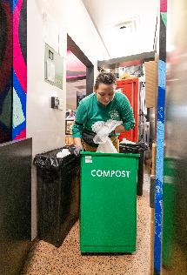
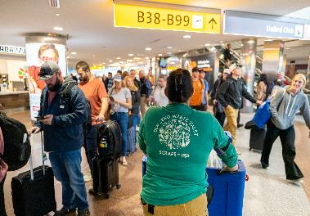
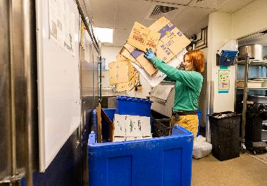
Waste Valet Service for DEN Concessions
The Waste Valet team will collaborate with DEN concessions to ensure the proper transport of recyclable and compostable materials to designated disposal areas. In addition, the team will provide staff education on effective waste sorting practices. Launched initially on Concourse B in Spring 2024, the program will now expand to include Concourses A and C.
​KEY INFORMATION ​
Anticipated Advertisement Date: Q2 2026
Estimated Project Value: $2M to $4.99M
Small Business Program Goal: TBD
Key Scope/Industry:​ Proven experience working with food and beverage (F&B) operations or organizations.
Project Manager​: Alexa Rosenstein| alexa.rosenstein@flydenver.com
Notes:
45- 60 Seconds Max

Slide 51
Climate Technology (ClimateTech) Driven Utility Data Validation & Sustainability Reporting for Airport Energy Demand Management
The City and County of Denver, Department of Aviation (DEN), is soliciting proposals from qualified vendors to provide a comprehensive suite of utility data management services and deliverables. The scope of work encompasses both ongoing services—such as automated data capture, billing validation, payment processing support, and integration with enterprise systems—and tangible outputs, including validated datasets, analytical insights, and sustainability reports. These deliverables are intended for use within modern data platforms to support DEN’s operational efficiency and sustainability goals.
This effort supports DEN’s energy and climate goals by leveraging advanced ClimateTech solutions, including:
Data validation and forecasting
Machine learning and cloud-based analytics using low-carbon technologies
High-level, interpreted, object-oriented, multi-paradigm programming language with dynamic semantics (e.g. Python)
Proposed solutions must be fully compatible with modern systems and compliant with the City and County of Dever financial standards and protocols for seamless integration, usability, and long-term performance.
​KEY INFORMATION ​
Anticipated Advertisement Date: September-October 2025
Estimated Project Value: Less than $500K
Small Business Program Goal: TBD
Key Scope/Industry:​ Information Technology, Data Management, Cloud-Based Data Analysis, Machine Learning, Professional Services
Project Manager​: Akiya Simms | akiya.simms@flydenver.com
Notes:
45- 60 Seconds Max

Slide 52

DEN Procurement
Contract Types:
Competitive: Professional Services, Construction, Revenue Opportunities
Non-Competitive: Sole Source, Professional Preference, Amendments, Grants, Revenue Agreements
Task Orders:
Supports both competitive and non-competitive processes
Governance:
City & DEN Charter, Ordinances, and Regulations
Solicitation Types:
RFP, RFQ, RFO, RFI, IFB, Informal Competitive Procurement
Fast-Track Procurement Pilot
Goal: Increase agility by eliminating non-mandated steps
Shortened Advertisement: 1-week post, no pre-proposal meeting, 2-day Q&A
Streamlined Selection: 3-member panel; no interviews
Simplified Contracting: No negotiations—contract mirrors vendor proposal
Learn More: Visit our breakout room or scan the QR code to explore DEN’s procurement process on our website.
Notes:
45- 60 Seconds Max

Slide 53
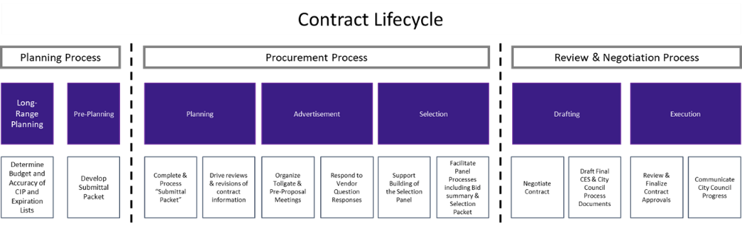
DEN Procurement – Contract Lifecycle
Active DEN Procurements & Solicitations are available on BidNet: https://www.bidnetdirect.com/colorado/cityandcountyofdenverdepartmentofaviation
  Important Dates:
    Published/Advertised Date
    Proposal Due Date
  Important Information:
    Pre-proposal meetings outlining project details
    Proposal Narrative Contents & Evaluation Criteria

Slide 54

ACDBE/SBEC Programs
Purpose:
As a primary airport receiving FAA funding, DEN ensures Airport Concessions Disadvantaged Business Enterprises (ACDBEs) have equal opportunities to compete for all concession contracts, in accordance with 49 CFR Parts 23 and 26.
The Small Business Enterprise Concessions (SBEC) program is a locally funded, race- and gender-neutral, defined-pool set-aside program in accordance with Chapter 28, Article 7 of the Denver Revised Municipal Code (DRMC).
Requirements:
ACDBE Concession-specific Goals: Calculated as a percentage of total estimated annual gross receipts from the concession (23.25(e)(1)(i)).
  ACDBE concession-specific goals can be met through Direct Ownership, Joint Venture, or G&S purchases from ACDBEs
SBEC Concession “defined-pool” program requirements: ONLY small businesses certified with CCD as SBEC in applicable NAICS codes at time of proposal due date can propose as a concessionaire.
  Concession must be owned and operated by certified SBEC firm(s)
Certification:
Apply and maintain certification with City & County of Denver
Access Small Business Certification & Contract Mgmt. System (B2GNow) Directory
How to Get Involved:
Attend / Apply / Sign Up
Scan the QR Code to learn more about small business concessions programs at DEN
Contact our team at DEN-ACDBE@flydenver.com
Notes:
Talking Points – 45 seconds - MAX – Remember you don’t have to read every line on the slide
At DEN, we’re committed to providing small and disadvantaged businesses with fair opportunities in airport concessions.
As a recipient of FAA funding, we follow federal regulations that require us to set participation goals for ACDBEs—Airport Concessions Disadvantaged Business Enterprises.
We also offer the SBEC Program, a local, race- and gender-neutral initiative that reserves certain concession opportunities exclusively for small, certified businesses.
These goals can be achieved by owning a concession, forming joint ventures, or purchasing goods and services from ACDBEs.
To qualify, businesses must be certified by the City & County of Denver and listed in the BG2Now Directory.
Getting involved is easy—attend events, apply, or simply scan the QR code to learn more.
If you want to learn more about our program, please contact our team at DEN-ACDBE@flydenver.com.

Slide 55





Division of Small Business Opportunity (DSBO)
Promoting equity, maximizing opportunities, and preventing discrimination and its effects against small, minority and women owned businesses.
Business Utilization
Community Engagement and Capacity Building
Certification (MWBE, SBE/EBE,
SBEC and DBE)
Compliance
TO LEARN MORE ABOUT DSBO AND THE CITY'S CERTIFICATION PROGRAMS PLEASE VISIT US IN THE BREAKOUT ROOM OR SCAN THE QR CODE.
Notes:
45- 60 Seconds Max

Slide 56
Small Business Certification Programs
Minority and Women Owned Business Enterprise (MWBE) Program​
Eligible small, independent businesses, owned and controlled by socially and economically disadvantaged individual(s) may participate as a MWBE​
Subcontracting opportunities on City funded projects with MWBE goals​
D.R.M.C. Chapter 28, Article III​
​
Small Business Enterprise (SBE) Programs​
Eligible small, independent businesses, owned and controlled by economically disadvantaged individual(s) may participate as an SBE, EBE, SBEC​
City defined pool contracts​
D.R.M.C. Chapter 28, Articles V and VII​
​
Disadvantaged Business Enterprise (DBE) Program​
Eligible small, independent businesses, owned and controlled by socially and economically disadvantaged individual(s) may participate as a DBE​
Subcontracting opportunities on federally funded transportation projects (state-wide)​
49 CFR Part 26 ​
​
Visit our website for more information on each certification program

Slide 57
Compliance
Preventing Discrimination: Ensuring fair practices in solicitation, contracting, and performance activities.​
​
Certified Business Requirements: Upholding commitments and Good Faith Efforts (GFE).​
​
Commercially Useful Functions: Ensuring firms perform a distinct element of the work of a contract and carry out such work, by performing, maintaining control, managing, and supervising the work involved.​
​
Contractor Prompt Payment: Overseeing and enforcing timely subcontractor payments ​
​
Tracking Participation: Monitoring certified business participation and self-performance requirements.​
​
Risk Prevention: Preventing certified subcontractors from working at risk.​
​
Certified Firm Utilization Changes: Ensuring terminations, substitutions, and scope reductions happen for good cause only.​
​
Subcontract Agreement Requirements: Helping stakeholders understand DSBO requirements.​
​
Compliance Reporting: Ensuring comprehensive compliance reporting.​
For more information about DSBO and to find certified firms, please visit: https://www.denvergov.org/content/denvergov/en/denver-office-of-economic-development/do-business-with-denver.html
Notes:
DSBO’s compliance team monitors small business utilization from solicitation through the contract term to ensure equity protections and adherence to our program requirements from enforcing timely subcontractor payments
Bring attention to the Small Biz, Big Wins

Slide 58
Certification (MWBE, EBE, SBE(C), and DBE)
Applying for Certification(s):
Online Application
Monthly webinar “Understanding Certification”
Must be actively certified (in the correct codes) at the time of bid or when the letter of intent is signed
Maintaining Your Certification(s):
Submit an Annual Update every year.
For changes to NAICS codes submit a NAICS Expansion Application
For changes in ownership, business structure, or control submit a Material Change Application
Visit our website for eligibility requirements, FAQs, and other application assistance.
Notes:
Eligible small businesses may apply for certification in one or more of our certification programs.

Slide 59
Community Engagement and Capacity Building
DSBO Equity & Empowerment Council(DEEC)​
Bi-monthly, in-person meetings where small businesses gather to network, learn about upcoming contracting opportunities, and engage with city representatives.​
Next meeting is Tuesday, October 28, 2025, 8:30-11:00 am​
Register here​
​
Mentor Protégé Program​
Connects certified small firms with experienced prime contractors and city agencies to build long-term relationship.​
Opportunity for certified small firms, through mentorship, to learn, build skills and receive guidance to help them succeed.​
Eligibility and 2026 application information.​
​
Visit our website for more information on capacity building opportunities for small and certified firms.​
​
Visit our website for more resources and programs available for small businesses.

Slide 60
Connect with Us
Visit our website: www.denvergov.org/dsbo
Call: (720) 913-1714
Sign up for the DSBO weekly newsletter
Certification: certificationinfo@denvergov.org
DEN Compliance: dsbo@flydenver.com
Downtown Compliance: dsbo@denvergov.org
General inquiries: dsbohelp@denvergov.org

Slide 61

General Services- Purchasing Division
Procures goods and related services (excludes construction/design) using competitive bidding and open market methods. Follows City Charter, D.R.M.C., and Fiscal Accountability Rules.
Key Roles: Manages bids, contracts, assets, surplus sales, vendor relations, and sustainable purchasing.
Vendor Support:
  Uses Rocky Mountain E-Purchasing System (BidNet).
  Offers bid tools, updates, and resources on its website.
  Sends weekly notices on bids, events, and opportunities.
  Join the vendor list by completing the Purchasing Communication Form.
Upcoming Vendor Event
Learn about Denver agencies, procurement processes, and networking opportunities.
Open to providers of goods, services, and construction.
To learn more, visit me in the breakout room and scan the QR code.
Notes:
45- 60 Seconds Max
General Services Purchasing – What We Do
We handle the purchase of goods and services (except for construction and design) through competitive bidding and open market methods.
Everything we do adheres to city rules and guidelines to ensure fairness and accountability.
Our primary responsibilities include managing bids and contracts, tracking assets and surplus sales, collaborating with vendors, and promoting sustainable purchasing practices.
If you’re a vendor, all opportunities are posted on BidNet, the Rocky Mountain E-Purchasing System.
You’ll also find bid tools, updates, and helpful info on our website.
We send weekly emails with new bids, events, and important opportunities.
To learn more, visit me in the breakout room and scan the QR code.

Slide 62

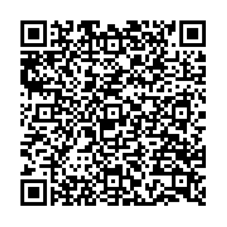
Denver Construction Careers Program (DCCP)
Overview
Workforce Ordinance Applies To:
Contracts/work orders ≥ $10M, advertised/issued after May 30, 2025
On-call/task orders evaluated individually
Contractors must sign a Workforce Commitment Form
Key Percentage Requirements
Priority Areas: Track/report hours worked by residents from DCCP-identified priority neighborhoods
Pre-Apprenticeship Grads: Track/report hours worked by grads from DCCP-approved programs
Veterans: Track/report hours worked by veterans
Registered Apprenticeships: Track/report hours by workers in registered apprenticeship programs
including first-year and target category registered apprentices
Reporting & Enforcement
LCPtracker is used to track and submit data
DCCP monitors compliance; non-compliance may lead to penalties
Get Involved
Jobseekers, employers, and community orgs — connect with DEDO & DCCP to grow Denver’s construction workforce.
Why It Matters
Meets high demand for skilled construction workers
Builds career pathways for Denver residents
Aligns workforce with city infrastructure investments
To learn more, visit me in the breakout room or scan the above QR code.
Notes:
45- 60 Seconds Max

Slide 63
PRL Specialty Retail
Breakout Room # 22

Slide 64
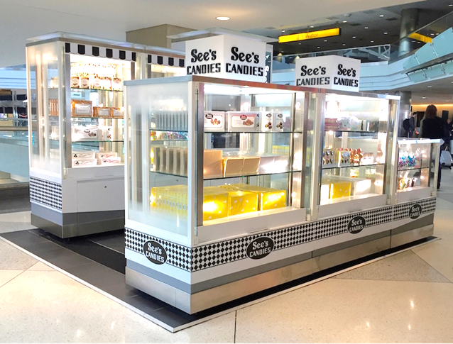

Empowering Small Business in Airport Retail
Who We Are
Retail partner at DEN empowering local, small, minority & women-owned businesses.
Mission
Enhance travel, grow local economies, launch small businesses.
Why PRI?
No RFP, no construction
Short-term, low-risk
Turnkey support: logistics, onboarding, training
PRI-provided kiosks/RMUs
2024 Highlights
37% sales from ACDBE partners
Avg. kiosk sales: $30K+/mo
Costs
Monthly: $4K–$6K
Overage: 15%
Fees: ~$650 + 0.5% (DEN marketing)
Connect
Cord Rauba | cord@priretail.com
📞 303.342.6817 | 📱 303.885.0815
https://www.priretail.com/den-airport
Notes:
45- 60 Seconds Max

Slide 65
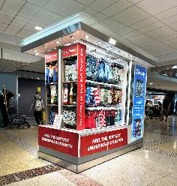
Empowering Small Business in Airport Retail
Who We Are
PRI offers dynamic, revenue generating retail opportunities in airports
Proven success at DEN and SJC
We support local, small, minority and women-owned business through our Small Business Launchpad
Our Mission
  Enhance passenger experience, drive local economic growth and equip small businesses to succeed in airport retail
Key Benefits
No RFP, No Construction
Short-term, low-risk commitment
2024 highlights
  37% of sales represented by ACDBE businesses and average monthly Kiosk/RMU sales over $30,000

Slide 66














Participation, Services & Contract
Turnkey Support for Merchants
Product receipt, storage & delivery
Onboarding, training & badging
Full administrative and operational support
Retail Space/Structure
  Kiosks & RMUs provided by PRI (some custom exceptions)
General Participation Costs
Monthly Minimum: ~$4000 - $6000
Sales Overage: 15% over natural breakpoint
Ancillary Fees: ~$650
DEN Marketing Fee: 0.5% of all gross sales
Let’s Connect!
Cord Rauba
cord@priretail.com
303.342.6817 of 303.885.0815

Slide 67

Program Purpose
To reduce barriers for small businesses to operate autos unescorted airside, DEN Risk Management introduces the new Airside Excess Auto Liability Program, also known as the AirsideDrive Program. The program provides $9M in excess of $1M in coverage for entities to meet the minimum unescorted airside driving insurance requirements of $10M Combined Single Limit each occurrence of Auto Liability.
Benefits: Supporting our Airside Partners
Affordable Coverage
Bridging the Gap
Easy Access
Comprehensive Protection
Small/Emerging Business Boost
Scan now to learn more
Notes:
45- 60 Seconds Max

Slide 68
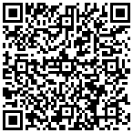
Event Follow Up
This information will be shared with all attendees in a follow-up email from Eventbrite.com, which will also include the registration list and presentations.
Additionally, it will be posted on our website at www.flydenver.com/business-and-community/outreach-and-engagement/#pastevents within the next 3 business days.
Post-Event Survey
Notes:
After today’s event, we’ll send all attendees a follow-up email from Eventbrite.com. This email will include the registration list and the presentations.
You can also find this information on our website within the next three business days.
Finally, please take a moment to complete the post-event survey — your feedback helps us improve future events.

Slide 69
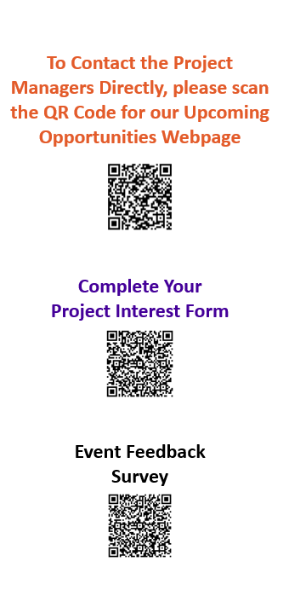
Breakout Room Assignments
Notes:
Thank you to all of today’s speakers!
Here is a list of breakout rooms, feel free to join any of the rooms at your leisure
In addition to the projects we have also included resource rooms such as DSBO, ACDBE, Contract, and Purchasing
Please Take advantage of this opportunity to connect with the DEN PMs before these RFPs are posted and then they go into a cone of silence
Turn on your cameras
Introduce yourself and your company
Ask questions
Make connections with others in the room for possible connections
Let them know if you are interested in priming or subbing?
If you are a large firm, I would encourage you to
take advantage of this space to connect with small business partners
If you are a Small Business
Prepare and get ready now before these RFPs are released
Identify Business Partners who are pursuing the work you are interested in
Make sure your certifications are up to date
If you are looking to sub, connect with those Prime firms who are interested in pursuing the work and
Find out their qualification process
Get on their bidlist
Identify your point of contact
Continue to build your relationship
And finally, please take a few minutes before leaving the event today and help us improve our programs by scanning the QR code and taking a quick survey for us
Lets open the rooms, if you cannot see a window pop up click on the More Button with 3 dots at the bottom of your screen and click on breakout rooms

