Slide 1
Doing Business at DEN
December 2025
Notes:
Good afternoon and welcome to today’s event! <<next slide>>

Slide 2
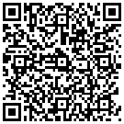
Housekeeping
Please note the following Zoom housekeeping items as you enter:
All cameras and microphones must remain off during the main session
Please note that the Chat and Q&A Functions are closed
  If you would like to introduce your firm to everyone, please scan the QR Code and let us know the projects you are interested in.
Complete Your Project Interest Form
Notes:
As our final piece of housekeeping:
Please keep your cameras and microphones off to maintain focus during the event and minimize distractions for our speakers. If you are muted at any point during the presentation, please be advised that you will have difficulties accessing your mics during the breakout rooms.

Slide 3
Legal Disclaimer​
This event is intended to provide the business community with early notice for potential procurement opportunities at DEN, allow companies to meet DEN project managers, and allow firms to network and foster relationships with each other. Projects included in this event are in their early stages of planning, and critical information about these projects (e.g. dates and goals) may be unknown and are otherwise subject to change. The City and County of Denver may, in its discretion, cancel, modify, or place any project on hold at any time, for any reason. ​
Notes:
This event is intended to provide the business community with early notice for potential procurement opportunities at DEN, allow companies to meet DEN project managers, and allow firms to network and foster relationships with each other. Projects included in this event are in their early stages of planning, and critical information about these projects (e.g. dates and goals) may be unknown and are otherwise subject to change. The City and County of Denver may, in its discretion, cancel, modify, or place any project on hold at any time, for any reason. ​

Slide 4


MISSION: THROUGH THE POWER OF OUR PEOPLE, BE THE BEST IN CLASS
SUSTAINABILITY & RESILIENCY | EQUITY, DIVERSITY, INCLUSION & ACCESSIBILITY OPERATIONAL EXCELLENCE | ENHANCING THE CUSTOMER EXPERIENCE
GROWING OUR INFRASTRUCTURE
EXPANDING OUR GLOBAL CONNECTIONS
EMPOWERING OUR PEOPLE
MAINTAINING WHAT WE HAVE
Provide necessary tools and growth opportunities, enabling our employees to excel in their roles and contribute to DEN’s success
Build facilities and infrastructure through well-coordinated planning and new service
delivery models
Ensure longevity, reliability, and performance
of existing facilities and assets
Expand our air network to the continent of Africa, and other unserved
international destinations
Recruit, train, and support ongoing learning, innovation, and professional growth
Grow revenue across existing and new streams to maintain financial resiliency
Consistently surprise and delight our customers by providing an exceptional experience at DEN
Leverage our strong performance to grow our domestic air network
Establish and preserve belonging and inclusion as cornerstones of DEN’s employee culture
Become the most environmentally sustainable airport in the world
Leverage data-driven insights to inform decision-making processes, optimize operations, and drive innovation
Notes:
Vision 100 and Operation 2045 are two phases of DEN’s strategic plan. Vision 100 is phase one and is focused on preparing the airport to serve 100 million annual passengers in the next several years. Operation 2045 is phase two and is focused on preparing the airport for its 50th anniversary in 2045 and for an expected 120 million-plus annual passengers. Both phases combined serve as a blueprint to align decision-making and accountability.

Slide 5


Taking Flight at DEN
Monthly event showcasing multiple procurement opportunities, set for the 2nd Thursday of each month at 1 p.m.
January 8
  February 12
March 12
  April 9
May 14
June 11
July 9
August 13
September 10
October 8
November 12
December 11
Notes:
Thank you for an incredible year of Taking Flight at DEN!
We appreciate your engagement and partnership throughout 2025.
Follow us to stay connected and be the first to hear about 2026 events and opportunities.

Slide 6


Meet the Primes
Virtual outreach event held twice a month to connect Prime firms at DEN with local, small, and historically underutilized firms, scheduled for the 3rd Thursday at 1 p.m.
February 19 - Concessions Prime Operators
April 16 - Rental Car Company
June 18- General Contractors
August 20 - Construction Specialty Trade Contractor
October 15 - Airlines, Hotelier and Commercial Developers on DEN property
December 17 - Architecture, Engineering, and Professional Services
Scan to Attend & Network!
Notes:
As we conclude this year’s Meet the Primes at DEN,
we thank all participating companies, partners, and attendees for making it a success.
Stay engaged and follow us for 2026 event announcements.

Slide 7



Community Panelist Program
Volunteer program for those who want to participate in a procurement evaluation panel.
Great experience for potential primes
Attain an understanding of the evaluation process
Become familiar with DEN’s values
Gain experience with DEN’s interview format
Scan to Sign Up Today!
We Want Your Story!
Notes:
Volunteer as a Community Panelist to help review procurement proposals and share your valuable insights. It’s a great way to influence future projects! We will drop a link in the chat to learn more.

Slide 8

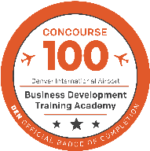
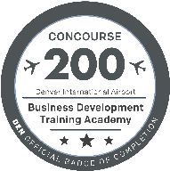

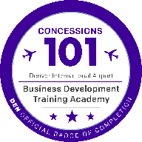

2026 BDTA Programming
CONCOURSE – ARCHITECTURE, ENGINEERING, CONSTRUCTION (AEC)
Cohort 5
Cohort 4
Pilot
  APPLY TODAY
  2026 Applications
  Are Now Open
CONCESSIONS – FOOD, BEVERAGE, RETAIL (FBR)
Cohort 3
Cohort 2
Notes:
Applications are now open for DEN’s Business Development & Training Academy. BDTA offers no-cost programs that help small businesses understand DEN processes, build connections, and prepare to compete for future airport opportunities.
Programs include AEC Concourse 100, Concessions 101, and the AEC Concourse 300 Pilot—an advanced program focused on leadership and contract readiness.
Apply by January 16 for AEC 300, or January 23 for AEC 100 and Concessions 101, and get a head start on 2026 opportunities.

Slide 9
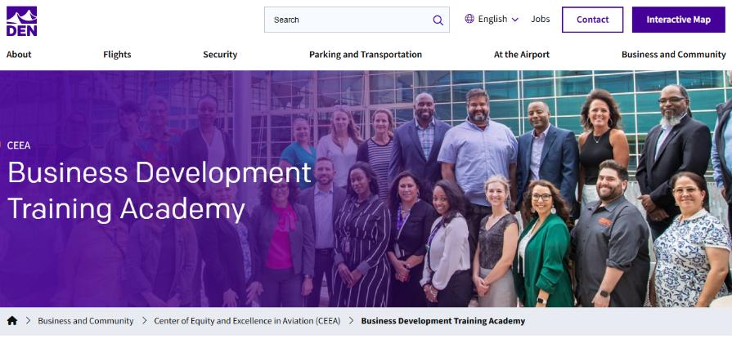
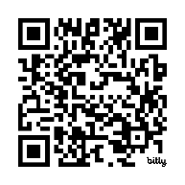
Stay Informed
BDTA Page: https://www.flydenver.com/business-and-community/ceea/bdta/
Business Connect: https://lp.constantcontactpages.com/sl/QFiuIds
Contact Business Learning & Development at DENTrainingAcademy@flydenver.com
Notes:
To stay informed about BDTA programs and upcoming opportunities, visit the BDTA page on flydenver.com, sign up for Business Connect, or scan the QR code. You can also reach us directly at DENTrainingAcademy@flydenver.com.

Slide 10
Community Panelist Program
Volunteer program for those who want to participate in a procurement evaluation panel.
Great experience for potential primes
Attain an understanding of the evaluation process
Become familiar with DEN’s values
Gain experience with DEN’s interview format
Scan to Sign Up Today!
We Want Your Story!
Notes:
Volunteer as a Community Panelist to help review procurement proposals and share your valuable insights. It’s a great way to influence future projects! We will drop a link in the chat to learn more.

Slide 11
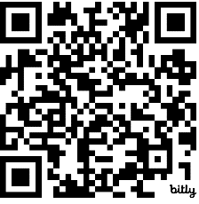
Stay Connected & Join Our Mailing List
Weekly Business Connect Newsletter Includes:
DEN Outreach Event Email Notifications
Training Email Invitations
Community Events Calendar
Advertise your company’s outreach events
Email DoBusinessWithDEN@flydenver.com
Sign-up for our mailing list to receive more information
https://lp.constantcontactpages.com/sl/QFiuIds
Signup for our weekly Business Connect newsletter

Slide 12
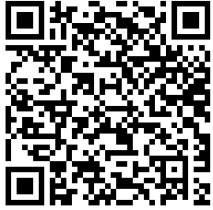
Connect with Us on LinkedIn
Learn about upcoming events and opportunities
DEN Outreach Event Email Notifications
Stay Up-To-Date On Procurement Opportunities
Get Resources For Doing Business With DEN
Follow us on LinkedIn

Slide 13

Changes to DBE and ACDBE Programs
Effective October 3, 2025:
  Interim Final Rule (IFR) removed sex and race-based presumptions of disadvantage
  Every ACDBE and DBE firm must submit a Personal Narrative (PN) and Personal Net Worth (PNW) statement to their Jurisdiction of Certification (JOC) for reevaluation
  Colorado UCP Submission Date: January 16, 2026
  Interstate firms must reapply once they have been reevaluated by their JOC
  No counting or goal setting until entire Colorado UCP reevaluation is complete
  No impact to local programs!
Register Now!
Scan the QR code or visit: https://bit.ly/48B8veA
Colorado UCP/CCD Webinar
Dec. 18, 2025
11a.m. – 12:30 p.m.
Notes:
45- 60 Seconds Max

Slide 14
ConRAC Participation RFQ
We will soon release an RFQ for rental car companies interested in operating at the ConRAC. This RFQ will be a simple form to confirm that companies meet the minimum qualifications, which will be defined in the RFQ itself.
KEY INFORMATION
Anticipated Advertisement Date: Q1 2026
Estimated Project Value: TBD – Revenue Based
Project Manager: Maximillian Katzer
Key Scope: Rental Car Operators | maximillian.katzer@flydenver.com
Notes:
45- 60 Seconds Max

Slide 15
Continuous Monitoring Program
Implement a Continuous Monitoring Program (CMP) for DEN's Concession Program. Project's goal is to enhance oversight of the concessions self-reported revenues to ensure they are accurate and complete and the payments are timely. Deliverables: 1) Design and implement an automated continuous monitoring program for all concession agreements; 2) Provide timely, actionable dashboards and reports on concessionaire performance and compliance.
KEY INFORMATION
Anticipated Advertisement Date: Q4 2025
Estimated Project Value: Less than $500K
Small Business Program Goal: TBD
Key Scope/Industry:
Experience in Auditing & IT for conducting data analytics, &
Building dashboards.
Project Manager: Garrett Meyer | garrett.meyer@flydenver.com
Notes:
45- 60 Seconds Max

Slide 16
DIW (Deicing Industrial Waste) Pond 009 Rehabilitation Project
Project to rehabilitate DIW Pond 009’s infrastructure to operational standard. SOW includes liners, ballast tubes, concrete surfaces, pumps, valves, actuators, wet well, and influence pipes. A PLC (SCADA) system, new discharge line, 2 MG glycol tank, and a secondary power supply are also included.
KEY INFORMATION
Anticipated Advertisement Date: Q1 2026
Estimated Project Value: $10M to $49.99M
Small Business Program Goal: TBD
Key Scope/Industry:
General Civil Contractor
Specialty Contractors:
Heavy civil - grading,
utilities (PVC pipes),
structures,
mechanical system,
electrical system,
concrete, and
asphalt.
Project Manager: John Yu | john.yu@flydenver.com
Notes:
45- 60 Seconds Max

Slide 17
DS (Delta Sierra) West Phase 2
The DS West Ph 2 project will construct up to 18 deice spots to the north and west of Concourse C in two separate schedules. This project also include the construction of Taxilanes DS and DN, and the extension of Taxiway H. A new GSE/SRE pad, an AGTS Maintenance access road, and the rerouting of a jet fuel line are also in this project. Design is scheduled to be completed by November to December of 2025, and construction bid will start in December of 2025. Construction duration will go from June 2026 to October 2027 with NTP planned for early June of 2026.
KEY INFORMATION
Anticipated Advertisement Date: Q4 2025
Estimated Project Value: $100M+
Small Business Program Goal: TBD
Key Scope/Industry:
General Civil Contractor
Specialty Contractors:
Earthwork (subgrade prep and embankment)
PCC and HMA pavement
Storm sewer piping
Structural vaults
Jet fuel line installation
Geotechnical testing
Surveying
Traffic control management
Tunnel boring
Electrical
Project Manager: John Yu | john.yu@flydenver.com & Terry Seifert: terry.seifert@flydenver.com
Notes:
45- 60 Seconds Max

Slide 18
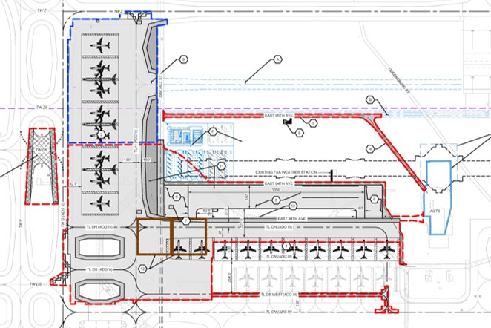
DS West Phase 2 Site Plan Layout
Notes:
45- 60 Seconds Max

Slide 19
AGTS Maintenance Facility Expansion
The AGTS Maintenance Facility Expansion project will modernize and expand the existing facility to accommodate the growing fleet of AGTS cars and increasing operational demands at DEN. This will include adding / upgrading maintenance bays, storage, admin spaces, energy-efficient systems, power, security & safety. Phased construction will minimize operational disruptions.
  Anticipated to advertise in Q1 2026, with NTP before 30% CDs in Q4 2026
  CMGC
KEY INFORMATION --
Anticipated Advertisement Date: Q1 2026
Estimated Project Value: $50M to $99.99M
Small Business Program/DCCP Goals: 18% MWBE Goals, Full DCCP Goals
Project Managers: Brittney Warga| Brittney.Warga@flydenver.com, Victor Macedo| Victor.Macedo@flydenver.com, Ella Giammo | Ella.Giammo@flydenver.com
Notes:
45- 60 Seconds Max

Slide 20
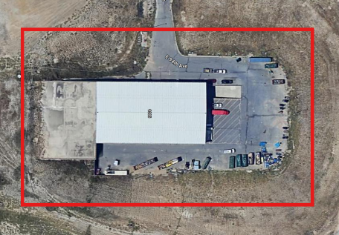
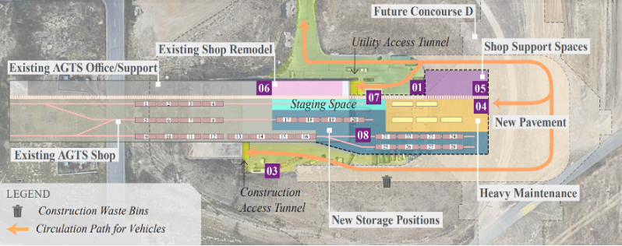
AGTS Maintenance Facility Expansion
Key Scope/Industry:
General Construction Contractors --
  Automated Guideway Transit
  Structural Steel
  Electrical
  Mechanical
  Plumbing
  Earthwork
  Concrete
  Civil Utilities
Conceptual Design
Current Conditions
Notes:
45- 60 Seconds Max

Slide 21
Tunnel Switchgear Heaving Remediation
Six switchgear rooms in the East and West cores of ACON, BCON, and CCON have experienced soil heaving, causing damage to both equipment and enclosures. Additionally, ACON East and West sub-cores face significant water intrusion, impacting switchgear performance.
Demolish damaged switchgear and enclosures.
Install new switchgear on a structural element that prevents any future heaving will not damage new switchgear
Construct code-compliant enclosures with fire-rated walls, fire suppression, and HVAC.
Implement water mitigation at ACON sub-cores.
Design-Build, Two-part procurement with RFQ & RFP
KEY INFORMATION
Anticipated Advertisement Date: Q1 2026
Estimated Project Value: $10M to $49.99M
Small Business Program Goal: 10% MWBE Goal
Key Scope/Industry: Electrical, Concrete, Masonry, Earthwork, Civil Utilities, Mechanical, Electrical, Plumbing
Project Manager: Mark Tabugadir| mark.tabugadir@flydenver.com
Notes:
45- 60 Seconds Max

Slide 22
HVAC Duct Cleaning
Denver International Airport (DEN) is seeking a qualified contractor to provide comprehensive duct cleaning services across airport facilities. The selected specialist will clean and maintain HVAC ductwork, vents, air handling units, and related components in accordance with industry standards and airport operational requirements. These services will be performed periodically as on-call, task-based awards to support system performance, air quality, and ongoing maintenance needs.
KEY INFORMATION ​
Anticipated Advertisement Date: Q1 2026
Estimated Project Value: $25M
Small Business Program Goal: TBD
Key Scope/Industry:​ Sheet Metal Worker
Project Manager​: Sara Namerow | sara.namerow@flydenver.com
Notes:
45- 60 Seconds Max

Slide 23
HVAC Coil Cleaning, Air Filter Replacement, and Preventative Maintenance
Denver International Airport (DEN) is seeking a qualified contractor to provide inspection, cleaning, and preventative maintenance services for cooling and heating coils, including condensing and evaporator coils, as well as airport-wide AHU and RTU units.
KEY INFORMATION ​
Anticipated Advertisement Date: Q1 2026
Estimated Project Value: $50M
Small Business Program Goal: TBD
Key Scope/Industry:​ Sheet Metal Worker
Project Manager​: Sara Namerow | sara.namerow@flydenver.com
Notes:
45- 60 Seconds Max

Slide 24
On-Call Safety Equipment Certification Program
Denver International Airport (DEN) is seeking a professional specialist to inspect and test safety devices related to fall protection throughout the facility, in accordance with the Occupational Health and Safety Administration (OSHA) guidelines. These inspections or groups of inspections will be performed periodically as on-call tasks-based awards.
KEY INFORMATION ​
Anticipated Advertisement Date: Q1 2026
Estimated Project Value: Less than $500K
Small Business Program Goal: TBD
Key Scope/Industry:​ Professional engineer licensed in the State of Colorado who is familiar with OSHA requirements
Project Manager​: Cate Marshall | cate.marshall@flydenver.com
Notes:
45- 60 Seconds Max

Slide 25
Landside Outlying Janitorial Services
The Contractor is responsible for providing all necessary labor, tools, equipment, and supplies to perform the janitorial services. The primary deliverables is the provision of professional janitorial services for specific outlying facilities at Denver International Airport. The initial term is three years from the effective date, with the possibility of two one-year extensions by written notice from the CEO.
KEY INFORMATION ​
Anticipated Advertisement Date: Q1 2026
Estimated Project Value: $10M to $49.99M
Small Business Program Goal: TBD
Key Scope/Industry:​ This includes Floor Care; Carpet Cleaning; Cleaning and Disinfecting; General Cleaning; Supply Management and Reporting and Compliance. The purpose is to provide all labor, supervision, management, equipment, tools, materials, supplies and transportation required to deliver janitorial and custodial services for the designated outlying facilities. These outlying facilities will also include ARFF Station 35 and the Center of Equity and Excellence in Aviation offices which is location on level four (4) adjacent to Jefferson Terminal.
Project Manager​: Curtis Harry | Curtis.harry@flydenver.com
Notes:
45- 60 Seconds Max

Slide 26
HVAC System Deficiency ARFF 1 2 and 3 Project
This project involves correcting HVAC system deficiencies across ARFF1, ARFF2, and ARFF3 (Aircraft Rescue and Fire Fighting Facilities) at Denver International Airport. The work will address a variety of mechanical infrastructure issues. The objective is to restore proper heating, cooling, and air circulation functionality while aligning with current building performance, energy efficiency, and operational reliability standards.
KEY INFORMATION ​
Anticipated Advertisement Date: Q3 2026
Estimated Project Value: $500K to $1.99M
Small Business Program Goal: TBD
Key Scope/Industry:​ HVAC Pipe Fitting, Sheetmetal, Electrical, Controls, and Insulation
Project Manager​: Cara James | Cara.James@flydenver.com
Notes:
45- 60 Seconds Max

Slide 27
DEN Mechanical Services Contract
Contractor shall perform scheduled and unscheduled repair to chillers, boilers and any HVAC equipment associated with DEN.
KEY INFORMATION ​
Anticipated Advertisement Date: Q2 2026
Estimated Project Value: $10M to $49.99M
Small Business Program Goal: TBD
Key Scope/Industry:​ Electrical, Plumbing, HVAC, Mechanical Engineer, Sheet Metal Worker
Project Manager​: Cara James | Cara.James@flydenver.com
Notes:
45- 60 Seconds Max

Slide 28
AHU Pneumatic Actuator Replacement - Central Utility Plant
The purpose of this project is to replace all existing pneumatic actuators with electric actuators within the Central Utility Plant (CUP) at Denver International Airport (DEN). The upgrade aims to improve reliability, reduce maintenance, enhance control precision, and eliminate the need for pneumatic systems. This modernization aligns with long-term operational efficiency goals and supports ongoing energy management initiatives.
KEY INFORMATION ​
Anticipated Advertisement Date: Q3 2026
Estimated Project Value: $500K to $1.99M
Small Business Program Goal: TBD
Key Scope/Industry:​ Mechanical, Electrical, Controls (BAS), Commissioning
Project Manager​: Cara James | Cara.James@flydenver.com
Notes:
45- 60 Seconds Max

Slide 29
Central Utility Plant (CUP) Mechanical Contract
This is a contract to provide scheduled maintenance or emergency repair services for the chillers, boilers and associated equipment at Denver International Airport.
KEY INFORMATION ​
Anticipated Advertisement Date: Q2 2026
Estimated Project Value: $10M to $49.99M
Small Business Program Goal: TBD
Key Scope/Industry:​ Mechanical, Electrical, HVAC, Plumbing
Project Manager​: Cara James | Cara.James@flydenver.com
Notes:
45- 60 Seconds Max

Slide 30
Fire Extinguisher Inspections and Service
DEN is seeking a vendor to perform monthly, annual, 6-year, and hydrostatic inspections of fire extinguishers. The scope includes:
Replacing missing or used extinguishers
Assessing if additional extinguishers are needed per code
Reporting inspection data via Maximo system
Areas covered include the Terminal, Concourses, and all DEN-managed outbuildings. Approximately 2,000–2,200 extinguishers are involved.
KEY INFORMATION ​
Anticipated Advertisement Date: Q2 2026
Estimated Project Value: Less than $500K
Small Business Program Goal: TBD
Key Scope/Industry:​ Fire Extinguisher Inspector/Technician
Project Manager​: Cara James | Cara.James@flydenver.com
Notes:
45- 60 Seconds Max

Slide 31
Fire Suppression (Fire Pump & Emergency Services)
Denver International Airport is seeking a contractor to provide 24/7 emergency repair and testing services for fire suppression systems. This includes weekends and holidays to ensure uninterrupted airport operations and safety.
A key component is the annual testing of eight fire pumps, in compliance with NFPA 25 and NFPA 20. Contractors must have the capability to respond quickly to emergencies and meet all regulatory standards.
Scope Overview:
24/7 emergency repair & testing services for fire suppression systems
Year-round availability, including weekends and holidays
Rapid response required to ensure safety and airport operations continuity
Annual testing of 8 fire pumps per NFPA 25 & NFPA 20 standards
Ensures compliance and full functionality of fire protection systems
​
KEY INFORMATION ​
Anticipated Advertisement Date: Q1 2026
Estimated Project Value: $2M to $4.99M
Small Business Program Goal: TBD
Key Scope/Industry:​ Fire Suppression repair and testing
Project Manager​: Cara James | Cara.James@flydenver.com
Notes:
45- 60 Seconds Max

Slide 32
High Ceiling and Hard Surface Cleaning
DEN seeks vendors for specialized cleaning in public and tenant areas, including:
Surface cleaning and dust control
Vacuuming ceilings, lights, and walls
Cleaning air diffusers with certified biodegradable solution
Solution Must Be:
Biodegradable, non-abrasive, phosphate-free, non-flammable, and SCS-certified
Hours: 24/7 (scheduled per task)
Equipment:
19–20 ft lift with operator
HEPA backpack vacuum (or equivalent)
Extension cords, vacuum pole, soft brushes
Telescoping spray wand, dual-layer drop cloths
KEY INFORMATION ​
Anticipated Advertisement Date: Q1 2026
Estimated Project Value: $2M to $4.99M
Small Business Program Goal: 12% MWBE
Key Scope/Industry:​ Janitorial. Need to be able to use a lift and ladders, work is above 20’.
Project Manager​: Cara James| Cara.James@flydenver.com
Notes:
45- 60 Seconds Max

Slide 33
Overhead and Automatic Door Installation and Maintenance
Consultant shall provide comprehensive overhead door services across DEN facilities, including:
Installation of new overhead doors with all necessary hardware and accessories
Routine maintenance of existing overhead and automatic doors
24/7 emergency service response
Replacement of doors on an as-needed basis
Procurement of relevant goods and services as required
Scope Includes:
Maintenance and servicing of over 147 high-speed fabric doors and low-energy handicap automatic doors
Coverage of existing and future installations throughout the airport complex
​
KEY INFORMATION ​
Anticipated Advertisement Date: Q1 2026
Estimated Project Value: $2M to $4.99M
Small Business Program Goal: 7% MWBE
Key Scope/Industry:​ Garage Door Maintenance
Project Manager​: Cara James | Cara.James@flydenver.com
Notes:
45- 60 Seconds Max

Slide 34
On Call Electrical Services
DEN seeks to acquire an On-Call Electrical Services contractor to provide electrical services for projects and tasks on airport property. These services may include but are not necessarily limited to, the furnishment and installation of the following:
  Power Devices, Equipment and Circuiting
  Lighting
  Low-Voltage and special systems
  Life Safety
  Medium Voltage
  Other disciplines (only when ancillary to electrical work).
KEY INFORMATION ​
Anticipated Advertisement Date: Q2 2026
Estimated Project Value: $2M to $4.99M
Small Business Program Goal: TBD
Key Industry: Electrical, Low and Medium Voltage
Project Manager​: Jacqueline Wilson | jacqueline.wilson@flydenver.com
Notes:
v

Slide 35
DEN Guard Gates Maintenance, Repair, and Emergency Services
Provide preventative maintenance, corrective maintenance and emergency repair services to extend the life of DEN’s electric security gates and be responsible for expedited time-critical gate repairs that may impact public safety and airport security.
Scope includes:
Preventative and corrective maintenance
Emergency repair services
Gate and gate operator installation/removal
Troubleshooting and diagnostics
PLC (Programmable Logic Controller) experience required
Qualifications:
Provide personnel skilled in diagnosing technical issues with complex gate system
Familiarization with DEN's preferred manufacturers for new and replacement parts
KEY INFORMATION ​
Anticipated Advertisement Date: Q4 2026
Estimated Project Value: $2M to $4.99M
Small Business Program Goal: TBD
Key Industry: Mechanical, Welding, Logical Programming (PLC Technicians), Electrical, Emergency Services/Rapid Response
Project Manager​: Jacqueline Wilson | jacqueline.wilson@flydenver.com
Notes:
v

Slide 36
Central Utility Plant & Outlying Building Boiler Maintenance
Contractor to perform inspection, maintenance, repair, testing, and calibration safety as necessary to be compliant DEN Safety standards, OSHA regulations, and ASME and Pressure Vessel Code requirements.
Scope of Work:
Boilers: 1, 2, 3A, 3B, 4, 5A, 5B, 6, Outlying Buildings (6-7)
Ensure compliance with DEN Safety Standards, OSHA, ASME, and Pressure Vessel Code
Includes semi-annual and annual inspections
Requirements:
The contractor must provide all labor, tools, materials, supervision, and equipment necessary to complete the requested scope of work.
KEY INFORMATION ​
Anticipated Advertisement Date: Q4 2025
Estimated Project Value: Less than $3M
Small Business Program Goal: TBD
Key Scope/Industry:​ Commercial and industrial machinery repair and maintenance services / Industrial equipment and machinery repair and maintenance services / Material handling equipment repair and maintenance services / Service machinery and equipment repair and maintenance services
Project Manager​: Jacqueline Wilson | jacqueline.wilson@flydenver.com
Notes:
v

Slide 37
Underground Piping Repair & Response Service (UPRRS)
Contractor to provide comprehensive maintenance, repair, and replacement services for onsite sanitary sewer, stormwater, and deice water piping systems. This includes knowledge of the NAICS Code 221300, Water and Sewage. Relative locations include sewer system, glycol rehabilitation treatment plants, retention ponds and underground drainage system.
Scope of Work Includes limited to:
Safety & Permitting:
  Ensure compliance with relevant safety protocols during excavation and repair work to include traffic control and hazard identification
  Permitting as required
  Minimum impact on airport operations, preferably conducting scheduled work during off-peak hours
Excavation & Restoration: Utility locating, pipe repair/replacement, surface restoration, testing & commissioning.
​
KEY INFORMATION ​
Anticipated Advertisement Date: Q2 2026
Estimated Project Value: > $10M
Small Business Program Goal: TBD
Key Scope/Industry:​ GPR (Ground-penetrating radar), Power Equipment Operators, Welding, Plumbing, Pipe Assessment Management, Landscaping, Trenching & Excavation
Project Manager​: Jacqueline Wilson | jacqueline.wilson@flydenver.com
Notes:
v

Slide 38
Deicing Waste System
Contractor for oversight, maintenance, and technical support of the Aircraft Deicing Waste System. This includes technical expertise for software, upgrades, maintenance and hardware interface for the SCADA (Supervisory Control and Data Acquisitions) system. The underground piping convenyance system consists of 212 miles of sanitary lines, storm lines, and seven of those miles include de-ice.
Scope of Work Includes but not limited to:
System Management:
  Monitor water system performance (pressure, flow, temperature)
  Conduct inspections and preventive maintenance
  Ensure safety and regulatory compliance
Deicing Operations Support:
  Coordinate and optimize deicing activities
  Provide system-specific technical guidance
Data & Reporting:
  Analyze water system and deicing data
  Deliver reports with performance insights and improvement recommendations
KEY INFORMATION
Anticipated Advertisement Date: Q1 2026
Estimated Project Value: > $10M to $49.99M
Small Business Program Goal: TBD
Key/Scope/Industry: Deicing Operations, Water Quality Management, Environment Impact Assessment Management, Sustainability, Inland Pump Station System upgrades, Glycol Retention Ponds, Glycol Rehabilitation Treatment Systems, SCADA System Analysis and Reporting
Procurement Project Manager : Jacqueline Wilson | jacqueline.wilson@flydenver.com
Project Manager : Darren Ingersoll | darren.ingersoll@flydenver.com
Notes:
45- 60 Seconds Max

Slide 39
Total Queue Management (TQM)
The scope of work for this project is to manage the queue systems, customer service, and wayfinding services at and around the security screening checkpoints operated by the Transportation Security Administration (TSA), as well as within the Federal Inspection Services (FIS) facility operated by US Customs and Border Protection (CBP).
Key Scope:
Excellent face-to-face customer service skills
Ability to multitask in a dynamic environment
Line and queue management experience
Strong teamwork and collaboration
Clear and effective wayfinding assistance
KEY INFORMATION ​
Anticipated Advertisement Date: Q4 2025
Estimated Project Value: $5M to $9.99M
Small Business Program Goal: TBD
Project Manager​: Dave Dalton | Dave.Dalton@flydenver.com
Notes:
45- 60 Seconds Max

Slide 40
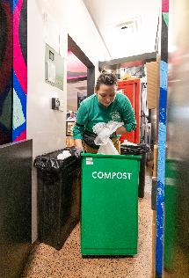
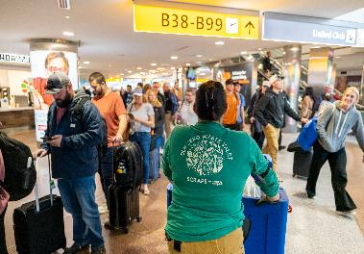
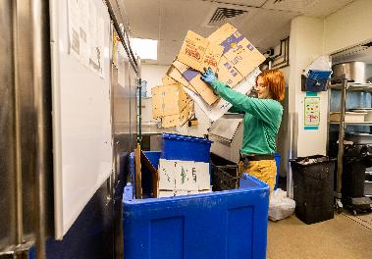
Waste Valet Service for DEN Concessions
The Waste Valet team will work with DEN concessions to transport recyclable and compostable materials to designated disposal areas. In addition, the team will provide staff education on effective waste sorting practices. Launched initially on Concourse B in Spring 2024, the program will now expand to include Concourses A and C.
​KEY INFORMATION ​
Anticipated Advertisement Date: January 2026
Estimated Project Value: $10M
Small Business Program Goal: None
Key Scope/Industry:​ Proven experience working with food and beverage (F&B) operations and expertise in recycling and composting.
Project Manager​: Alexa Rosenstein| alexa.rosenstein@flydenver.com
Notes:
45- 60 Seconds Max

Slide 41

DEN Procurement
Contract Types:
Competitive: Professional Services, Construction, Revenue Opportunities
Non-Competitive: Sole Source, Professional Preference, Amendments, Grants, Revenue Agreements
Task Orders:
Supports both competitive and non-competitive processes
Governance:
City & DEN Charter, Ordinances, and Regulations
Solicitation Types:
RFP, RFQ, RFO, RFI, IFB, Informal Competitive Procurement
Fast-Track Procurement Pilot
Goal: Increase agility by eliminating non-mandated steps
Shortened Advertisement: 1-week post, no pre-proposal meeting, 2-day Q&A
Streamlined Selection: 3-member panel; no interviews
Simplified Contracting: No negotiations—contract mirrors vendor proposal
Learn More: Visit our breakout room or scan the QR code to explore DEN’s procurement process on our website.
Notes:
45- 60 Seconds Max

Slide 42
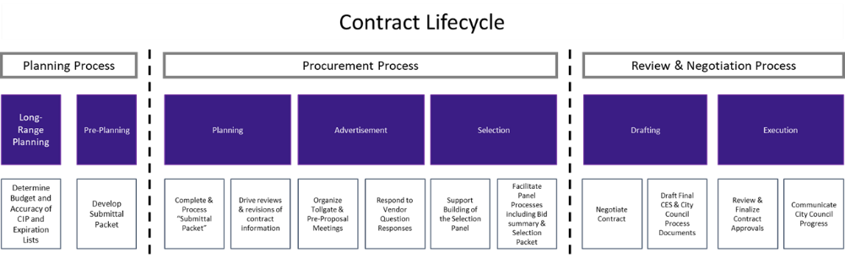
DEN Procurement – Contract Lifecycle
Active DEN Procurements & Solicitations are available on BidNet: https://www.bidnetdirect.com/colorado/cityandcountyofdenverdepartmentofaviation
  Important Dates:
    Published/Advertised Date
    Proposal Due Date
  Important Information:
    Pre-proposal meetings outlining project details
    Proposal Narrative Contents & Evaluation Criteria

Slide 43
Changes to DBE and ACDBE Programs
Effective October 3, 2025:
  Interim Final Rule (IFR) removed sex and race-based presumptions of disadvantage
  Every ACDBE and DBE firm must submit a Personal Narrative (PN) and Personal Net Worth (PNW) statement to their Jurisdiction of Certification (JOC) for reevaluation
  Colorado UCP Submission Date: January 16, 2026
  Interstate firms must reapply once they have been reevaluated by their JOC
  No counting or goal setting until entire Colorado UCP reevaluation is complete
  No impact to local programs!
Notes:
45- 60 Seconds Max

Slide 44
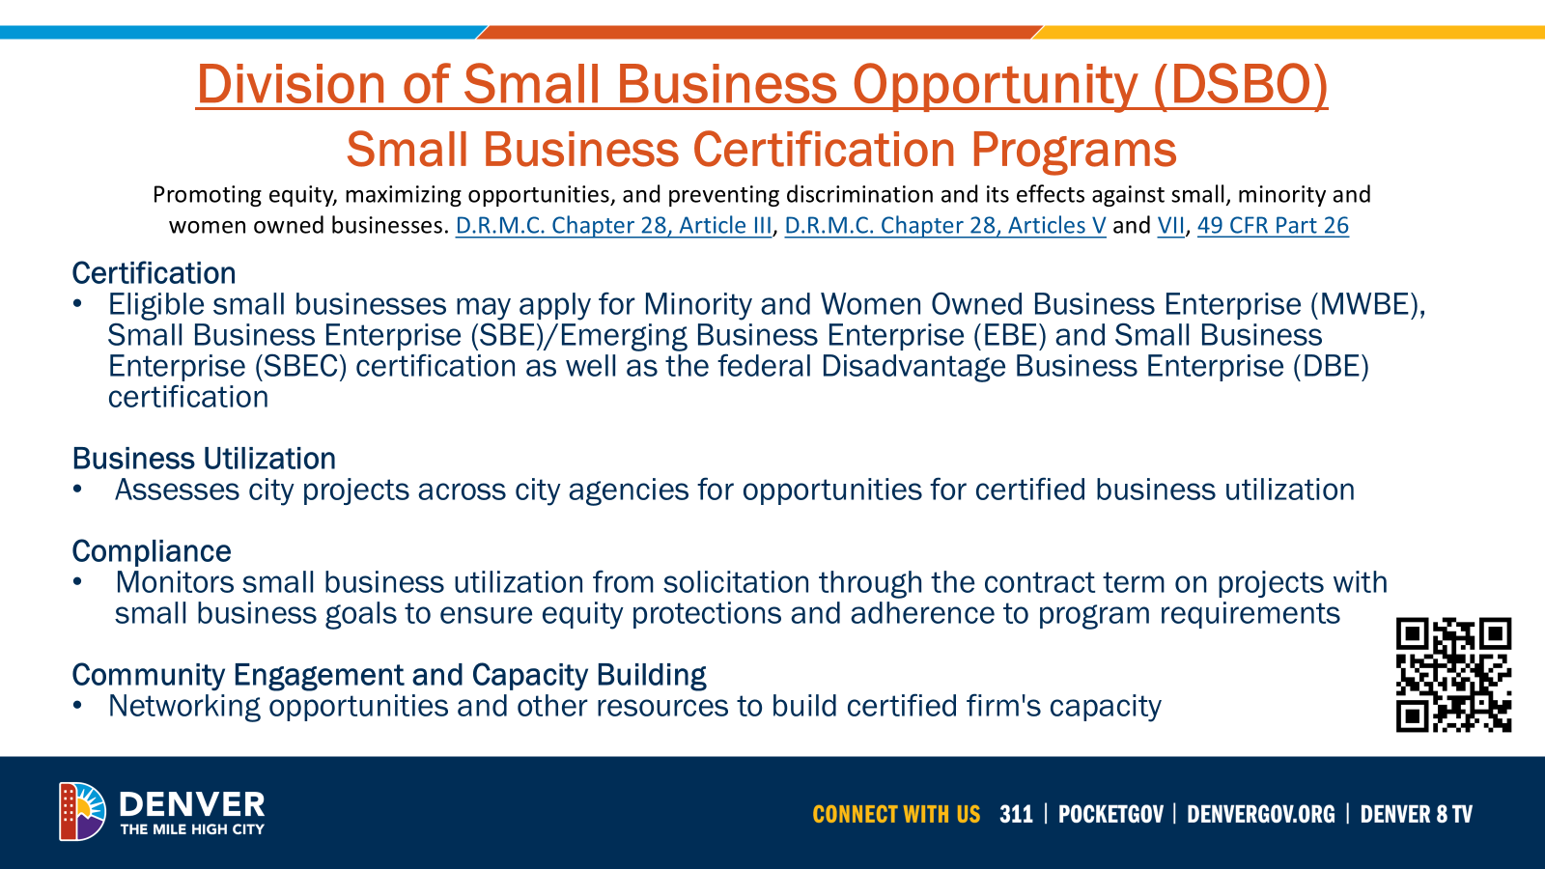
Division of Small Business Opportunity (DSBO)

Slide 45

General Services- Purchasing Division
Procures goods and related services (excludes construction/design) using competitive bidding and open market methods. Follows City Charter, D.R.M.C., and Fiscal Accountability Rules.
Key Roles: Manages bids, contracts, assets, surplus sales, vendor relations, and sustainable purchasing.
Vendor Support:
  Uses Rocky Mountain E-Purchasing System (BidNet).
  Offers bid tools, updates, and resources on its website.
  Sends weekly notices on bids, events, and opportunities.
  Join the vendor list by completing the Purchasing Communication Form.
Upcoming Vendor Event
Learn about Denver agencies, procurement processes, and networking opportunities.
Open to providers of goods, services, and construction.
To learn more, visit me in the breakout room and scan the QR code.
Notes:
45- 60 Seconds Max
General Services Purchasing – What We Do
We handle the purchase of goods and services (except for construction and design) through competitive bidding and open market methods.
Everything we do adheres to city rules and guidelines to ensure fairness and accountability.
Our primary responsibilities include managing bids and contracts, tracking assets and surplus sales, collaborating with vendors, and promoting sustainable purchasing practices.
If you’re a vendor, all opportunities are posted on BidNet, the Rocky Mountain E-Purchasing System.
You’ll also find bid tools, updates, and helpful info on our website.
We send weekly emails with new bids, events, and important opportunities.
To learn more, visit me in the breakout room and scan the QR code.

Slide 46

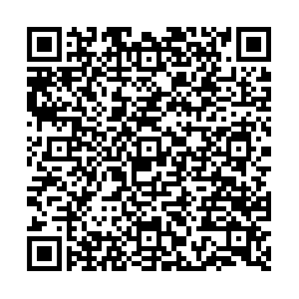
Denver Construction Careers Program (DCCP)
Overview
Workforce Ordinance Applies To:
Contracts/work orders ≥ $10M, advertised/issued after May 30, 2025
On-call/task orders evaluated individually
Contractors must sign a Workforce Commitment Form
Key Percentage Requirements
Priority Areas: Track/report hours worked by residents from DCCP-identified priority neighborhoods
Pre-Apprenticeship Grads: Track/report hours worked by grads from DCCP-approved programs
Veterans: Track/report hours worked by veterans
Registered Apprenticeships: Track/report hours by workers in registered apprenticeship programs
including first-year and target category registered apprentices
Reporting & Enforcement
LCPtracker is used to track and submit data
DCCP monitors compliance; non-compliance may lead to penalties
Get Involved
Jobseekers, employers, and community orgs — connect with DEDO & DCCP to grow Denver’s construction workforce.
Why It Matters
Meets high demand for skilled construction workers
Builds career pathways for Denver residents
Aligns workforce with city infrastructure investments
To learn more, visit me in the breakout room or scan the above QR code.
Notes:
45- 60 Seconds Max

