Slide 1
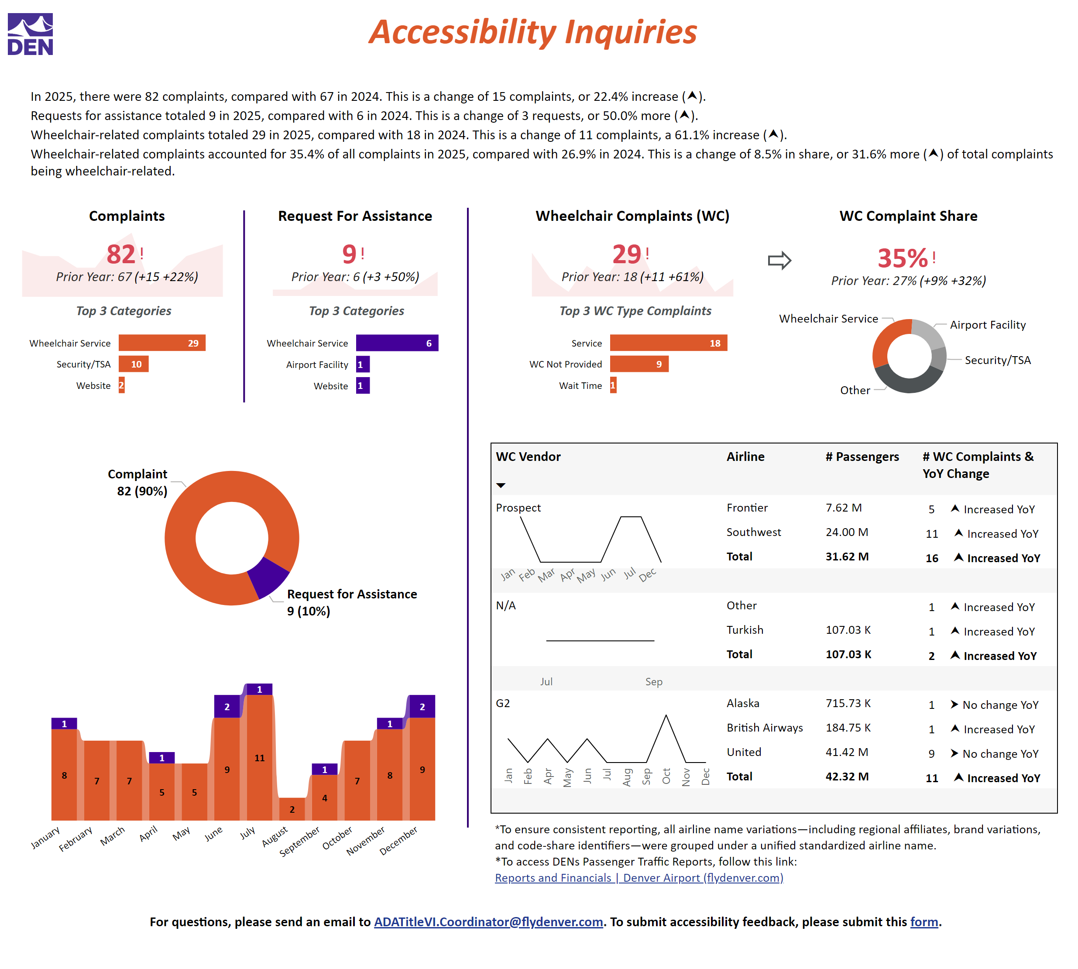
Overview
Notes:
Title
No alt text provided
Top 3 Categories
Top 3 complaint categories are Wheelchair Service with 29 complaints, Security and TSA with 10, and Website with 2.
Contact Info
No alt text provided
By Monthly Distribution
Bar chart showing monthly totals from January to November, with higher volumes in June and July and the lowest volume in August.
Top 3 WC Type Complaints
Bar chart showing Top 3 wheelchair service complaints by type: Service related with 18 complaints, Wheelchair was not Provided with 9, and Communication with 1.
Collection of Airline Data
No alt text provided
DEN Logo
No alt text provided
Top 3 Categories
Top 3 assistance categories are Wheelchair Service with 6 requests, Airport Facility with 1, and Website with 1.
Wheelchair Complaints (WC)
Wheelchair complaints: 29 total, up from 18 last year, an increase of 61 percent.
areaChart
No alt text provided
Complaints
Complaints: 82 total, up from 67 last year, an increase of 22 percent.
areaChart
No alt text provided
Request For Assistance
Requests for Assistance: 9 total, up from 6 last year, an increase of 50 percent.
lineChart
No alt text provided
shape
No alt text provided
shape
No alt text provided
WC Complaint Share
Wheelchair-related complaints account for 35 percent of all complaints, up from 27 percent last year.
Summary:
No alt text provided
lineChart
Line chart showing monthly prospect activity from January to December, with fluctuations throughout the year and a peak in October.
lineChart
Line chart showing a flat trend between July and September.
lineChart
Line chart showing values by month from January to December, with a decline in early months, a rise mid-year, and a slight decrease toward year end.
pivotTable
No alt text provided
donutChart
Donut chart showing complaints make up 90 percent of contacts and requests for assistance make up 10 percent.
shape
No alt text provided
donutChart
Donut chart showing wheelchair service as the largest share of complaints, compared with airport facility, security and TSA, and other categories.

