Slide 1
Snack &
Souvenir Expo
May 19, 2026
Notes:
Welcome Remarks – Michelle

Slide 2
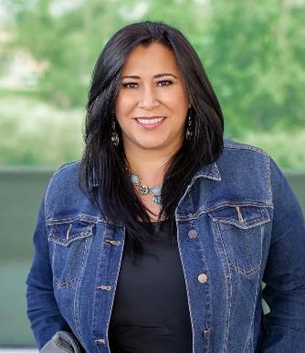
WELCOME
Michelle Sandoval
Director of Strategic Outreach & Engagement

Slide 3
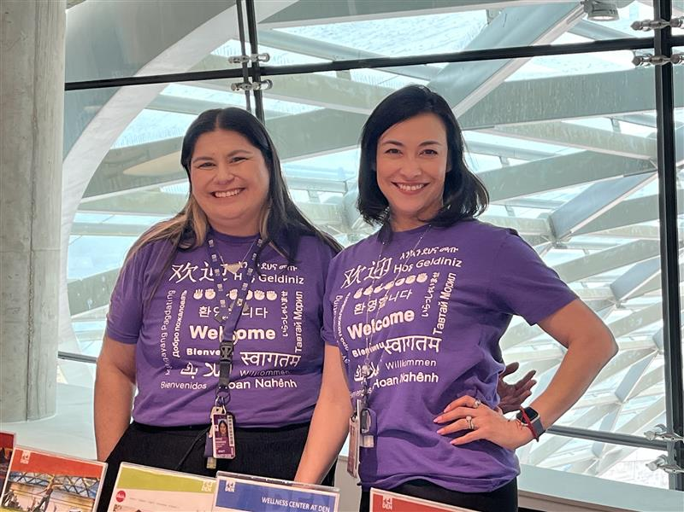
HOUSEKEEPING
Restrooms
Airport Environment
Alarms
Emergency Exits
Please see event staff with any questions.
Notes:
DEN staff identification
If there is an emergency or you need help, please notify DEN staff. They’re easy to spot in purple and black T‑shirts.
Emergency exits
Your nearest emergency exits are just through the doors and on either side behind you.
Emergency assistance
For immediate assistance, contact Airport Operations at 303-342-4211.
Restrooms
Restrooms are located near the escalator, just past the Glass Double Doors.
Airport Reminder
This is an active working office space, so we ask that everyone stay within the designated event areas. Some sections of the space are reserved for employees and not open to guests.
This is an active airport environment. Always keep personal belongings with you and report unattended items to 303-342-4211 and to a member of our team in the purple/black volunteer t-shirts.

Slide 4
AGENDA
9:30 a.m. | Welcome Remarks
9:40 a.m. | Small Business Spotlight
9:45 a.m. | Concessions Masterplan
10:05 a.m. | Certification Overview
10:10 a.m. | Business Development Training Academy
10:15 a.m. | Supplier Opportunities Panel
11 a.m. | Expo Floor Open
12:30 p.m. | Kiosk Workshop
2:30 p.m. | Expo Ends
Notes:
Michelle

Slide 5
EXPO NAVIGATION WITH WHOVA
Download Whova on iOS or Android
Find the Expo: Search “Snack & Souvenir Expo 2026”
Create Profile and start connecting
Save Contacts by July 21, 2026
Whova Co‑Pilot: Meet attendees, partners, buyers
Engage: Message and take notes
Notes:
Michelle

Slide 6
What to Expect
Notes:
Michelle

Slide 7
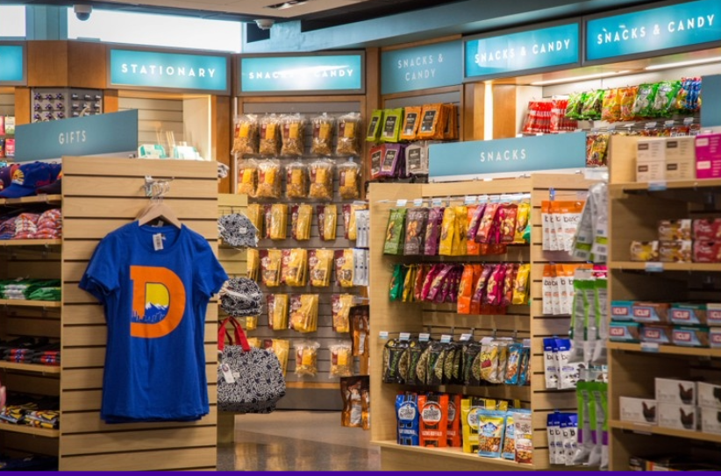
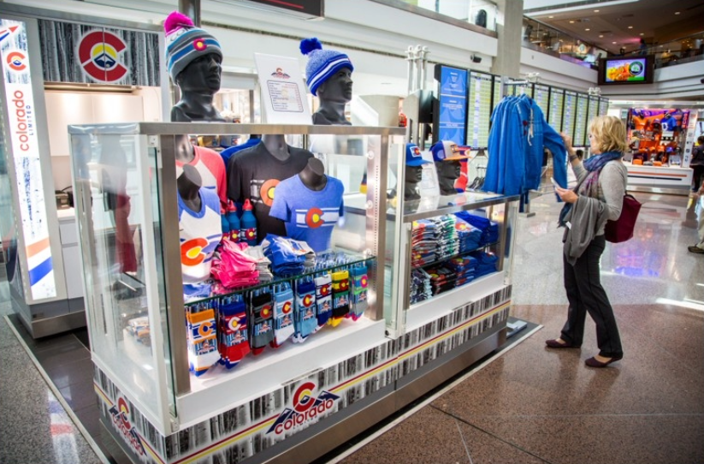
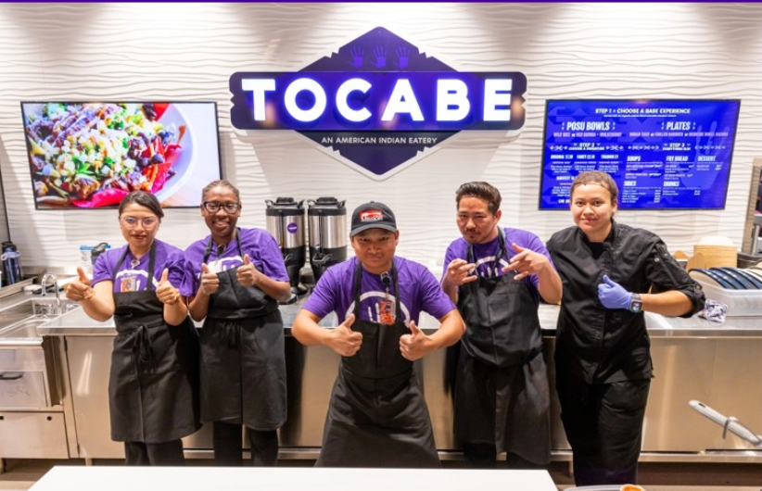
CHOOSE YOUR PATH TO SUCCESS
^{Product on a Shelf}
^{Kiosk Operator}
^{Store Front Operator}
^{Resources}
Training · Certification · Outreach Events · Newsletters · Resources

Slide 8
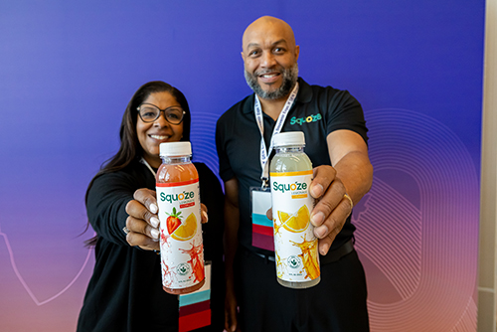
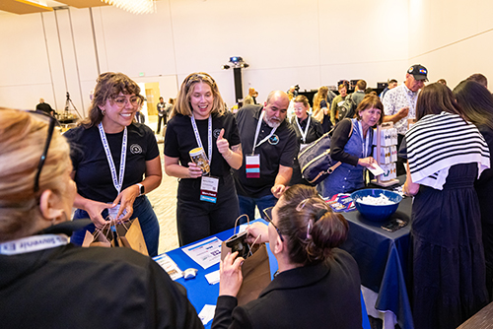
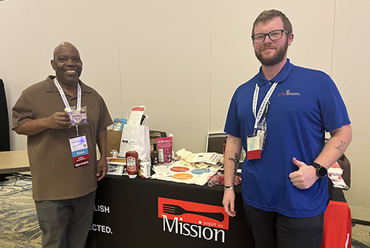
HOW TO MAXIMIZE YOUR TIME TODAY
^{Retail Ready Starts Here}
^{Shelf-ready product}
^{30‑second product pitch}
Highlight - locally relevant and scalable
Be ready to discuss - capacity and distribution capabilities
^{Make the Right Connections}
^{Introduce yourself}
Ask for feedback on pricing, packaging, shipping
^{Take notes}
^{Exchange information}
^{From Expo to DEN Shelves}
Identify next steps with interested buyers
Refine your product based on feedback
Submit any requested materials quickly
^{Follow up}

Slide 9



OUTREACH EVENTS
Taking Flight at DEN
2nd Thursday of each month
1-2:30 p.m.
Meet the Primes
3rd Thursday – Bi-Monthly
Jan., March, May, July, Sept. Nov.
1-2:30 p.m.
Navigating the ACDBE Program
3rd Thursday – Bi-Monthly
Feb., April, June, Oct., Dec.
1-2:30 p.m.
Notes:
Michelle
We offer three recurring virtual events to connect businesses with opportunities at DEN:
Taking Flight at DEN
When: Monthly, second Thursday, 1–2:15 p.m.
A high-level update on upcoming DEN business opportunities, ideal for new and long-time vendors. Learn about DEN’s latest initiatives.
Meet the Primes
When: Bimonthly, third Thursday, 1–2:15 p.m.
Connect with prime contractors across sectors like construction, concessions, rental cars, airlines, and more. Learn about active and upcoming procurement opportunities.
Navigating the ACDBE Program Series
When: Bimonthly, third Thursday, 1–2:15 p.m. (alternates with Meet the Primes)
Provides guidance for small businesses in food, beverage, retail, and traveler services on qualifying for and thriving in the ACDBE program.
Register for all events on our website. These sessions are free, virtual, and a great way to stay connected with DEN.

Slide 10
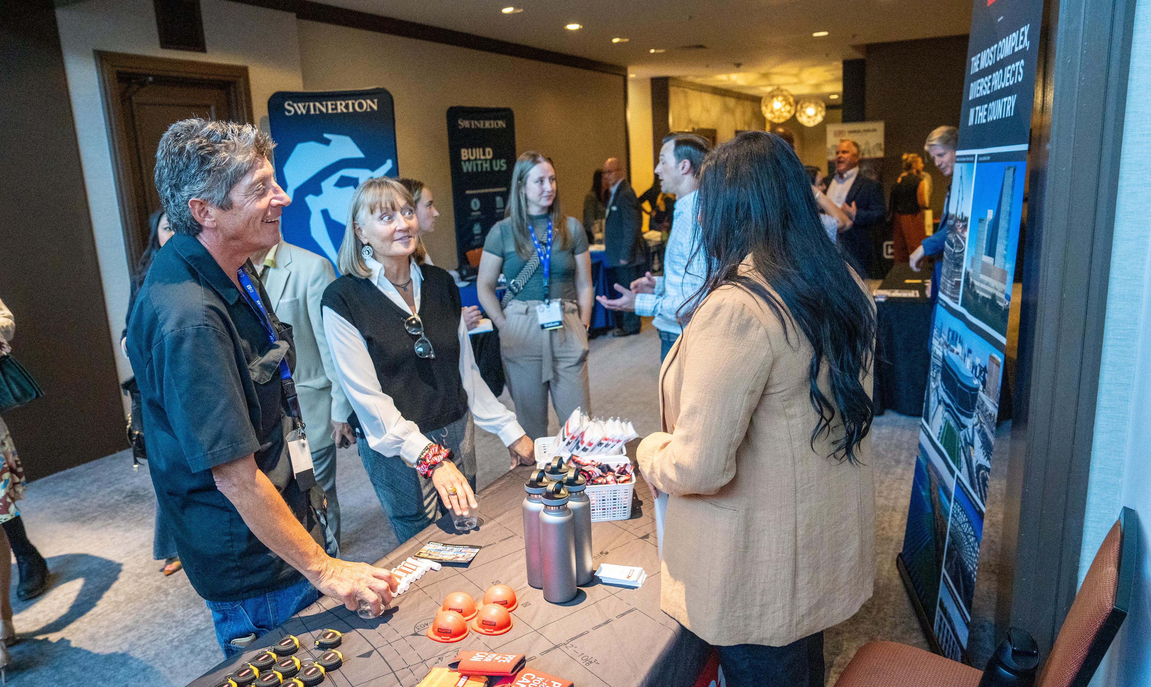
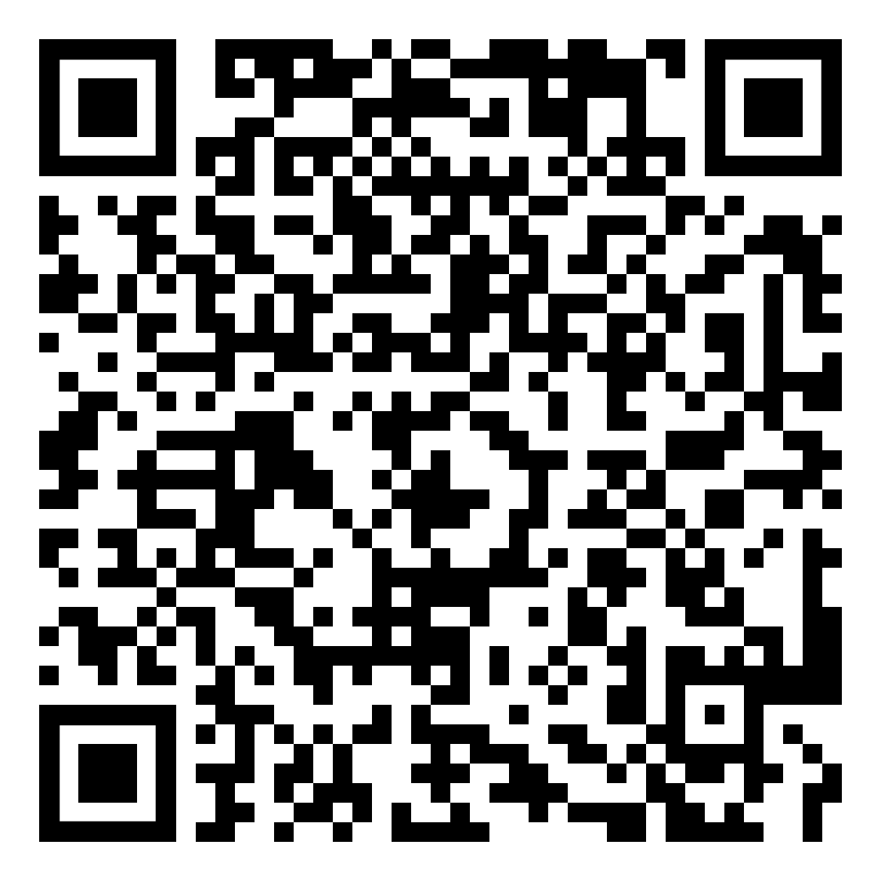
PROCUREMENT TRADESHOW
August 20, 2026
Hotel Transit Center - Level 4, CEEA Facility
Meet with prime firms in:
Concessions, Architecture, Engineering, Construction, Airlines and more
DEN Project Managers
Notes:
Michelle - Save the Date – August 20 Procurement Tradeshow
Join us on August 20 at the CEEA HTC Level 4 - Westin Denver International Airport for our next major business engagement event.
This tradeshow is designed to build connections between:
Denver International Airport
The City and County of Denver
Prime contractors
Small businesses
Resource partners
A key opportunity to explore upcoming projects, meet decision-makers, and grow your network.
Sign up for our newsletter to receive information and updates.
General registration opens summer 2026—don’t miss it!

Slide 11


COMMUNITY PANELIST PROGRAM
Prime Experience
Evaluation Insight
DEN Values
Interview Practice
Scan QR Code
Notes:
Michelle
Consider volunteering as a Community Panelist for an upcoming procurement evaluation.
This is a valuable opportunity to gain insights into the evaluation process and enhance future proposals. Simply scan the QR code to learn more.

Slide 12



STAY CONNECTED WITH DEN
Follow us on our socials
Share your photos with us
Scan the QR Codes to signup for:
  Business Connect newsletter
  Do Business With DEN database
DENAirport
DENAirport
denverinternationalairport
DEN Department of Aviation
Business Connect Newsletter
Do Business With DEN
Notes:
Michelle
Stay Connected with DEN
Your journey with DEN doesn’t end at the Snack & Souvenir Expo—keep soaring with us!
Follow DEN on social media for updates, news, and opportunities.
Sign up for DEN’s weekly newsletter for info on:
Upcoming events
Bid opportunities
Business resources
DEN is committed to equitable engagement, providing year-round access to resources and events.

Slide 13
George’s Gourmet Pound Cakes
Small Business Spotlight
Notes:
Michelle - We’re excited to begin today’s program by hearing from the leaders behind DEN’s award-winning concessions program—visionaries who are shaping the future of dining, retail, and guest experience at one of the busiest airports in the country.
Please join me in welcoming the DEN Concessions leadership team:
Christopher Herndon, CHIEF COMMERCIAL OFFICER, oversees the airport’s entire commercial strategy—from concessions to parking and revenue development—and plays a key role in long-term planning and equity-driven growth.
PAM DECHANT, SENIOR VICE PRESIDENT OF CONCESSIONS, leads the strategic direction of DEN’s concessions program. With a strong background in hospitality, Pam focuses on innovation, diversity, and delivering an exceptional traveler experience.
BRANDEN SOWERS, SENIOR DIRECTOR OF CONCESSIONS, manages the daily operations, tenant relations, and program execution—ensuring partnerships run smoothly and that the concessions program remains efficient, dynamic, and responsive.
Together, this team is driving DEN’s vision for a more inclusive, innovative, and customer-focused concessions experience.
Please help me welcome Penny, Pam, and Branden.

Slide 14
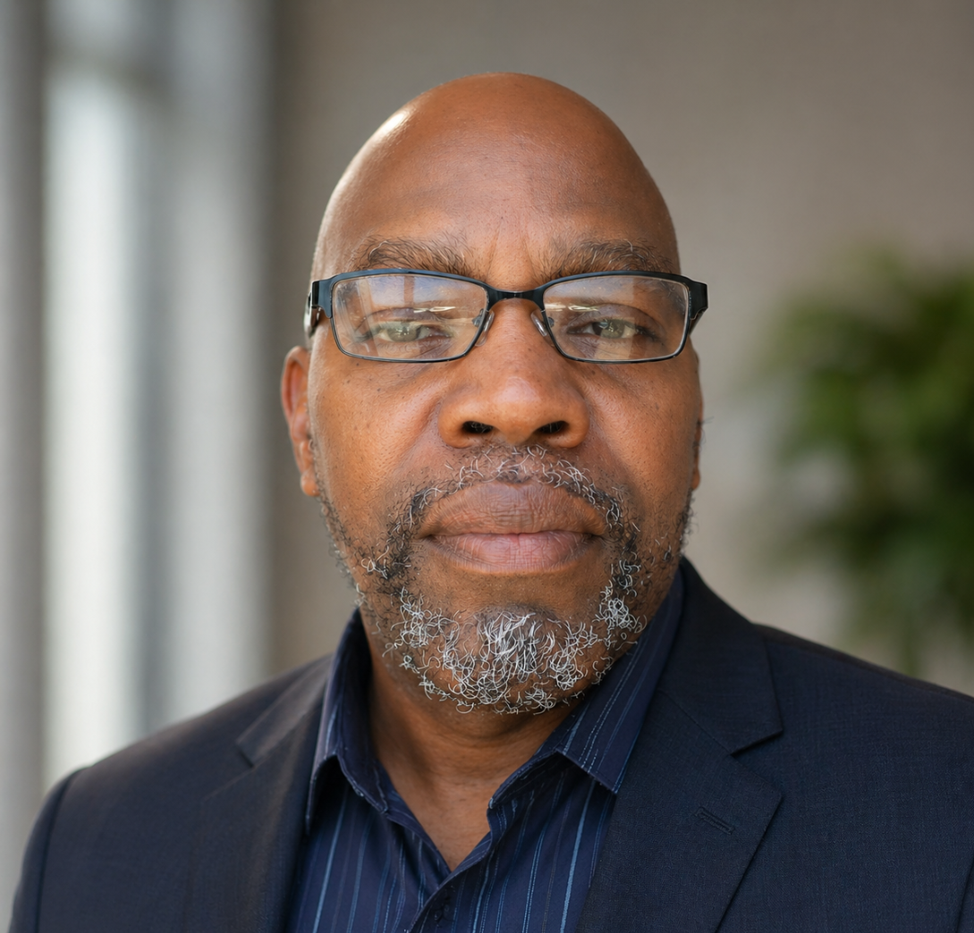
SMALL BUSINESS SPOTLIGHT
George Baines
Founder
George’s Gourmet
Poundcakes

Slide 15
DEN Concessions
Blueprint for the Future: Exploring the Concessions Masterplan
Notes:
Michelle - We’re excited to begin today’s program by hearing from the leaders behind DEN’s award-winning concessions program—visionaries who are shaping the future of dining, retail, and guest experience at one of the busiest airports in the country.
Please join me in welcoming the DEN Concessions leadership team:
Christopher Herndon, CHIEF COMMERCIAL OFFICER, oversees the airport’s entire commercial strategy—from concessions to parking and revenue development—and plays a key role in long-term planning and equity-driven growth.
PAM DECHANT, SENIOR VICE PRESIDENT OF CONCESSIONS, leads the strategic direction of DEN’s concessions program. With a strong background in hospitality, Pam focuses on innovation, diversity, and delivering an exceptional traveler experience.
BRANDEN SOWERS, SENIOR DIRECTOR OF CONCESSIONS, manages the daily operations, tenant relations, and program execution—ensuring partnerships run smoothly and that the concessions program remains efficient, dynamic, and responsive.
Together, this team is driving DEN’s vision for a more inclusive, innovative, and customer-focused concessions experience.
Please help me welcome Penny, Pam, and Branden.

Slide 16
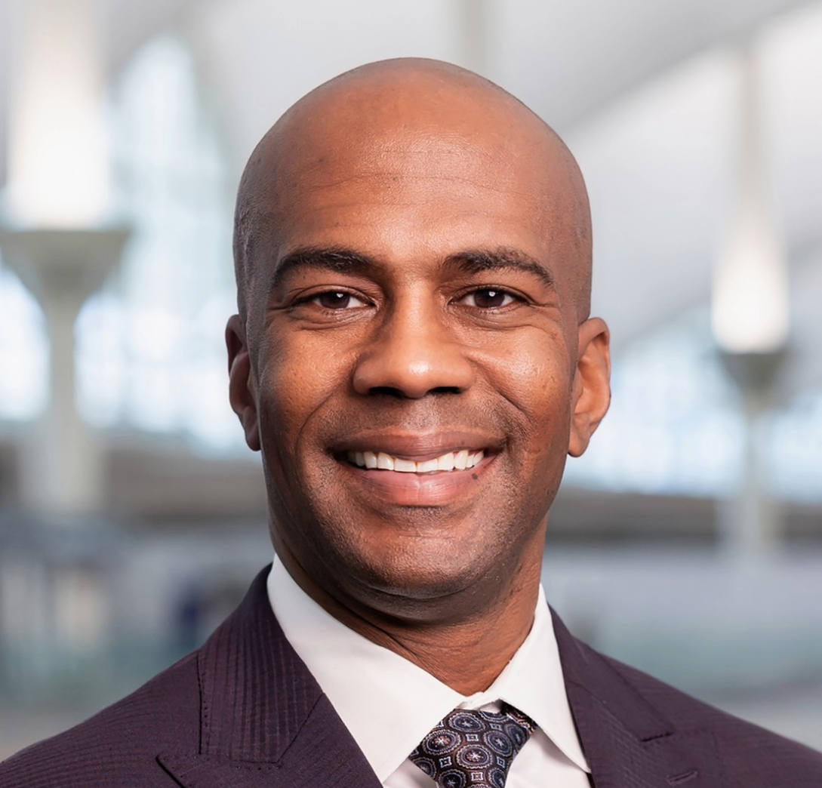
CONCESSIONS MASTERPLAN
Christopher Herndon
Chief Commercial Officer
DEN Concessions
Notes:
What a great group in this room the right brands, the right buyers, the right conversations. This is exactly where we want to be.
I’m Chris Herndon, the new Chief Commercial Officer at Denver International Airport, and I'm genuinely excited to be building something here with all of you.
DEN is one of the busiest airports in the country, and our concessions program is one of the most visible retail stages you can stand on. The travelers coming through our doors every single day are looking for something great, and we want that to be your product.
To give you a real sense of the opportunity in front of us, let's take a quick look at DEN by the numbers.

Slide 17
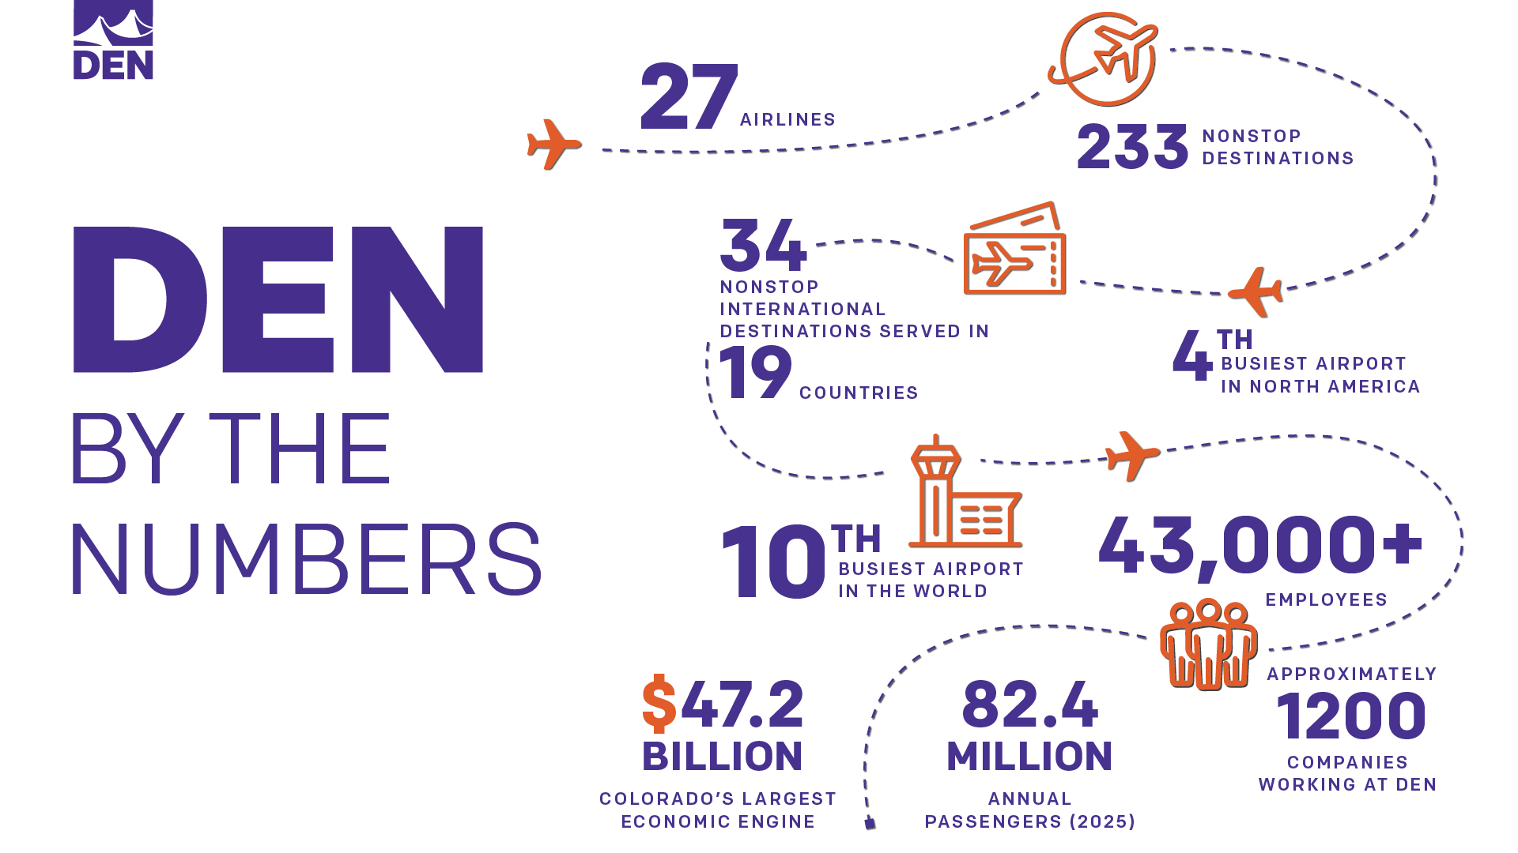
Den by the numbers
Notes:
Let's talk about scale. DEN is the 4th busiest airport in North America and the 10th busiest in the world. We have 27 airlines serving 233 nonstop destinations including 34 international destinations across 19 countries.
In 2025, we expect 82.4 million passengers to walk through our doors. That's 82.4 million opportunities to put your product in someone's hands.
With over 43,000 employees and approximately 1,200 companies operating on campus, DEN is also Colorado's largest economic engine generating $47.2 billion for our state.

Slide 18
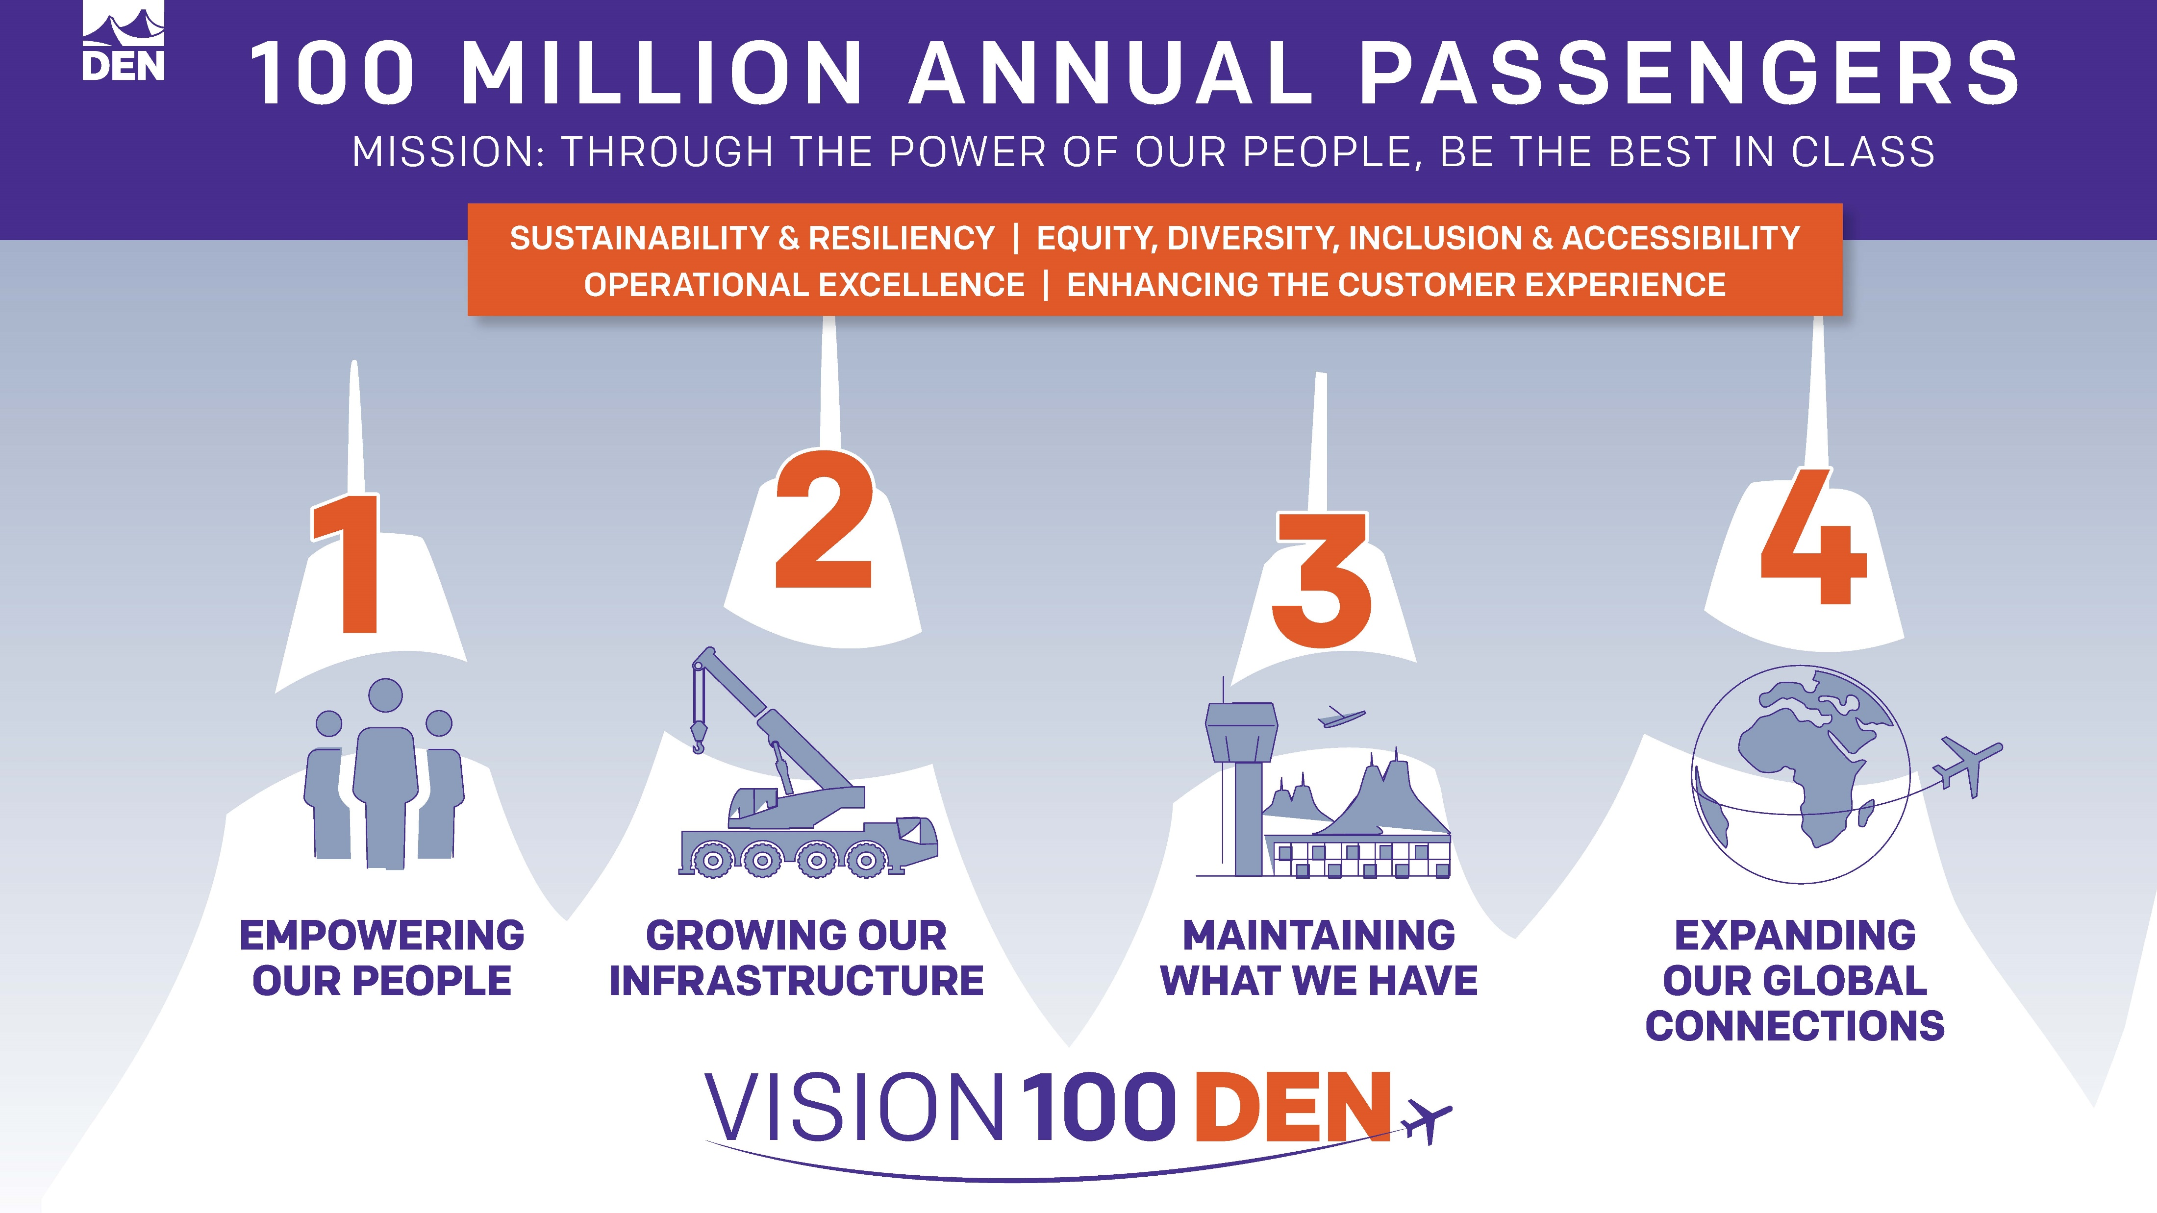
DEN Vision 100
Notes:
To address that continued growth, we developed a strategy to get the airport ready to serve 100 million annual passengers.
We call that strategy Vision 100
In orange you see our guiding principles; they describe how we behave as we do our work
Vision 100 features four pillars of activity that span our operations
We need to improve in each of these areas to achieve Vision 100

Slide 19
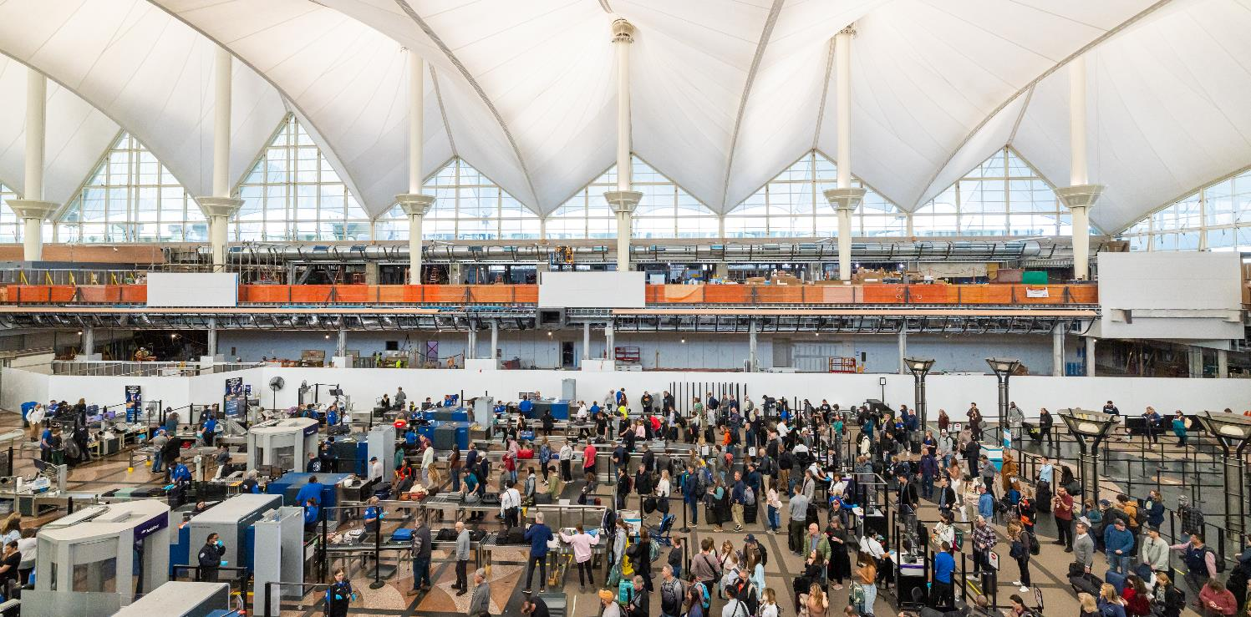


VISION 100 AND OPERATION 2045
Phase I
Phase II
DEN’s strategic plan to effectively serve 100 million passengers
DEN will turn 50 years old requiring an even greater emphasis on maintenance and expanded infrastructure to serve 120+ million passengers
1995
50 MAP
2023
77.8 MAP
2027
100 MAP
2027
100 MAP
2045
120+ MAP
2022
69.3M
2032
100M*
2045
120+M
*FAA approved projection
Notes:
Here’s another way to look at how Vision 100 and Operation 2045 work together to keep DEN prepared
This timeline spans from current-day to 2045 when DEN will serve over 120 million annual passengers

Slide 20

COMMITMENT TO SMALL BUSINESS
  Cap on RFP submittal and design size to promote a level playing field
  New Small Business Enterprise Concessions (SBEC) opportunities to limit the competition pool to same-sized companies
  Added EDIA language to competitive solicitations
  A required EDIA Plan submission as part of proposals that will be scored and factored into each proposal’s final assessment
Notes:
One thing I want to be clear about DEN is serious about creating real opportunities for small businesses, not just saying we are.
We've put a cap on RFP submittal and design size to level the playing field.
We've created dedicated Small Business Enterprise Concessions opportunities that limit the competition pool to same-sized companies, so you're not up against a corporate giant on day one.
We've also added EDIA language to our competitive solicitations, and any proposal submitted must include an EDIA Plan which is scored and factored directly into the final assessment.
We want the best businesses in this room, and we've built the process to give you a fair shot at getting here.
I’d like to next hand it over to Branden Sowers, Sr. Director of Concessions to share more about the Concessions Master Plan and our upcoming Concession Opportunities.

Slide 21
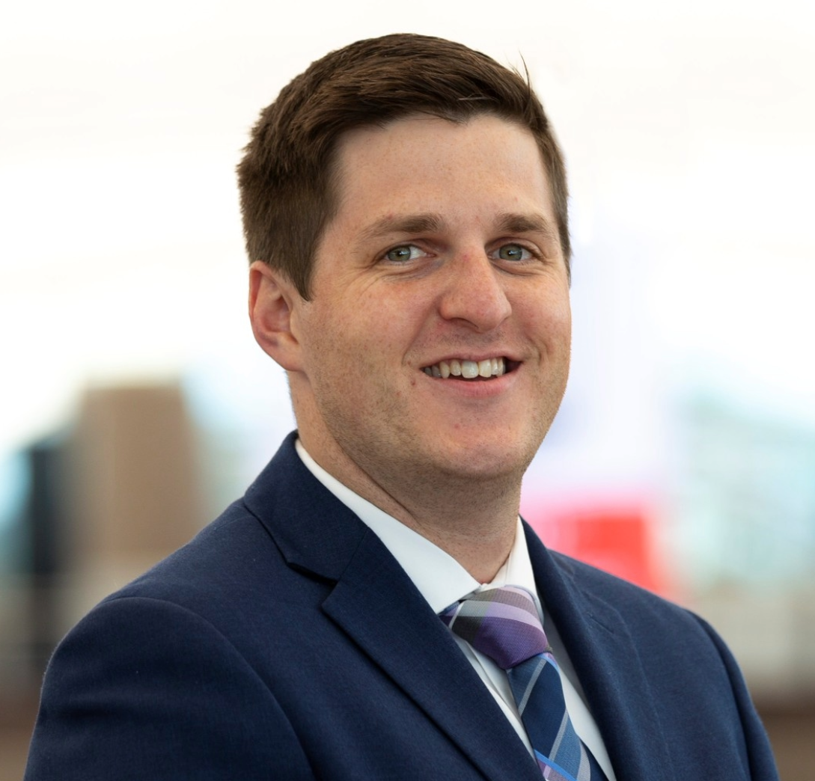
Branden Sowers
Senior Director
DEN Concessions
CONCESSIONS MASTERPLAN

Slide 22
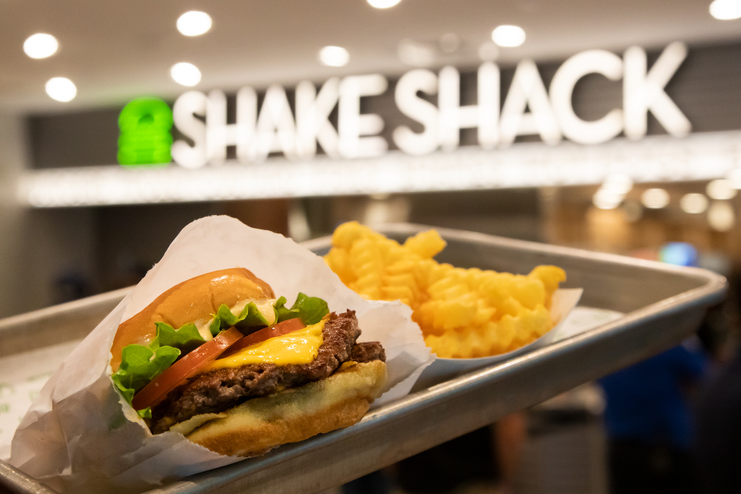
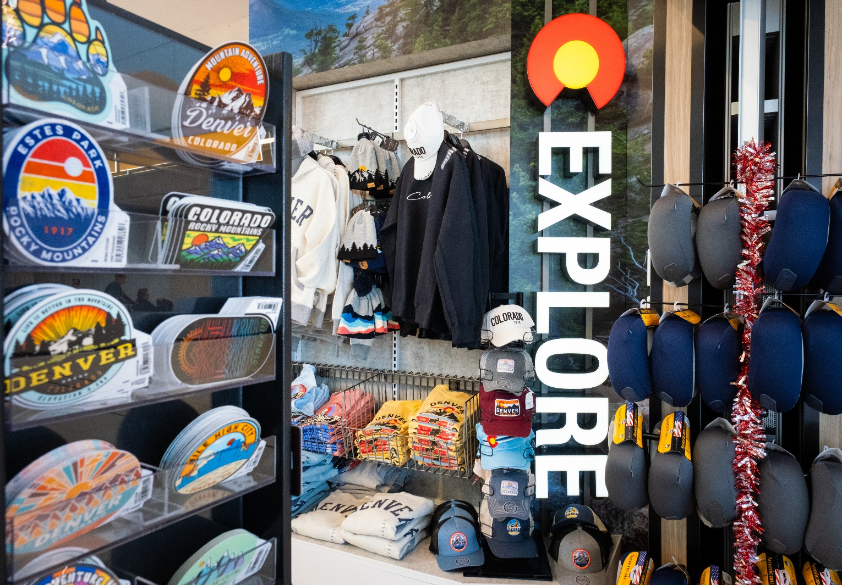
CONCESSIONS 2025
200+
Shopping and
dining options
~250k SF
Concession space
$665M
Gross
sales in 2025
$16.13
SPE for 2025
Notes:
Oversee 287+ contracts

Slide 23

IMPACT OF GROWTH
Crowding, long lines and lack of options hurting revenue performance
Passenger movement becoming more difficult​
Concessions are undersized for passenger volumes​
Decrease in customer satisfaction when our guests cannot get their needs met

Slide 24
OUR SOLUTION: Concessions Master Plan
A road map to efficiently meet airport growth and serve 100 million passengers.
Master Plan Functions
Adding square footage
Transforming layout of current space
Outlines core commercial planning principles
Strategy for each category
Master Plan Goals
Create a true “DEN | Colorado Experience”
Make Every Moment Count
Operational Excellence
Commercial plans that reflect and support small, local, and ACDBE businesses
Notes:
In 2019, we launched our concessions master plan, a road map to efficiently meet the fast-approaching 100Million passengers
Nearly two years of development and data analysis were used to build our future strategy and master plan
Our master plan has 2 major functions
It addresses issues related to adding square footage and transforming layout of current space
It outlines core commercial planning principles used to redevelop the entire program
The needs of small, local, and ACDBE businesses are part of the foundation of our commercial plans
NEXT SLIDE

Slide 25

CORE PLANNING PRINCIPLES
Each concourse should have its own personality and characteristics
1
Passenger flow & journey should be intuitive
7
2
Commercial zoning in the center cores and sub cores
Concessions Master
Plan
Views and natural light should be leveraged wherever possible
6
3
Plan should add more seating in and around the commercial areas
5
4
Master Plan should support the needs of small, local, and ACDBE businesses
Design should encourage passengers to dwell in commercial spaces
Notes:
With such a massive program filled with nuanced details in every area, there are some basic planning principles we use as we aim for a consistent, intuitive journey for our guests
7 of our core planning principles are listed here as an example of the type of filter we use when making decisions and ask that respondents to these RFPs use as well
(examples) - 1-7 – core planning principles

Slide 26
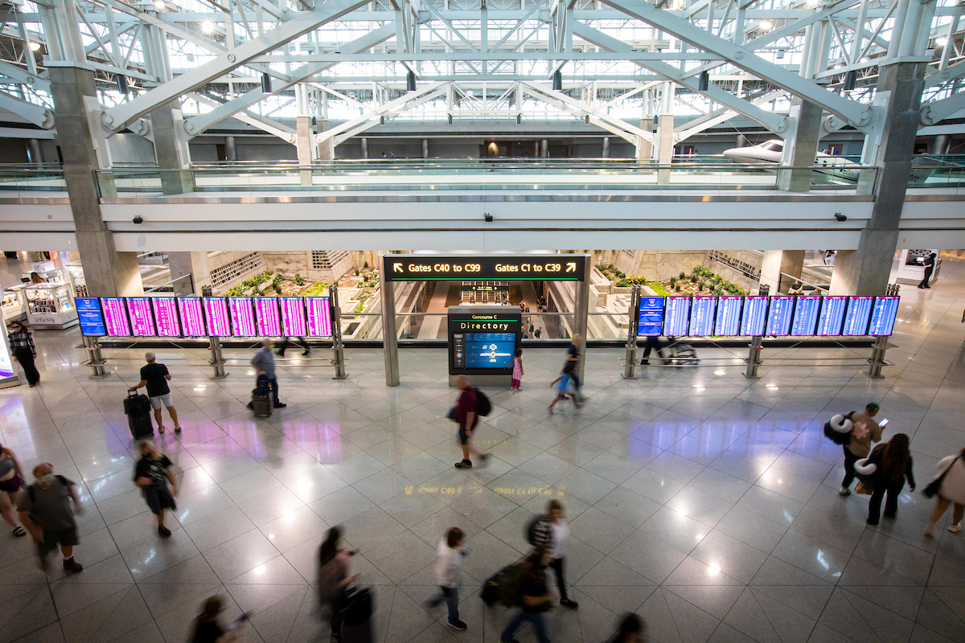
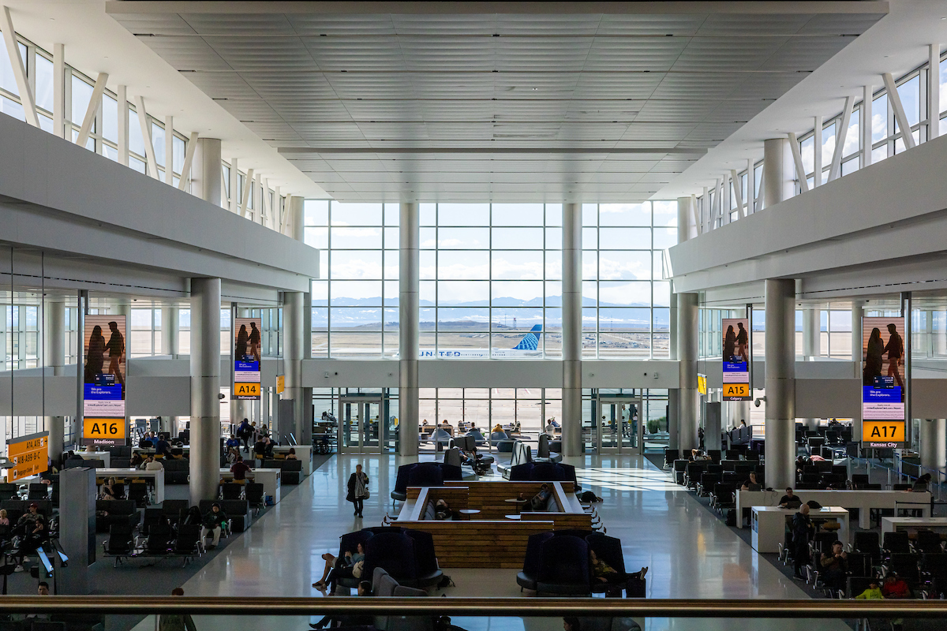
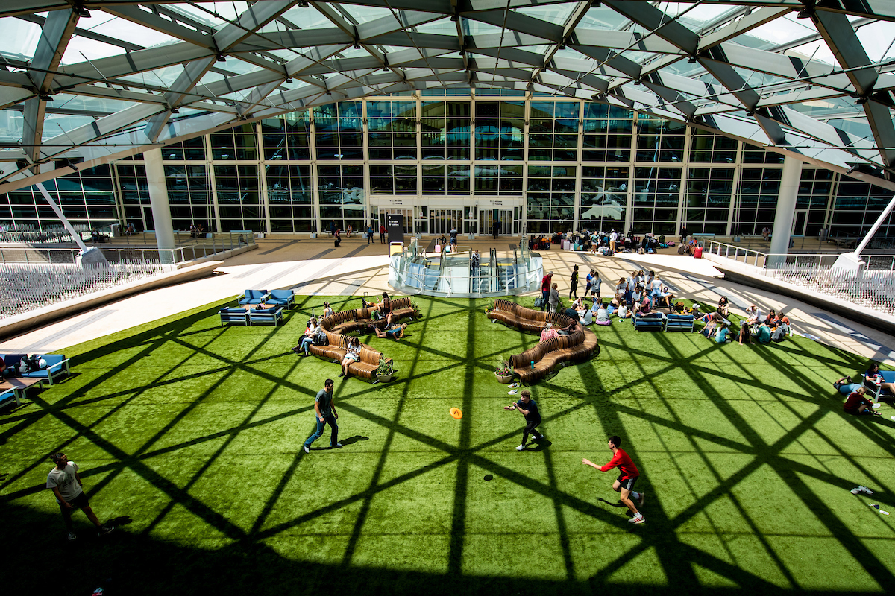
COMMERCIAL PRINCIPLES
DRIVERS OF EXPERIENCE AND COMMERCIAL PERFORMANCE
Flow, dwell, journey
Manage flow,
orientation, and dwell
Layout & design
Configure
the space to optimize value potential
Environment and
sense of place
Create a unique
DEN experience

Slide 27
FUTURE VISION – EXAMPLE OF COMMERCIAL PRINCIPLES

Slide 28




CONCESSIONS MASTER PLAN ACHIEVEMENTS
Choice and interest in Retail and Food / Beverage
“Distinctly Colorado” Experience
Opportunities for small / medium businesses
Balanced with larger packages for economy of scale
Adding choice = increase in satisfaction
Bringing more local and regional brands into the airport
Creating space for entry into the DEN market
Allows for large investments and delivers a world-class experience
28
Notes:
Since 2019 when we launched the Master Plan we’ve opened more than 100 new locations, just last year we opened 30 new concepts, and this year we are on pace to open an additional 29 new locations.
When we launched the master plan in 2019, we had only about 20% local F&B Concepts, we now have over 40% local F&B Concepts which has emensly diversified the entire program.

Slide 29
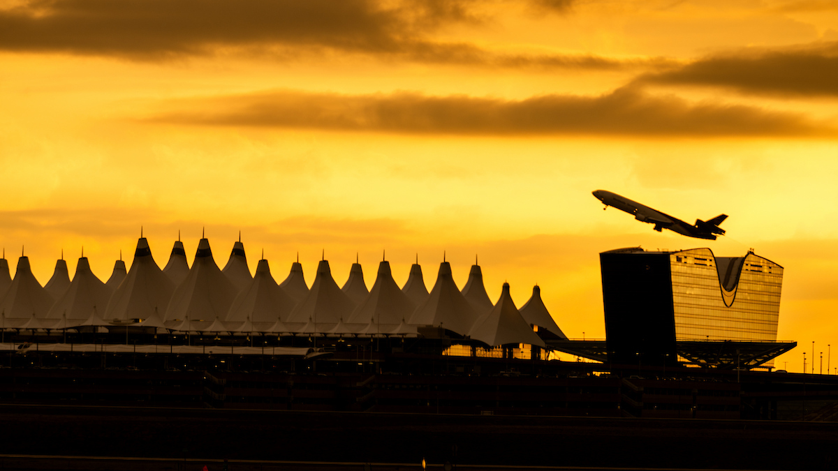
FUTURE OPPORTUNITIES
  Over the next three years DEN will be releasing over 30+ locations for RFP.
2026
2027
2028
21
8
9
*Dates and opportunities are subject to change

Slide 30
2026 RFP LOCATIONS – Q3
Concourse | Concept Type | Location | Sq Ft
Concourse A | QSR Burger | Concourse A Center Core | +/- 1,600
Concourse A | SBEC Snack Kiosk | Concourse A East Sub Core 1 | +/- 600
Concourse A | Common Use Lounge | Concourse A East Sub Core 1 Mezzanine | +/- 12,000
Concourse A | Casual Dining w/ Bar | Concourse A Mezzanine NW Quadrant | +/- 4,900
Concourse A | QSR Mexican | Concourse A Mezzanine NW Quadrant | +/- 1,400
Concourse B | QSR Burger | Concourse B Center Core | +/- 2,400
Concourse B | SBEC Snack | Concourse B West Sub Core 3 | +/- 930
Concourse B | Common Use Lounge | Concourse B East Regional Jet Facility | +/- 3,000
Concourse B | SBEC Snack Kiosk | Concourse B West Sub Core 1 | +/- 560
Concourse B | SBEC Coffee Kiosk | Concourse B West Sub Core 2 | +/- 480
Concourse C | QSR Pizza / Asian | Concourse C Center Core | +/- 1,000
Concourse C | QSR Burger | Concourse C Center Core | +/- 1,100
Great Hall | Landside Lounge | Great Hall Level 6 Mod 3 | +/- 1,800
*Dates and opportunities are subject to change
Notes:
Anticipating launching RFPs for 13 locations in Q3. Of which, four will be SBEC Opportunities.

Slide 31
2026 RFP LOCATIONS – Q4
Concourse | Concept Type | Location | Sq Ft
Concourse A | Travel Convenience | Concourse A West Sub Core 1 | +/- 1,900
Concourse A | Specialty Retail | Concourse A Center Core | +/- 2,500
Concourse B | F&B Marketplace | Concourse B Center Core | +/- 3,585
Concourse B | Passenger Service | Concourse B East Sub Core 3 | +/- 1,700
Concourse B | Travel Convenience | Concourse B East Regional Jet Facility | +/- 300
Concourse B | Specialty Retail | Concourse B Center Core | +/- 2,700
Concourse B | Specialty Retail | Concourse B Center Core | +/- 1,800
Concourse C | Specialty Retail | Concourse C Center Core | +/- 2,900
*Dates and opportunities are subject to change
Notes:
Anticipating launching RFPs for 13 locations in Q3. Of which, four will be SBEC Opportunities.

Slide 32
2027 RFP LOCATIONS – Q1
Concourse | Concept Type | Location | Sq Ft
Airport Wide | Luggage Cart Services | Airport Wide | Airport Wide
Airport Wide | Retail Kiosk Program | Airport Wide (40 kiosks) | 40 locations
Concourse A | Experiential Concession | Concourse A Center Core Mezzanine | +/- 1,200
Concourse B | QSR | Concourse B East Regional Jet Facility | +/- 1,700
Concourse B | Bar | Concourse B East Regional Jet Facility | +/- 300
Concourse B | Coffee Kiosk | Concourse B East Regional Jet Facility | +/- 250
Concourse B | QSR Chicken | Concourse B Center Core | +/- 1,700
Concourse B | Experiential Concession | Concourse B East Sub Core 3 | +/- 1,354
*Dates and opportunities are subject to change
Notes:
Anticipating launching RFPs for 13 locations in Q3. Of which, four will be SBEC Opportunities.

Slide 33
2028 RFP LOCATIONS – Q1
Concourse | Concept Type | Location | Sq Ft
Concourse A | Travel Convenience | Concourse A East Sub Core 1 | +/- 955
Concourse A | Snack | Concourse A Center Core | +/- 500
Concourse A | Specialty Retail | Concourse A Center Core | +/- 1,209
Concourse B | Travel Convenience | Concourse B East Sub Core 1 | +/- 918
Concourse B | Travel Convenience | Concourse B West Sub Core 1 | +/- 909
Concourse B | Specialty Retail | Concourse B Center Core | +/- 1,011
Concourse C | Travel Convenience | Concourse C East Sub Core 1 | +/- 650
Concourse C | Specialty Retail | Concourse C Center Core | +/- 919
Great Hall | Travel Convenience | Great Hall Level 5 Mod 1 West | +/- 798
*Dates and opportunities are subject to change
Notes:
Anticipating launching RFPs for 13 locations in Q3. Of which, four will be SBEC Opportunities.

Slide 34



Upcoming Small Business Event
FROM LOCAL TO LAUNCH
Thursday, July 9, 2026, 1PM – 5PM
CEEA – Denver International Airport
Ready to Grow Your Business at DEN?
Register today!
Special session focused on helping small businesses grow and succeed at the airport.
Interactive workshop included.
Gain practical insights, hear real success stories, and explore how to bring your business to DEN.
For more information contact: concessions@flydenver.com

Slide 35
Small Business Certification What is it? Do you need it?
Notes:
BRANDEN - I’m pleased to introduce Sara Anderson, Manager of ACDBE Program

Slide 36
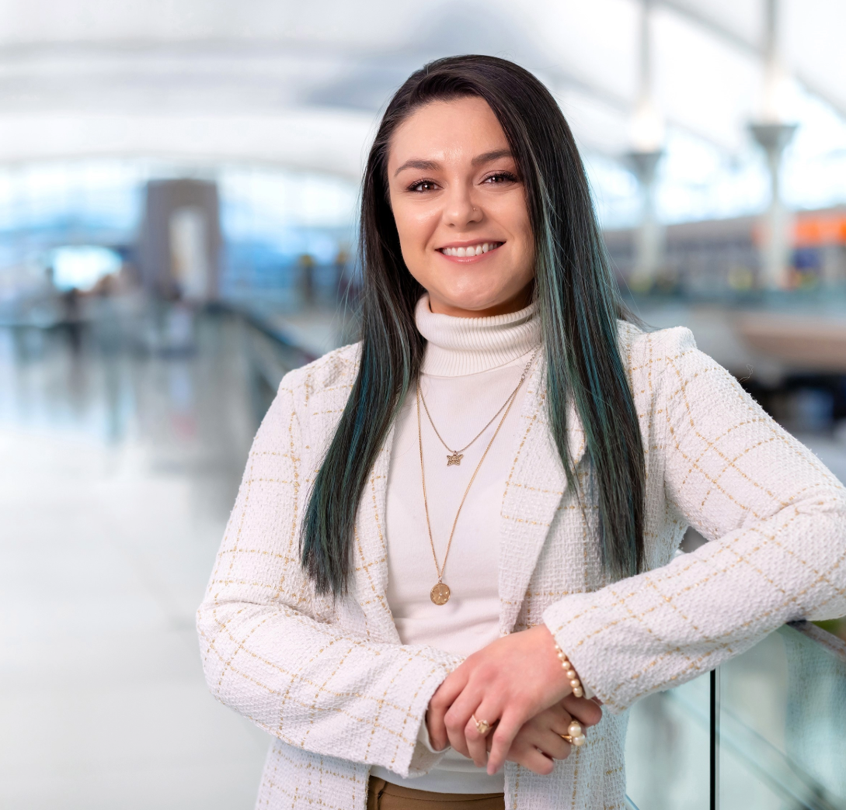
SMALL BUSINESS PROGRAMS AT DEN
Sara Anderson
Manager, ACDBE Program
Notes:
Sara - Thank you, Branden. As Branden mentioned, I’m with the Airport Concession Disadvantaged Business Enterprise (ACDBE) team.
The ACDBE Program is a federal initiative for airports receiving FAA grants. Its purpose is to provide a level playing field, allowing small businesses owned by socially and economically disadvantaged individuals to compete for concession contracts at DEN and other federally funded airports across Colorado. The program is race- and gender-conscious, as outlined in 49 CFR 23.1."

Slide 37


SMALL BUSINESS WORKSHOPS AND TRAININGS
Navigating the ACDBE Program
Bi-Monthly, 3rd Thursdays
Next Event: May 21
1 – 2:15 p.m.
In-Person Certification Workshops
Next Event: June 24
1 - 5:00 pm
Notes:
Our Navigating the ACDBE Series is a bi‑monthly program designed to help ACDBE concession businesses understand how to do business at DEN, with each session focused on a different stage of the process.
We also partner with the CCD Division of Small Business Opportunity to host bi‑monthly Small Business Certification Workshops.

Slide 38
Business Development Training Academy
Matthew Whipple
Notes:
Sara - Next, we’ll hear from Matt Whipple, who will take us through the Business Development Training Academy (BDTA).

Slide 39

BUSINESS DEVELOPMENT TRAINING ACADEMY
Matthew Whipple
Business Learning & Development Administrator II
Notes:
We would like to give special thanks to all of our speakers for providing an informative overview of how to do business with Denver International Airport.
Your expertise and valuable insights help us continue building strong partnerships and opportunities.
We appreciate your time and effort in making today’s event a success!

Slide 40
BDTA MISSION STATEMENT
Supports historically underutilized businesses through education, access and community to help firms build capacity, expand networks and strengthen readiness to pursue and execute contracts while growing a strong pipeline of certified companies prepared to work at DEN and beyond.
Notes:
matahji

Slide 41
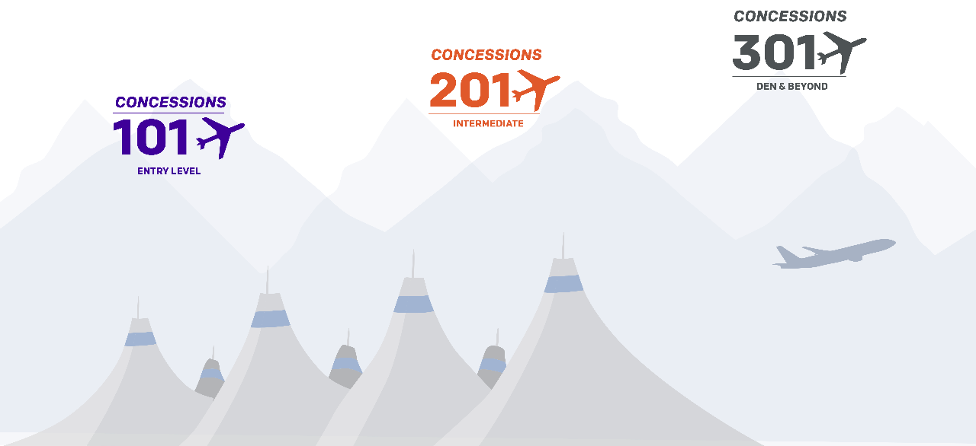
BDTA CONCESSIONS PROGRAM TIERS
Coming in 2026!
Typically runs June through July
Typically Runs March through April
Applications will open near the end of 2026. Subscribe to the Business Connect newsletter for academy updates

Slide 42


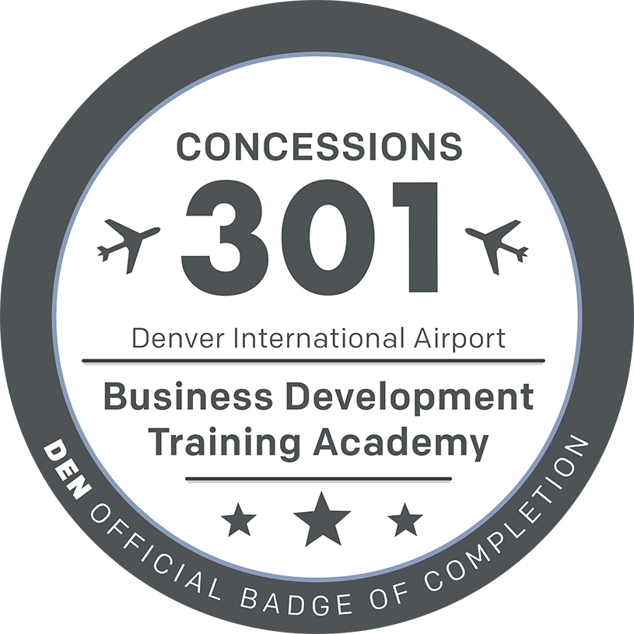
BDTA Concession Track
KNOWLEDGE | SKILL | APPLICATION
CONCESSIONS 101 Eight-week entry level course that will teach the critical DEN Concessions information | CONCESSIONS 201 Eight-week course aimed at creating skills necessary to craft proposals, win contracts, and execute work at DEN. | CONCESSIONS 301 Six-month advanced course that will be piloted in 2027
2027 PILOT
Notes:
Understanding their leadership identify, designing SMARTIE Goals, Leading with influence, change-management, finical stability

Slide 43

BDTA CONCESSIONS PROGRAM AUDIENCE
Must be an Operator in the Food & Beverage or Retail Industry
(Not Intended for Wholesale Businesses)
Must be Interested in Becoming a Concessionaire at DEN or Other Airports
Should Have ACDBE Certification

Slide 44
How to Become a Supplier
Panel Discussion
Notes:
Matt –
We’re now excited to continue with our panel on Unlocking Opportunities and Becoming a Supplier at DEN.
At this time, I’d like to reintroduce Pam Dechant, Senior Vice President of Concessions, who will now serve as the moderator for today’s panel.
Pam will guide us through a discussion with some of the key decision-makers about what it takes to become a supplier at Denver International Airport.

Slide 45
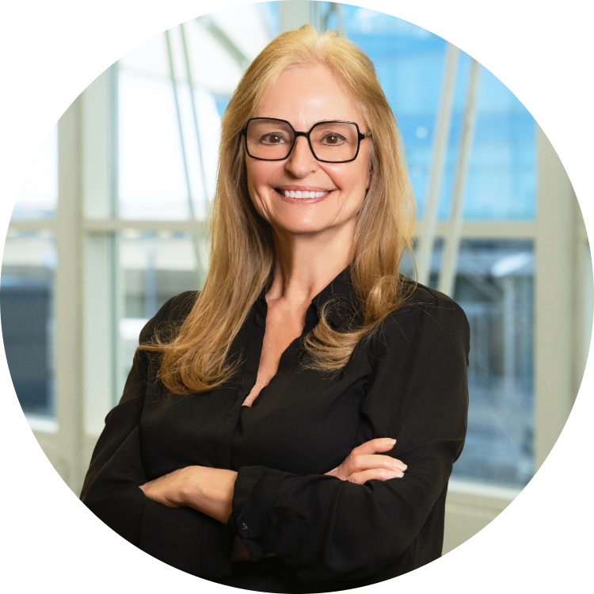

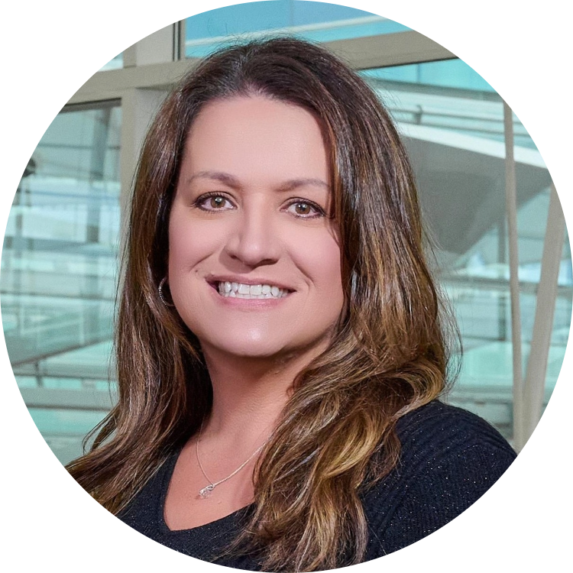
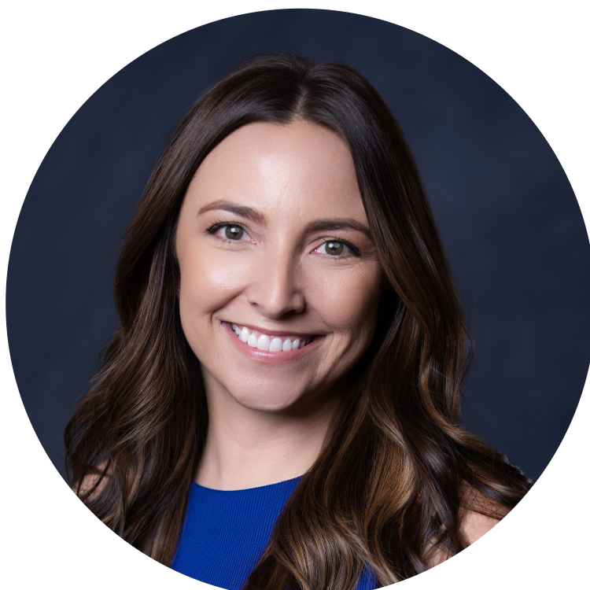

SUPPLIER PANEL
Cord Rauba
Provenzano Resources Inc
Jill Wright
Executive Shine
Moderator
Pamela Dechant
DEN Concessions
Alea LaRocque
WH Smith
Mark Fletcher
Paradies Lagardère
Notes:
Pam - Thank you, Matt, for that great session!
I’m excited to introduce our panel on Unlocking Opportunities and Becoming a Supplier at DEN. We’ve gathered a group of experienced operators from the concessions industry, including leaders in F&B, Retail, and the Kiosk Program.
Panelists:
Cord Rauba, Provenzano Resources Inc
Jill Wright, Executive Shine
Alea LaRocque, WH Smith
Mark Fletcher, Paradies Lagardère
Let’s hear from these experts on unlocking opportunities and becoming a supplier at DEN!
Questions to ask
Below are some areas that we’d like to cover, but we are also open to other suggestions.
How to do Business with…?
Airport badging and security
Insurance Requirements
Certifications and compliance
Delivery logistics and accessing secured areas
Success stories and lessons learned from working with new suppliers
How do deliveries work in the airport environment? Would I deliver directly to you or to a warehouse/distribution center?
Do you require vendors to carry certain liability insurance or certifications?
What kind of volume or sales performance do you expect from new products?
What is your process for onboarding new suppliers?
Are you looking for new product lines or local brands to add to your offerings?
Do you purchase products outright, or do you typically work on consignment?
Are there any packaging, labeling, or compliance requirements specific to your company retail/food sales?
Are you looking for new product lines or local brands to add to your offerings?

Slide 46
Expo Hall
11 a.m. – 2:30 p.m.
How to Launch a Kiosk at DEN Workshop
12:30 – 1:30 p.m.
Notes:
Pam - A Big Thank You to Our Speakers!
We’d like to extend a heartfelt thank you to all of our incredible speakers today for sharing their expertise and insights. Your contributions have been invaluable in making this event a success.
Next, Let’s Network!
We now encourage you all to go out and network with our exhibitors, who represent various buyers doing business in the aviation industry—both here at DEN and beyond. Also, take the opportunity to connect with our Industry and Resource Partners, who can help you navigate the complexities of doing business at DEN.
Reminder for Merchants:
Before you go, we ask all merchants to please complete the survey in the Whova app. Your feedback is extremely important to us and helps improve future events.
Thank you again for being part of today’s event, and we hope you enjoy the rest of your time here. Let’s make the most of the networking opportunities ahead!

Slide 47











Thank You!
Proserve
Corporation
Buyers
Resource Partners
DEN Teams
Volunteers
Notes:
Thank you to our Buyers, Resource partners, DEN Teams Volunteers, and special shoutout to Team members & that spent a year in planning: Nicole & Desiree, Lindsey & Miles

